Slide 1
Lecture 14 – Neural Networks
Machine Learning
March 18, 2010

Slide 2
Last Time
Perceptrons
  Perceptron Loss vs. Logistic Regression Loss
  Training Perceptrons and Logistic Regression Models using Gradient Descent

Slide 3
Today
Multilayer Neural Networks
  Feed Forward
  Error Back-Propagation

Slide 4
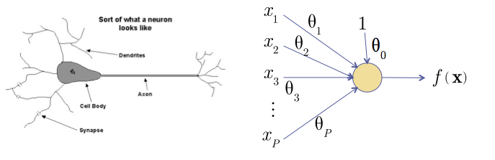
Recall: The Neuron Metaphor
Neurons
  accept information from multiple inputs,
  transmit information to other neurons.
Multiply inputs by weights along edges
Apply some function to the set of inputs at each node

Slide 5

Types of Neurons
Linear Neuron
Logistic Neuron
Potentially more. Require a convex
loss function for gradient descent training.
Perceptron

Slide 6
Multilayer Networks
Cascade Neurons together
The output from one layer is the input to the next
Each Layer has its own sets of weights

Slide 7
Linear Regression Neural Networks
What happens when we arrange linear neurons in a multilayer network?

Slide 8



Linear Regression Neural Networks
Nothing special happens.
  The product of two linear transformations is itself a linear transformation.
Notes:
f(x,\vec{\theta})&=&\sum_{i=0}^D\theta_{1,i}\sum_{n=0}^{N-1}\theta_{0,i,n} {x_n}\\f(x,\vec{\theta})&=&\sum_{i=0}^D\theta_{1,i}[\theta_{0,i}^T\vec{x}]\\f(x,\vec{\theta})&=&\sum_{i=0}^D[\hat\theta_{i}^T\vec{x}]\\

Slide 9
Neural Networks
We want to introduce non-linearities to the network.
  Non-linearities allow a network to identify complex regions in space

Slide 10
Linear Separability
1-layer cannot handle XOR
More layers can handle more complicated spaces – but require more parameters
Each node splits the feature space with a hyperplane
If the second layer is AND a 2-layer network can represent any convex hull.

Slide 11
Feed-Forward Networks
Predictions are fed forward through the network to classify

Slide 12
Feed-Forward Networks
Predictions are fed forward through the network to classify

Slide 13
Feed-Forward Networks
Predictions are fed forward through the network to classify

Slide 14
Feed-Forward Networks
Predictions are fed forward through the network to classify

Slide 15
Feed-Forward Networks
Predictions are fed forward through the network to classify

Slide 16
Feed-Forward Networks
Predictions are fed forward through the network to classify

Slide 17
Error Backpropagation
We will do gradient descent on the whole network.
Training will proceed from the last layer to the first.

Slide 18
Error Backpropagation
Introduce variables over the neural network
Notes:
\vec{\theta}=\{w_{ij}, w_{jk}, w_{kl}\}

Slide 19
Error Backpropagation
Introduce variables over the neural network
  Distinguish the input and output of each node
Notes:
\vec{\theta}=\{w_{ij}, w_{jk}, w_{kl}\}

Slide 20



Error Backpropagation
Notes:
\vec{\theta}=\{w_{ij}, w_{jk}, w_{kl}\}

Slide 21
Error Backpropagation
Training: Take the gradient of the last component and iterate backwards
Notes:
\vec{\theta}=\{w_{ij}, w_{jk}, w_{kl}\}

Slide 22
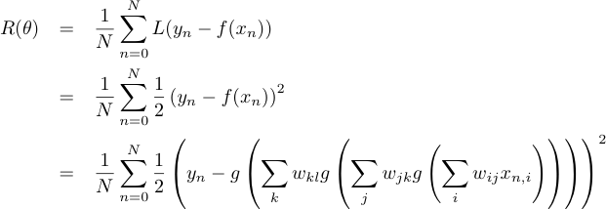
Error Backpropagation
Empirical Risk Function

Slide 23


Error Backpropagation
Optimize last layer weights w_{kl}
Calculus chain rule
Notes:
\frac{\partial R}{\partial w_{kl}}=\frac{1}{N}\sum_n\left[\frac{\partial L_n}{\partial a_{l,n}}\right]\left[\frac{\partial a_{l,n}}{\partial w_{kl}}\right]

Slide 24

Error Backpropagation
Optimize last layer weights w_{kl}
Calculus chain rule

Slide 25

Error Backpropagation
Optimize last layer weights w_{kl}
Calculus chain rule

Slide 26
Error Backpropagation
Optimize last layer weights w_{kl}
Calculus chain rule

Slide 27
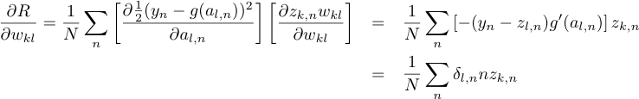
Error Backpropagation
Optimize last layer weights w_{kl}
Calculus chain rule

Slide 28


Error Backpropagation
Optimize last hidden weights w_{jk}
Notes:
\frac{\partial R}{\partial w_{kl}}=\frac{1}{N}\sum_n\left[\frac{\partial \frac{1}{2}(y_n-g(a_{l,n}))^2}{\partial a_{l,n}}\right]\left[\frac{\partial z_{k,n}w_{kl}}{\partial w_{kl}}\right]&=&\sum_n\left[-(y_n-z_{l,n})g'(a_{l,n})\right]z_{k,n}\\&=&\sum_n\delta_nz_{k,n}

Slide 29

Error Backpropagation
Optimize last hidden weights w_{jk}
Multivariate chain rule
Notes:
\frac{\partial R}{\partial w_{kl}}=\frac{1}{N}\sum_n\left[\frac{\partial \frac{1}{2}(y_n-g(a_{l,n}))^2}{\partial a_{l,n}}\right]\left[\frac{\partial z_{k,n}w_{kl}}{\partial w_{kl}}\right]&=&\sum_n\left[-(y_n-z_{l,n})g'(a_{l,n})\right]z_{k,n}\\&=&\sum_n\delta_nz_{k,n}

Slide 30

Error Backpropagation
Optimize last hidden weights w_{jk}
Multivariate chain rule
Notes:
\frac{\partial R}{\partial w_{kl}}=\frac{1}{N}\sum_n\left[\frac{\partial \frac{1}{2}(y_n-g(a_{l,n}))^2}{\partial a_{l,n}}\right]\left[\frac{\partial z_{k,n}w_{kl}}{\partial w_{kl}}\right]&=&\sum_n\left[-(y_n-z_{l,n})g'(a_{l,n})\right]z_{k,n}\\&=&\sum_n\delta_nz_{k,n}

Slide 31

Error Backpropagation
Optimize last hidden weights w_{jk}
Multivariate chain rule
Notes:
\frac{\partial R}{\partial w_{kl}}=\frac{1}{N}\sum_n\left[\frac{\partial \frac{1}{2}(y_n-g(a_{l,n}))^2}{\partial a_{l,n}}\right]\left[\frac{\partial z_{k,n}w_{kl}}{\partial w_{kl}}\right]&=&\sum_n\left[-(y_n-z_{l,n})g'(a_{l,n})\right]z_{k,n}\\&=&\sum_n\delta_nz_{k,n}

Slide 32

Error Backpropagation
Optimize last hidden weights w_{jk}
Multivariate chain rule
Notes:
\frac{\partial R}{\partial w_{jk}}=\frac{1}{N}\sum_n\left[\sum_l\delta_l w_{kl}g'(a_{k,n})\right]\left[z_{j,n}\right]\\

Slide 33
Error Backpropagation
Repeat for all previous layers
Notes:
\frac{\partial R}{\partial w_{ij}}&=&\frac{1}{N}\sum_n\left[\frac{\partial L_n}{\partial a_{j,n}}\right]\left[\frac{\partial a_{j,n}}{\partial w_{ij}}\right]=\frac{1}{N}\sum_n\left[ \sum_k\delta_{k,n}w_{jk}g'(a_{j,n}) \right]z_{i,n} =\frac{1}{N} \sum_n\delta_{j,n}z_{i,n}

Slide 34
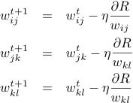
Error Backpropagation
Now that we have well defined gradients for each parameter, update using Gradient Descent
Notes:
\frac{\partial R}{\partial w_{jk}}=\frac{1}{N}\sum_n\left[\sum_l\delta_l w_{kl}g'(a_{k,n})\right]\left[z_{j,n}\right]\\

Slide 35
Error Back-propagation
Error backprop unravels the multivariate chain rule and solves the gradient for each partial component separately.
The target values for each layer come from the next layer.
This feeds the errors back along the network.

Slide 36
Problems with Neural Networks
Interpretation of Hidden Layers
Overfitting

Slide 37
Interpretation of Hidden Layers
What are the hidden layers doing?!
Feature Extraction
The non-linearities in the feature extraction can make interpretation of the hidden layers very difficult.
This leads to Neural Networks being treated as black boxes.

Slide 38
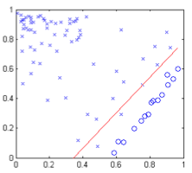
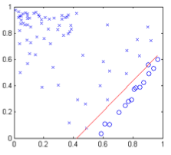
Overfitting in Neural Networks
Neural Networks are especially prone to overfitting.
Recall Perceptron Error
  Zero error is possible, but so is more extreme overfitting
Logistic
Regression
Perceptron

Slide 39

Bayesian Neural Networks
Bayesian Logistic Regression by inserting a prior on the weights
  Equivalent to L2 Regularization
We can do the same here.
Error Backprop then becomes Maximum A Posteriori (MAP) rather than Maximum Likelihood (ML) training

Slide 40
Handwriting Recognition
Demo: http://yann.lecun.com/exdb/lenet/index.html

Slide 41
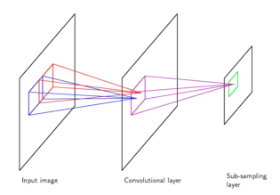
Convolutional Network
The network is not fully connected.
Different nodes are responsible for different regions of the image.
This allows for robustness to transformations.

Slide 42
Other Neural Networks
Multiple Outputs
Skip Layer Network
Recurrent Neural Networks

Slide 43
Multiple Outputs
Used for N-way classification.
Each Node in the output layer corresponds to a different class.
No guarantee that the sum of the output vector will equal 1.

Slide 44
Skip Layer Network
Input nodes are also sent directly to the output layer.

Slide 45
Recurrent Neural Networks
Output or hidden layer information is stored in a context or memory layer.
Output Layer
Hidden Layer
Context Layer
Input Layer

Slide 46
Recurrent Neural Networks
Output or hidden layer information is stored in a context or memory layer.
Output Layer
Hidden Layer
Context Layer
Input Layer

Slide 47
Time Delayed Recurrent Neural Networks (TDRNN)
Output layer from time t are used as inputs to the hidden layer at time t+1.
Output Layer
With an optional decay
Hidden Layer
Input Layer

Slide 48
Maximum Margin
Perceptron can lead to many equally valid choices for the decision boundary
Are these really
“equally valid”?

Slide 49
Max Margin
How can we pick which is best?
Maximize the size of the margin.
Small Margin
LargeMargin
Are these really
“equally valid”?

Slide 50
Next Time
Maximum Margin Classifiers
  Support Vector Machines
  Kernel Methods

