Slide 1
Building Machine Learning System with Python
5, Sept, 2016

Slide 2
“Life is short you need Python”
-- Bruce Eckel

Slide 3
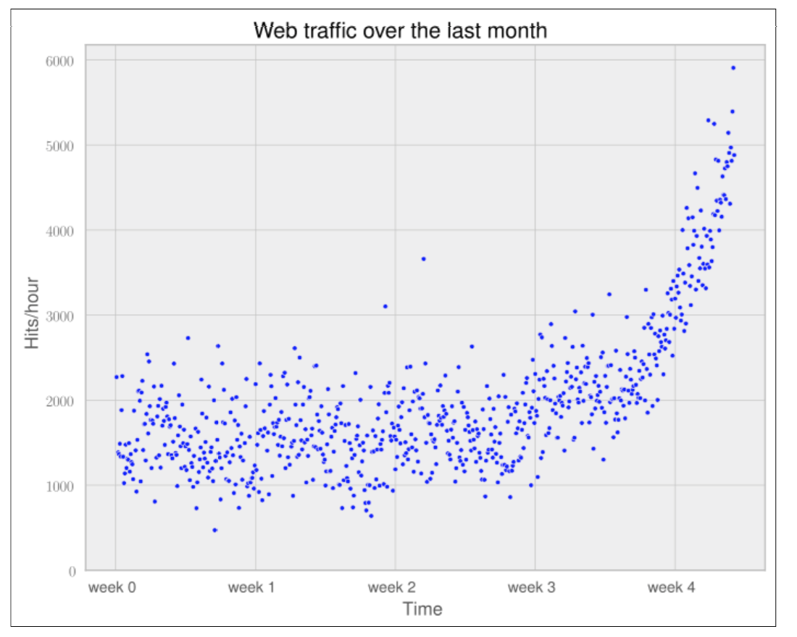
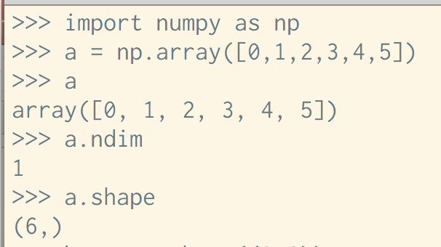
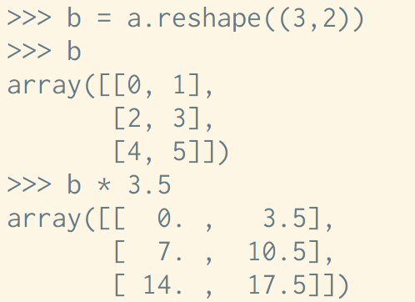
NumPy, SciPy, and Matplotlib
NumPy and SciPy:
Highly optimized storage and operation for multidimensional arrays, which are the basis data structure of most state-of-the-art algorithms.
Matplotlib:
One of the most convenient library to plot high-quality graph using Python.

Slide 4
Scikit-learn
Scikit-learn is a marvelous machine learning toolkit in Python.
http://scikit-learn.org/stable/install.html
Getting started with Scikit-learn:
http://scikit-learn.org/stable/tutorial/basic/tutorial.html

Slide 5
Installing Python
Install Python, NumPy, SciPy, Scikit-learning, and etc. step by step.
https://www.python.org/downloads/
Install Python distribution, such as Anaconda.
https://www.continuum.io/downloads
For those who favors an IDE, PyCharm is a powerful IDE for Python and scientific development.
Recommended
P.S. For consistency, we use Python 2.7.

Slide 6
References
Python programming:
Python official tutorial: https://docs.python.org/2/tutorial/index.html
Stackoverflow!
Machine Learning:
Building Machine Learning Systems with Python. Willi Richert, Luis Pedro Coelho: library.ust.hk
Cross Validated!

Slide 7
The first machine learning application

Slide 8
Dataset
UC Irvine (UCI) Machine Learning Repository
Iris dataset: Classify the flowers’ species using the following features.
Sepal length.
Sepal width.
Petal length.
Petal width.

Slide 9
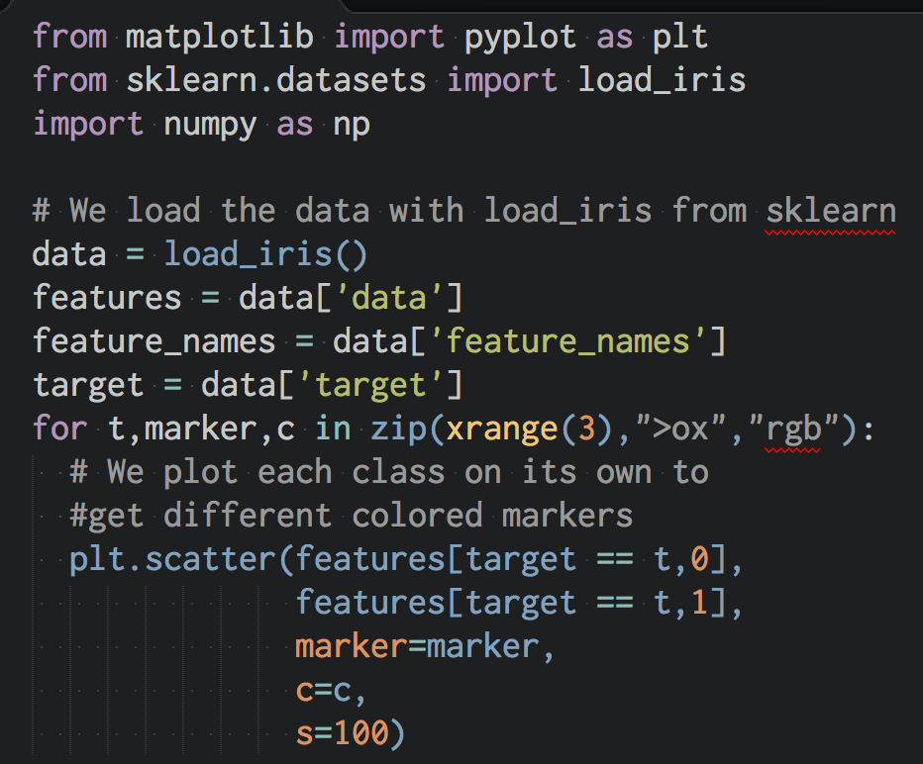
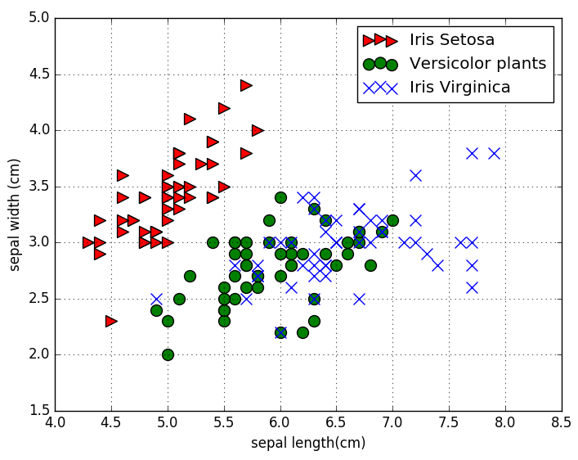
Data Visualization

Slide 10
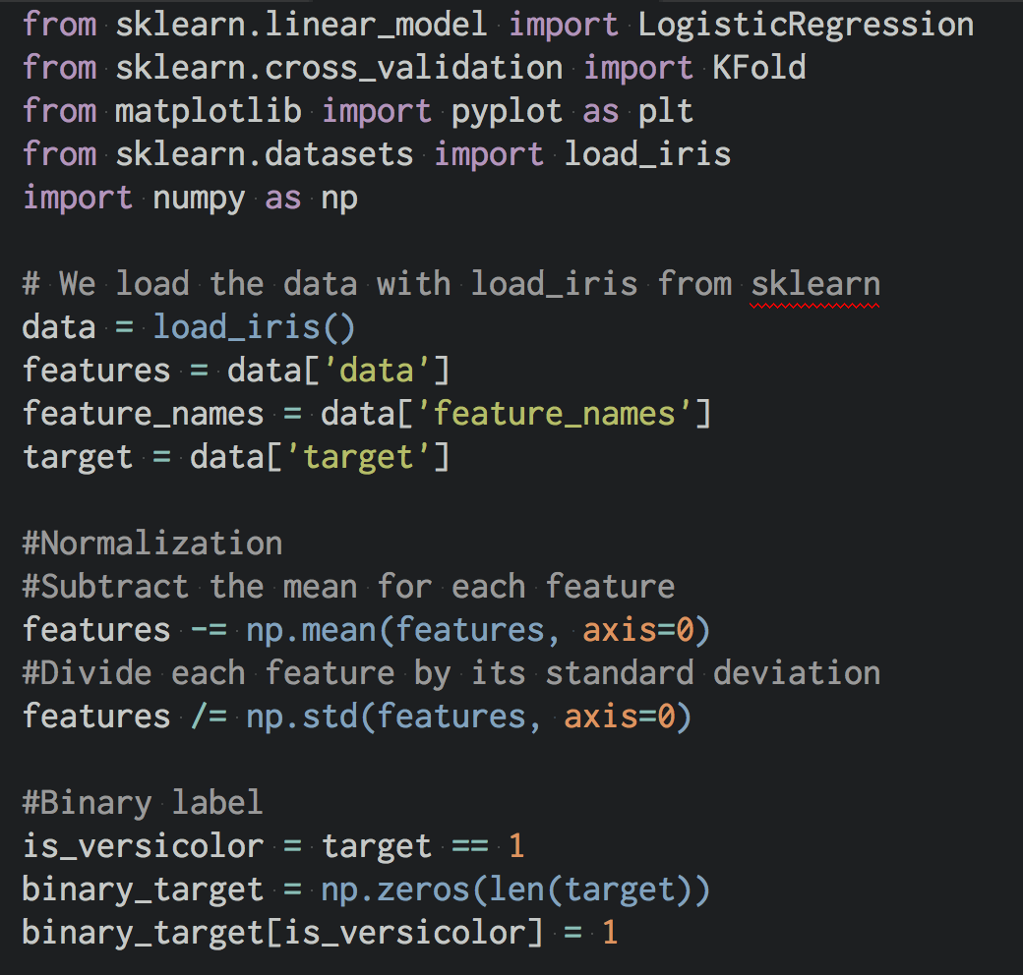
Data Preprocessing

Slide 11
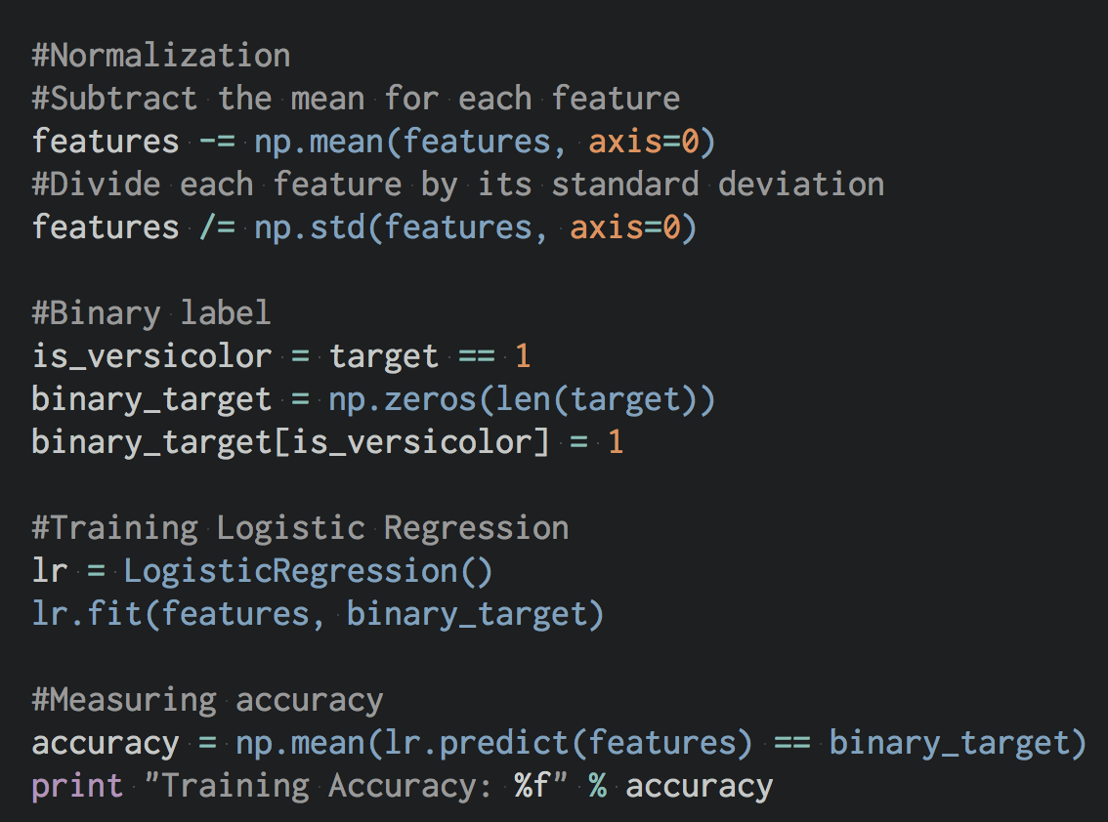
Learning Logistic Regression Model
Training Accuracy: 0.726667

Slide 12
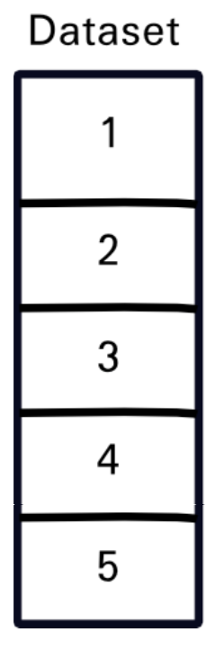
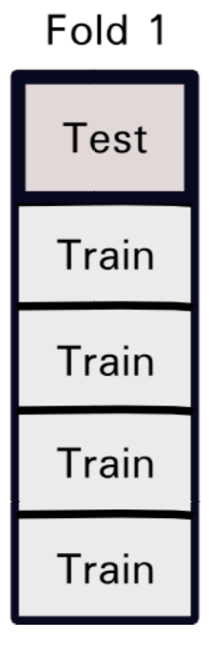
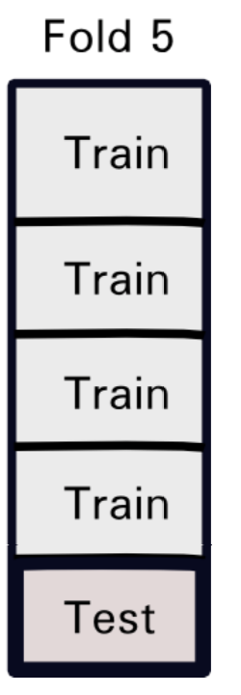
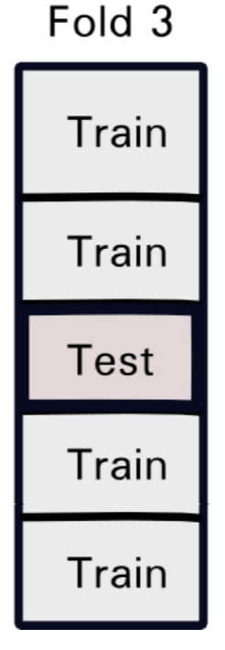
Cross Validation
Train-test split
5-Fold Cross Validation
Training
Testing

Slide 13
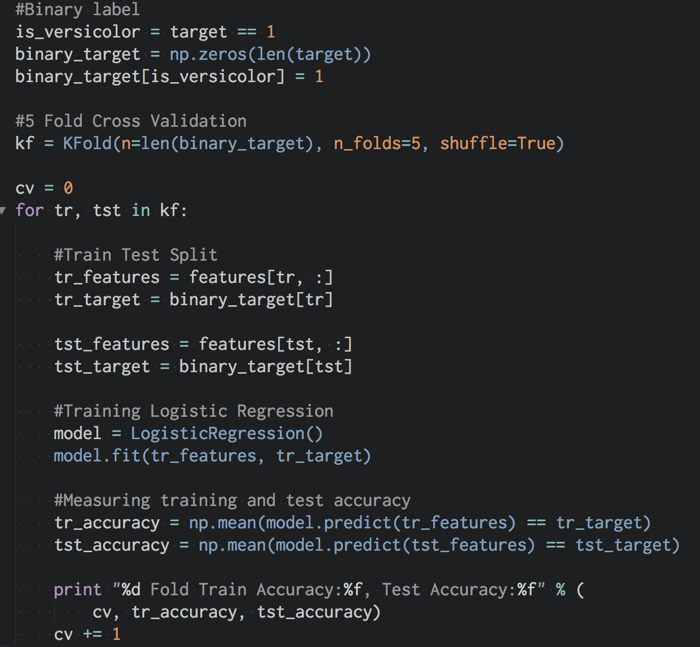
0 Fold Train Accuracy:0.716667,
Test Accuracy:0.733333
1 Fold Train Accuracy:0.766667,
Test Accuracy:0.633333
2 Fold Train Accuracy:0.783333,
Test Accuracy:0.566667
3 Fold Train Accuracy:0.691667,
Test Accuracy:0.866667
4 Fold Train Accuracy:0.741667,
Test Accuracy:0.733333

Slide 14
From Logistic Regression
to Support Vector Machine
0 Fold Train Accuracy:0.975000,
Test Accuracy:0.966667
1 Fold Train Accuracy:0.966667,
Test Accuracy:0.966667
2 Fold Train Accuracy:0.966667,
Test Accuracy:0.966667
3 Fold Train Accuracy:0.983333,
Test Accuracy:0.933333
4 Fold Train Accuracy:0.966667,
Test Accuracy:1.000000
P.S.: from sklearn.svm import SVC

Slide 15
Parameter Tuning
sklearn.svm.SVC
C: Penalty parameter.
Kernel: rbf, poly, linear.
Degree: for polynomial kernel.
Gamma: for rbf kernel.
Etc.
LogisticRegression
C: Penalty parameter.
penalty: l1 or l2.
fit_intercept:
solve: lbfgs, lblinear, netwon-cg.
Etc.
NEVER USE YOUR TEST DATA FOR TUNING

Slide 16
Resources
LIBSVM and LIBLINEAR
Chih-Jen Lin, National Taiwan University.
Simple and easy-to-use support vector machines tool.
Hsu, C.W., Chang, C.C. and Lin, C.J., 2003. A practical guide to support vector. classification. https://www.csie.ntu.edu.tw/~cjlin/papers/guide/guide.pdf
SVMlight
Thorsten Joachims, Cornell University.
An implementation of Support Vector Machines (SVMs) in C.
Vowpal Wabbit
Microsoft Research and (previously) Yahoo! Research
Fast and scalable tool for learning linear model.
Mahout on Hadoop.
MlLib on Spark.
Petuum.

Slide 17
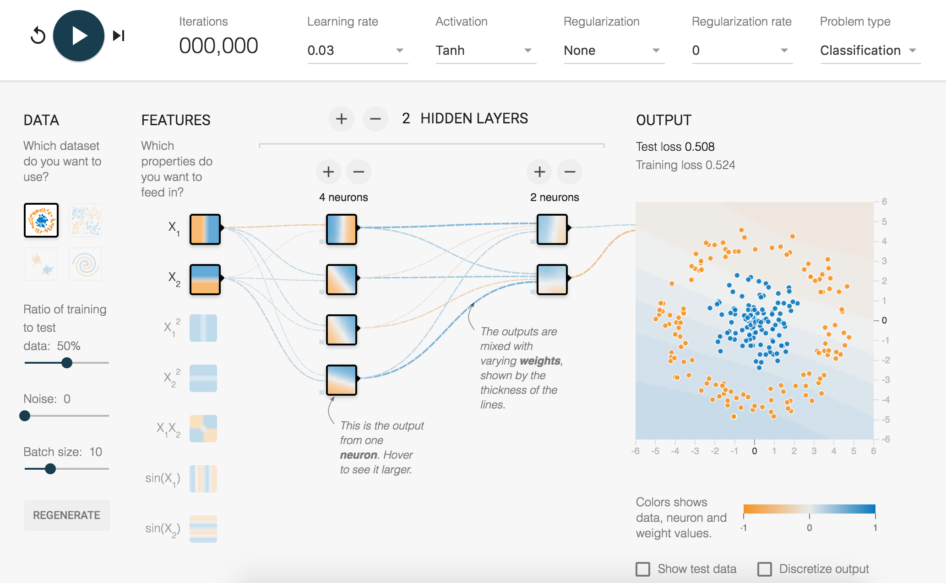
Play with more UCI datasets.
archive.ics.uci.edu/ml
Play with Tensorflow playground.
playground.tensorflow.org

Slide 18
Thank you!

