Slide 1
Video Summarization via Transferrable Structured Learning
Presenter: PENG, Peng
2011-3-29

Slide 2
Outline
Paper present
Transfer learning in Social Network

Slide 3
Video Summarization
What is Video Summarization?

Slide 4
Video Summarization

Slide 5
Video Summarization
Assumption in this paper:
Each shot is accompanied by certain textual information
Textual information and video information are highly correlated (e.g., TV series)

Slide 6
Video Summarization
Notes:
Explain Video information and textual information first and then explain that the learning problem is also a subset selection problem, where the output is a sequence rather than a scalar. Therefore, we need structural SVM to learn the video summarization model.

Slide 7
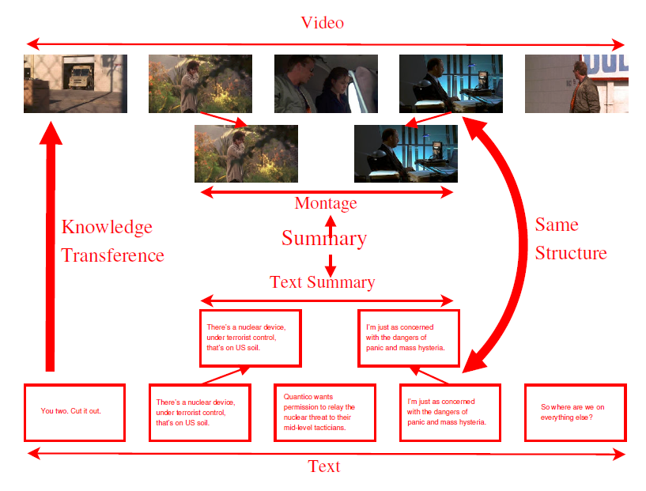
Video Summarization
Notes:
Explain how transfer learning works in this framework

Slide 8
Video Summarization

Slide 9
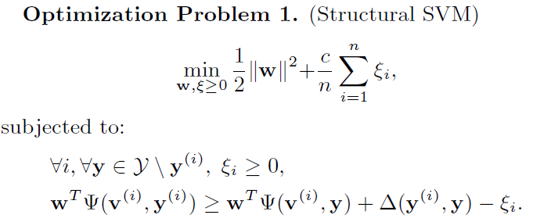
Video Summarization
Notes:
Text: fai, Video: sai
Structure SVM: JMLR 2005 Large Margins Methods for Structured and Interdependent Output Variable

Slide 10
Video Summarization
Notes:
Use w*fai(t,l) to replace delta(y,y’) which represent the loss function, the difference between candidate montages.

Slide 11
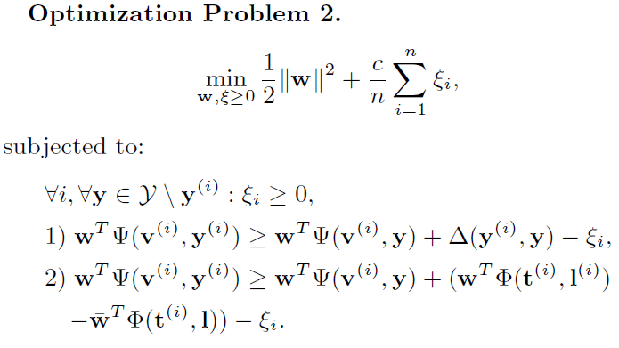
Video Summarization
Notes:
This is what transfer happens: a new constraint is generated by the text summarization model

Slide 12
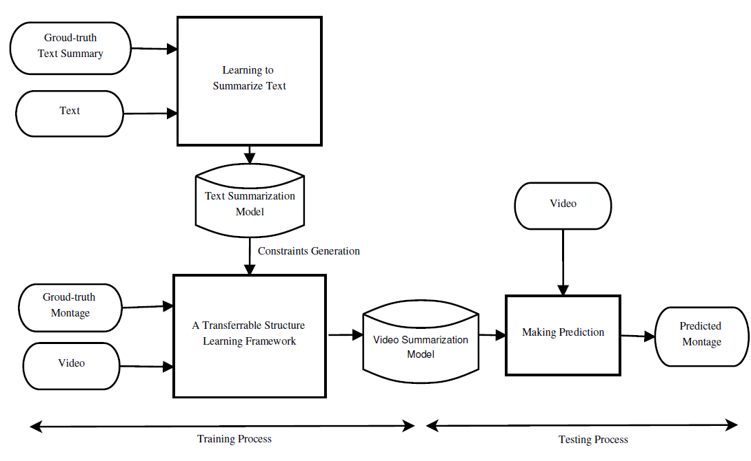
Video Summarization

Slide 13
Video Summarization
Problem:
How to select some representative shots beforehand?
How to know the ground truth?

Slide 14
Transfer Learning
D_{s}(X, P(X)), T_{s}(Y, P(Y|X))
D_{t}(X, P(X)), T_{t}(Y, P(Y|X))
In social network, what can be the same and what can be different?
Notes:
Two approaches to the learning problem, the problem of choosing desired dependence on the basis of empirical data
The first approach is based on the idea that the quality of the chosen function can be evaluated by a risk functional. In this case the choice of the approximating function from a given set of functions is a problem of minimizing the risk functional on the basis of empirical data. This problem is rather general. It embeds many problems of statistics: pattern recognition, regression estimation and density estimation.
The second approach to the learning problem is based on estimating desired stochastic dependencies (densities, conditional densities, conditional probabilities). It requires solution of integral equations (determining these dependencies) in situations where some elements of the equations are known only approximately. Using estimated stochastic dependence, the pattern recognition and regression estimation problems can be solved as well. However, the function obtained by solution of the integral equations provides much more details than is required for these problems. The price we pay for these details is the necessity to solve ill-posed problems.

Slide 15
Q&A

Slide 16
Thank You!

Slide 17
Transfer Learning in Social Networks
Large amounts of unlabeled data
How to avoid negative transfer?

Slide 18
Topics in Social Networks
Community Detection and Graph-based Clustering
Information Influence, Diffusion and Outbreak Detection
Link Prediction and Collaborative Filtering
Social Tagging and Learning
Collective intelligence and Crowd-sourcing

Slide 19
Transfer Learning
What is the sufficient and necessary condition for positive transfer?
How to keep consistency between the source data and the target data?
How to guarantee the correctness of the transferred data in the target tasks?
What is the way to measure the relatedness between two different tasks?

