Slide 1


First Index-Free
Manifold Ranking-based Image Retrieval with Output Bound
Dandan LIN (Department of CSE, HKUST)
Victor Junqiu WEI (Noah’s Ark Lab of Huawei)
Raymond Chi-Wing WONG (Department of CSE, HKUST)

Slide 2
Outline
Introduction
Problem definition
What is Manifold Ranking-based Image Retrieval (MRIR)?
Proposed approach: MCMR
Experiments
Conclusion

Slide 3
Outline
Introduction
Problem definition
What is Manifold Ranking-based Image Retrieval (MRIR)?
Proposed approach: MCMR
Experiments
Conclusion

Slide 4


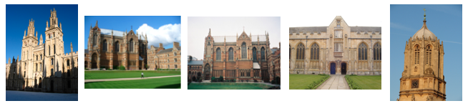
Introduction
Image Retrieval
  Input: a query image
  Output: the images which are similar to the query one
Image Retrieval Handler
Query Image
Outputs
Images Database
Notes:
Image retrieval keeps attracting a lot of attention in both academic and inducstry.
The problem statement of image retrieval is easy to understand.
Suppose that there is a server for response and a database which contains a lot of images.
Given a query image as an input, the server can output the images with the same object as the query one from the images databases.

Slide 5


Introduction
Image Retrieval
  it has a lot of applications in industry
    “similar item search” in Taobao
    Image search engine in Google
Notes:
In industry, giant technology companies in the world also have a lot of attractive applications about image retrieval
On example is Taobao, the biggest mobile e-commerce platform in China.
Its application is called “similar iterm search” which returns a list of iterms which are similar to the photo of an item that a customer would like to buy.
Another example is Google, the world leading search company in US.
It has a function called image search engine which returns a list of images similar to an upload image.

Slide 6
Introduction
Generally, image retrieval involves two phases:
  Feature Extraction and Similarity Measure
Images Database
Feature Extraction
Feature vectors
Similarity Measure
Top-k images with the highest similarity score
Feature vector
Query Image
Notes:
The feature extraction is to find a representation of each image called feature vector
Which is in the form of a d-dimensional vector.
When there is a query image coming, its feature vector will be found by using the same feature extraction method.
After that, the similarity measure phase is to find a list of images which are ‘similar’ to the query one.

Slide 7
Introduction
Feature Extraction is well-studied by exploiting deep learning approaches.
Images Database
Feature Extraction
Similarity Measure
VGG [arXiv 2014]
ResNet [CVPR 2016]
MAC [TPAMI 2018]
…
Notes:
Feature extraction is well-studied recently, especially exploiting the deep learning approaches.
However, most of studies directly adopt a traditional L^p norm-based measure of evaluating the similarity of two images.
The performance of similarity measure is not that good.

Slide 8

Introduction
However, the performance of similarity measure is not that good.
Images Database
Feature Extraction
Similarity Measure
Traditional $ℒ^{p}$-norm-based measures
Euclidean Distance of the feature vectors of two images
Inner Product of these two vectors
…
Notes:
For the similarity measure, most studies directly adopt a traditional L-norm-based measure
Such as euclidean distance of the feature vectors of two images or inner product
However, these measure only captures the similarity between 2 images locally without considering the similarity among a group of similar images globally.
In other words, we say that those lp norm measure cannot consider the global similarity.

Slide 9

Introduction
However, the performance of similarity measure is not that good.
Images Database
Feature Extraction
Similarity Measure
Not good at all since they only capture the similarity between 2 images locally
Traditional $ℒ^{p}$-norm-based measures
Euclidean Distance of the feature vectors of two images
Inner Product of these two vectors
…
Notes:
For the similarity measure, most studies directly adopt a traditional L-norm-based measure
Such as euclidean distance of the feature vectors of two images or inner product
However, these measure only captures the similarity between 2 images locally without considering the similarity among a group of similar images globally.

Slide 10
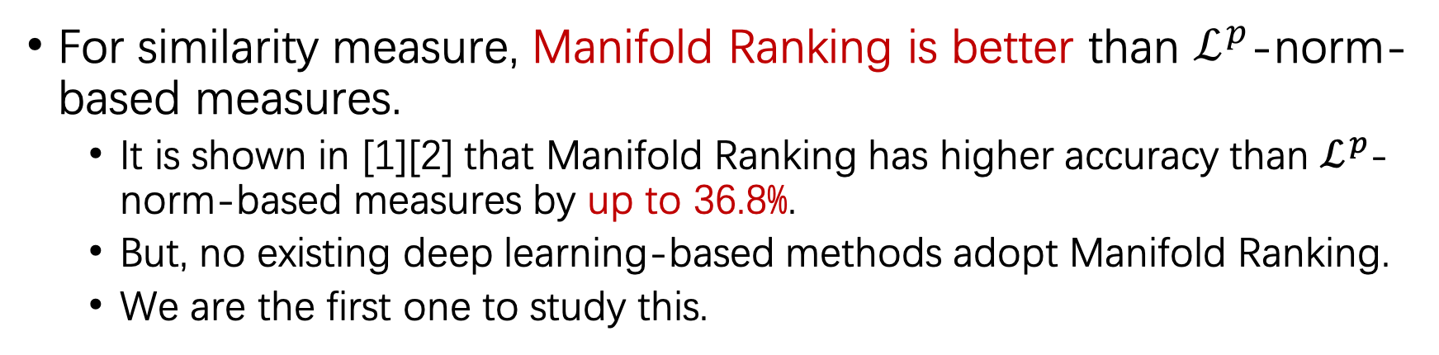
Introduction
For similarity measure, Manifold Ranking is better than $ℒ^{p}$-norm-based measures.
  It is shown in [1][2] that Manifold Ranking has higher accuracy than $ℒ^{p}$-norm-based measures by up to 36.8%.
  But, no existing deep learning-based methods adopt Manifold Ranking.
  We are the first one to study this.
Reference:
[1] Zhou, D., Weston, J., Gretton, A., Bousquet, O., & Schölkopf, B. (2004). Ranking on data manifolds. In Advances in neural information processing systems (pp. 169-176).
[2] He, J., Li, M., Zhang, H. J., Tong, H., & Zhang, C. (2004, October). Manifold-ranking based image retrieval. In Proceedings of the 12th annual ACM international conference on Multimedia (pp. 9-16). ACM.

Slide 11
Outline
Introduction
Problem definition
What is Manifold Ranking-based Image Retrieval (MRIR)?
Proposed approach: MCMR
Experiments
Conclusion

Slide 12

Problem definition
Top-$k$ MRIR search problem
  Input: an image database, a query image $q$, and a constant $k$
  Output: $k$images with the highest Manifold Ranking (MR) scores w.r.t $q$
Notes:
Given a querying image,
Manifold ranking makes use of both the local similarity and global similarity to compute a score called MR score for each images.
In a top-k query, the images with the highest MR scores are returned as an output.
Here, we give the formal definition of this top-k manifold ranking search problem.
This is the problem to be studied in our paper.

Slide 13
Three requirements
We consider the following 3 requirements for evaluating a method for Manifold Ranking:
  Index-free: it has no index for computing MR scores.
  Output-bound: The MR scores of images returned by this method should have a theoretical quality guarantee.
  Efficiency: Computing MR scores should be computationally cheap.
None of the existing algorithms satisfies the 3 requirements simultaneously.

Slide 14
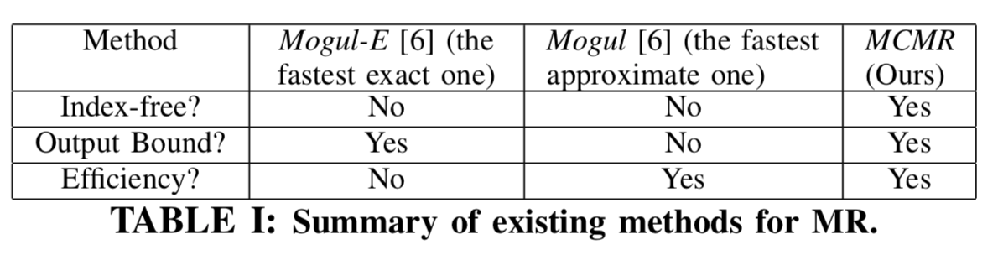
Motivation
Deficiencies of existing algorithms about manifold ranking:
  Some of them require to build a bulky index
  Some of them do not have any theoretical bound on the output
  Some of them are time-consuming.
Thus, we propose a method that satisfies the 3 requirements simultaneously.

Slide 15
Contributions
The following shows our contributions:
  We are the first one to show that the accuracy of using Manifold Ranking for the image retrieval tasks is higher than the existing traditional deep learning approaches by up to 31.7%.
  We propose an index-free approach, called MCMR, by utilizing Random Walk Sampling.
  We prove that the results returned by MCMR have the output-bound.
  We show by experiments that MCMR outperforms the existing algorithms by up to 4 orders of magnitude in terms of query time.
Notes:
Here
This is the first best-known time complexity result in literature of computing the approximate MR score with output bound.

Slide 16
Outline
Introduction
Problem definition
What is Manifold Ranking-based Image Retrieval (MRIR)?
Proposed approach: MCMR
Experiments
Conclusion

Slide 17
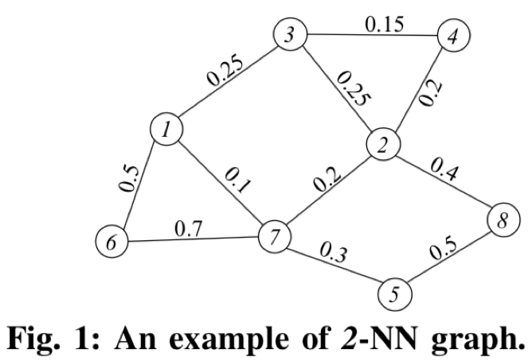

Manifold Ranking-based Image Retrieval (MRIR)
Manifold Ranking-based Image Retrieval (MRIR) requires a $k$-NN graph where
  Each image is represented by a node in the graph
  If two images are $k$-nearest neighbor of each other, these two nodes are linked with an undirected edge
a weight computed by a heat kernel

Slide 18
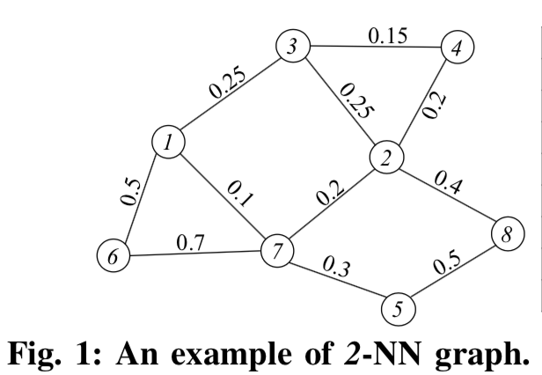
Manifold Ranking-based Image Retrieval (MRIR)
The information is only 1.0.
MRIR can be regarded as a process of information propagation:
  Initially, the query node holds a certain amount of information.
  Each node holding information propagates information to its neighbors.
  Then, each node in the graph constantly receives a certain amount of information from its neighbors.
  Finally, the propagation terminates until the total information held by each node remains unchanged.
Notes:
Based on this k-NN graph,
Manifold Ranking can be regarded as a process of information propagation
Initially, the query node has a fixed number of information
Which will be propagated along the edges in the graph.
Then, each node in the graph constantly receives the information from its neighors.
The whole propagation finishes if the total information hold by each node would not changed any more.
It means that the information on the graph has been in the stationary distribution.
Take this graph for example,
Suppose the query node is node 1.
The initial information to query node is only 1
And then, this information will propagate to the neighbors of node 1 according to the weights on each edge.

Slide 19
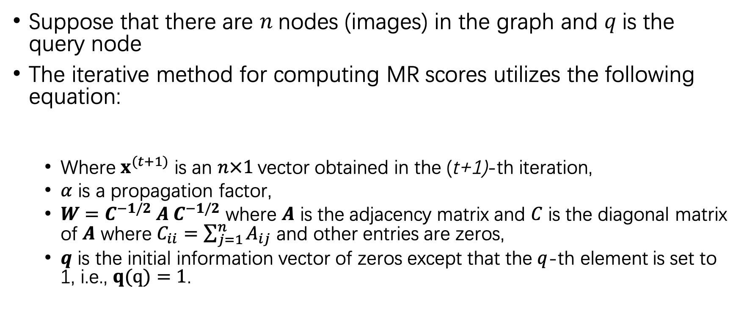
Manifold Ranking-based Image Retrieval (MRIR)
Suppose that there are $n$nodes (images) in the graph and $q$is the query node
The iterative method for computing MR scores utilizes the following equation:
  Where $x^{(t+1)}$ is an $n×1$vector obtained in the (t+1)-th iteration,
  $α$ is a propagation factor,
  $W=C^{−1/2} A C^{−1/2}$ where $A$ is the adjacency matrix and $C$ is the diagonal matrix of $A$ where $C_{ii}=\sum_{j=1}^{n}{A_{ij}}$ and other entries are zeros,
  $q$ is the initial information vector of zeros except that the $q$-th element is set to 1, i.e., $q(q)=1$.
Notes:
This propagation process could be represented by the iterative method

Slide 20
Outline
Introduction
Problem definition
What is Manifold Ranking-based Image Retrieval (MRIR)?
Proposed approach: MCMR
Experiments
Conclusion
Notes:
Next, I am going to introduce our proposed method by exploiting Random Walk sampling

Slide 21
MCMR
We propose MCMR with a new random walk sampling strategy.
Our MCMR has two phases:
  Simulation phase
    Simulates a number of weighted random walks from the query node
  Estimation phase
    Estimates MR scores of all nodes in the graph based on the simulated random walks
Notes:
Due to the time limit, let’s skip the details in each phase.

Slide 22
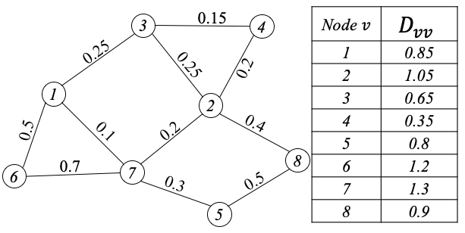
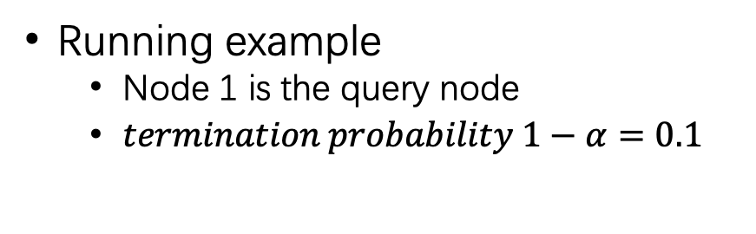
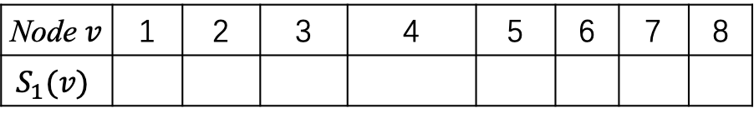

MCMR
Running example
  Node 1 is the query node
  $termination probability 1−α=0.1$
The i-th walk | Random walk | Scalar of This Walk
1 | 1→3→4
Node $v$ | 1 | 2 | 3 | 4 | 5 | 6 | 7 | 8
$$S_{1}(v)$$
$$S_{1}=0.85×0.65=0.5525$$
0
0
0
0.5525
0
0
0
0
Notes:
The table shows the sum of weights for each node in the graph.
Node 1 is the query node.
In the simulation phase,

Slide 23

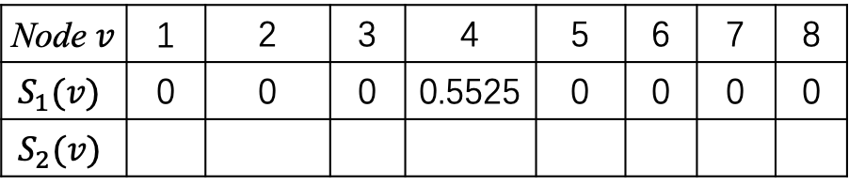
MCMR
Running example
  Node 1 is the query node
  $termination probability 1−α=0.1$
The i-th walk | Random walk | Scalar of This Walk
1 | 1→3→4
2
Node $v$ | 1 | 2 | 3 | 4 | 5 | 6 | 7 | 8
$$S_{1}(v)$$ | 0 | 0 | 0 | 0.5525 | 0 | 0 | 0 | 0
$$S_{2}(v)$$
$$S_{1}=0.85×0.65=0.5525$$
0
1.105
0
0
0
0
0
0
1→7→2
$$S_{2}=0.85×1.3=1.105$$
Notes:
Similarly, we can simulate the second weighted walk from query node 1.
We could simulate the random walks for many times (e.g., $n_{r}$), and we could collect a lot of results by exploiting $n_{r}$ weighted random walks.

Slide 24

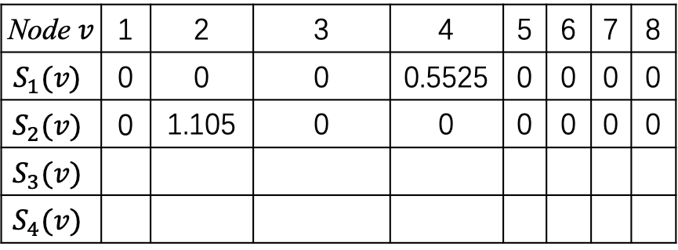


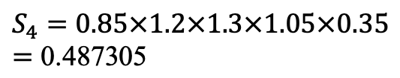
MCMR
Running example
  Node 1 is the query node
  $termination probability 1−α=0.1$
The i-th walk | Random walk | Scalar of This Walk
1 | 1→3→4
2
3
4
Node $v$ | 1 | 2 | 3 | 4 | 5 | 6 | 7 | 8
$$S_{1}(v)$$ | 0 | 0 | 0 | 0.5525 | 0 | 0 | 0 | 0
$$S_{2}(v)$$ | 0 | 1.105 | 0 | 0 | 0 | 0 | 0 | 0
$$S_{3}(v)$$
$$S_{4}(v)$$
$$S_{1}=0.85×0.65=0.5525$$
1→7→2
$$S_{2}=0.85×1.3=1.105$$
0 0 0.85 0 0 0 0 0
1→3
$$S_{3}=0.85$$
0 0 0.487305 0 0 0 0 0
1→6→7→2→4→3
$$S_{4}=0.85×1.2×1.3×1.05×0.35=\text{0.487305}$$
Notes:
Another two simulations could be done similarly.

Slide 25
MCMR
We propose MCMR with a new random walk sampling strategy.
Our MCMR has two phases:
  Simulation phase
    Simulates a number of weighted random walks from the query node
  Estimation phase
    Estimates MR scores of all nodes in the graph based on the simulated random walks
Notes:
Due to the time limit, let’s skip the details in each phase.

Slide 26

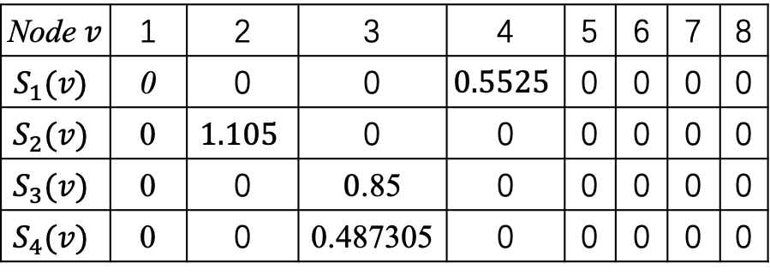
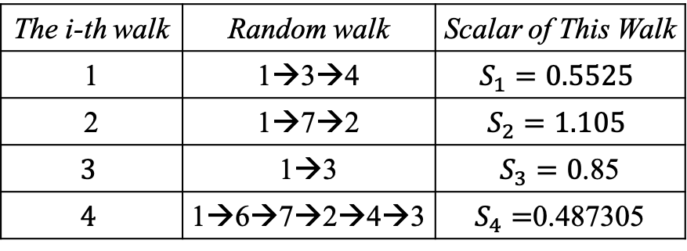
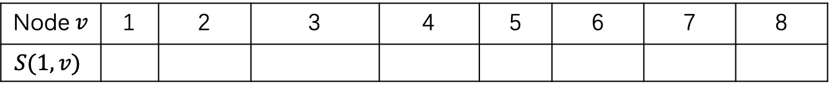
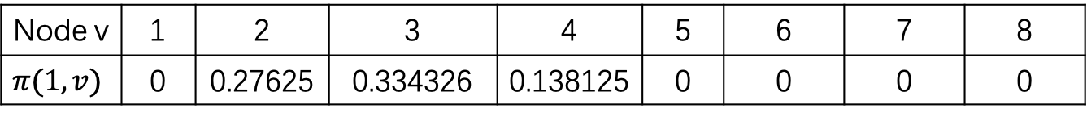
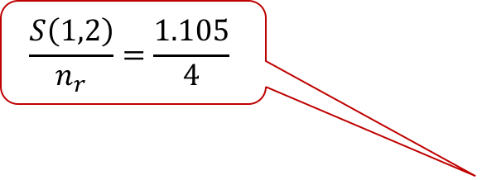
Running example
  Suppose that $n_{r}=4$, we can estimate the MR score as follows.
The i-th walk | Random walk | Scalar of This Walk
1 | 1→3→4 | $$S_{1}=0.5525$$
2 | 1→7→2 | $$S_{2}=1.105$$
$$3$$ | 1→3 | $S_{3}=0$.85
$$4$$ | 1→6→7→2→4→3 | $S_{4}=$0.487305
Node $v$ | 1 | 2 | 3 | 4 | 5 | 6 | 7 | 8
$$S_{1}(v)$$ | 0 | 0 | 0 | $$0.5525$$ | 0 | 0 | 0 | 0
$$S_{2}(v)$$ | 0 | $$1.105$$ | 0 | 0 | 0 | 0 | 0 | 0
$$S_{3}(v)$$ | 0 | 0 | $0$.85 | 0 | 0 | 0 | 0 | 0
$$S_{4}(v)$$ | 0 | 0 | 0.487305 | 0 | 0 | 0 | 0 | 0
For node 1, $S\left(1,1\right)=S_{1}\left(1\right)+S_{2}\left(1\right)+S_{3}\left(1\right)+S_{4}\left(1\right)=0$
Similar estimation could be done for all other nodes.
For node 2, $S\left(1,2\right)=S_{1}\left(2\right)+S_{2}\left(2\right)+S_{3}\left(2\right)+S_{4}\left(2\right)=1.105$
For node 3, $S\left(1,3\right)=S_{1}\left(3\right)+S_{2}\left(3\right)+S_{3}\left(3\right)+S_{4}(3)=1.337305$
Node $v$ | 1 | 2 | 3 | 4 | 5 | 6 | 7 | 8
$$S(1,v)$$
$$\frac{S\left(1,2\right)}{n_{r}}=\frac{1.105}{4}$$
0
1.105
1.337305
0.5525
0
0
0
0
Node v | 1 | 2 | 3 | 4 | 5 | 6 | 7 | 8
$$π(1,v)$$ | 0 | 0.27625 | 0.334326 | 0.138125 | 0 | 0 | 0 | 0

Slide 27
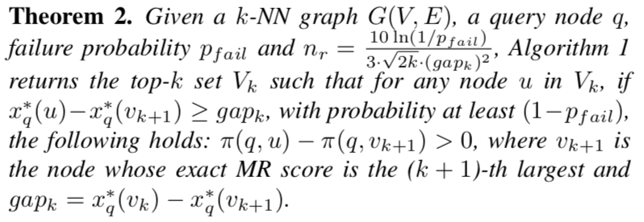
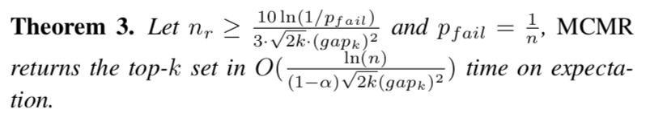
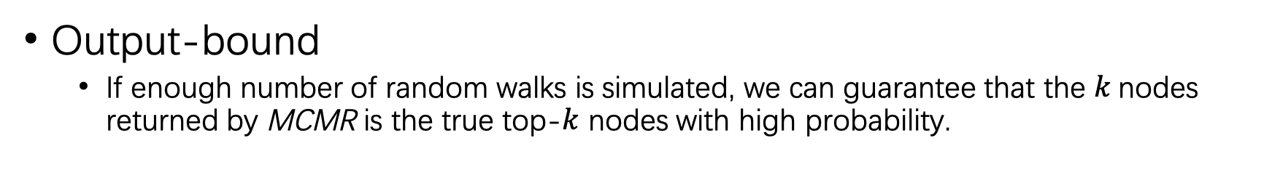
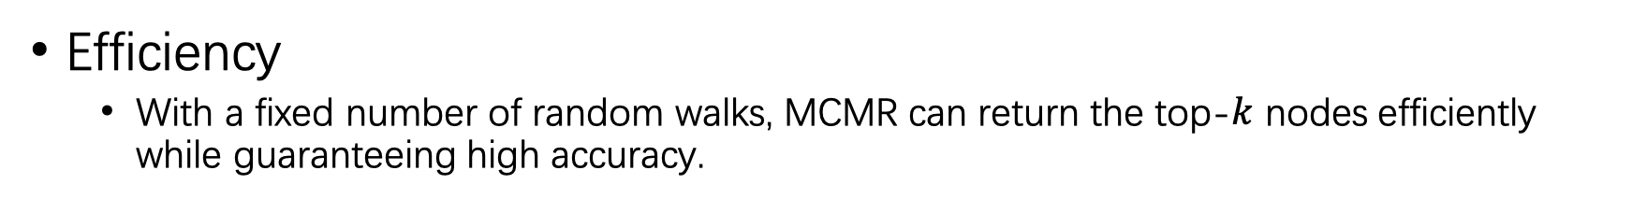
MCMR
Output-bound
  If enough number of random walks is simulated, we can guarantee that the $k$nodes returned by MCMR is the true top-$k$ nodes with high probability.
Efficiency
  With a fixed number of random walks, MCMR can return the top-$k$ nodes efficiently while guaranteeing high accuracy.
Notes:
For more details, please refer to our paper.

Slide 28
Outline
Introduction
Problem definition
What is Manifold Ranking-based Image Retrieval (MRIR)?
Proposed approach: MCMR
Experiments
Conclusion

Slide 29
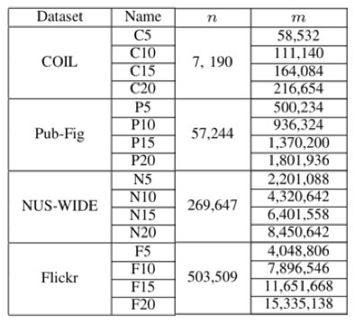
Experiments
Settings
  Datasets
Notes:
In this presentation,
We focus on the results of Flickr due to time limit

Slide 30
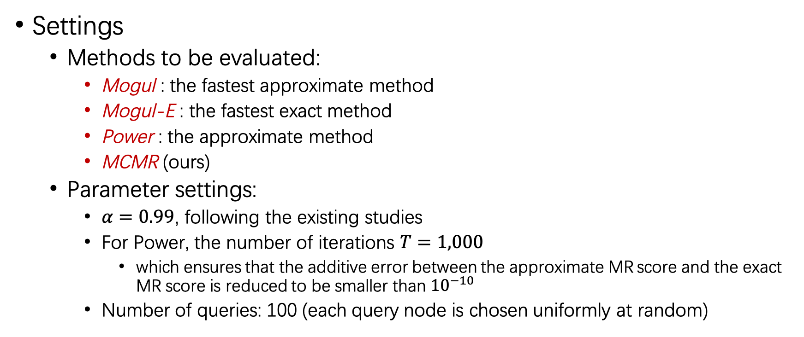
Experiments
Settings
  Methods to be evaluated:
    Mogul : the fastest approximate method
    Mogul-E : the fastest exact method
    Power : the approximate method
    MCMR (ours)
  Parameter settings:
    $α=0.99$, following the existing studies
    For Power, the number of iterations $T=1,000$
      which ensures that the additive error between the approximate MR score and the exact MR score is reduced to be smaller than ${10}^{−10}$
    Number of queries: 100 (each query node is chosen uniformly at random)

Slide 31
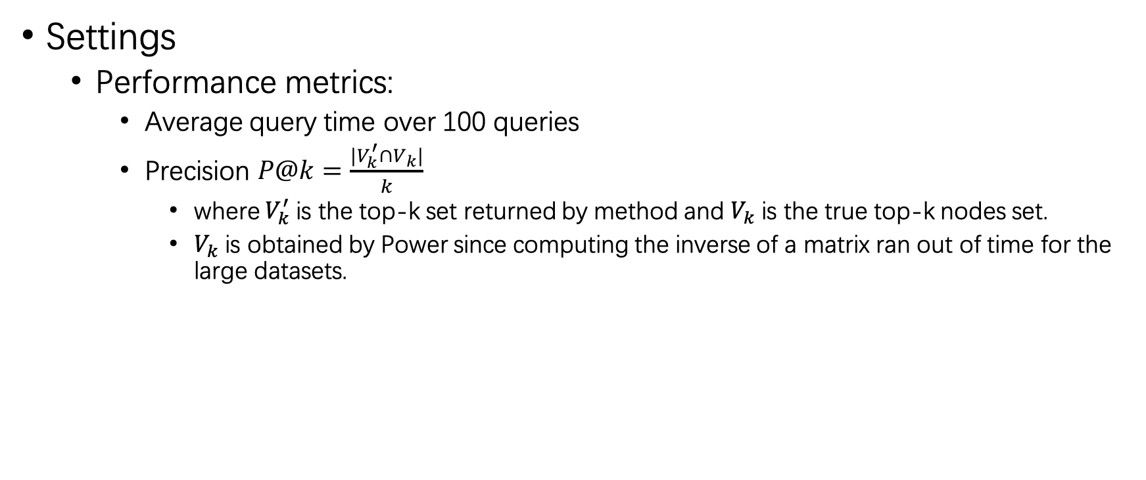
Experiments
Settings
  Performance metrics:
    Average query time over 100 queries
    Precision $P@k=\frac{|V_{k}^{′}∩V_{k}|}{k}$
      where $V_{k}^{′}$ is the top-k set returned by method and $V_{k}$ is the true top-k nodes set.
      $V_{k}$ is obtained by Power since computing the inverse of a matrix ran out of time for the large datasets.

Slide 32
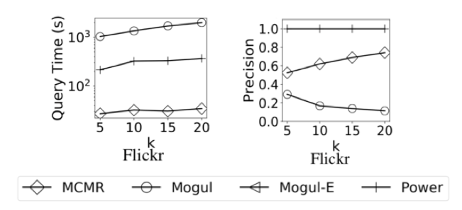
Experiments
Results on the Flickr dataset
Our proposed method MCMR ran faster than existing algorithms by up to 4 orders of magnitude.
Our proposed method MCMR achieved higher precision than the existing approximate method by up to 8 times.
Mogul-E is not plotted here since it ran over 4 days.

Slide 33
Outline
Introduction
Problem definition
What is Manifold Ranking-based Image Retrieval (MRIR)?
Proposed approach: MCMR
Experiments
Conclusion

Slide 34
Conclusion
We are the first to apply Random Walk Sampling to Manifold Ranking-based Image Retrieval (MRIR) problem
MCMR is the first index-free algorithm with output bound for the top-k MRIR query
Our experiments demonstrate the effectiveness and efficiency of MCMR on 4 real-world datasets

Slide 35
Thank You
Q & A

Slide 36




Introduction
Global similarity:
  The global similarity between two images is revealed among all images.
A
B
C
D
If two images are linked by an edge, it means that they are local similar.
Notes:
In fact, image A and image D are similar in context (in our words, similar globally)
Because Image A and Image B are local similar, Image B and Image C are local similar,
Image C and Image D are local similar.

Slide 37
Introduction
Global similarity:
  The global similarity between two images is revealed among all images.
A
B
C
D
In fact, Image A and Image B are similar globally.
Notes:
In fact, image A and image D are similar in context (in our words, similar globally)
Because Image A and Image B are local similar, Image B and Image C are local similar,
Image C and Image D are local similar.

Slide 38

Case study
To show how MR has better performance than other existing approaches, a case study is conducted:
  Approaches:
    VGG16,
    ResNet101,
    MAC
    MRIR(MAC) →Manifold Ranking-based Image Retrieval
used the traditional $ℒ^{p}$-norm-based similarity
Notes:
We included 3 deep learning approaches for comparison,
Namely VGG16, ResNet101, and MAC,
Where MAC is considered as the state-of-the-art in the literature.
All these three models used the traditional l-norm-based similarity.
We also included 2 popular similarity approaches for comparison
Namely personalized pagerank and weighted personalized pagerank.
And finally, our framework is called Manifold Ranking image retrieval.
We used a benchmark dataset, oxford5k,
It contains around 5 thousand images of different buildings in Oxford.

Slide 39

Introduction
For similarity measure, Manifold Ranking is better than $ℒ^{p}$-norm-based measures.
Since it can capture the global similarity among all images as well as the local similarity between 2 images.

Slide 40
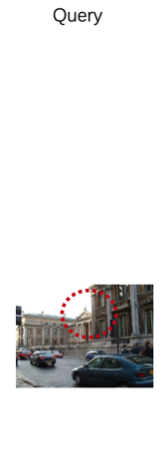
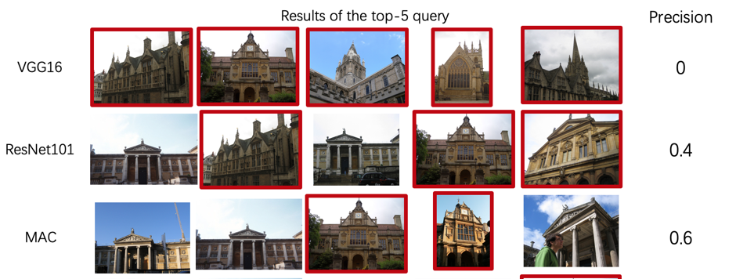
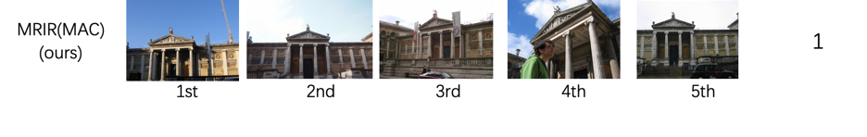
Case study

Slide 41
Introduction
Notes:
This is the second query image,
We can also see the similar result with the first one.

Slide 42
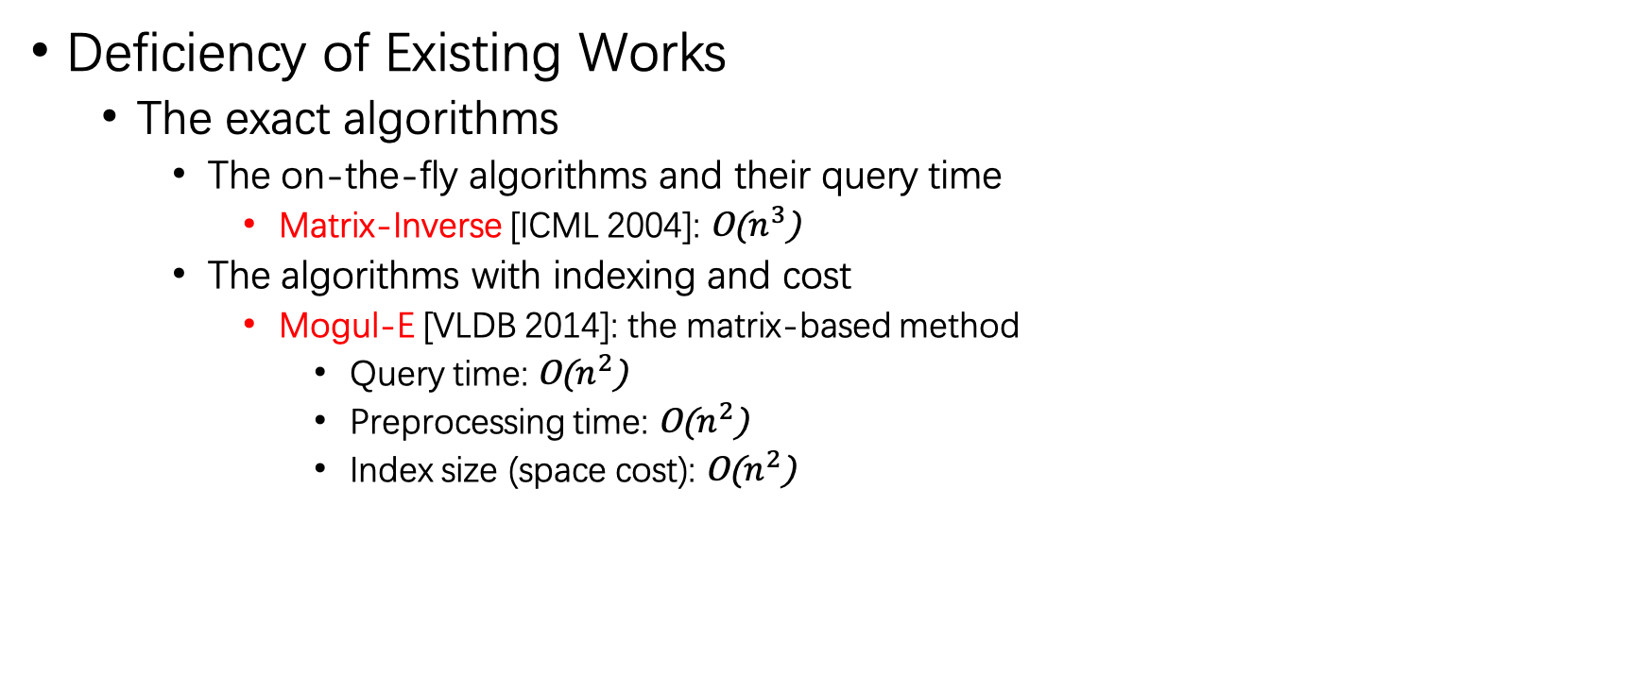
Existing works
Deficiency of Existing Works
  The exact algorithms
    The on-the-fly algorithms and their query time
      Matrix-Inverse [ICML 2004]: O($n^{3}$)
    The algorithms with indexing and cost
      Mogul-E [VLDB 2014]: the matrix-based method
        Query time: O($n^{2}$)
        Preprocessing time: O($n^{2}$)
        Index size (space cost): O($n^{2}$)

Slide 43
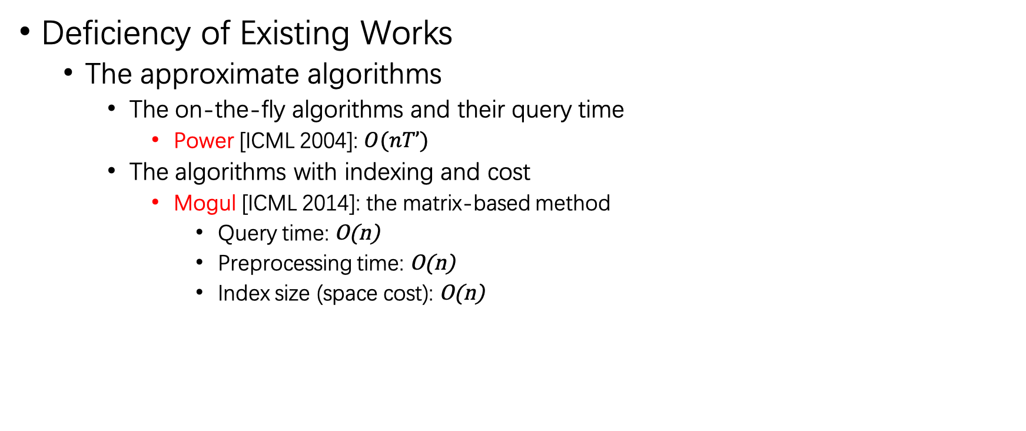
Existing works
Deficiency of Existing Works
  The approximate algorithms
    The on-the-fly algorithms and their query time
      Power [ICML 2004]: $O(nT’)$
    The algorithms with indexing and cost
      Mogul [ICML 2014]: the matrix-based method
        Query time: O(n)
        Preprocessing time: O(n)
        Index size (space cost): O(n)

Slide 44

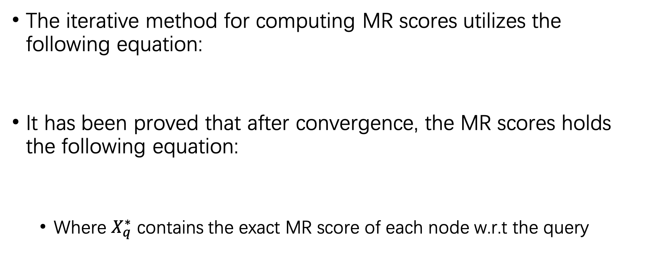
What is Manifold Ranking
The iterative method for computing MR scores utilizes the following equation:
It has been proved that after convergence, the MR scores holds the following equation:
  Where $X_{q}^{∗}$ contains the exact MR score of each node w.r.t the query
Notes:
So, it means that one can obtain the exact MR scores by matrix inversion.
However, the time cost for computing a matrix inversion is O(n^3). (n cubic)
It is too time consuming.

Slide 45
Manifold Ranking-based Image Retrieval (MRIR)
When the propagation finishes,
  The global similarity among all images can be revealed
    in the form of the final information held by each node
This is exactly the MR score of each node w.r.t the query node.
Notes:
It is easy to see that

Slide 46
Manifold Ranking-based Image Retrieval (MRIR)
Although the information propagation process of MRIR looks similar to the “influence spread” process (such as the influence maximization problem), they are different at all due to the following reason:
  The influence spread focuses on activating a node during the spread process.
    If a node is activated, it cannot be activated again.
  However, the information propagation process of MRIR focuses on propagating information from the query node to any other nodes in the graph.
    If a node has received an amount of information, it could receive again.

Slide 47
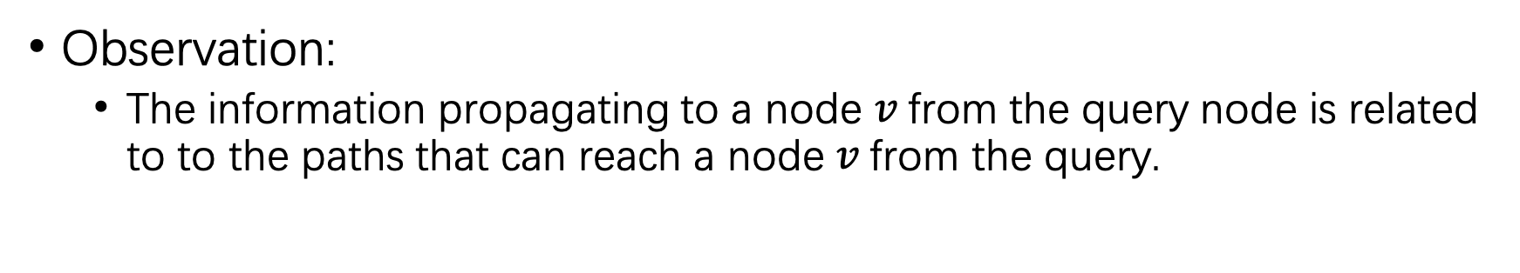
MCMR
Observation:
  The information propagating to a node $v$from the query node is related to to the paths that can reach a node $v$from the query.
Notes:
For example, node 1 is the query node.
The information that node 1 propagates to node 3 might use this path.

Slide 48
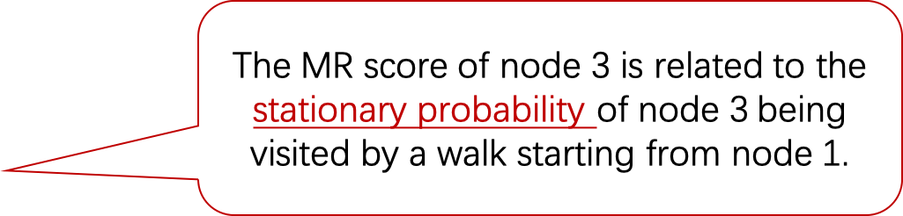
MCMR
Observation:
  The information propagating to a node $v$from the query node is related to to the paths that can reach a node $v$from the query.
The MR score of node 3 is related to the stationary probability of node 3 being visited by a walk starting from node 1.
Notes:
For example, node 1 is the query node.
The information that node 1 propagates to node 3 might use this path.

Slide 49
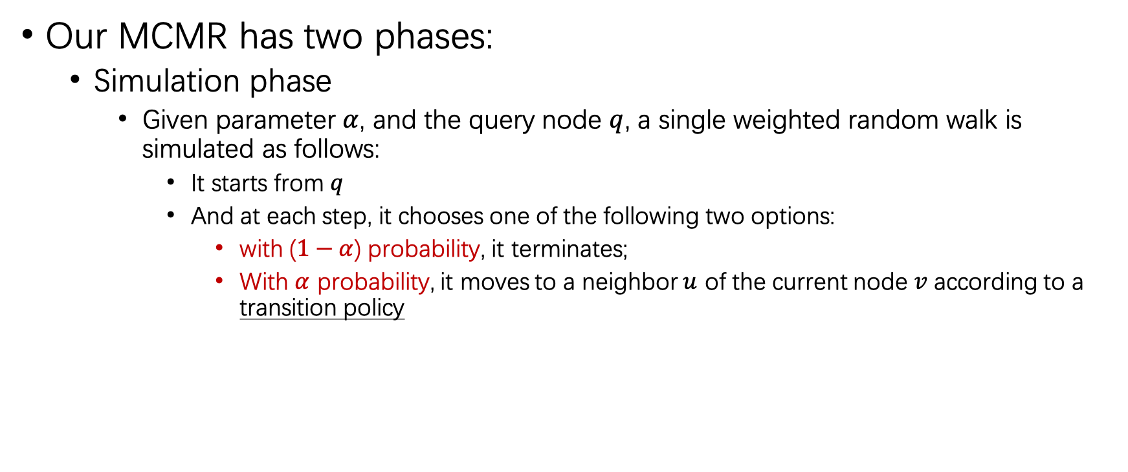
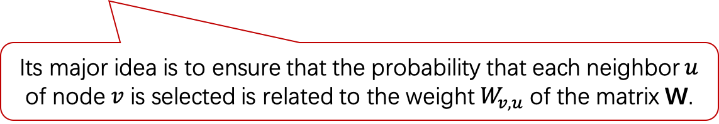
MCMR
Our MCMR has two phases:
  Simulation phase
    Given parameter $α$, and the query node $q$, a single weighted random walk is simulated as follows:
      It starts from $q$
      And at each step, it chooses one of the following two options:
        with ($1−α$) probability, it terminates;
        With $α$ probability, it moves to a neighbor $u$ of the current node $v$ according to a transition policy
Its major idea is to ensure that the probability that each neighbor $u$ of node $v$ is selected is related to the weight $W_{v,u}$ of the matrix W.

Slide 50
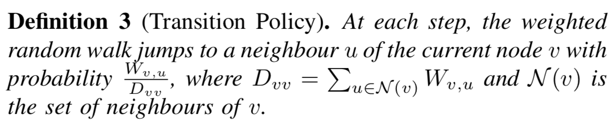
MCMR
Our MCMR has two phases:
  Simulation phase
    Given parameter $α$, and the query node $q$, a single weighted random walk is simulated as follows:
      It starts from $q$
      And at each step, it chooses one of the following two options:
        with ($1−α$) probability, it terminates;
        With $α$ probability, it moves to a neighbor $u$ of the current node $v$ according to a transition policy

Slide 51

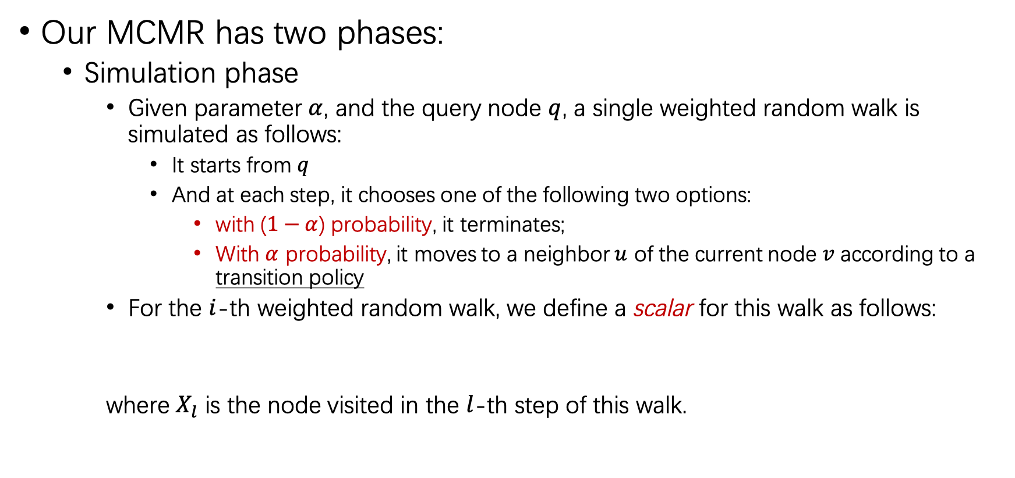
MCMR
Our MCMR has two phases:
  Simulation phase
    Given parameter $α$, and the query node $q$, a single weighted random walk is simulated as follows:
      It starts from $q$
      And at each step, it chooses one of the following two options:
        with ($1−α$) probability, it terminates;
        With $α$ probability, it moves to a neighbor $u$ of the current node $v$ according to a transition policy
    For the $i$-th weighted random walk, we define a scalar for this walk as follows:
    where $X_{l}$ is the node visited in the $l$-th step of this walk.
Notes:
That means, at each step, it needs to collect the information D_xl xl

Slide 52


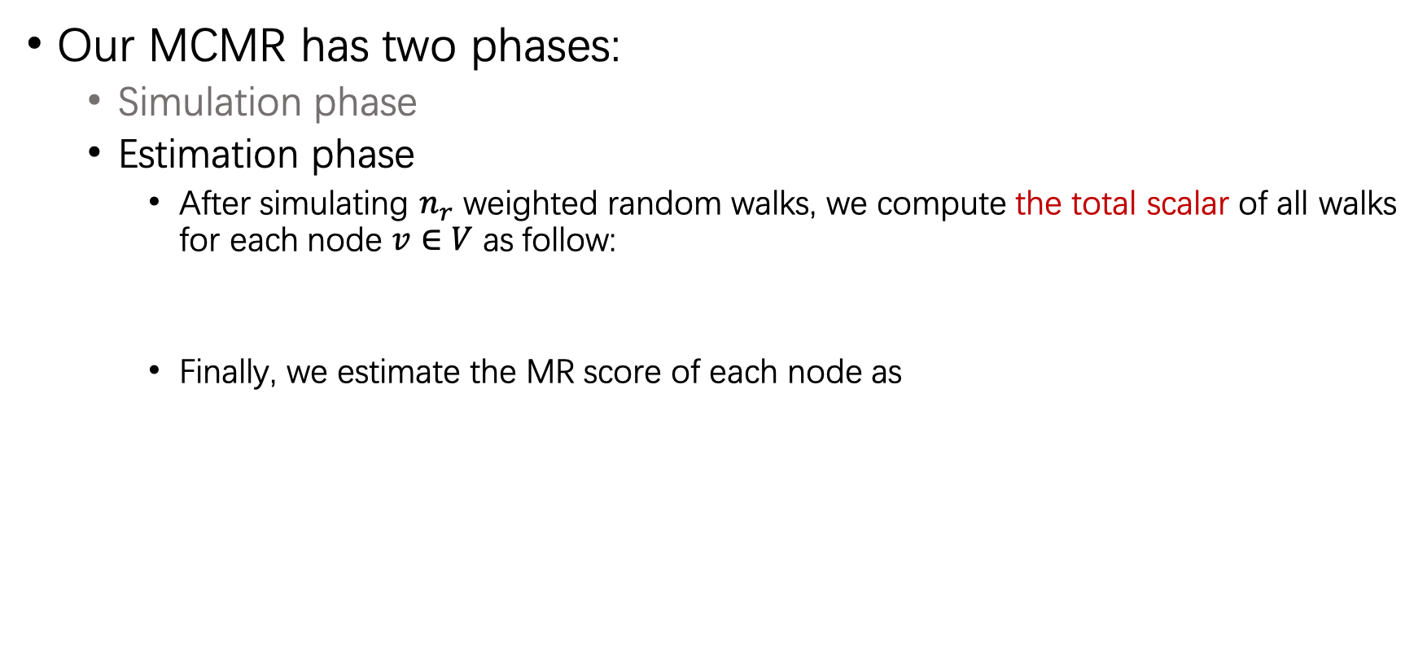
MCMR
Our MCMR has two phases:
  Simulation phase
  Estimation phase
    After simulating $n_{r}$ weighted random walks, we compute the total scalar of all walks for each node $v∈V$ as follow:
    Finally, we estimate the MR score of each node as
Notes:
We proved that the estimator by this method is unbiased and the expectation of this estimator is the exact MR score.
Meanwhile, we gave that for the top-k query, when the number of random walks are specified, the precision of the top-k results could be guaranteed.

Slide 53
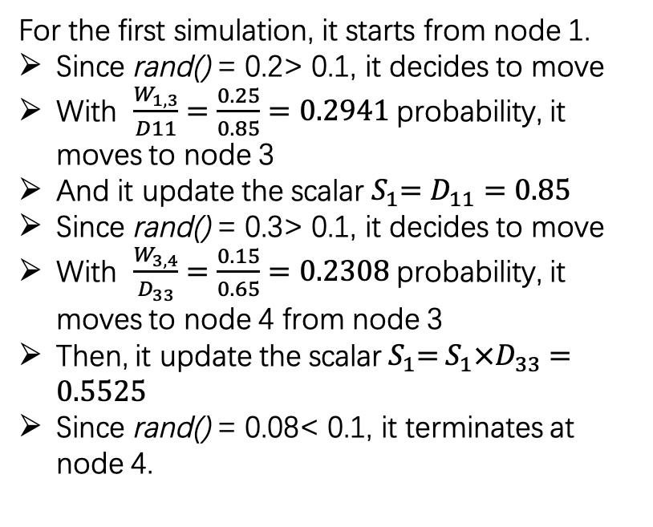
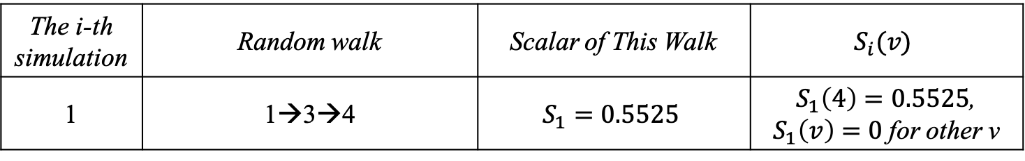
MCMR
The i-th simulation | Random walk | Scalar of This Walk | $$S_{i}(v)$$
1 | 1→3→4 | $$S_{1}=0.5525$$ | $S_{1}\left(4\right)=0.5525$, $S_{1}\left(v\right)=0$ for other v
Running example
  Node 1 is the query node
  $termination probability 1−α=0.1$
For the first simulation, it starts from node 1.
Since rand() = 0.2> 0.1, it decides to move
With $\frac{W_{1,3}}{D11}=\frac{0.25}{0.85}=0.2941$ probability, it moves to node 3
And it update the scalar${ S}_{1}=D_{11}=0.85$
Since rand() = 0.3> 0.1, it decides to move
With $\frac{W_{3,4}}{D_{33}}=\frac{0.15}{0.65}=0.2308$ probability, it moves to node 4 from node 3
Then, it update the scalar${ S}_{1}={ S}_{1}×D_{33}=0.5525$
Since rand() = 0.08< 0.1, it terminates at node 4.
Notes:
The table shows the sum of weights for each node in the graph.
Node 1 is the query node.
In the simulation phase,

Slide 54
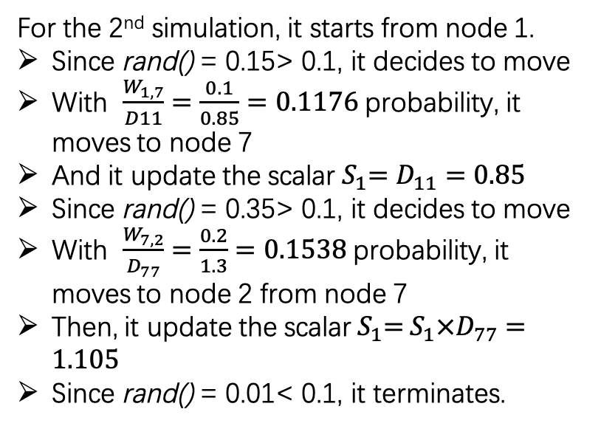
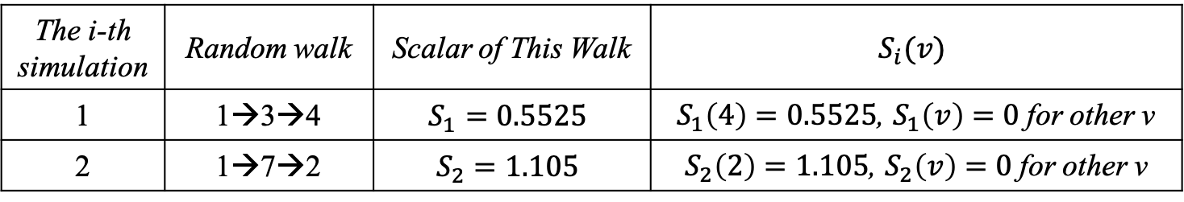
MCMR
The i-th simulation | Random walk | Scalar of This Walk | $$S_{i}(v)$$
1 | 1→3→4 | $$S_{1}=0.5525$$ | $S_{1}\left(4\right)=0.5525$, $S_{1}\left(v\right)=0$ for other v
2 | 1→7→2 | $$S_{2}=1.105$$ | $S_{2}\left(2\right)=1.105$, $S_{2}\left(v\right)=0$ for other v
Running example
  Node 1 is the query node
  $termination probability 1−α=0.1$
For the 2nd simulation, it starts from node 1.
Since rand() = 0.15> 0.1, it decides to move
With $\frac{W_{1,7}}{D11}=\frac{0.1}{0.85}=0.1176$ probability, it moves to node 7
And it update the scalar${ S}_{1}=D_{11}=0.85$
Since rand() = 0.35> 0.1, it decides to move
With $\frac{W_{7,2}}{D_{77}}=\frac{0.2}{1.3}=0.1538$ probability, it moves to node 2 from node 7
Then, it update the scalar${ S}_{1}={ S}_{1}×D_{77}=1.105$
Since rand() = 0.01< 0.1, it terminates.
Similar simulations could be done.
Notes:
The table shows the sum of weights for each node in the graph.
Node 1 is the query node.
In the simulation phase,

Slide 55
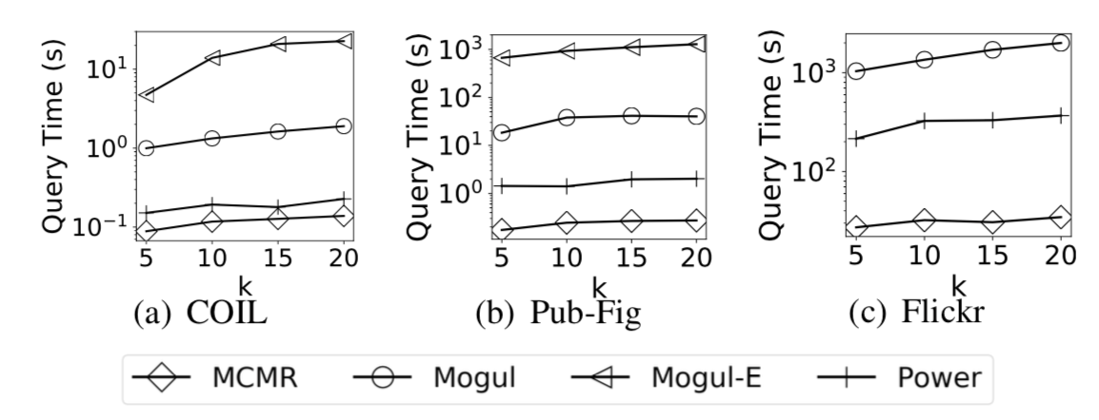
Experiments
Results of efficiency
  Average query time on different datasets

Slide 56
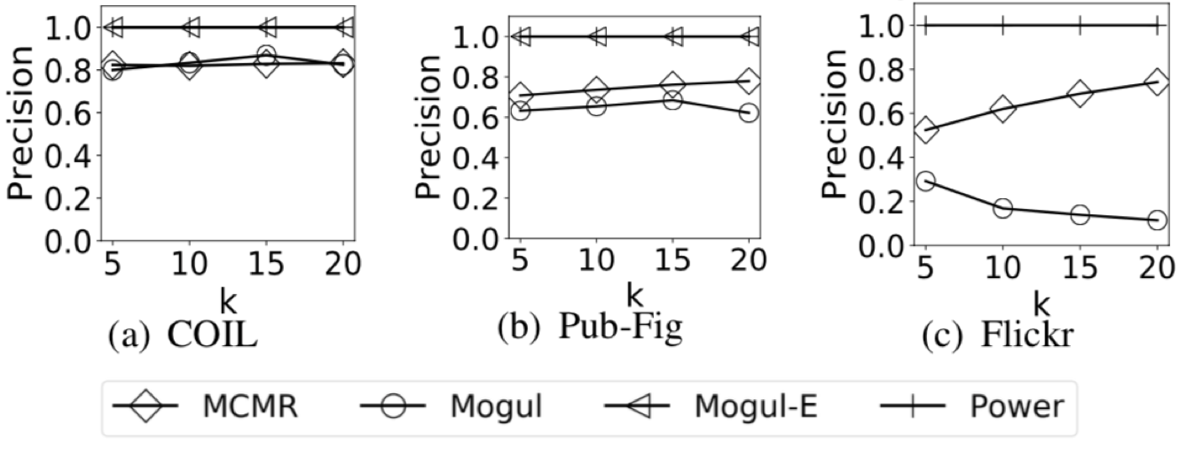
Experiments
Results of accuracy
  Average precision on different datasets

