Slide 1
Architecture-Intact Oracle for Fastest Path and Time Queries on Dynamic Spatial Networks
Victor Junqiu Wei (Noah’s Ark Lab, Huawei Technologies),
Raymond Chi-Wing Wong (The Hong Kong University of Science and Technology),
Cheng Long (Nanyang Technological University)
Presented by Victor Junqiu Wei
Prepared by Victor Junqiu Wei
Notes:
In this work, we proposed a new problem, namely nearby-fit spatial keyword queries.

Slide 2
Outline
Introduction
  Related Work
Problem Statement
Proposed Algorithm
Experiment
Conclusion & Future Works
Notes:
Here is the outline. I will give an introduction first and then formally define the problem and present the proposed algorithms and the experiments. Finally, I will conclude the work and propose several research directions in the future.

Slide 3
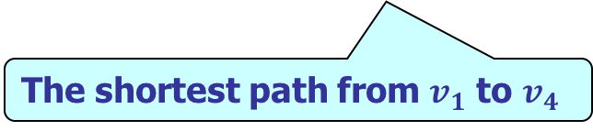

1. Introduction
Road Network
  Consists of vertices, weighted edges
  Shortest Distance/Path Between s and t
The shortest distance from $v_{1}$ to $v_{4}$ is 5.
The shortest path from $v_{1}$ to $v_{4}$
Notes:
First, what is a spatial network? It consists of vertices and edges. Each vertex has a location and each edge has a weight. The physical meaning of the weight could be distance or travle time. This figure shows an example of a spatial work. It has 8 vertices. The shortest path from v1 to v4 is the red path and the shortest distance from v1 to v4 is the length of the red path which is 5.

Slide 4
1. Introduction
Shortest Distance/Path Queries on Dynamic Road Networks
  It is important to compute the shortest distance/path in real time.
    Emergency applications: delivering ambulances to the target areas.
  Road networks are highly dynamic and unpredictable.
    Car accidents, traffic congestions, public events, etc.
Notes:
The shortest distance and shortest path queries are building blocks for many database and data mining algorithm. For example, in the optimal location finding problem, the shortest distance queries are frequently performed to measure the goodness of a location. In the clustering, it is important to measure the inner-cluster and inter-cluster distances.
The shortest distance and shortest path queries are also subroutines for the spatial analytical queries. For example, the figure shows the geographical heat map for the average drive distance from living place to work place for people in California. This is of immense interest of transportation planners and was computed from the US Census Bureau by performing 13, 645, 807 road network distance computations.

Slide 5
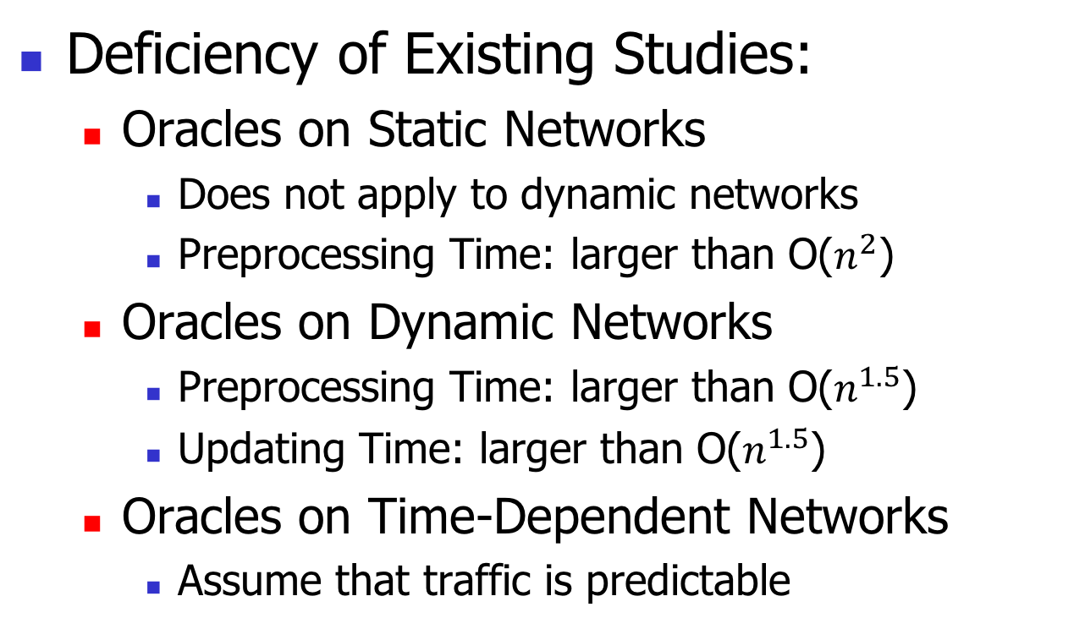
1. Introduction
Deficiency of Existing Studies:
  Oracles on Static Networks
    Does not apply to dynamic networks
    Preprocessing Time: larger than O($n^{2}$)
  Oracles on Dynamic Networks
    Preprocessing Time: larger than O($n^{1.5}$)
    Updating Time: larger than O($n^{1.5}$)
  Oracles on Time-Dependent Networks
    Assume that traffic is predictable
Their empirical updating time is not small enough.
Different from our problem setting.
Notes:
In this work, …...

Slide 6
1. Introduction
Our Contributions:
  We proposed a novel distance and path oracle for dynamic road networks.
  We derived theoretical bounds and remarkably, our oracle is the first one which has a poly-log updating time.
  We conducted experiments on real and synthetic datasets and verified the efficiency of our algorithms.
Notes:
In this work, …...

Slide 7
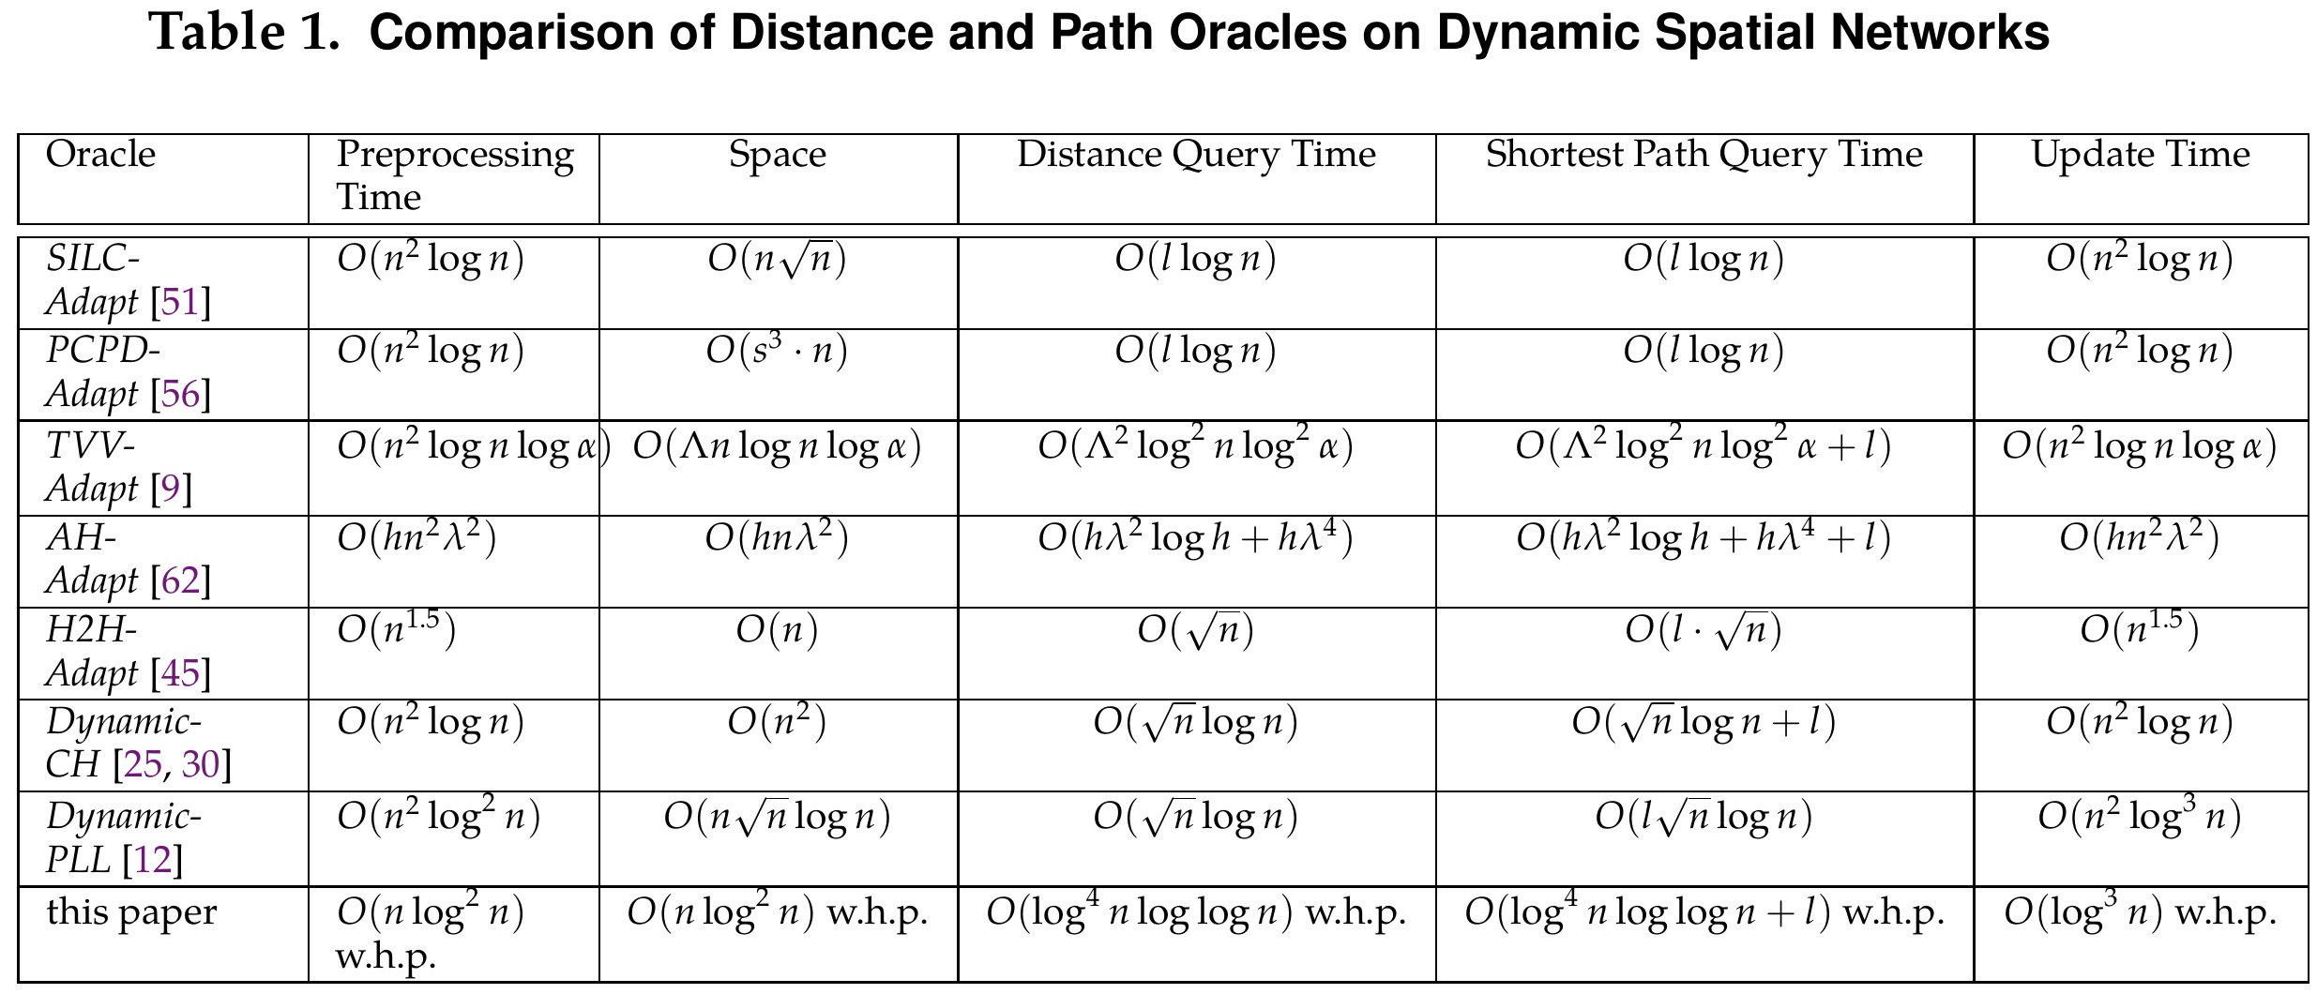
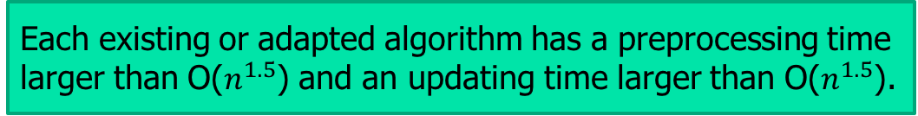
1. Introduction
Each existing or adapted algorithm has a preprocessing time larger than O($n^{1.5}$) and an updating time larger than O($n^{1.5}$).
Comparison in Theory.
  Adapted from Oracles on Static Networks
  Oracles on Dynamic Networks
  Ours has a O($n\log^{2}n$) preprocessing time and a O($\log^{3}n$) updating time w.h.p.
Notes:
In this work, …...

Slide 8
Outline
Introduction
  Related Work
Problem Statement
Proposed Algorithm
Experiment
Conclusion & Future Works

Slide 9
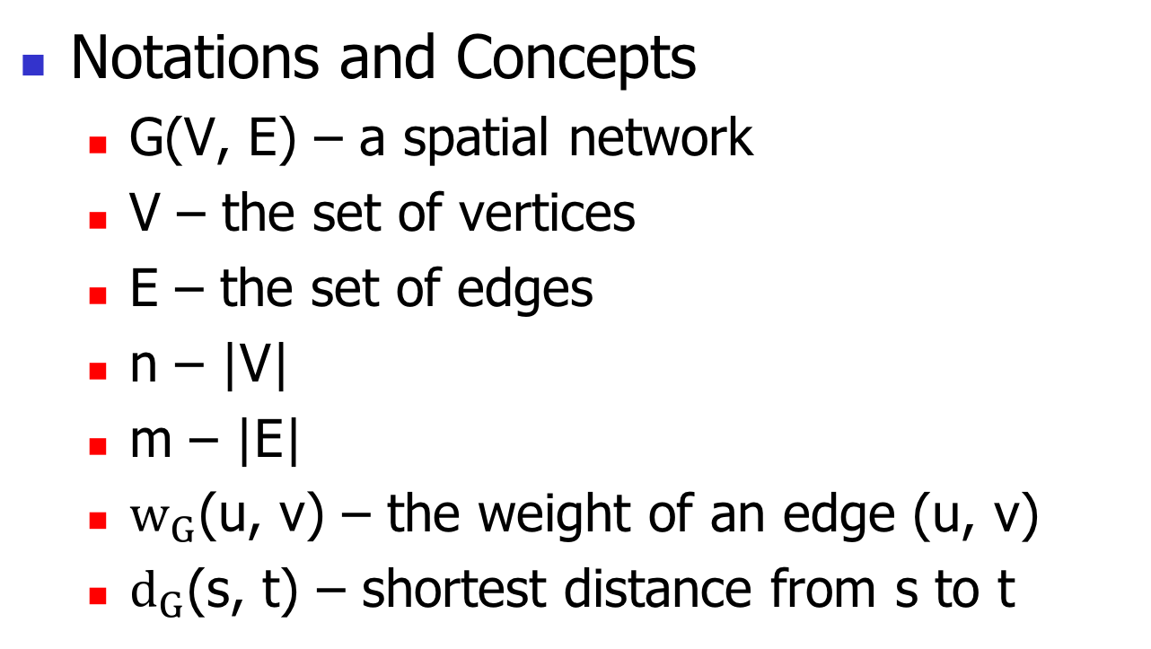
2. Problem Definition
Notations and Concepts
  G(V, E) – a spatial network
  V – the set of vertices
  E – the set of edges
  n – |V|
  m – |E|
  $w_{G}\text{(}\text{u}\text{, }\text{v}\text{)}$ – the weight of an edge (u, v)
  $d_{G}$(s, t) – shortest distance from s to t
Notes:
Let G(V, E) denote …...
In this example, there are 8 vertices so n = 8. The shortest path from v1 to v4 is ......$d_{G}$($v_{1}$, $v_{4}$) is equal to 5.
Our problem is that …...

Slide 10
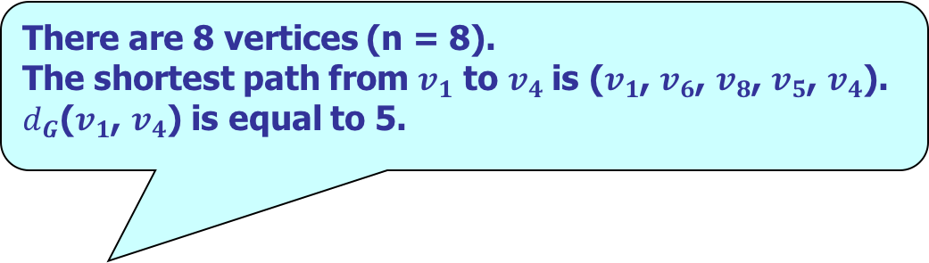

2. Problem Definition
There are 8 vertices (n = 8).
The shortest path from $v_{1}$ to $v_{4}$is ($v_{1}$, $v_{6}$, $v_{8}$, $v_{5}$, $v_{4}$).
$d_{G}$($v_{1}$, $v_{4}$) is equal to 5.
Notations and Concepts
$$Problem$$
We would like to design an oracle that supports a short update time, and at the same time, answers any shortest path/distance query efficiently.
Notes:
Let G(V, E) denote …...
In this example, there are 8 vertices so n = 8. The shortest path from v1 to v4 is ......$d_{G}$($v_{1}$, $v_{4}$) is equal to 5.
Our problem is that …...

Slide 11
Outline
Introduction
  Related Work
Problem Statement
Proposed Algorithm
Experiment
Conclusion & Future Works

Slide 12
3. Proposed Algorithm
    Each existing architecture has to satisfy many constraints or properties. Thus, it is costly to dynamically maintain an architecture. The reason why our oracle is efficient in terms of updating time is that it satisfies the architecture-intact property.
Preliminary: Architecture-intact
Architecture: Given a data structure, the architecture of this data structure is defined to be a set of all components in this data structure excluding all non-structural information (e.g., the weight information).
Architecture-intact Property: We say that an oracle constructed from a spatial network satisfies the architecture-intact property if the architecture of the data structure used in this oracle remains unchanged even when there is an update on the weight of an edge in the spatial network.
Our proposed oracle satisfies the property but all existing oracles (including existing oracles on dynamic networks and oracles adapted from the ones on static networks) do not satisfy.
Notes:
The last technique is called Hierarchy Technique. It imposes a total order of all vertices and then add some auxiliary edges, namely shortcuts, into the network and obtain a transformed network G’. Consider the road network. due to the time limit of the prestnation, we will not mention the details of the method about the ordering. If you are interested in it, you could ask it in the Q&A session. The vertices are in the order of v1, v2, v3, …. And so on so forth. v1 has the lowest order and v8 has the highest order. The dot edge is a shortcut. Each solid edge is an edge in the original network. The transformed network G’ has two important features. The first one is that ror any two vertices s and t, 𝑑_𝐆 "(s, t)"=𝑑_𝐆′ "(s, t)". The second one is that in G’, for any two vertices s and t, there is a shortest path from s to t satisfying some properties based on the total order of vertices.

Slide 13
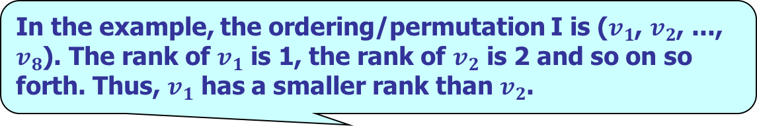
3. Proposed Algorithm
    In the example, the ordering/permutation I is ($v_{1}$, $v_{2}$, ..., $v_{8}$). The rank of $v_{1}$ is 1, the rank of $v_{2}$ is 2 and so on so forth. Thus, $v_{1}$ has a smaller rank than $v_{2}$.
Key Concepts
Rank of A Vertex: Given an ordering/permutation I of all vertices, the rank of each vertex v in V is defined to be its position of this ordering/permutation I.
Notes:
Next, let me explain how to do query processing. It first finds the shortest path from s to t on G’ satisfying an order constraint. Specifically, the order constraint means that the shortest path satisfies the properties based on the total order of vertices as mentioned before. Then, it finds the shortest path on the original network G based on the shortest path on G’. Details are omitted here.

Slide 14
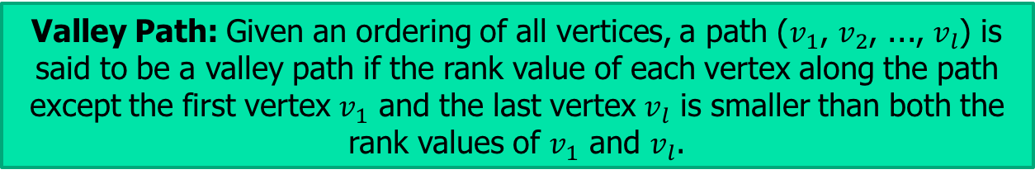
3. Proposed Algorithm
Key Concepts
Valley Path: Given an ordering of all vertices, a path ($v_{1}$, $v_{2}$, ..., $v_{l}$) is said to be a valley path if the rank value of each vertex along the path except the first vertex $v_{1}$ and the last vertex $v_{l}$ is smaller than both the rank values of $v_{1}$ and $v_{l}$.
Ternary Valley Path: Given an ordering of all vertices, we say that a path is a ternary valley path if it is a valley path and this path involves 3 vertices only.
Notes:
Next, let me explain how to do query processing. It first finds the shortest path from s to t on G’ satisfying an order constraint. Specifically, the order constraint means that the shortest path satisfies the properties based on the total order of vertices as mentioned before. Then, it finds the shortest path on the original network G based on the shortest path on G’. Details are omitted here.

Slide 15
3. Proposed Algorithm
Property 1 (Shortcut Property): For each pair of vertices, namely u and v, such that there exists a valley path from u to v, G ′ must have a shortcut from u to v (i.e., edge (u, v)) with weight equal to the length of the shortest valley path from u to v on the original network G.
Property 2 (Ternary Valley Path Property). The shortest valley path from u to v on G has the length equal to min{w, w′ }.
Our Oracle: Update Efficient (UE)
  Preprocessing Phase:
    Impose a Randomized Ordering of Vertices.
    Initialize G’ to be the original network G.
    Contract Vertices One by One in Order:
      In the contraction of a vertex o:
        For each pair of (u, v), where u and v are neighbors of o, we add a shortcut (u, v) to G’ if (u, v) does not exist in G.
        Update the weight of (u, v) to be min{w, w’}.
    Output G’
    Promises attractive theoretical performance with high probability.
Let w be the length of the shortest ternary valley path from vertex u to vertex v on the UE spatial network G′ . Let w′ be the weight of the edge (u, v) (if any) on the original graph G (if there is no edge (u, v) on G, w′ is set to ∞).
Architecture-Intact: The definition of our shortcuts is independent of the weight information and only related to the topology of G and ordering of vertices. Thus, the topology of G’ keeps intact.
    I.e., we add a shortcut (u, v) iff there is a valley path from u to v in G.
Notes:
Next, let me explain how to do query processing. It first finds the shortest path from s to t on G’ satisfying an order constraint. Specifically, the order constraint means that the shortest path satisfies the properties based on the total order of vertices as mentioned before. Then, it finds the shortest path on the original network G based on the shortest path on G’. Details are omitted here.

Slide 16
3. Proposed Algorithm
    Due to Property 2 (Ternary Valley Path Property), it is sufficient to check w and w’ when (x, v) is updated.
Let w be the length of the shortest ternary valley path from vertex x to vertex v on the UE spatial network G ′. Let w′ be the weight of the edge (x, v) (if any) on the original graph G (if there is no edge (x, v) on G, w′ is set to ∞).
Our Oracle: Update Efficient (UE)
  Updating Phase
    From the edge with a weight update, search and update the affected weights of the shortcuts in a BFS fashion.
    Update the weight of (x, v) to be min{w, w’}. If the weight of (x, v) is changed, recursively updated the shortcuts affected by the change of the weight of (x, v).
    Very efficient due to the Architecture-intact property (i.e., there is no need to insert/delete shortcuts due to the definition of shortcut) .
Notes:
Next, let me explain how to do query processing. It first finds the shortest path from s to t on G’ satisfying an order constraint. Specifically, the order constraint means that the shortest path satisfies the properties based on the total order of vertices as mentioned before. Then, it finds the shortest path on the original network G based on the shortest path on G’. Details are omitted here.

Slide 17
3. Proposed Algorithm
    Order Constraint: explore the vertices with high ranks only in the forward/backward search.
Our Oracle: Update Efficient (UE)
  Query Phase
    To find the shortest path on G’, perform a Bi-Dijkstra’s Search with an Order Constraint
    Find the shortest path on the original network G based on the shortest path on G’.
    Correctness is ensured due to Property 1 (Shortcut Property).
Notes:
Next, let me explain how to do query processing. It first finds the shortest path from s to t on G’ satisfying an order constraint. Specifically, the order constraint means that the shortest path satisfies the properties based on the total order of vertices as mentioned before. Then, it finds the shortest path on the original network G based on the shortest path on G’. Details are omitted here.

Slide 18
Outline
Introduction
  Related Work
Problem Statement
Proposed Algorithms
Experiment
Conclusion & Future Works

Slide 19
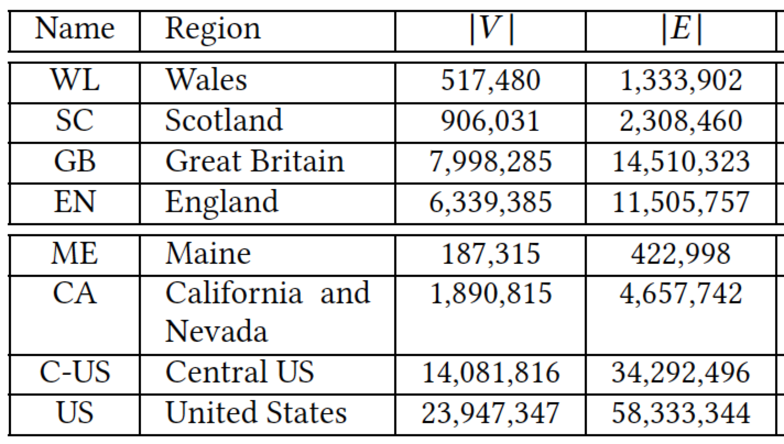
4. Experiment
Datasets
  Linux Machine (2.67Hz CPU and 48GB memory).
  Algorithms (implemented in C++)
    Baselines: SILC-Adapt, PCPD-Adapt, AH-Adapt, H2H-Adapt, Dynamic-CH, Dynamic-PLL, BPL.

Slide 20
4. Experiment
    Other algorithms are 2-3 orders of magnitudes slower in terms of updating time which could not be finished in a reasonable time. Thus, we do not show here.
  Result (Updating Time)
    Several Orders of magnitudes faster than baselines.

Slide 21
4. Experiment
    Although the query time of UE is not fastest, its query time is fast enough (i.e., with 1 ms) for real applications.
    Note that the update time of UE is the fastest (several orders magnitude faster than baselines).
Result (Query Time)

Slide 22
Outline
Introduction
  Related Work
Problem Statement
Proposed Algorithms
Experiment
Conclusion & Future Works

Slide 23
5. Conclusion & Future Works
In this paper, we proposed a distance and path oracle on dynamic spatial networks
We derived theoretical bounds on the proposed oracle and remarkably, it has a poly-log updating time.
Our experiments demonstrate that our oracle is very efficient and scalable on sizable networks.
It is interesting to further design more advanced updating algorithm for UE.

Slide 24
Q&A

Slide 25
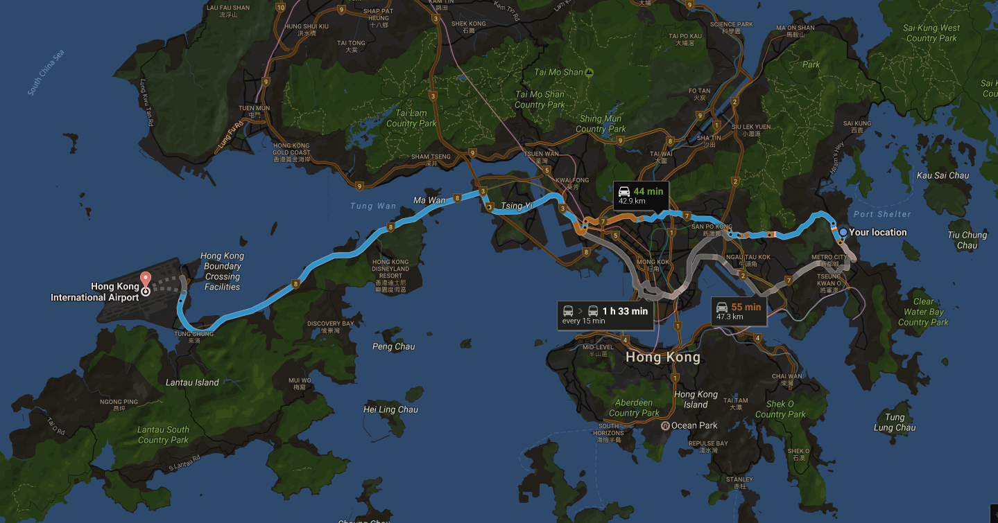
1. Introduction
Shortest Distance/Path Queries on Dynamic Road Networks
  Application:
    The shortest path/distance queries are frequently used in Location-Based Services such as navigations.
Notes:
This shortest path and shortest distance queries on the spatial networks have two important applications. First, they are frequently used in the LBS such as navigations. The figure shows the navigation service provided by Google Map. The blue path is a shortest path from UST to the airport. It provides a route for the drivers.

Slide 26
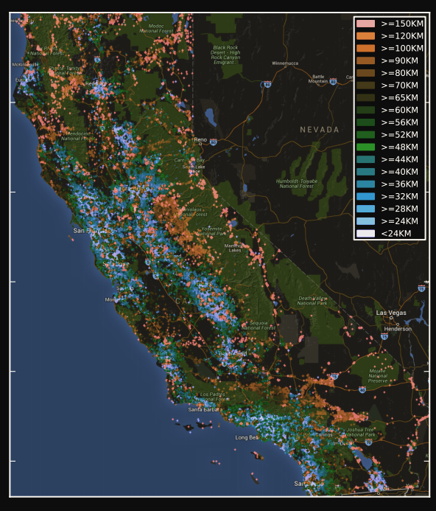
1. Introduction
Geographical heat map for the average drive distance from living place to workplace for people in California.
13, 645, 807 shortest distance computations
Shortest Distance/Path Queries on Dynamic Road Networks
  Application 2:
    A building block for many database and data mining algorithms such as optimal location finding and clustering.
  Application 3:
    A subroutine for the spatial analytical queries where millions of shortest distance queries are required.
Notes:
The shortest distance and shortest path queries are building blocks for many database and data mining algorithm. For example, in the optimal location finding problem, the shortest distance queries are frequently performed to measure the goodness of a location. In the clustering, it is important to measure the inner-cluster and inter-cluster distances.
The shortest distance and shortest path queries are also subroutines for the spatial analytical queries. For example, the figure shows the geographical heat map for the average drive distance from living place to work place for people in California. This is of immense interest of transportation planners and was computed from the US Census Bureau by performing 13, 645, 807 road network distance computations.

Slide 27
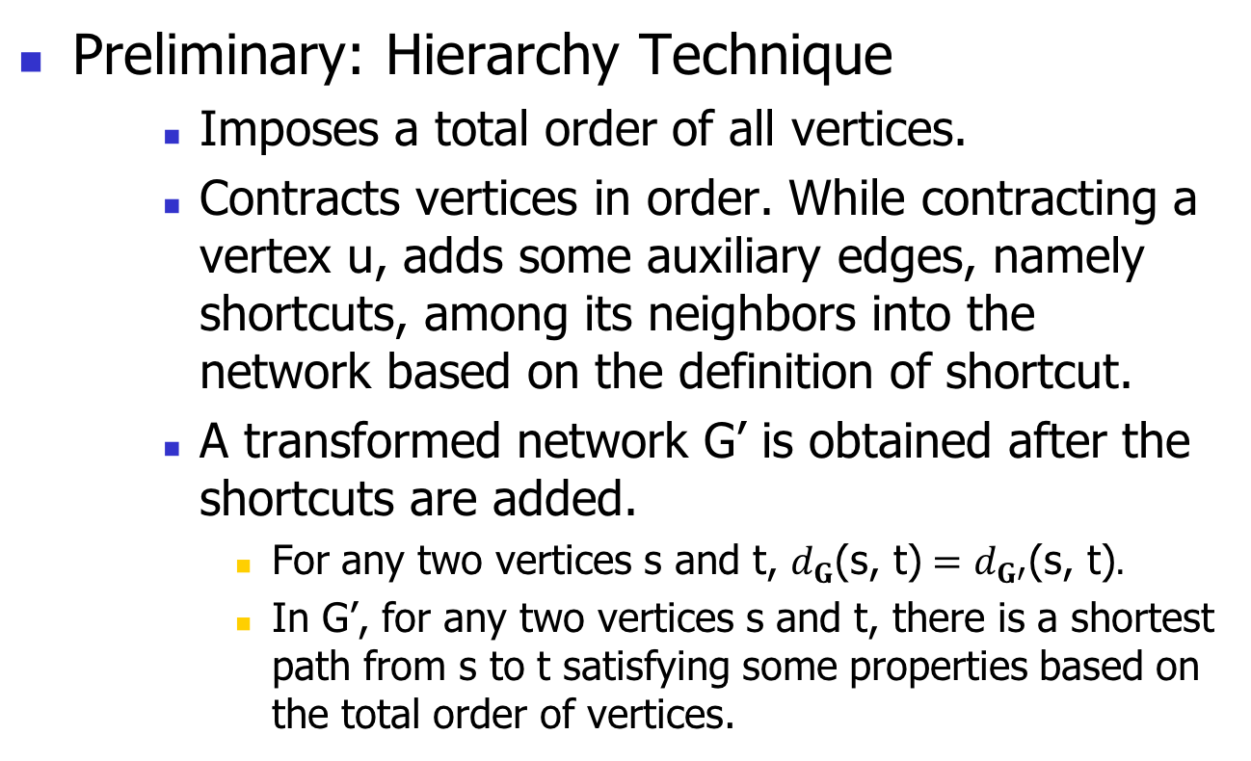
3. Proposed Algorithm
ESA 2008
SIGMOD 2013
Preliminary: Hierarchy Technique
    Imposes a total order of all vertices.
    Contracts vertices in order. While contracting a vertex u, adds some auxiliary edges, namely shortcuts, among its neighbors into the network based on the definition of shortcut.
    A transformed network G’ is obtained after the shortcuts are added.
      For any two vertices s and t, $d_{G}\text{(}\text{s}\text{,} \text{t}\text{)}=d_{G′}\text{(}\text{s}\text{,} \text{t}\text{)}.$
      In G’, for any two vertices s and t, there is a shortest path from s to t satisfying some properties based on the total order of vertices.
Notes:
The last technique is called Hierarchy Technique. It imposes a total order of all vertices and then add some auxiliary edges, namely shortcuts, into the network and obtain a transformed network G’. Consider the road network. due to the time limit of the prestnation, we will not mention the details of the method about the ordering. If you are interested in it, you could ask it in the Q&A session. The vertices are in the order of v1, v2, v3, …. And so on so forth. v1 has the lowest order and v8 has the highest order. The dot edge is a shortcut. Each solid edge is an edge in the original network. The transformed network G’ has two important features. The first one is that ror any two vertices s and t, 𝑑_𝐆 "(s, t)"=𝑑_𝐆′ "(s, t)". The second one is that in G’, for any two vertices s and t, there is a shortest path from s to t satisfying some properties based on the total order of vertices.

Slide 28
3. Proposed Algorithm
    Contraction Hierarchy (CH), ESA 2008
    Arterial Hierarchy (AH), SIGMOD 2013
    Specifically, the shortest path satisfies the properties based on the total order of vertices as mentioned before.
Preliminary: Hierarchy Technique
    Query Processing
      To find the shortest path on G’, perform a Bi-Dijkstra’s Search with an Order Constraint
      Find the shortest path on the original network G based on the shortest path on G’.
ESA 2008
SIGMOD 2013
Higher Rank
Notes:
Next, let me explain how to do query processing. It first finds the shortest path from s to t on G’ satisfying an order constraint. Specifically, the order constraint means that the shortest path satisfies the properties based on the total order of vertices as mentioned before. Then, it finds the shortest path on the original network G based on the shortest path on G’. Details are omitted here.

Slide 29

3. Proposed Algorithm
Key Concepts
Valley Path: A path ($v_{1}$, $v_{2}$, ..., $v_{l}$) is said to be a valley path if the rank value of each vertex along the path except the first vertex $v_{1}$ and the last vertex $v_{l}$ is smaller than both the rank values of $v_{1}$ and $v_{l}$.
Ternary Valley Path: We say that a valley path from a vertex to another vertex is ternary if this path involves 3 vertices only.
Notes:
Next, let me explain how to do query processing. It first finds the shortest path from s to t on G’ satisfying an order constraint. Specifically, the order constraint means that the shortest path satisfies the properties based on the total order of vertices as mentioned before. Then, it finds the shortest path on the original network G based on the shortest path on G’. Details are omitted here.

Slide 30
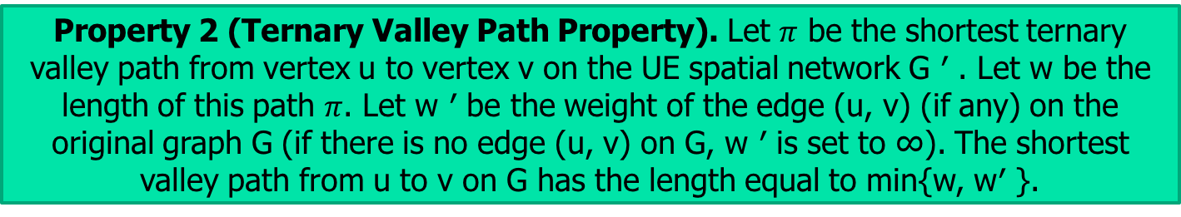
3. Proposed Algorithm
Our Oracle: Update Efficient (UE)
  Preprocessing Phase:
    Impose a Randomized Ordering of Vertices.
    A Novel Definition of Shortcut.
      Independent of the weight information of edges.
      Thus, UE is Architecture-intact (i.e., the topology of G’ always keeps intact).
    We add a shortcut (u, v) iff there is a valley path from u to v in G.
Property 2 (Ternary Valley Path Property). Let $π$ be the shortest ternary valley path from vertex u to vertex v on the UE spatial network G ′ . Let w be the length of this path $π$. Let w ′ be the weight of the edge (u, v) (if any) on the original graph G (if there is no edge (u, v) on G, w ′ is set to ∞). The shortest valley path from u to v on G has the length equal to min{w, w′ }.
Notes:
Next, let me explain how to do query processing. It first finds the shortest path from s to t on G’ satisfying an order constraint. Specifically, the order constraint means that the shortest path satisfies the properties based on the total order of vertices as mentioned before. Then, it finds the shortest path on the original network G based on the shortest path on G’. Details are omitted here.

Slide 31
3. Proposed Algorithm
Our Oracle: Update Efficient (UE)
  Preprocessing Phase:
    Impose a Randomized Ordering of Vertices.
    A Novel Definition of Shortcut.
      Independent of the weight information of edges.
      Thus, UE is Architecture-intact (i.e., the topology of G’ always keeps intact).
    We add a shortcut (u, v) iff there is a valley path from u to v in G.
Property 1 (Shortcut Property). For each pair of vertices, namely u and v, such that there exists a valley path from u to v, G ′ must have a shortcut from u to v (i.e., edge (u, v)) with weight equal to the length of the shortest valley path from u to v on the original network G.
Notes:
Next, let me explain how to do query processing. It first finds the shortest path from s to t on G’ satisfying an order constraint. Specifically, the order constraint means that the shortest path satisfies the properties based on the total order of vertices as mentioned before. Then, it finds the shortest path on the original network G based on the shortest path on G’. Details are omitted here.

Slide 32
3. Proposed Algorithm
Our Oracle: Update Efficient (UE)
  Preprocessing Phase:
    Impose a Randomized Ordering of Vertices.
    A Novel Definition of Shortcut.
      Independent of the weight information of edges.
      Thus, UE is Architecture-intact (i.e., the topology of G’ always keeps intact).
    We add a shortcut (u, v) iff there is a valley path from u to v in G.
Property 2 (Ternary Valley Path Property). Let $π$ be the shortest ternary valley path from vertex u to vertex v on the UE spatial network G ′ . Let w be the length of this path $π$. Let w ′ be the weight of the edge (u, v) (if any) on the original graph G (if there is no edge (u, v) on G, w ′ is set to ∞). The shortest valley path from u to v on G has the length equal to min{w, w′ }.
Notes:
Next, let me explain how to do query processing. It first finds the shortest path from s to t on G’ satisfying an order constraint. Specifically, the order constraint means that the shortest path satisfies the properties based on the total order of vertices as mentioned before. Then, it finds the shortest path on the original network G based on the shortest path on G’. Details are omitted here.

Slide 33
2. Problem Definition
There are 8 vertices (n = 8).
The shortest path from $v_{1}$ to $v_{4}$is ($v_{1}$, $v_{6}$, $v_{8}$, $v_{5}$, $v_{4}$).
$d_{G}$($v_{1}$, $v_{4}$) is equal to 5.
Notations and Concepts
  G(V, E) – a spatial network
  V – the set of vertices
  E – the set of edges
  n – |V|
  m – |E|
  $w_{G}\text{(}\text{u}\text{, }\text{v}\text{)}$ – the weight of an edge (u, v)
  $d_{G}$(s, t) – shortest distance from s to t
$$Problem$$
We would like to design an oracle that supports a short update time, and at the same time, answers any shortest path/distance query efficiently.
Notes:
Let G(V, E) denote …...
In this example, there are 8 vertices so n = 8. The shortest path from v1 to v4 is ......$d_{G}$($v_{1}$, $v_{4}$) is equal to 5.
Our problem is that …...

Slide 34
3. Proposed Algorithm
    Contracts vertices in order. While contracting a vertex u, adds some auxiliary edges, namely shortcuts, among its neighbors into the network based on the definition of shortcut.
    A transformed network G’ is obtained after the shortcuts are added.
    Promises attractive theoretical performance with high probability.
Our Oracle: Update Efficient (UE)
  Overview:
    Randomized Ordering of Vertices.
    A Novel Definition of Shortcut.
      Independent of the weight information of edges.
      Thus, UE is Architecture-intact (i.e., the topology of the transformed network G’ always keeps intact when the edge weight changes).
    Efficient Updating Algorithm.
      From the edge with a weight update, search and update the affected weights of the shortcuts in a BFS fashion.
    Very efficient due to the Architecture-intact property.
Notes:
Next, let me explain how to do query processing. It first finds the shortest path from s to t on G’ satisfying an order constraint. Specifically, the order constraint means that the shortest path satisfies the properties based on the total order of vertices as mentioned before. Then, it finds the shortest path on the original network G based on the shortest path on G’. Details are omitted here.

