Slide 1
Activity (or Process), State, and Event-based Knowledge Graphs
Yangqiu Song
Department of CSE, HKUST

Slide 2
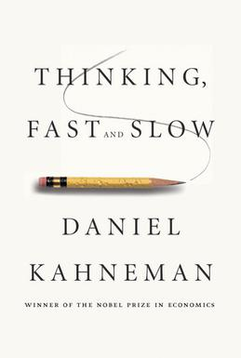
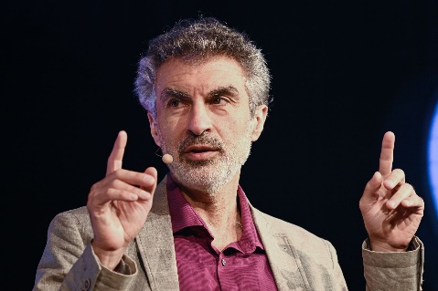
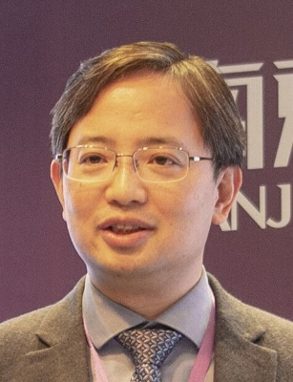
Why Do We (Still) Need Knowledge Graphs in the Era of Deep Learning?
Deep Learning for System II Processing, as proposed by Yoshua Bengio
We need to equip machine learning systems with “slow, logical, sequential, conscious, linguistic, algorithmic, planning, reasoning”
Particularly, such a system requires the “understanding of how actions” (including events and activities/processes) “interact with changes in distribution” which can be reflected by states.
Need “new priors to help systematic & OOD generalization”
Language models need sensory grounding for meaning and understanding, as argued by Yann LeCun
Multi-objective federated learning, proposed by Qiang Yang
One of the utility sources to make sure federation follows common sense
Abductive learning, proposed by Zhihua Zhou
KB plays an important role to provide weak labels
http://www.iro.umontreal.ca/~bengioy/AAAI-9feb2020.pdf
https://wp.nyu.edu/consciousness/do-large-language-models-need-sensory-grounding-for-meaning-and-understanding/

Slide 3
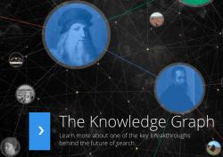
Knowledge Graphs
Many large-scale knowledge graphs about entities and their attributes (property-of) and relations (thousands of different predicates) have been developed since Google released its knowledge graph in 2012
Millions of entities and concepts
Billions of relationships
Are they enough to characterize our mental world?
NELL
Google Knowledge Graph (2012)
570 million entities and 18 billion facts

Slide 4
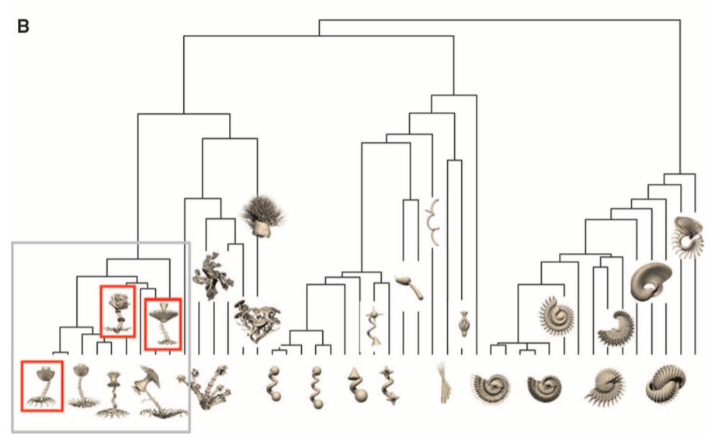
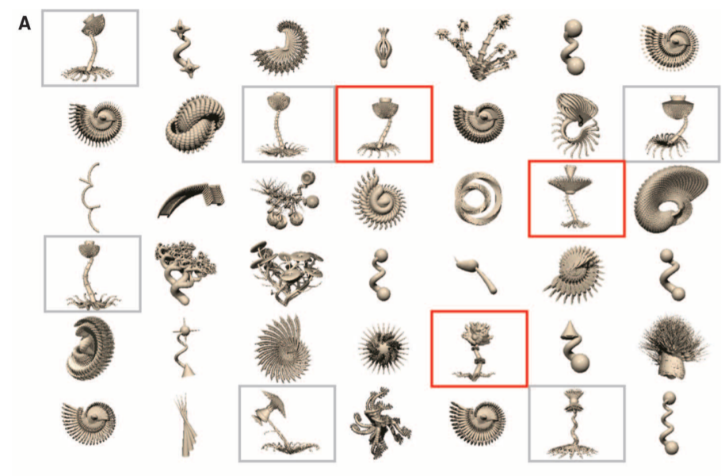
Challenge 1: How to Grow a Mind? --Statistics, Structure, and Abstraction
“In coming to understand the world—in learning concepts, acquiring language, and grasping causal relations—our minds make inferences that appear to go far beyond the data available.”
The ability of performing powerful abstraction is the key
How to grow a mind: statistics, structure, and abstraction. Science. Joshua B Tenenbaum, Charles Kemp, Thomas L Griffiths, Noah D Goodman. 2011.

Slide 5
The True Structure of Conceptualization
What you may think of
What it really likes
E.g., mapping Tesla to a company, big company, IT company, AI company, high-tech company, automobile company, when comparing it with Google, Toyota, some small company, needs the right level of comparison
leaves
leaves
The nature of conceptual abstraction (aggregation of objects’ attributes) and the (dynamic) compositionality make the number of concepts grow vastly comparable to entities we have in the world

Slide 6
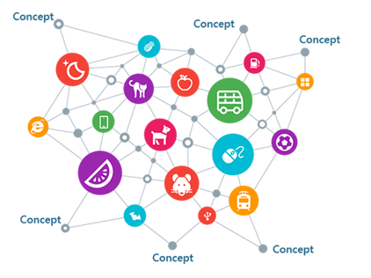
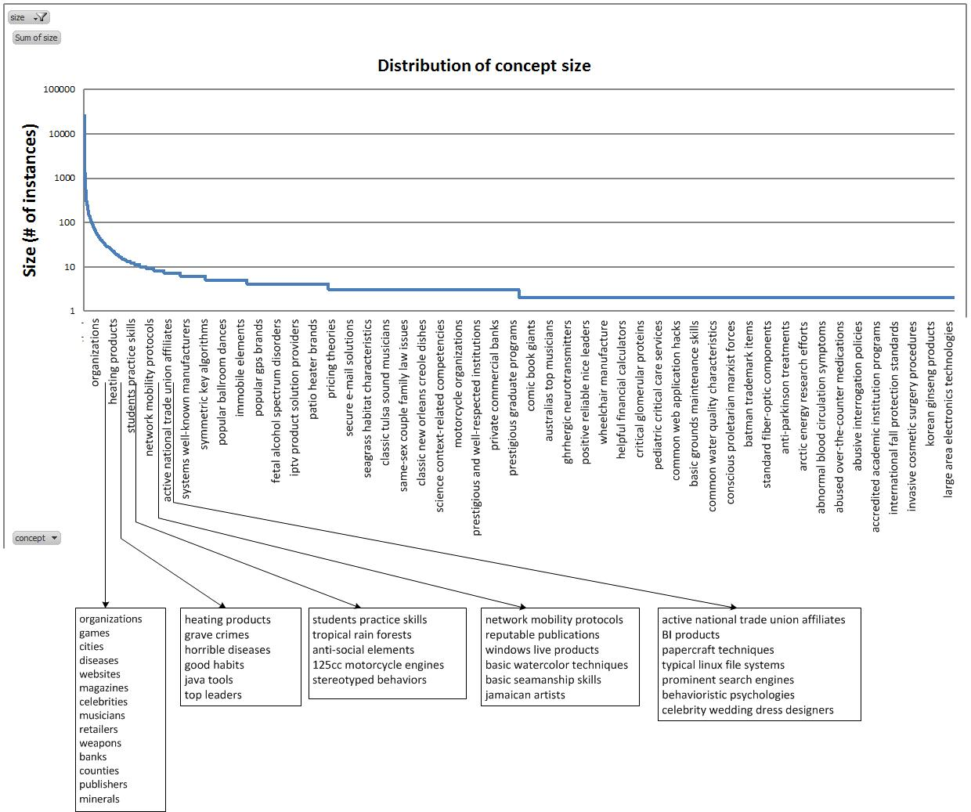
(2011 at MSRA)
Basic watercolor techniques
2.7 million concepts
cities
Celebrity wedding dress designers
Probase is a large, universal, probabilistic knowledge base with an extremely large concept space
Slide Credit: Haixun Wang
Data are available at https://concept.research.microsoft.com/
Wentao Wu, Hongsong Li, Haixun Wang, Kenny Qili Zhu: Probase: a probabilistic taxonomy for text understanding. SIGMOD Conference 2012: 481-492

Slide 7
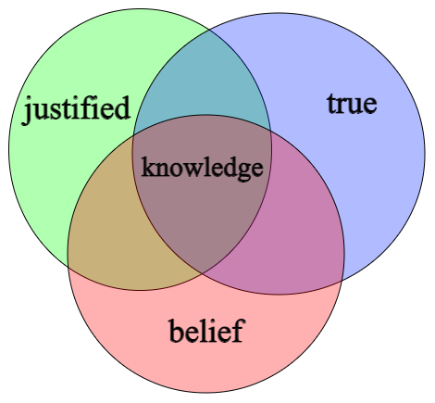
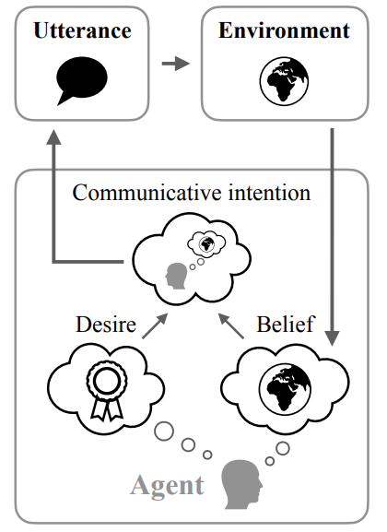
Challenge 2: Knowledge Graph or More General Mind Graphs to Describe Mental World?
What is our knowledge?
Knowledge is often defined as justified true belief
What makes us take actions?
Beliefs and desires are mediated by intentions which in turn controls human’s actions (Kashima et al., 1998)
Theory of Mind
Needs the reasoning about intents, feelings, mental states, and realities (actions or reactions) (Sap et al., 2022)
Figure taken from Wikipedia
Figure taken from Andreas (2022)
https://en.wikipedia.org/wiki/Knowledge
Jacob Andreas: Language Models as Agent Models. EMNLP (Findings) 2022: 5769-5779
Kashima, Yoshihisa, Allison McKintyre, and Paul Clifford. "The Category of the Mind: Folk Psychology of Belief, Desire, and Intention." Asian Journal Of Social Psychology 1, no. 3 (December 1998): 289–313.
Maarten Sap, Ronan Le Bras, Daniel Fried, Yejin Choi: Neural Theory-of-Mind? On the Limits of Social Intelligence in Large LMs. EMNLP 2022: 3762-3780
Notes:
Readers need to model Bob’s mental state (called first-order ToM), as well as Bob’s estimation of Alice’s mental state (second-order ToM) to answer questions. (Sclar et al., 2023)

Slide 8
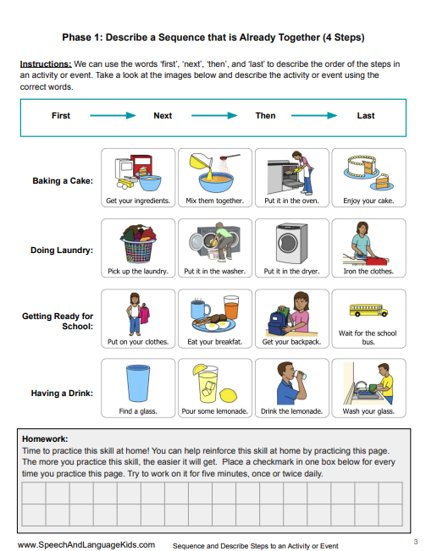
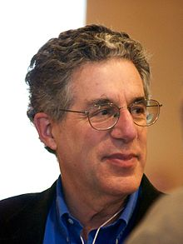
Challenge 3: Primitive Semantic Units in Our Mind
Semantic meaning in our language can be described as ‘a finite set of mental primitives and a finite set of principles of mental combination (Jackendoff, 1990)’.
The primitive units of semantic meanings include
Thing (or Object),
Activity (or Process),
State,
Event,
Place,
Path,
Property,
Amount,
etc.
Ray Jackendoff, Rumelhart Prize winner, studied under linguists Noam Chomsky
Jackendoff, R. (Ed.). (1990). Semantic Structures. Cambridge, Massachusetts: MIT Press.

Slide 9
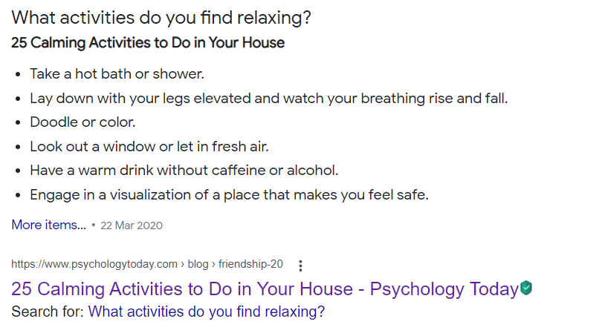
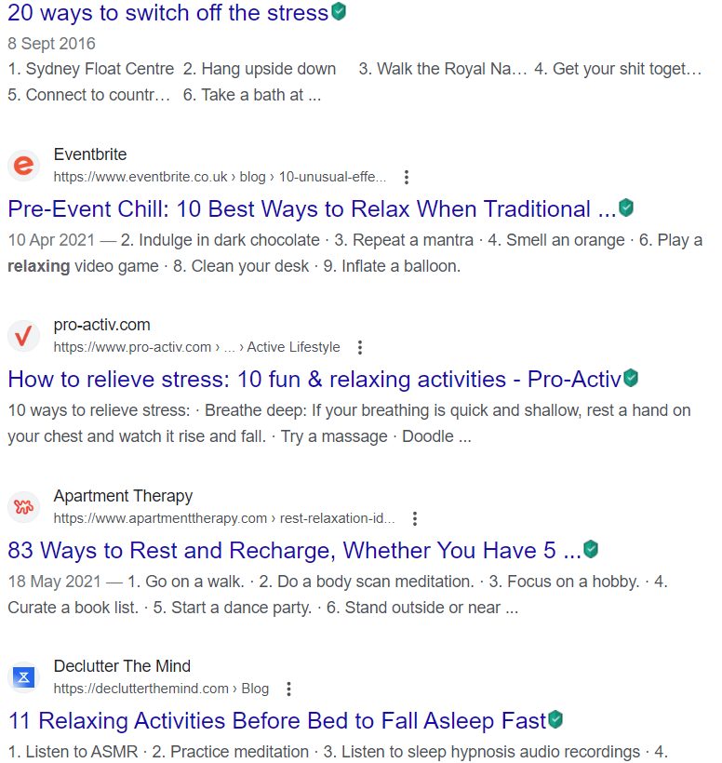
Activities and Events can also be Conceptualized

Slide 10
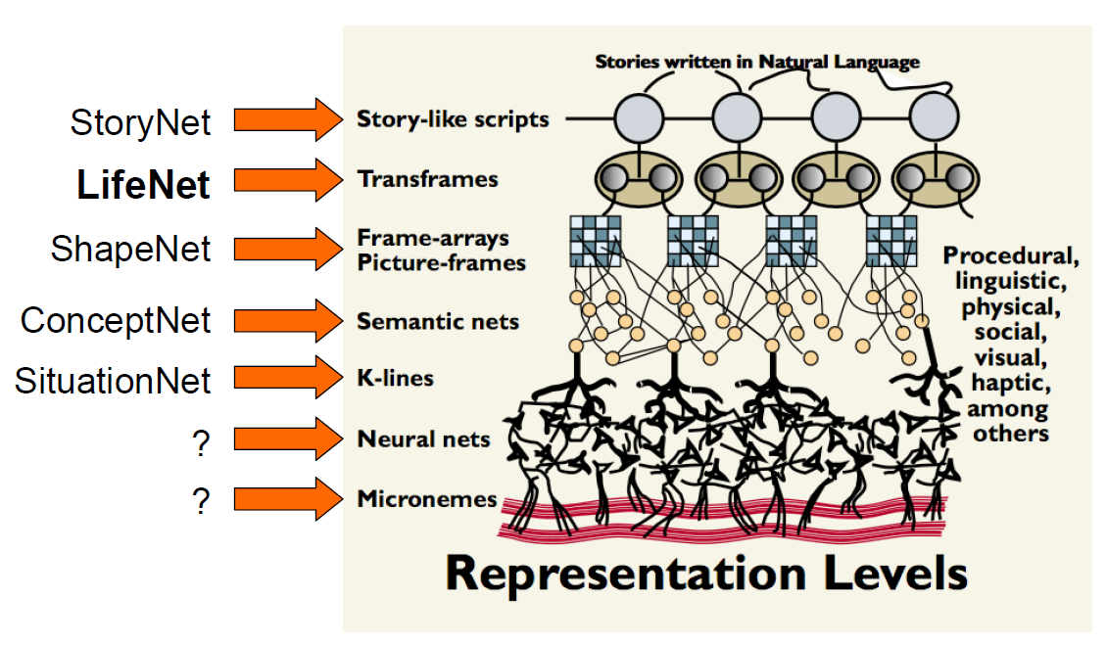
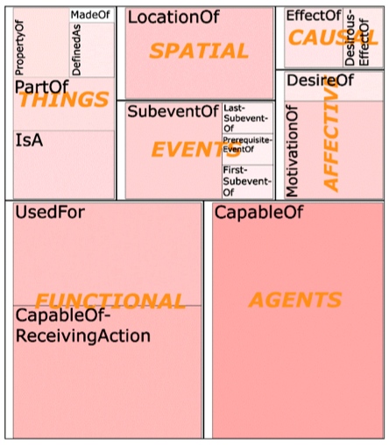
That’s Why ConceptNet was Designed in Such a Way
Knowledge in ConceptNet
Things, Spatial, Location, Events, Causal, Affective, Functional, Agents
Singh, Barbara Barry, and Hugo Liu (2004). Teaching machines about everyday life.BT Technology Journal, 22(4):227-240.
Figure taken from: https://ocw.mit.edu/courses/media-arts-and-sciences/mas-961-ambient-intelligence-spring-2005/lecture-notes/week4_push_singh.pdf

Slide 11
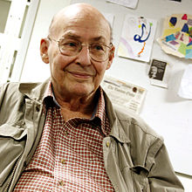
A More Fundamental Layer is Called K-Line
Encode memories in “abstract” form.
Search all memory for the “nearest match.”
Use prototypes with detachable defaults.
M. Minsky, “K-Lines: A theory of Memory," Cognitive Science 4 (1980). 117-133.
Figure taken from: https://ocw.mit.edu/courses/media-arts-and-sciences/mas-961-ambient-intelligence-spring-2005/lecture-notes/week4_push_singh.pdf

Slide 12
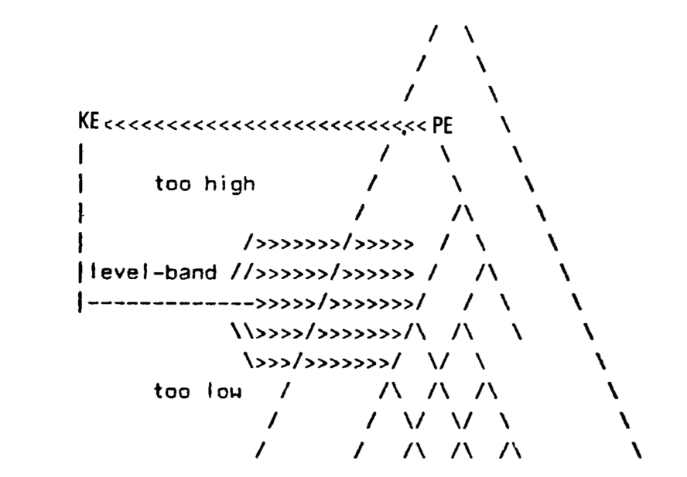
The Implementation of K-Line Theory
We need the right level and right perspective of conceptualization of events
Different levels of abstractness
“PersonX drinks coca cola” → “[drinking coca cola],” “[drinking beverage],” “[event]”
Different perspectives
“Coca cola” → “[sugary beverage],” “[phosphate containing beverage],” “[iced drink],” not in a strict hierarchical taxonomy
PersonX drinks [iced drink], xReact, refreshed
PersonX drinks [sugary beverage], xEffect, gain weight
Attach a K-node (a mental state, KE) to a “Pyramid” agent (PE) at a certain level
The pyramid is a tree structure that we use to conceptualize the world
The mapping has a lower-band limit and a higher-band limit, to compare the right common, non-conflicting properties
Figure taken from: M. Minsky (1980)
M. Minsky, “K-Lines: A theory of Memory," Cognitive Science 4 (1980). 117-133.
Mutian He, Tianqing Fang, Weiqi Wang, and Yangqiu Song. Acquiring and Modelling Abstract Commonsense Knowledge via Conceptualization. 2022.

Slide 13
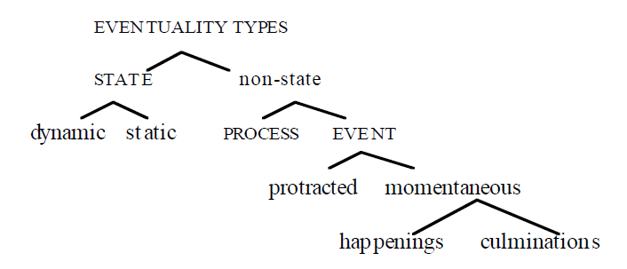
ASER (Activities, States, Events, and their Relations)
Mourelatos’ taxonomy (1978)
Bach’s taxonomy (1986)
State: A state is usually described by a stative verb and cannot be qualified as actions.
“The coffee machine is ready for brewing coffee.”
Activity (or process): Both activity and event are occurrences (actions) described by active verbs.
“The coffee machine is brewing coffee with following steps: …”
Event: An event is defined as an occurrence that is inherently countable.
“The coffee machine brews a cup of coffee once more” is an event because it admits a countable noun “a cup” and cardinal count adverbials “once”
Alexander P. D. Mourelatos. Events, processes, and states. Linguistics and Philosophy, 2, 415-434. 1978.
Emmon Bach. The algebra of events. Linguistics and philosophy, 9 (1), 5-16. 1986.

Slide 14
ASER (Activities, States, Events, and their Relations)
Principle 1: Comparing semantic meanings by fixing grammar (Katz and Fodor, 1963)
Principle 2: The need of language inference based on ‘partial information’ (Wilks, 1975)
WWW’20
https://github.com/HKUST-KnowComp/ASER
Hongming Zhang, Xin Liu, Haojie Pan, Yangqiu Song, Cane Wing-Ki Leung: ASER: A Large-scale Eventuality Knowledge Graph. WWW 2020: 201-211
Katz, J. J., & Fodor, J. A. (1963). The structure of a semantic theory. Language, 39(2), 170–210.
Yorick Wilks. 1975. An intelligent analyzer and understander of English. Communications of the ACM, 18(5):264–274.

Slide 15
Scales of Verb Related Knowledge Graphs
300x larger
6000x larger

Slide 16
Conceptualization
(person, have, animal)
(positive-emotion, come)
……
……
ResultIn [freq=3]
0.281
0.087
He, have, a little dog
the happiness, come
……
……
ResultIn [freq=2]
0.333
0.125
I, have, my own horse
the exhilaration, come
0.222
……
You, will have, a duckling
……
P( | , ) = $0.281 × 3 ×0.087+0.333×2×0.125$
= $0.157$
ResultIn
(person, have, animal)
(positive-emotion, come)

Slide 17
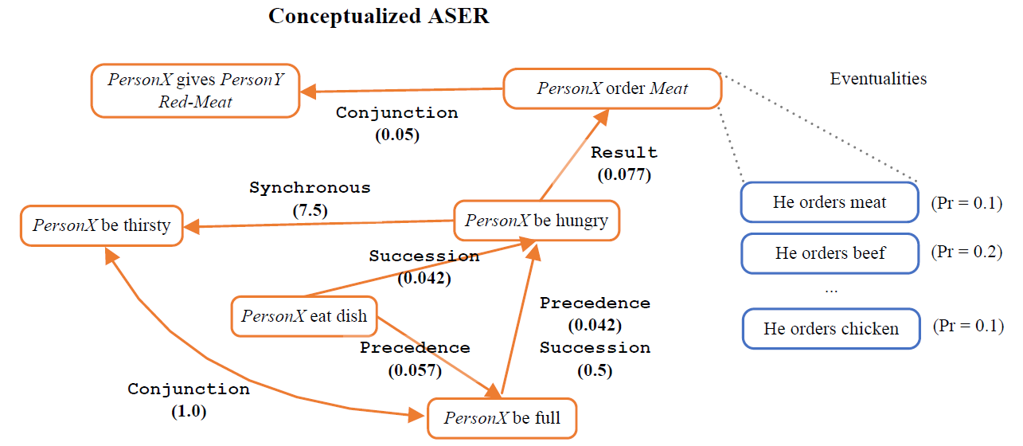
Conceptualization Examples
AIJ’22
https://github.com/HKUST-KnowComp/ASER
Hongming Zhang, Xin Liu, Haojie Pan, Haowen Ke, Jiefu Ou, Tianqing Fang, Yangqiu Song: ASER: Towards large-scale commonsense knowledge acquisition via higher-order selectional preference over eventualities. Artif. Intell. 309: 103740 (2022)

Slide 18
Apply the Same Tech to ATOMIC: AbstractATOMIC
Under Review by AIJ
3x Larger (about 2.95M triplets) than ATOMIC
Mutian He, Tianqing Fang, Weiqi Wang, and Yangqiu Song. Acquiring and Modelling Abstract Commonsense Knowledge via Conceptualization. 2022.

Slide 19
Language models finetuned by AbstractATOMIC can significantly improve their zero-shot ability on downstream commonsense QA tasks.
ACL’23
Arxiv’23
Weiqi Wang*, Tianqing Fang*, Baixuan Xu, Chun Yi Louis Bo, Yangqiu Song, Lei Chen. 🐈CAT: A Contextualized Conceptualization and Instantiation Framework for Commonsense Reasoning. ACL, 2023
Weiqi Wang*, Tianqing Fang*, Wenxuan Ding, Baixuan Xu, Xin Liu, Yangqiu Song, Antoine Bosselut. 🚗CAR: Conceptualization-Augmented Reasoner for Zero-Shot Commonsense Question Answering. Arxiv, 2023.

Slide 20
ASER Statistics
1.0 (in 2019): Rule based extraction (14 Eventuality Patterns)
272 millions eventualities and 206 millions relations
2.0 (in 2021): Discourse Parser (18 Eventuality Patterns + Wang and Lan 2015)
439 millions eventualities and 649 millions relations
Conceptualization Core (Using top 5 concepts for each detected instance):
Concepts: 15 millions (based on 14 millions eventualities, 1.X times)
Concept Relations: 224 millions (based on 53 millions eventuality relations, 4.X times)
https://github.com/HKUST-KnowComp/ASER
Hongming Zhang, Xin Liu, Haojie Pan, Haowen Ke, Jiefu Ou, Tianqing Fang, Yangqiu Song: ASER: Towards large-scale commonsense knowledge acquisition via higher-order selectional preference over eventualities. Artif. Intell. 309: 103740 (2022)

Slide 21
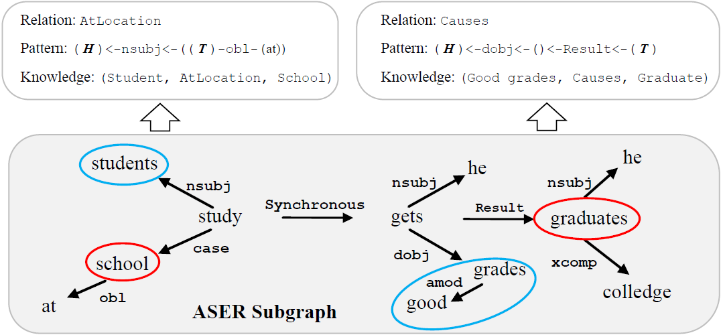
TransOMCS: Transform ASER to ConceptNet
Knowledge Base Population (KBP)
IJCAI’20
100x Larger (about 18M triplets) than OMCS in ConceptNet
Hongming Zhang, Daniel Khashabi, Yangqiu Song, and Dan Roth. TransOMCS: From Linguistic Graphs to Commonsense Knowledge. International Joint Conference on Artificial Intelligence (IJCAI). 2020.

Slide 22
Transform ASER to ATOMIC
Knowledge Base Population (KBP)
WWW’21
EMNLP’21
EMNLP’22
3x Larger (about 3.4M triplets) than ATOMIC
Tianqing Fang, Quyet V. Do, Hongming Zhang, Yangqiu Song, Ginny Y. Wong and Simon See. PseudoReasoner: Leveraging Pseudo Labels for Commonsense Knowledge Base Population. Findings of EMNLP, 2022.
Tianqing Fang*, Weiqi Wang*, Sehyun Choi, Shibo Hao, Hongming Zhang, Yangqiu Song, Bin He. Benchmarking Commonsense Knowledge Base Population with an Effective Evaluation Dataset. EMNLP, 2021
Tianqing Fang, Hongming Zhang, Weiqi Wang, Yangqiu Song, and Bin He. DISCOS: Bridging the Gap between Discourse Knowledge and Commonsense Knowledge. WWW, 2021.

Slide 23
Incorporating More Types: Process Induction
EMNLP’20
Hongming Zhang, Muhao Chen, Haoyu Wang, Yangqiu Song, and Dan Roth. Analogous Process Structure Induction for Sub-event Sequence Prediction. EMNLP. 2020.

Slide 24
Incorporating More Types: Process Generation
Coherence controller: a candidate is coherent with the process and prior generated sub-events
Local coherence: randomly copy a sub-event in the current process and place it at a random location.
Global coherence: randomly choose a sub-event from other processes with a different theme and insert it at a random location
EMNLP’22
Zhaowei Wang, Hongming Zhang, Tianqing Fang, Yangqiu Song, Ginny Y. Wong, and Simon See. SubeventWriter: Iterative Sub-event Sequence Generation with Coherence Controller. EMNLP, 2022

Slide 25
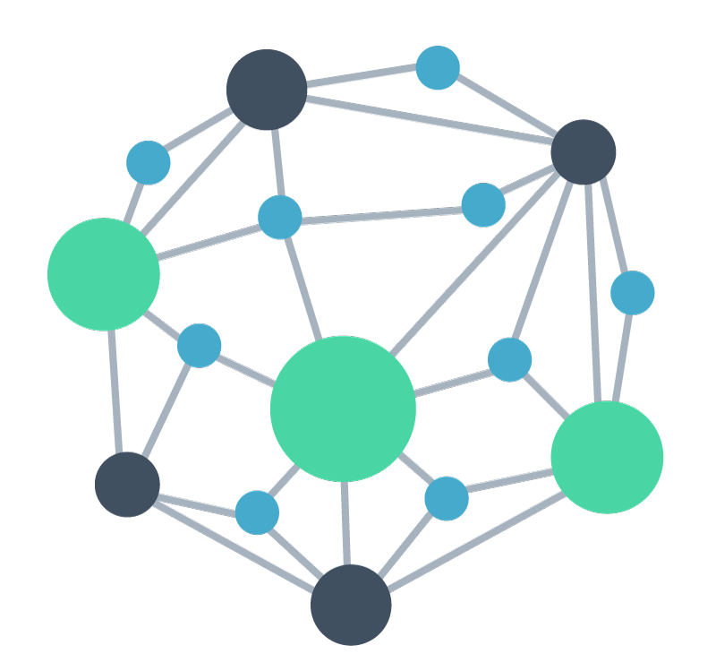
Beyond Belief/Knowledge Graph: FolkScope
Intention Knowledge Graph for E-commerce Commonsense Discovery
AIG-KG
Explainable recommendation
UserU bought [A] because
Query-item relevance
PersonX searches [Q] to
User behavior rationalization
Intention KG
PersonX bought [A] and [B] because
AI Generator
PersonX searched [A] and bought [B] because
Pattern mining, Filtering, Normalization, Conceptualization
ACL’23
Prompts
Changlong Yu, Weiqi Wang, Xin Liu, Jiaxin Bai, Yangqiu Song, Zheng Li, Yifan Gao, Tianyu Cao, and Bing Yin. FolkScope: Intention Knowledge Graph Construction for E-commerce Commonsense Discovery. Findings of ACL. 2023.

Slide 26
Beyond Belief/Knowledge Graph: FolkScope

Slide 27
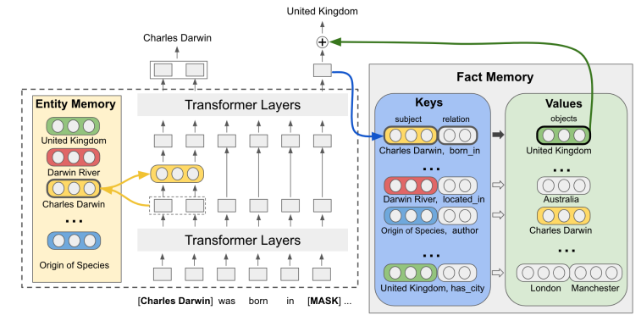
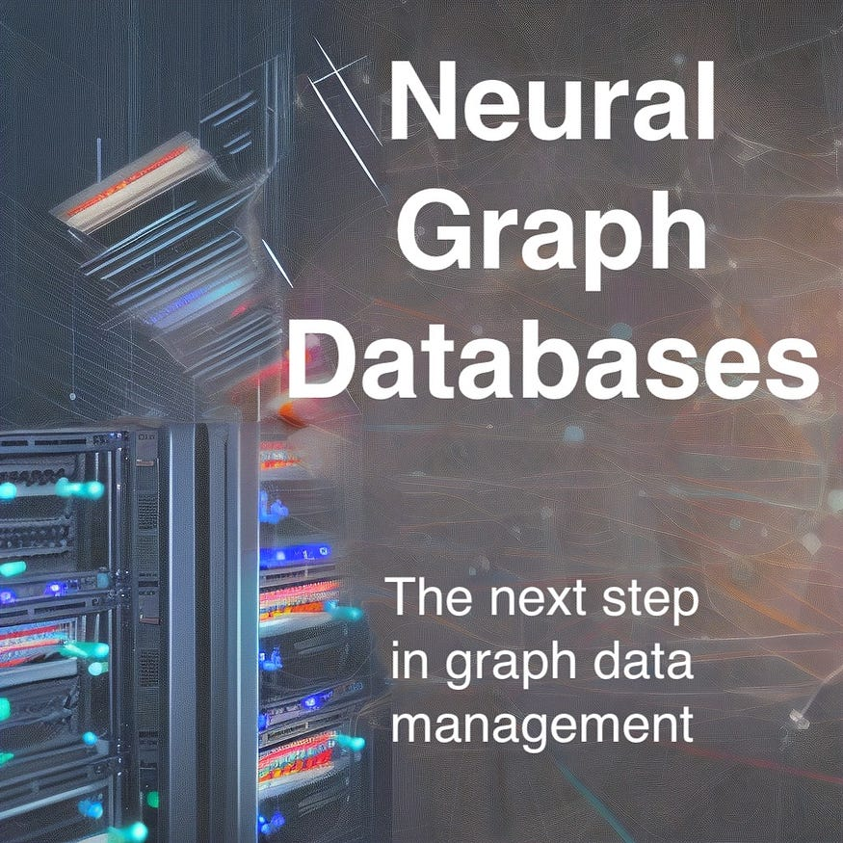
How to help LLMs?
Entities/Facts as Memories
Neural Graph Databases
Figure taken from: Pat Verga, Haitian Sun, Livio Baldini Soares, William W. Cohen: Adaptable and Interpretable Neural Memory Over Symbolic Knowledge. NAACL-HLT 2021: 3678-3691
Figure taken from: https://towardsdatascience.com/neural-graph-databases-cc35c9e1d04f

Slide 28
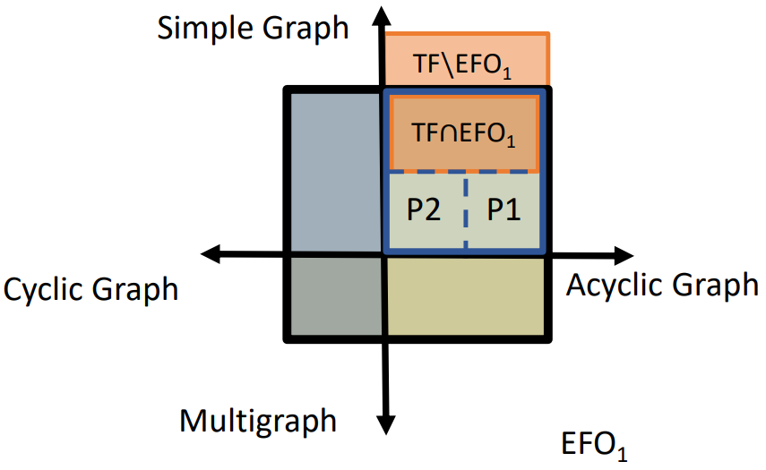
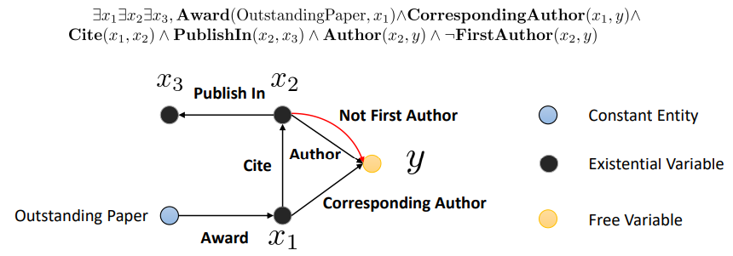
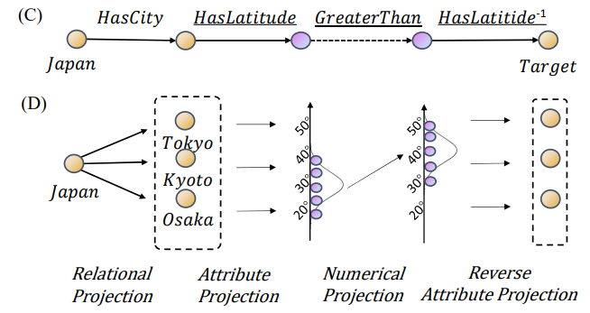
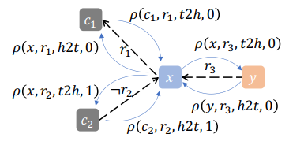
Logical Queries over Knowledge Graphs
Benchmarking EFO-1 (Existential First-Order Queries with Single Free Variable)
EFO-1 queries with cycles
EFO-K more than one variables
NeurIPS’21
Arxiv’23
Arxiv’23
Data
Models
Particle filtering of logical sequential queries
Learning in the inference step as a GNN (one-hop logical inference based MPNN)
Number and attribute queries
NAACL’22
ICLR’23
KDD’23
Hang Yin, Zihao Wang, and Yangqiu Song. EFO_k-CQA: Towards Knowledge Graph Complex Query Answering beyond Set Operation. Arxiv 2023
Jiaxin Bai, Chen Luo, Zheng Li, Qingyu Yin, Bing Yin, Yangqiu Song. Knowledge Graph Reasoning over Entities and Numerical Values. KDD 2023
Hang Yin, Zihao Wang, and Yangqiu Song. Rethinking Existential First Order Queries and their Inference on Knowledge Graphs. Arxiv 2023
Zihao Wang, Yangqiu Song, Ginny Y. Wong, and Simon See. Logical Message Passing Networks with One-hop Inference on Atomic Formulas. In The Eleventh International Conference on Learning Representations, ICLR 2023
Jiaxin Bai, Zihao Wang, Hongming Zhang, and Yangqiu Song. Query2Particles: Knowledge Graph Reasoning with Particle Embeddings. In Findings of the Association for Computational Linguistics: NAACL-HLT 2022, 2022
Zihao Wang, Hang Yin, and Yangqiu Song. Benchmarking the Combinatorial Generalizability of Complex Query Answering on Knowledge Graphs. In NeurIPS Datasets and Benchmarks Track, 2021

Slide 29
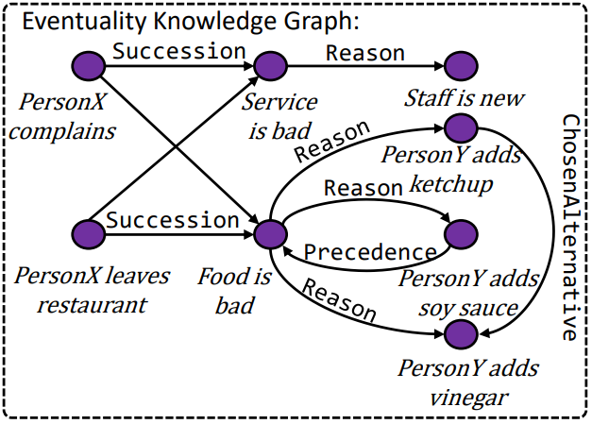
Logical Queries on ASER with Logical Constraints
Precedence(V1, V2)
V1 occurs before V2
ChosenAlternative(V1, V2)
Instead of V2 occurs, V1 occurs
Arxiv’23
Jiaxin Bai, Xin Liu, Weiqi Wang, Chen Luo, Yangqiu Song. Complex Query Answering on Eventuality Knowledge Graph with Implicit Logical Constraints. Arxiv 2023

Slide 30
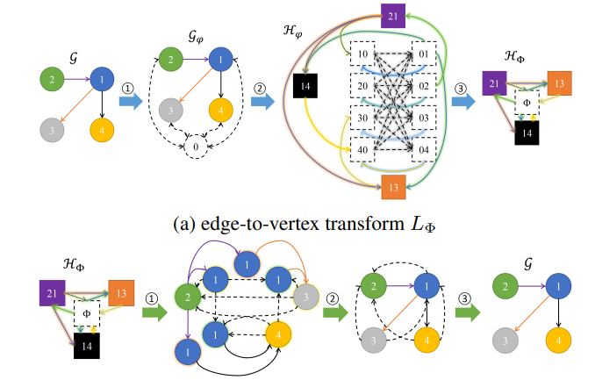
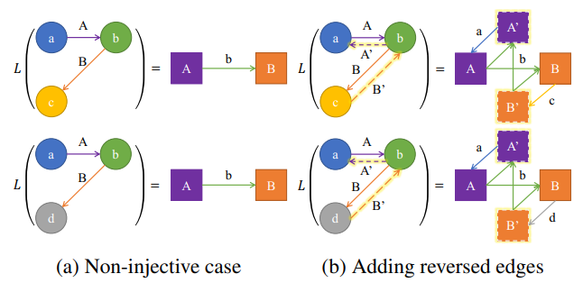
Knowledge Logical Counting or Subgraph Counting
Such KG query needs global memory and inference
Subgraph counting is NP-Complete; Very Difficult for LLMs (Transformer) to conduct
KDD’20
Dual graph counting
Global dummy node
AAAI’22
ICML’22
Xin Liu, Jiayang Cheng, Yangqiu Song, and Xin Jiang. Boosting Graph Structure Learning with Dummy Nodes. In International Conference on Machine Learning (ICML), 2022.
Xin Liu and Yangqiu Song. Graph Convolutional Networks with Dual Message Passing for Subgraph Isomorphism Counting and Matching. In the AAAI Conference on Artificial Intelligence (AAAI), 2022.
Xin Liu, Haojie Pan, Mutian He, Yangqiu Song, Xin Jiang, and Lifeng Shang. Neural Subgraph Isomorphism Counting. In ACM SIGKDD Conference on Knowledge Discovery and Data Mining (KDD), 2020.

Slide 31
To Conclude
We build new types of graphs
Related to activity (or process), state, and event
Beyond knowledge and believes
We develop data sources and packages to support
Knowledge grounding
Complex knowledge queries
Logical reasoning
Improved zero-shot learning or indirect supervision for LLMs
Trustworthy LLMs

Slide 32
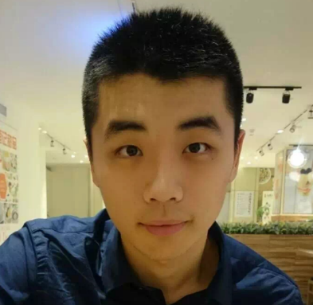
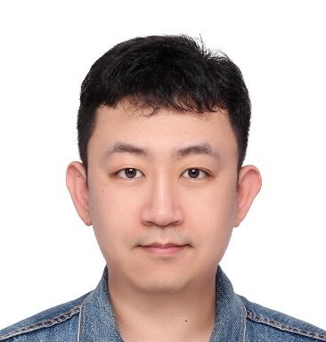
Thanks to Key Contributors
Hongming Zhang
Xin Liu
Haojie Pan
Tianqing Fang
Mutian He
Weiqi Wang
Jiaxin Bai
Zhaowei Wang
Changlong Yu
Zihao Wang
Hang Yin@THU
And many other PhD/MPhil students, UG interns, visiting students, and industrial collaborators!

Slide 33
Thank you for your attention! ☺

