Slide 1
From Foundation Knowledge Graph Construction to Foundation Knowledge Models
Yangqiu Song
Department of CSE, HKUST

Slide 2
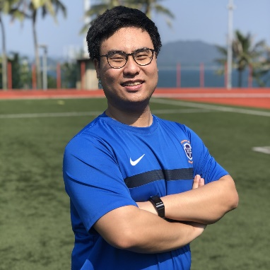
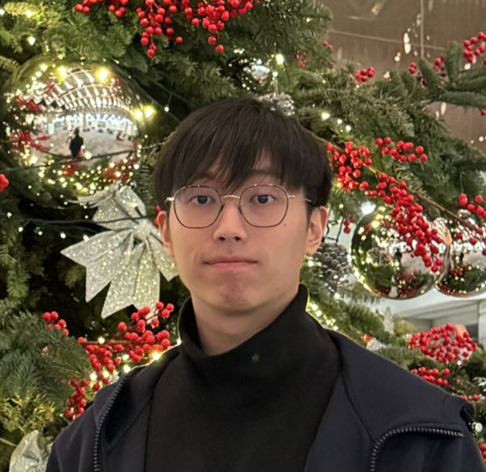
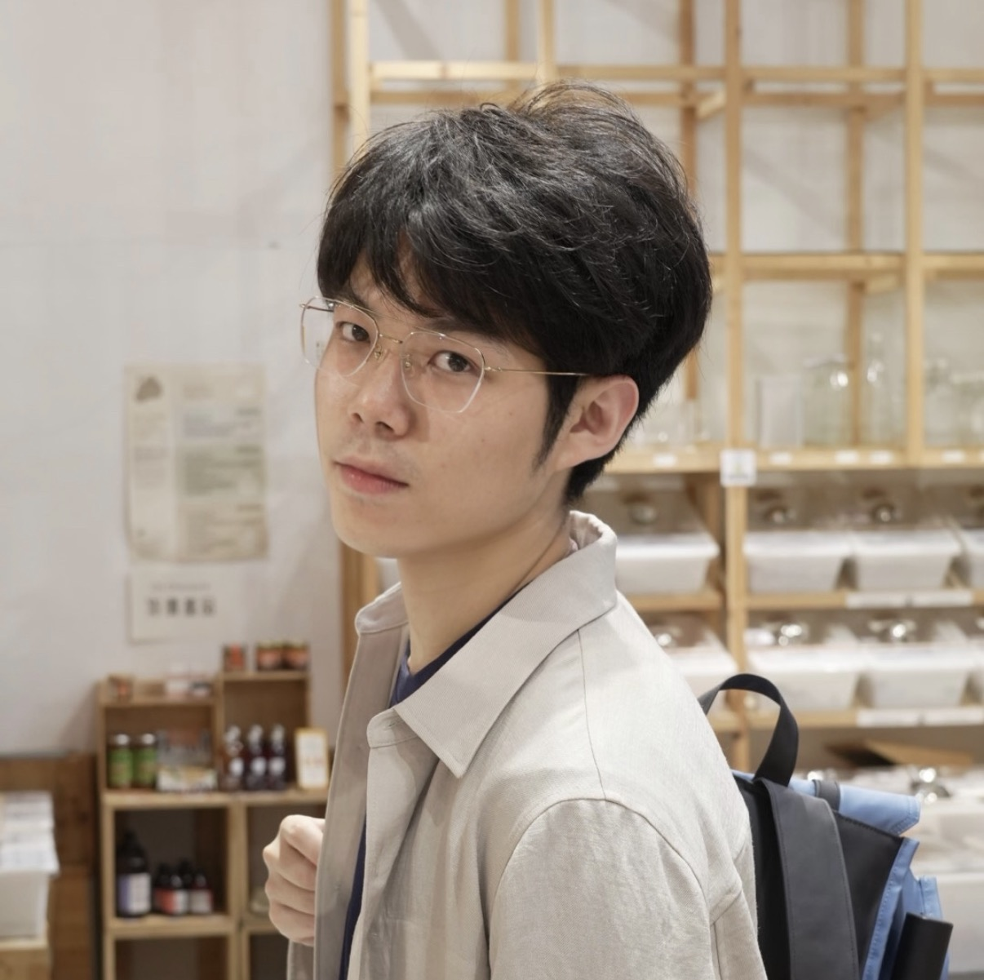

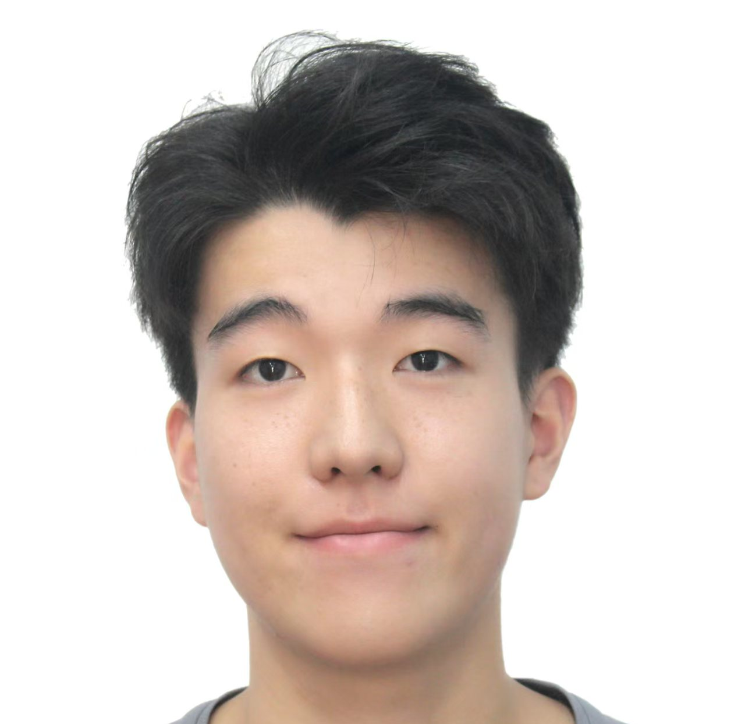
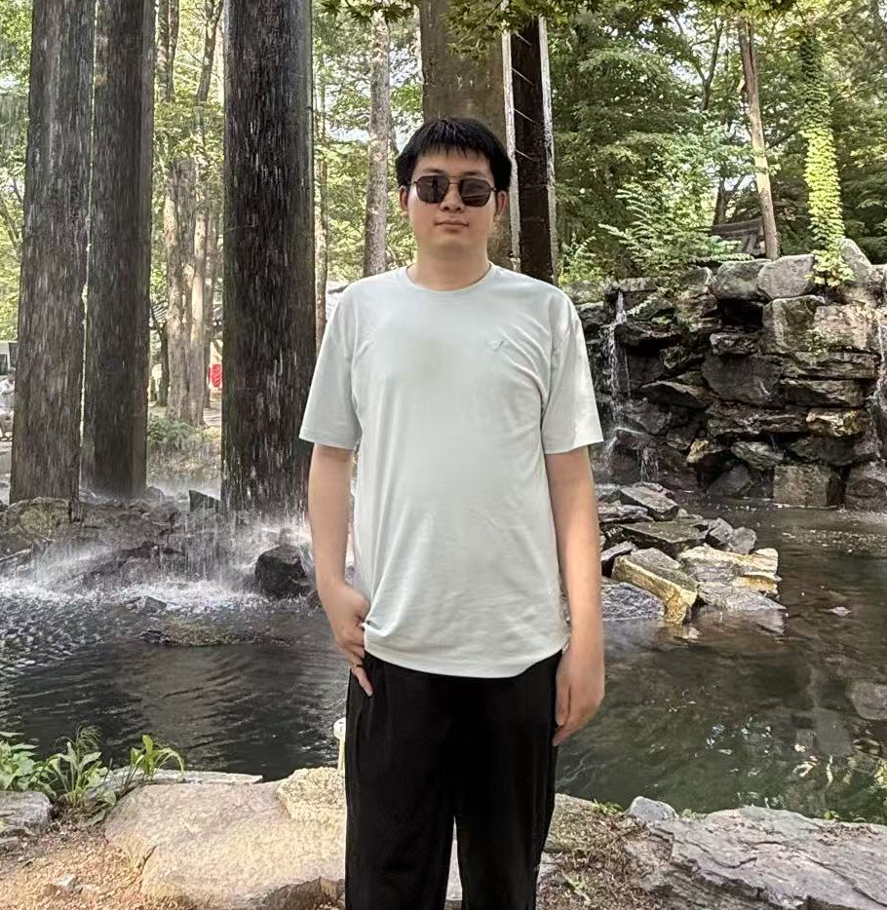
Main Contributors
Jiaxin Bai
Hong Ting Tsang
Haoyu Huang
Yufei Li
Zhongwei Xie
Yisen Gao

Slide 3



Why We STILL Need Foundation Knowledge Graphs?
Deliver explicit, structured knowledge through nodes and edges (as a global structure). Serve as an organized, readily navigable external memory that can be injected into LLMs with clear provenance.
Offers systematic provenance, semantic layer or schema/ontology, hampering traceability and increasing the risk of propagating noisy or contradictory information to LLMs.

Slide 4
The Inherent Paradox of Traditional KG Construction
Previous KG construction approaches face an inherent paradox: they require predefined schemas created by domain experts, which fundamentally limits their scalability, adaptability, and domain coverage.
expense
penalty
[Concept]
collection, storage,.., sharing and protection of personal information
[Concept]
possible sanctions
cost of operations
Traditional approaches (Freebase, YAGO) start with a manually designed ontology.
Even recent LLM-based methods (PiVE, iText2KG, GraphRAG) still rely on fixed prompts or heuristics.
Traditional ways of KG definitions capture static facts ("Paris is the capital of France"), but miss dynamic knowledge — temporal relationships, causality, and procedural knowledge among events.
[Increases]
[Subject]
[Govern]
[Concept]
regulation
[Concept]
data privacy and security laws
data
[Concept]
[Participated]
Country
The scope of data privacy and security regulations worldwide continues to evolve, and the adoption of increasingly restrictive regulations in this area is likely within the United States and other jurisdictions
[Concept]
[Participated]
United States
Notes:
KG construction today faces a paradox: it aims to capture all human knowledge, yet requires expert-designed schemas upfront. This is true for Freebase and YAGO, and surprisingly also for recent LLM-based methods like GraphRAG — they rely on fixed prompts that encode an implicit schema.
AutoSchemaKG breaks this dependency — it extracts triples and induces schemas directly from text, fully autonomously.

Slide 5
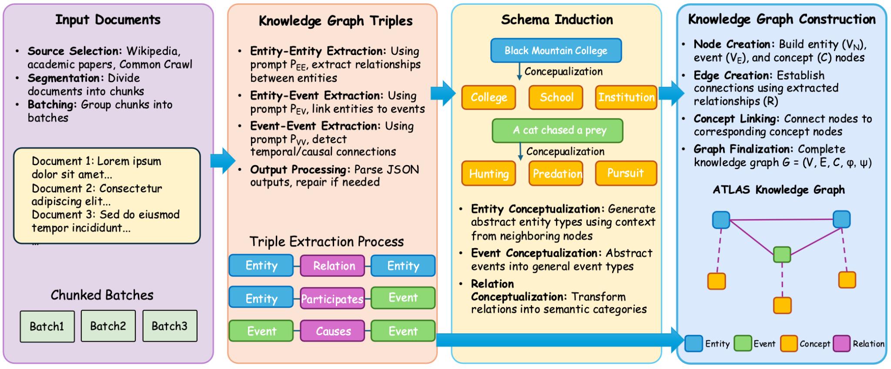
AutoSchemaKG Overview
In short, it removes the manual bottleneck and creates richer, more adaptable knowledge graphs.

Slide 6
AutoSchemaKG: Biggest Open Source GraphRAG SOTA
The ATLAS (Automated Triple Linking And Schema induction) knowledge graph family built from multiple corpora:
Metric | Total
Text Chunks | 52.557M
Entities | 387.022M
Events | 954.548M
Concepts | 45.056M
Total Nodes | 1.355B
Total Edges | 8.600B
Multi-hop QA Performance
Dataset | Method | EM | F1
HotpotQA | No Retriever | 37.0 | 47.3
 | GraphRAG [1] | 55.2 | 68.6
 | HippoRAG2 [2] | 62.7 | 75.5
 | AutoSchemaKG | 61.8 | 78.3
2Wiki | No Retriever | 36.5 | 42.8
 | GraphRAG | 51.4 | 58.6
 | HippoRAG2 | 65.0 | 71.0
 | AutoSchemaKG | 65.3 | 73.9
1B+
8.6B+
78,400
Total Nodes
Total Edges
GPU Hours
Key Finding: 12-18% improvement over state-of-the-art baselines on multi-hop QA tasks
https://github.com/HKUST-KnowComp/AutoSchemaKG
Computational Requirements: Built using 80GB GPUs with 1,513 TFLOPS of FP16 compute, running Llama-3-8B-instruct with Flash Attention.

Slide 7
Automation ≠ Good Enough for Downstream Tasks
Automatic Reconstruction
  AutoGraph-R1
Automatic Refinement
  DeepRefine

Slide 8
Building "Good" Graphs for Downstream Tasks
Key Insight
The bottleneck is not graph quality — it's task alignment.
A "good" graph by intrinsic standards may be:
• Too noisy for a text-indexing retriever
• Too sparse for a multi-hop reasoning retriever
Our question: Can we train the KG constructor to build graphs that are directly useful for downstream QA?
Different retrievers demand fundamentally different graph structures. This is the core motivation for our reward design.
Notes:
Traditional graph-based RAG has a fundamental disconnect: KG construction is decoupled from the downstream task. We extract triples, evaluate quality with intrinsic metrics, and feed the graph into RAG — but a factually accurate graph can still fail at QA. If one critical relational edge is missing, the entire multi-hop reasoning chain breaks. Different retrievers have fundamentally different needs. A text-indexing retriever like HippoRAG suffers from noisy edges that dilute PageRank signals. A multi-hop retriever like ToG suffers from sparse graphs that lack reasoning connectivity. So the optimal graph structure depends entirely on how the graph will be used. This raises our central question: can we train the KG constructor to build graphs that are directly useful for downstream QA?

Slide 9
AutoGraph-R1: Closing the Loop with Reinforcement Learning
KG Constructor (Trainable)
Frozen RAG Server
Task-Specific Reward
π_θ^KG: LLM maps documents → graph G
Only component that is updated
Retriever + Answer generator
Never updated during training
Uses G to produce answer ŷ
R(q, ŷ, y, G): measures graph's
functional utility in the RAG pipeline
→
→
Core innovation: The reward signal reflects the graph's FUNCTIONAL UTILITY — not intrinsic quality. This closes the loop between construction and application.
Notes:
AutoGraph-R1 frames KG construction as a reinforcement learning problem with three components. First, a trainable KG constructor — the LLM we fine-tune, mapping documents to a knowledge graph. Second, a completely frozen RAG server — the retriever and answer generator never change during training, so any improvement can only come from better graph construction. Third, a task-specific reward function that measures the graph's functional utility. The training loop: the constructor generates a graph, the frozen RAG server answers a question using it, the reward evaluates how well the graph supported correct answering, and this signal flows back via GRPO to update the constructor. The key innovation: the reward reflects functional utility, not intrinsic quality. We close the loop between construction and application.

Slide 10
Two Retrieval Paradigms, Two Reward Functions
Paradigm 1:
Graph as Knowledge Carrier
Paradigm 2:
Graph as Knowledge Index
Triples serve as the primary reasoning evidence.
The retriever extracts subgraphs via n‑hop expansion.
Challenge: Missing edges break multi‑hop chains.
Retrievers: Subgraph, Triples, ToG
Graph structure guides Personalized PageRank to rank and retrieve relevant text passages.
Challenge: Noisy edges dilute relevance signals.
Retrievers: HippoRAG, HippoRAG2
R_C(q, y, G) = 𝟙[deducible(q, y | G)]
R_I(q, D_gold, G) = |Top-k ∩ D_gold| / |D_gold|
Binary judge: "Can the answer be deduced from these triples?" → Encourages dense connectivity
Passage recall — simple set intersection, no model inference → Encourages clean, precise edges
⚠ Naive F1 score as reward leads to unstable training. Our structured rewards achieve stable convergence (Appendix B).
Notes:
Different retrievers need different graph structures, so AutoGraph-R1 supports two paradigms with distinct reward functions. Paradigm one: graph as knowledge carrier. Triples are the reasoning evidence. The challenge is missing edges breaking reasoning chains. We design reward R_C — a binary judge checking whether the answer can be deduced from the retrieved subgraph. This encourages dense connectivity. Paradigm two: graph as knowledge index. The graph structure guides Personalized PageRank to retrieve text passages. The challenge is noisy edges diluting relevance. We design reward R_I — simple passage recall with no model inference. This encourages clean, precise edges. Critically, naive F1 reward leads to unstable training. Our structured rewards achieve stable convergence.

Slide 11
Performance Summary of AutoGraph-R1
Knowledge Carrier
  +4.39 avg F1 (Qwen-3B)
  Gains on all 5 benchmarks
  Transfers across 3 retrievers
Knowledge Index
  +4.35 avg Recall@5
  Gains on all 5 benchmarks
  Transfers: HippoRAG & RAG2
Key Insight
  Both paradigms show consistent improvements. The RL-trained constructor generalizes across all retrievers within each paradigm.
GRPO — Group Relative Policy Optimization
1. Sample a batch of (query, documents, answer) tuples
2. Generate G candidate graphs from the current policy
3. For each graph: run the frozen RAG pipeline → compute R_C or R_I
4. Normalize advantages within the group: Â_i = (R_i − μ) / σ
5. Update the policy via GRPO with clipping
Hong Ting Tsang, Jiaxin Bai, Haoyu Huang, Qiao Xiao, Tianshi Zheng, Baixuan Xu, Shujie Liu, Yangqiu Song: AutoGraph-R1: End-to-End Reinforcement Learning for Knowledge Graph Construction. ACL (1) 2026

Slide 12
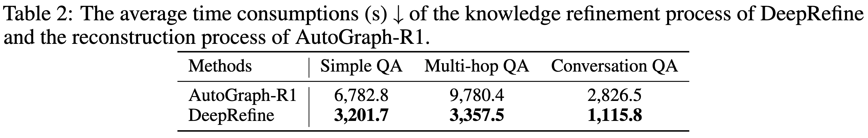
DeepRefine: Motivation
In many real deployments, the KB/KG has already been constructed, so re-training the constructor or re-compiling the whole KB/KG is expensive and impractical at scale, motivating our post-construction agent-compiled knowledge refinement paradigm, which is more agent-native.
Huang H, Bai J, Liu S, et al. DeepRefine: Agent-Compiled Knowledge Refinement via Reinforcement Learning[J]. arXiv preprint arXiv:2605.10488, 2026.

Slide 13
KGs/KBs are also Changing
Past RAG Paradigm
LLMs grounded in external knowledge bases via RAG.
Graph-based RAG: organizes content into KGs.
Static KBs are stateless: do not accumulate structured lessons.
Agent-Compiled Knowledge Bases
LLM agents ingest sources, synthesize articles.
Maintain cross-references over time (e.g., LLM-Wiki).
Make KBs evolvable rather than frozen at test time.
Re-constructing is expensive and operationally impractical.
Three Systematic Quality Defects:
Incompleteness: Missing evidence chains, cross-document links.
Incorrectness: Low-confidence or imprecise assertions.
Redundancy: Ambiguous or coreference resolution issues.
Huang H, Bai J, Liu S, et al. DeepRefine: Agent-Compiled Knowledge Refinement via Reinforcement Learning[J]. arXiv preprint arXiv:2605.10488, 2026.

Slide 14
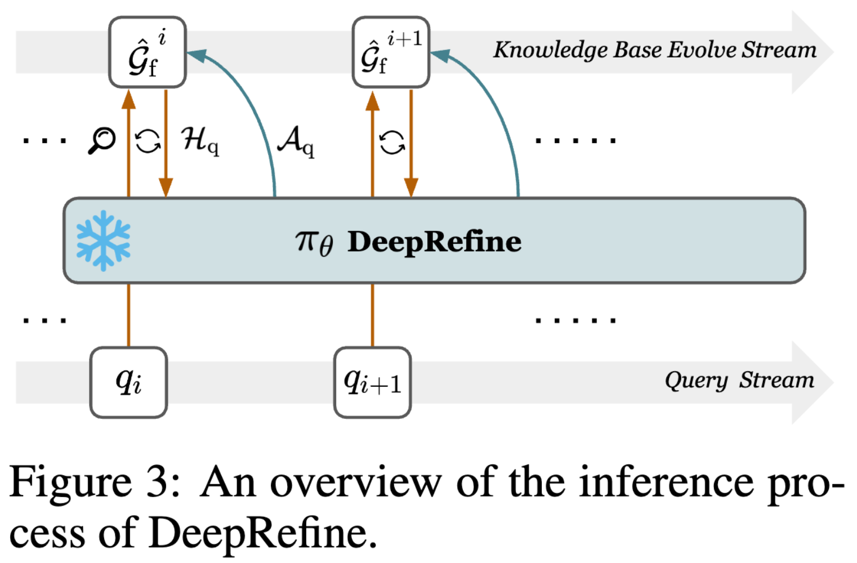
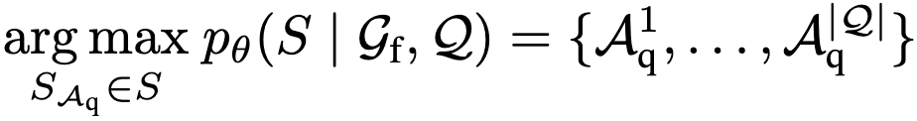
DeepRefine: Agentic Harness Design
Task of knowledge refinement: generating sequences of refinement actions that mitigates issues in the KB.
DeepRefine's agentic harness as a three-step reasoning process, including
Answerability Judgement Loop,
Error Abduction, and
Refinement Actions Generation.
Huang H, Bai J, Liu S, et al. DeepRefine: Agent-Compiled Knowledge Refinement via Reinforcement Learning[J]. arXiv preprint arXiv:2605.10488, 2026.

Slide 15


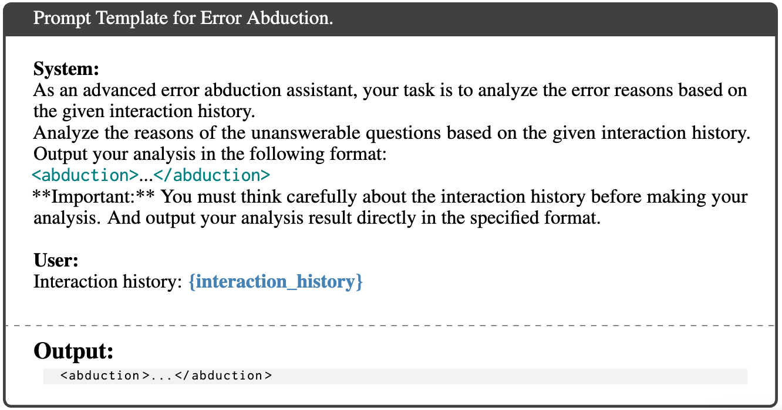
DeepRefine: Agentic Harness Design
Answerability Judgement
Conduct a simple dense retrieval to obtain the top-N related triples to the query.
Judge the answerability, if not, continue to expand the retrieved subgraph.
Error Abduction
Refinement Actions Generation space design:
incompleteness
insert_edge( )
_delete_edge()
incorrectness
delete_edge( )
_insert_edge()
redundancy
replace_node( )
_remove_node()
Issues
Actions
Atom DB Operators
Fixed schema.

Slide 16
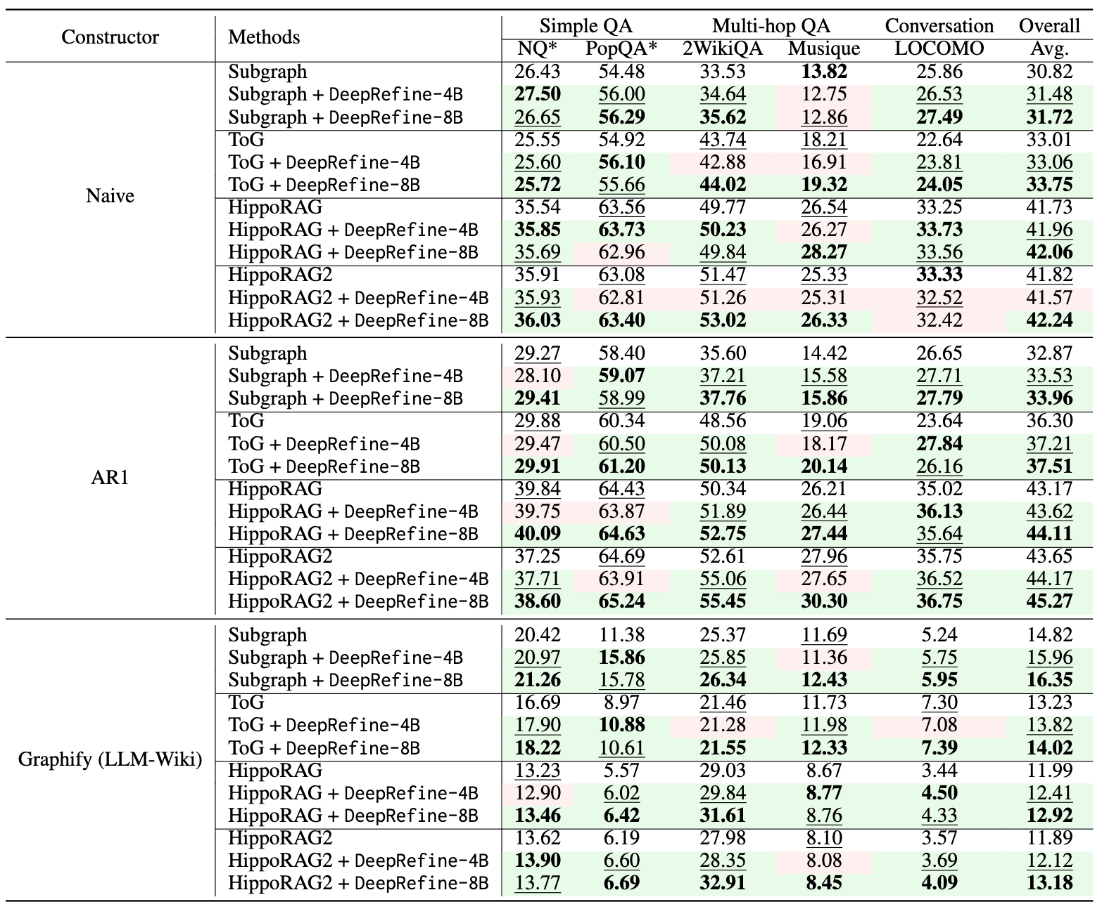
DeepRefine: Performance
OOD experimental settings.
DeepRefine brings consistent downstream gains over various knowledge base constructors and knowledge retrievers.
DeepRefine can sometimes introduce larger or competitive downstream gains than the reconstruction method, e.g., AutoGraph-R1(AR1).
Huang H, Bai J, Liu S, et al. DeepRefine: Agent-Compiled Knowledge Refinement via Reinforcement Learning[J]. arXiv preprint arXiv:2605.10488, 2026.

Slide 17
From Foundation KG Construction to
Foundation Knowledge Models
1. Read/write: relevancy and scalability.
2. Augmentation: LLM native (embeddings) or text native (natural language).
Knowledge Bases
Reactive: Enabled by LLMs to have a better fuzzy semantic search
Agent-Native: retrieve text information and perform context engineer
3. Interaction: Proactive or reactive.
Proactive: Database/knowledge base as a smart agent: understanding LLMs/users’ intention and making predictions for more structured data and NP-complete problems:
self-evolving, reasoning, in-context learning, etc.
Large Language Models (LLMs)
Embedding
Vector Databases
AI-Native: retrieve vectors and perform learning/inference

Slide 18
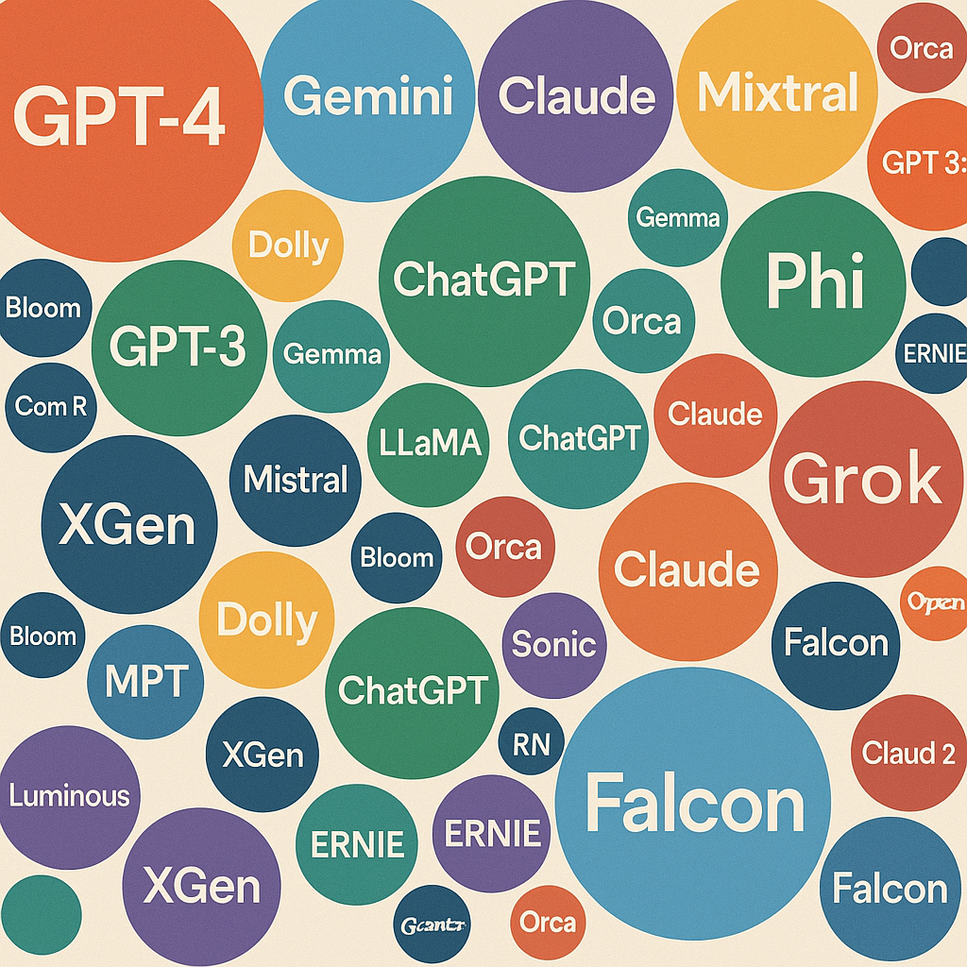
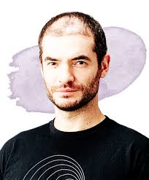
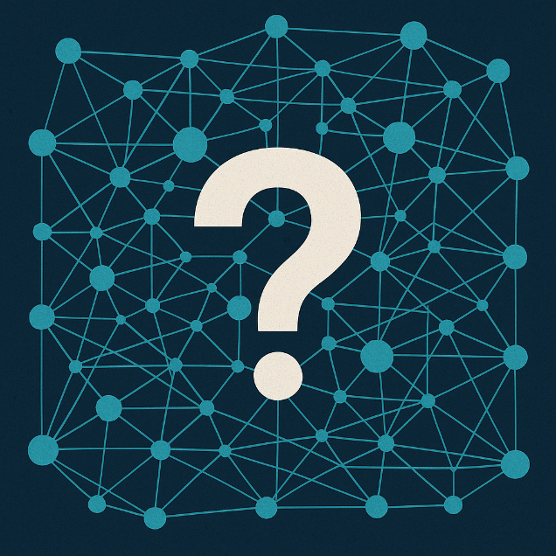
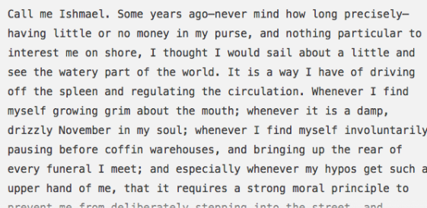
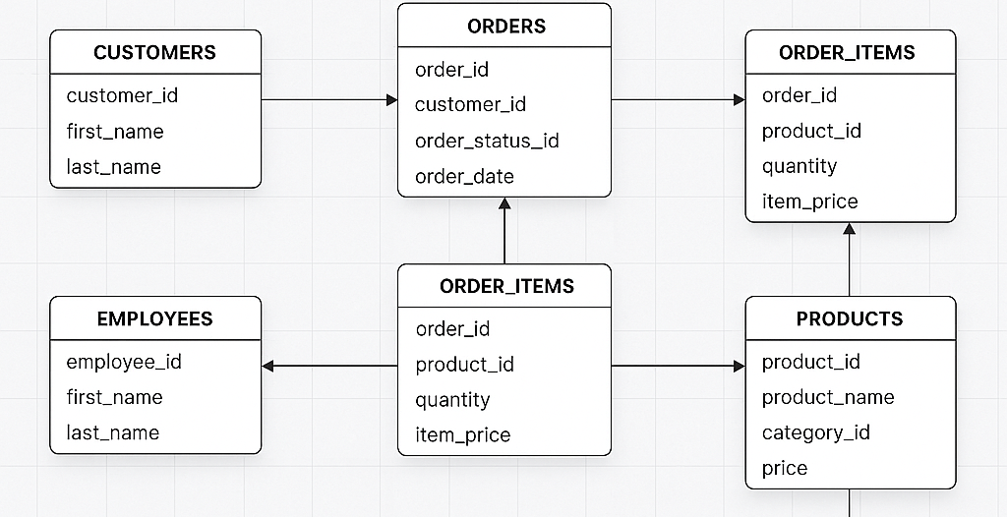
Generalization from Structured Data?
LLM Pre-training scaling will stop
because we only have one internet!
Ilya Sutskever [1]
Neural Graph Database (NGDB) show great potential for Database Memorization and Generalization!
Neuralization
Neuralization
Large Language Model
Neural (Graph) Databases
Text Data
Database Data
Data within databases continues to grow;
At very early stage where universities can do research [2];
Combines general applicability to real-world applications, positioning it to make industry impact;
Many private domain databases.
[1] https://youtu.be/1yvBqasHLZs
[2] Wang, Y., Wang, X., Gan, Q., Wang, M., Yang, Q., Wipf, D., & Zhang, M. (2025). Griffin: Towards a Graph-Centric Relational Database Foundation Model. arXiv preprint arXiv:2505.05568.

Slide 19

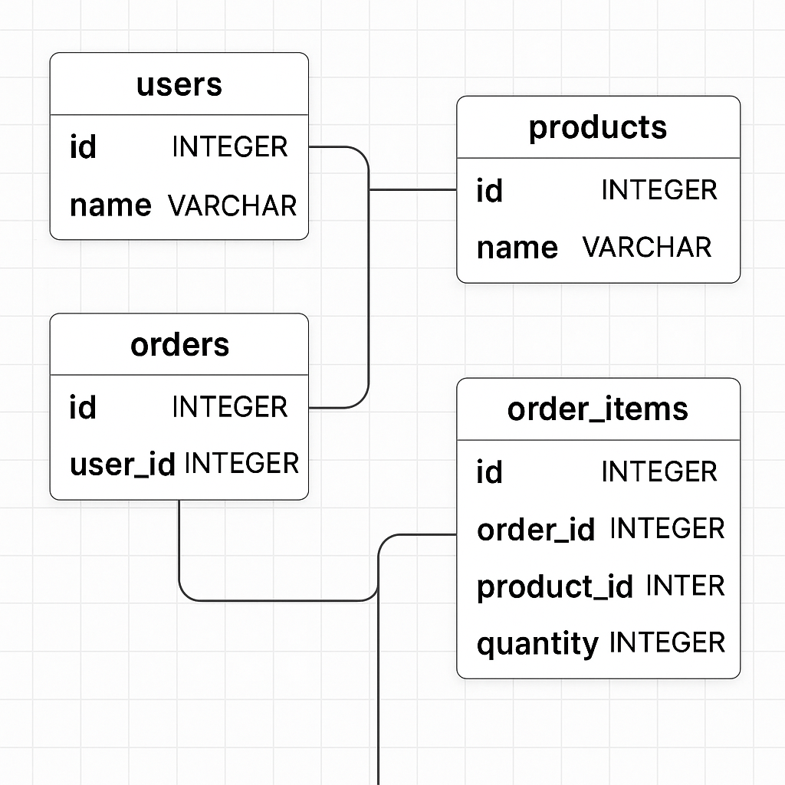
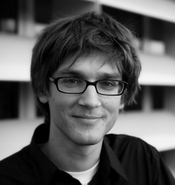
Recent Related Efforts: Relational Deep Learning
Data Is Stored in Databases
  Commerce
  Finance
  Social Media
  Medical
Core Concept: Applying deep learning directly to relational databases tables by treating them as graphs [1]
Statistical Relational Learning (SRL) has been a long standing research topic.
Jure Leskovek
(Stanford)
[1] Fey, M., Hu, W., Huang, K., Lenssen, J. E., Ranjan, R., Robinson, J., ... & Leskovec, J. (2024, July). Position: Relational deep learning-graph representation learning on relational databases. In Forty-first International Conference on Machine Learning.

Slide 20
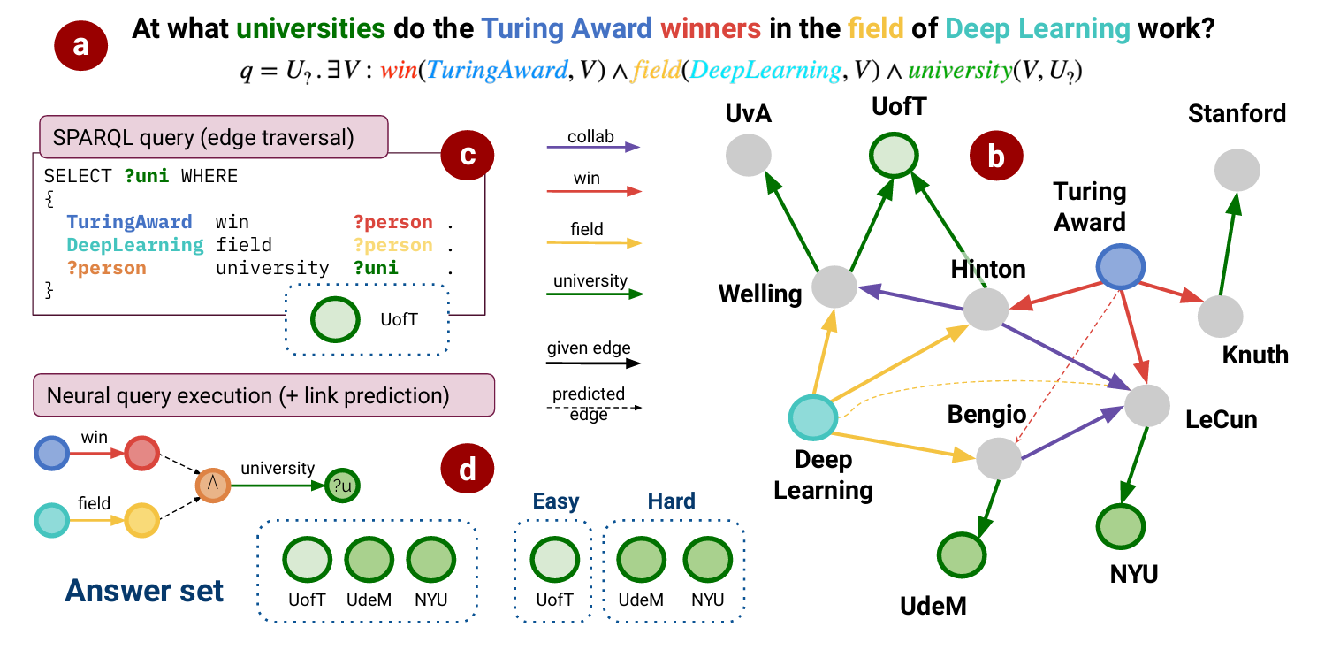
Graph Database Query
Limitation: Missing knowledge results in incomplete answer set.
Complex Graph Queries (Figure taken from Ren et al)
Ren H, Galkin M, Cochez M, Zhu Z, Leskovec J. Neural graph reasoning: Complex logical query answering meets graph databases. arXiv preprint arXiv:2303.14617. 2023 Mar 26.

Slide 21
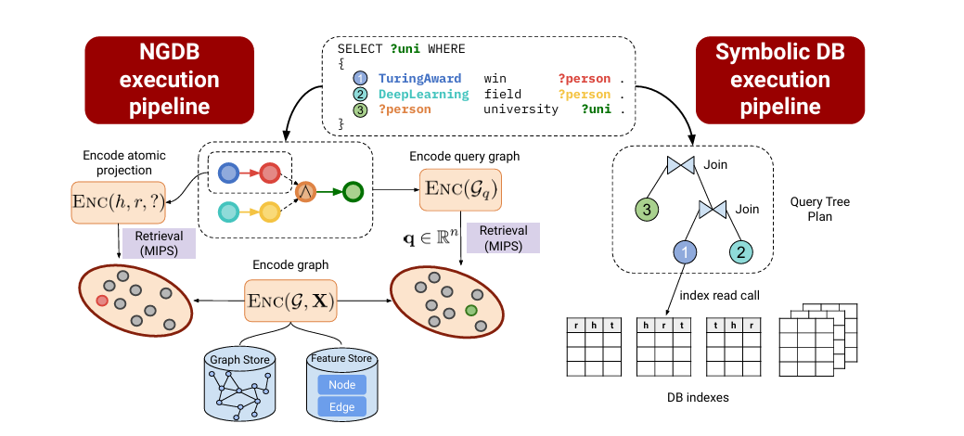
Neural Graph Databases (NGDBs)
Neural Graph Storage: employ graph store and feature store to obtain latent representations in the embedding store.
Neural Query Engine: derive the computation graph of the query and execute in the latent space.
Neural Graph Databases (Figure taken from Ren et al)
Ren H, Galkin M, Cochez M, Zhu Z, Leskovec J. Neural graph reasoning: Complex logical query answering meets graph databases. arXiv preprint arXiv:2303.14617. 2023 Mar 26.

Slide 22
Embedding Space and Set Representations
$$q=V_{?} . ∃V:Win\left(TuringAward, V\right) ∧¬Citizen\left(Canada,V\right)∧Graduate(V, V_{?})$$
GQE
Turing
Award
Has Winner
Vector Embeddings
Graduate
Query2Box
Has Citizen
Complement
Intersection
Canada
Box Embeddings
Computation Graph
Embedding Space
Query2Particle
The multi-hop logical operations make the query answers diversified
The answers embeddings are set(s) scattered in the embedding space
Particle Embeddings
William L. Hamilton, Payal Bajaj, Marinka Zitnik, Dan Jurafsky, Jure Leskovec. Embedding Logical Queries on Knowledge Graphs. NeurIPS 2018.
Hongyu Ren, Weihua Hu, Jure Leskovec. Query2box: Reasoning over Knowledge Graphs in Vector Space using Box Embeddings. ICLR 2020.
Example from: Jiaxin Bai, Zihao Wang, Hongming Zhang, Yangqiu Song: Query2Particles: Knowledge Graph Reasoning with Particle Embeddings. NAACL-HLT (Findings) 2022.

Slide 23
Scaling Predictive Complex Graph Queries
Existing predictive graph queries are not enough
  NGDBench
Graph databases are usually very large; training is still not scaling
  NGDB-ZOO
Training free; inference stage scaling: from foundation models to in-context learning (ICL)
  KGPFN

Slide 24
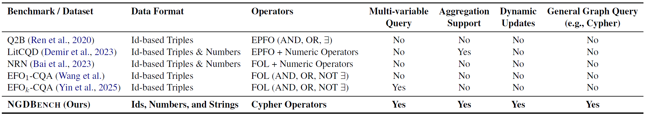
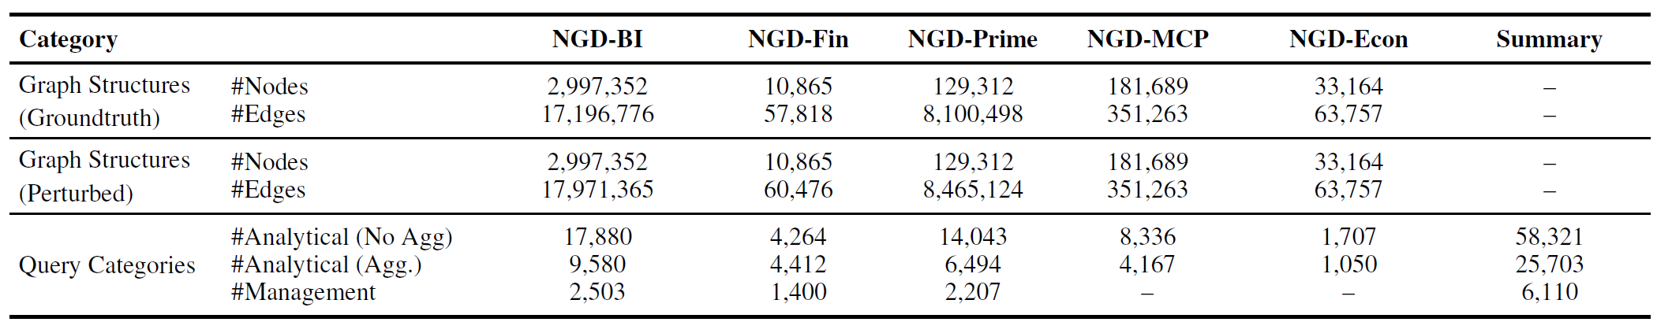
NGDBench: Data Type Scaling
Yufei Li, Yisen Gao, Jiaxin Bai, Jiaxuan Xiong, Haoyu Huang, Zhongwei Xie, Hong Ting Tsang, Yangqiu Song: Towards Neural Graph Data Management. CoRR abs/2603.05529 (2026)
Supports full Cypher queries and dynamic data management operations
From KnowComp
2021
Hongyu Ren, Weihua Hu, and Jure Leskovec. 2020. Query2box: Reasoning over knowledge graphs in vector space using box embeddings, ICLR 2020
Caglar Demir, Michel Wiebesiek, Renzhong Lu, Axel- Cyrille Ngonga Ngomo, and Stefan Heindorf. 2023. LitCQD: Multi-hop reasoning in incomplete knowledge graphs with numeric literals. ECML PKDD 2023
Jiaxin Bai, Chen Luo, Zheng Li, Qingyu Yin, Bing Yin, and Yangqiu Song. 2023. Knowledge graph reasoning over entities and numerical values, KDD 2023
ZihaoWang, Hang Yin, and Yangqiu Song. Benchmarking the combinatorial generalizability of complex query answering on knowledge graphs, NeurIPS Benchmarks Track (Round 2), 2021
Hang Yin, Zihao Wang, Weizhi Fei, and Yangqiu Song. EfOk-CQA: Towards knowledge graph complex query answering beyond set operation. KDD 2025.

Slide 25
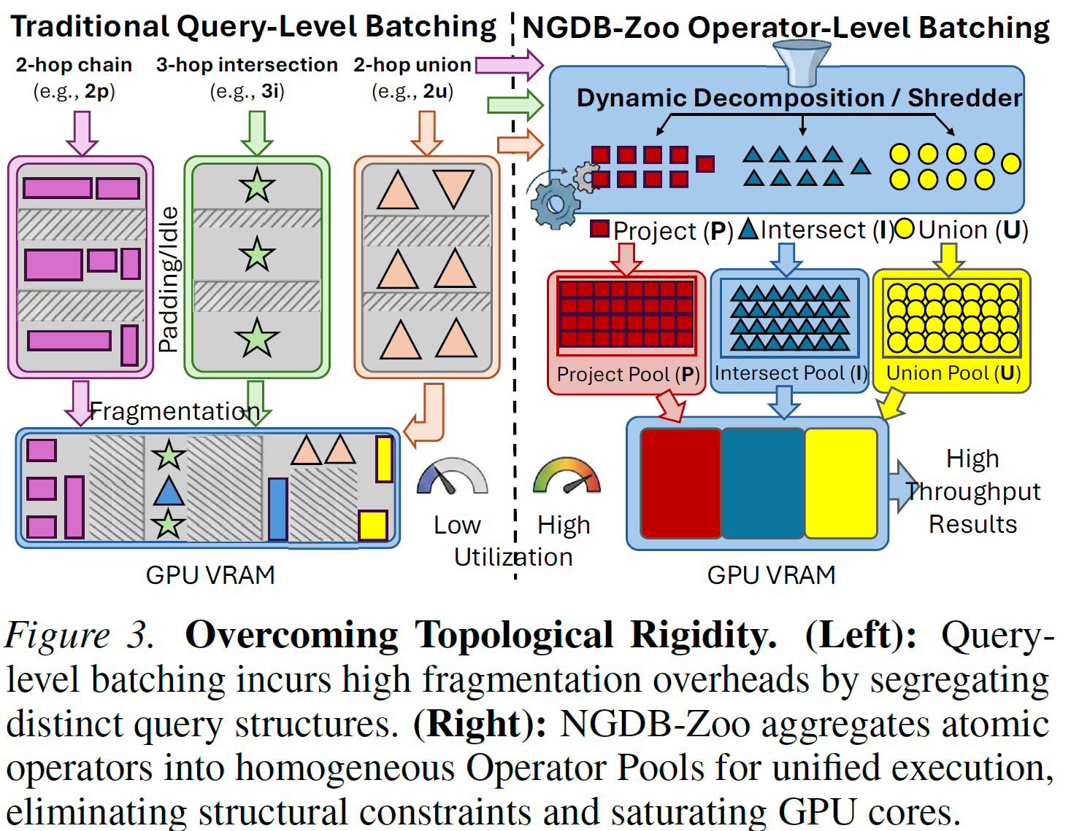
NGDBs Training Scaling
Low training efficiency
Expressivity are constrained by structure-exclusive embeddings
NGDB-Zoo: Towards Efficient and Scalable Neural Graph Databases Training

Slide 26
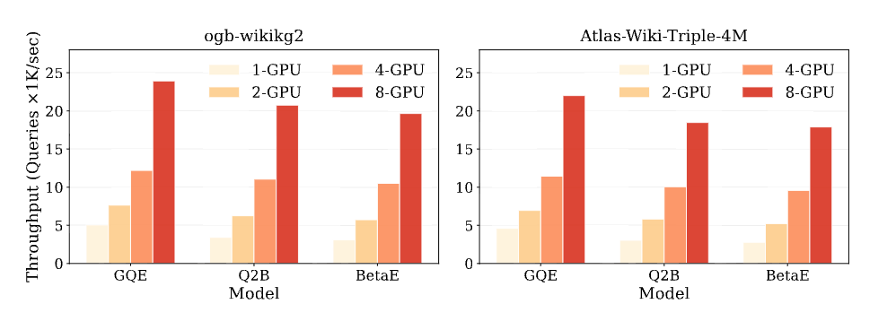
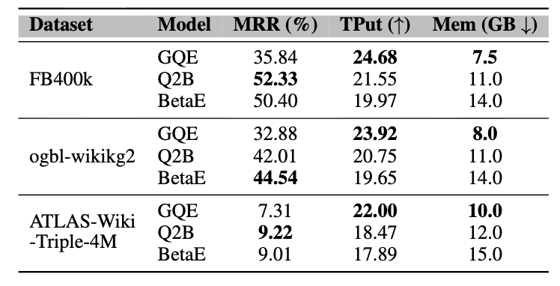
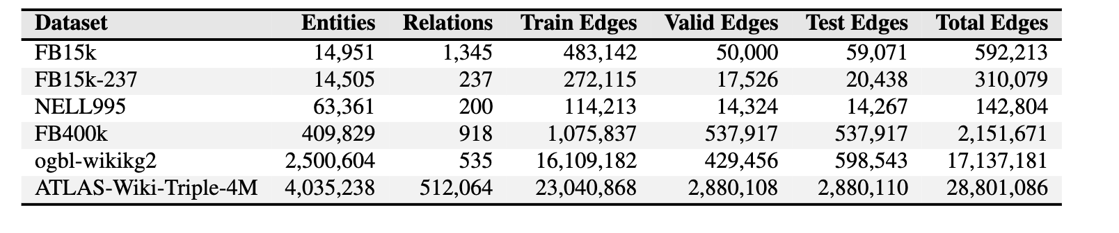
Scalability and Predictive Performance on Massive
Knowledge Graphs
The unit of throughput is 10³ queries/sec.
NGDB-Zoo enables high throughput and robust reasoning across diverse paradigms on production-scale graphs with millions of entities.
KG statistics with number of entities, relations, training, validation and test edges.

Slide 27
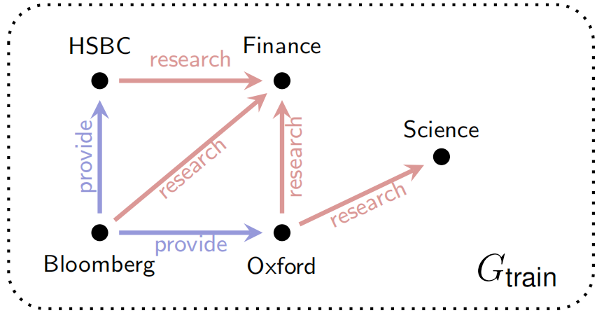
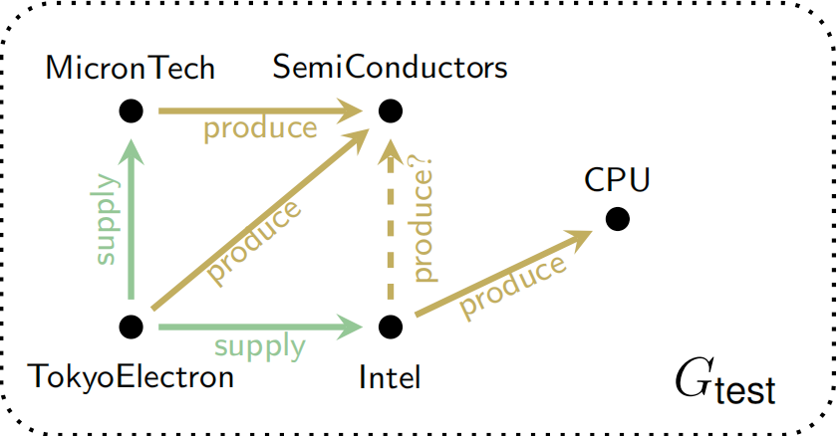
Revisit Knowledge Graph Foundation Model
Knowledge Graph Foundation Model (KGFM) need to be able to generalize on new graphs where the entities and relationships are completely different.
Figure1. Train graph
Figure2. Test graph
Figure Ref: ICML 2025
Invariance of the relational structure facilitates the transition to new relations——capturing the ‘relation’ of relation.
Towards Foundation Models For Knowledge Graph Reasoning. ICLR 2024
How Expressive are Knowledge Graph Foundation Models? ICML 2025

Slide 28
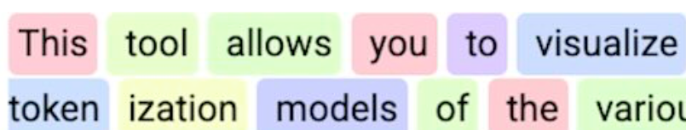
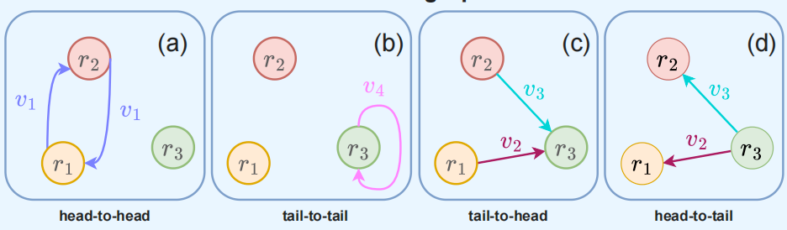
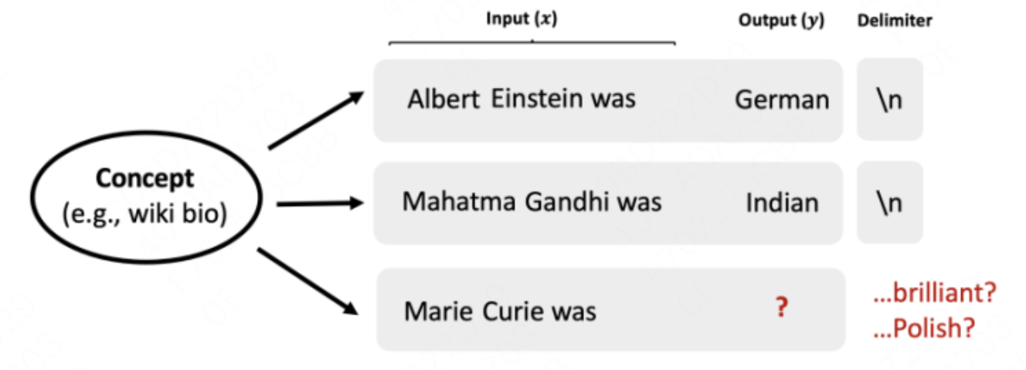
Rethink the Foundation Model
LLM vs KGFM
General invariant basic unit
Token
Relation Motif
Incontext Learning
Prompt
Missing

Slide 29
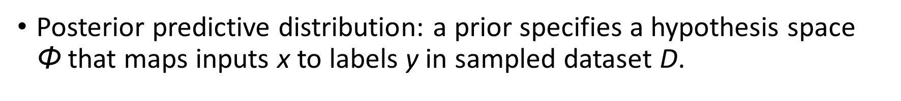
In-context Learning from a Bayesian View
ICL in LLM: Extract the shared concept from the prompt and conduct Bayesian inference.
Posterior predictive distribution: a prior specifies a hypothesis space Φ that maps inputs x to labels y in sampled dataset D.

Slide 30
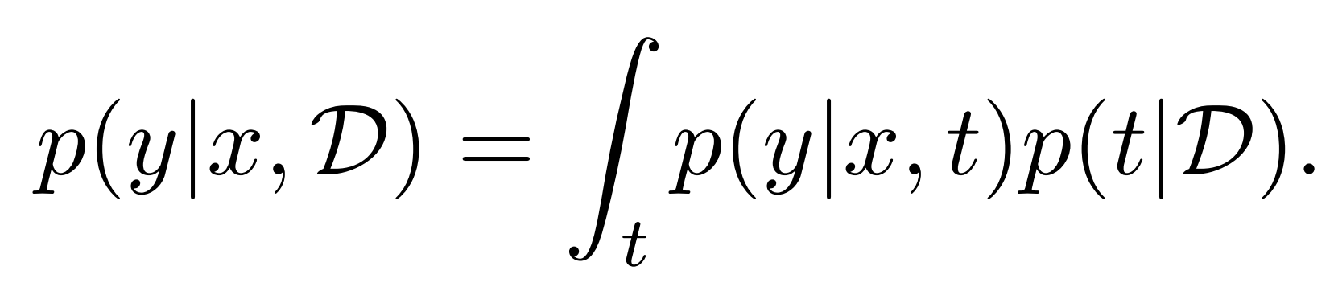
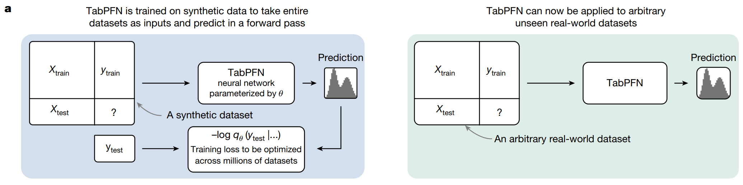
Prior-data Fitted Networks (PFNs)
Prior-data fitted networks(PFN) : cast in-context learning as amortized Bayesian inference:
a single parametric model is trained to output the posterior predictive distribution conditioned on a set of labeled context examples.
PFN has become the cornerstone of structured data incontext learning, including tables, relational databases and time series data.
Accurate predictions on small data with a tabular foundation model. Nature, 2024

Slide 31
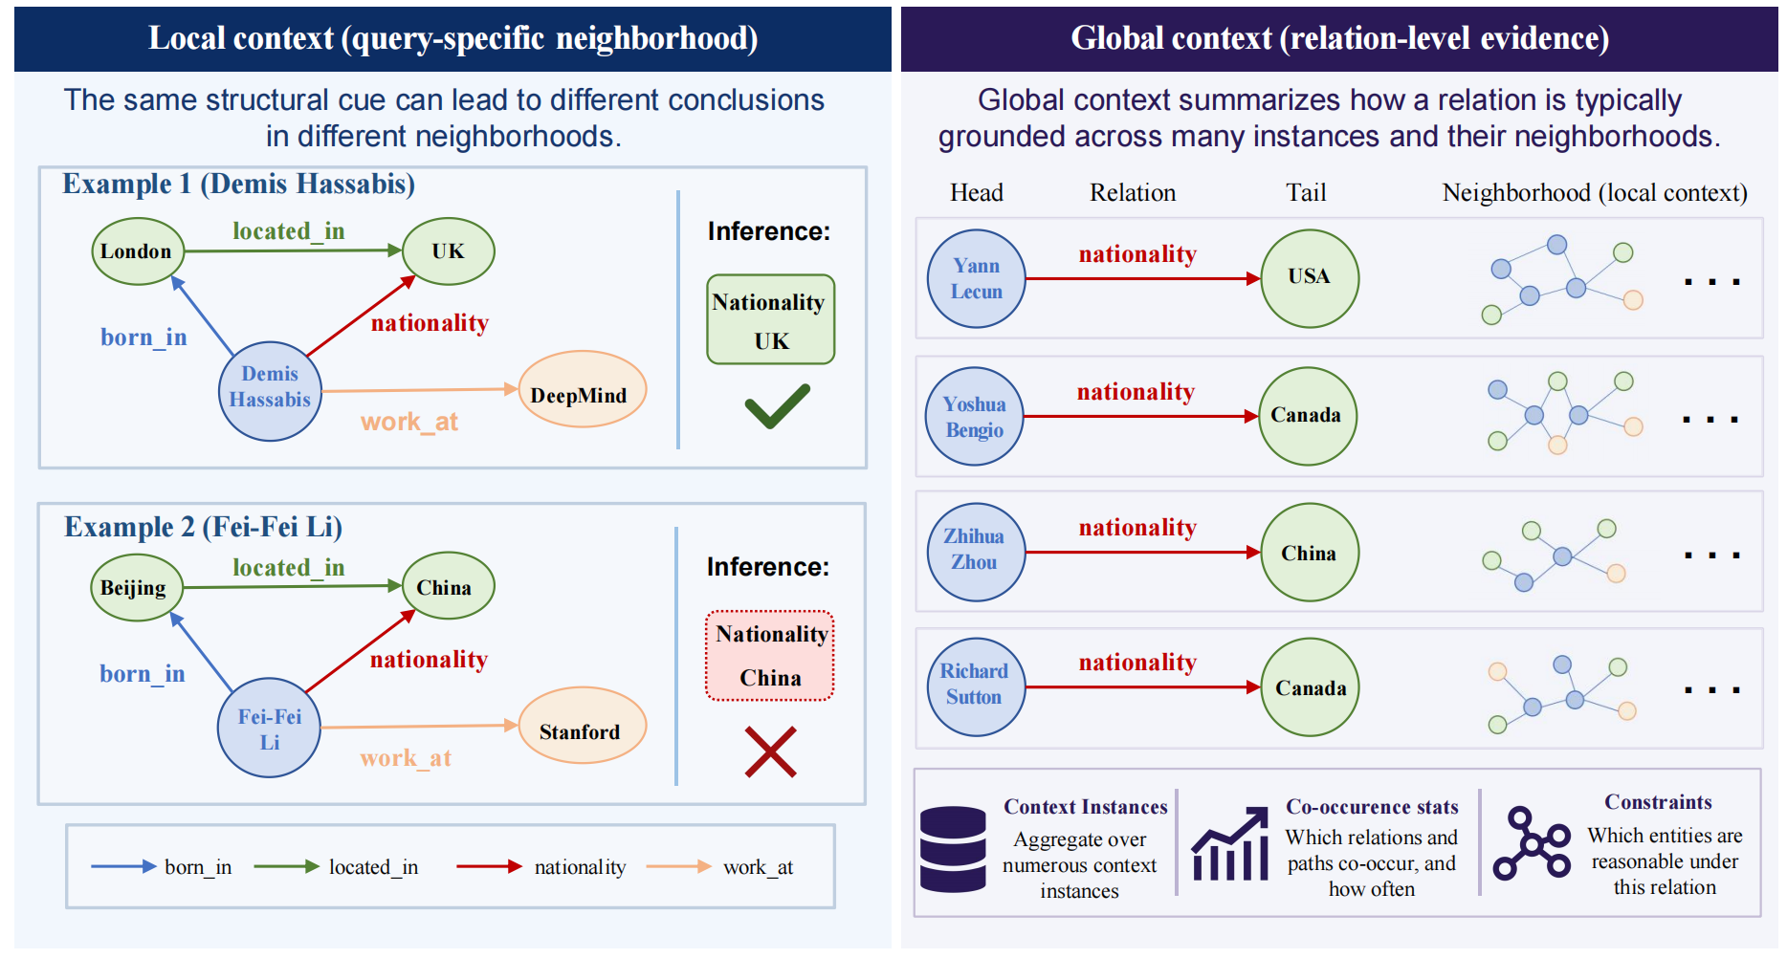
ICL for Knowledge Graph Foundation Model
Context in KG: local context and global context

Slide 32
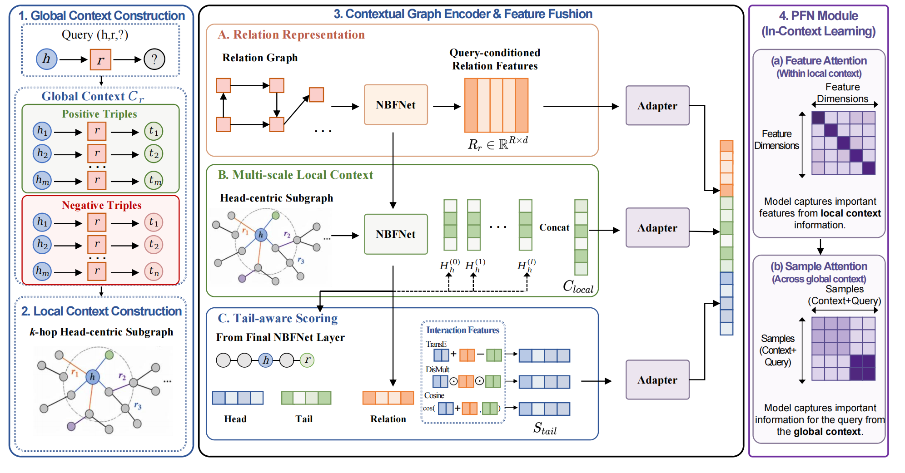
KGPFN: In Context Learning KGFM+PFN

Slide 33
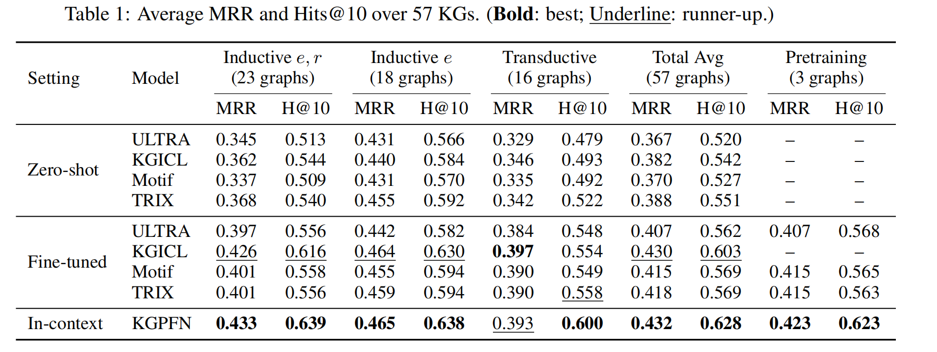
Experiment: Test/Inference Time Scaling
Link Prediction Performance on 57 KGs
KGPFN can defeat the fine-tuned KGFMs with in-context learning.
Yisen Gao, Jiaxin Bai, Haoyu Huang, Zhongwei Xie, Yufei Li, Hong Ting Tsang, Sirui Han, Yangqiu Song: KGPFN: Unlocking the Potential of Knowledge Graph Foundation Model via In-Context Learning. (2026)

Slide 34
Conclusions
We build foundation knowledge graphs automatically extracted or refined from Web-scale documents
  All entities, events, relations, and schemas are automatic
We build neuralized knowledge foundation model that can efficiently trained over large-scale graph databases
We extend the foundation model into in-context learning, which is one more big step towards foundation model real use

Slide 35
Thank you for your attention ☺

