Slide 1

An Overview of Commonsense Knowledge Graph Construction and Reasoning at HKUST
Yangqiu Song
Department of CSE, HKUST, Hong Kong

Slide 2
Understanding human’s language requires complex knowledge
"Crucial to comprehension is the knowledge that the reader brings to the text. The construction of meaning depends on the reader's knowledge of the language, the structure of texts, a knowledge of the subject of the reading, and a broad-based background or world knowledge.” (Day and Bamford, 1998)
  Pragmatics: Contexts and knowledge contributes to the meanings
https://www.thoughtco.com/world-knowledge-language-studies-1692508

Slide 3
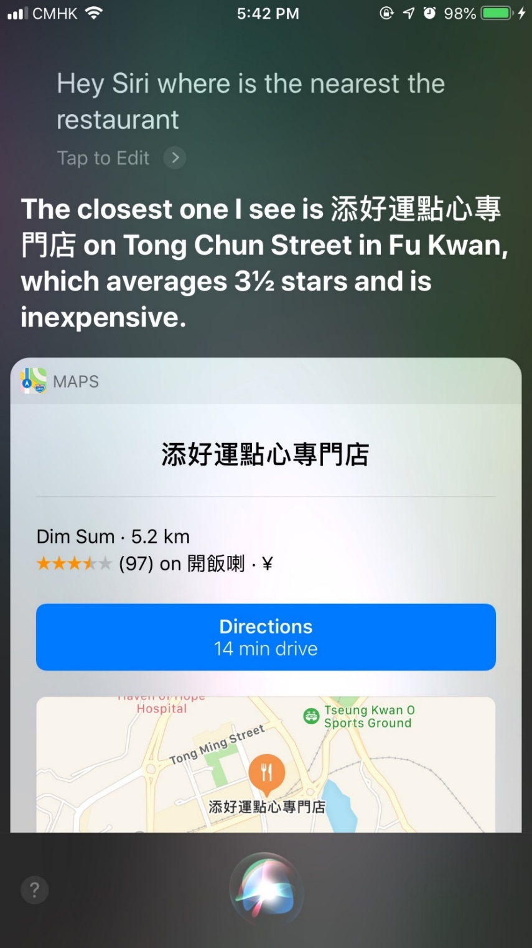
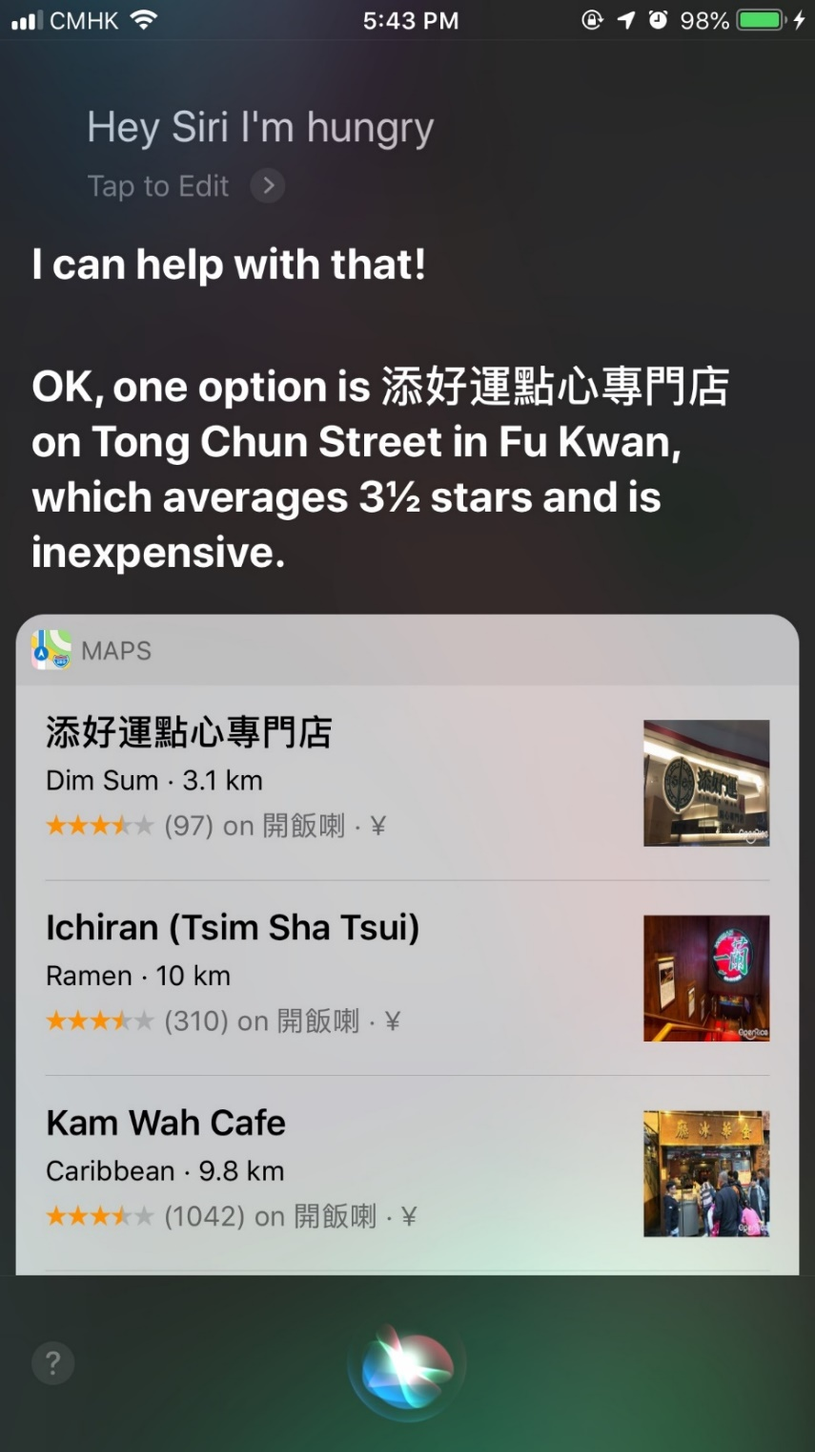
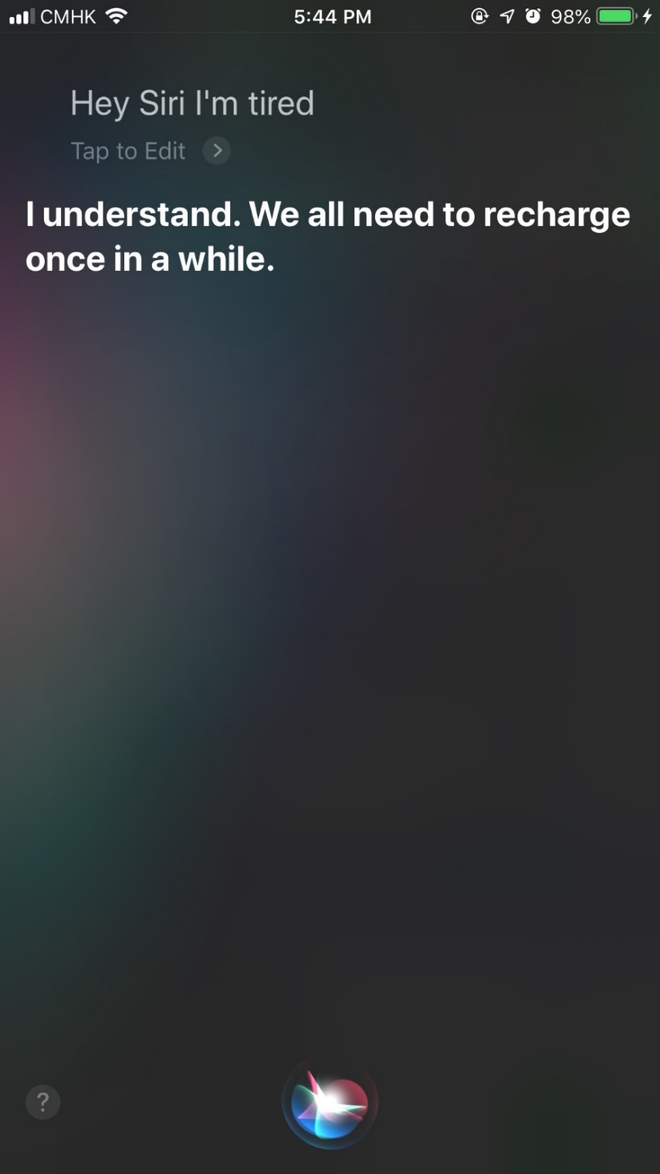
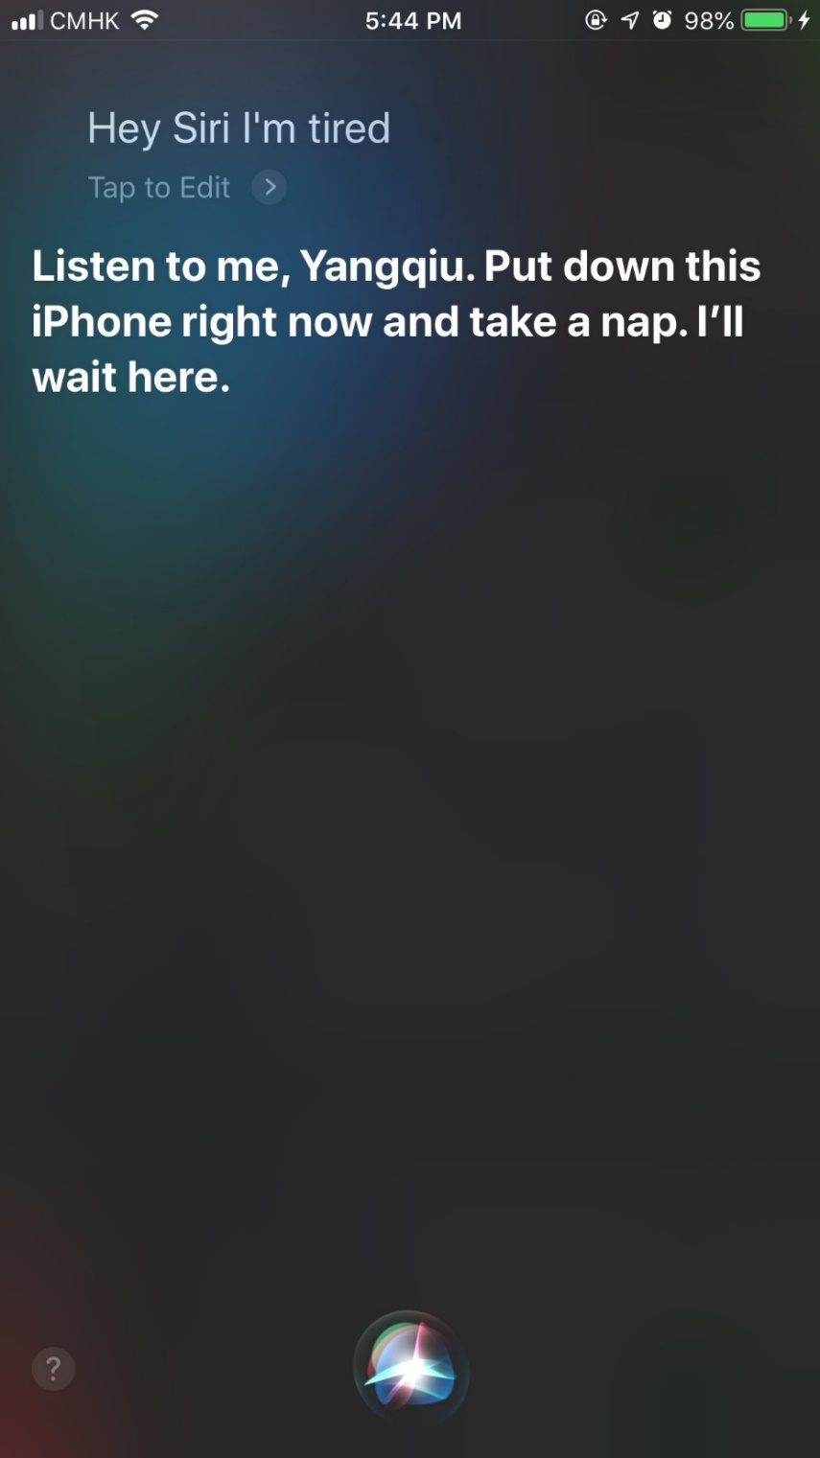
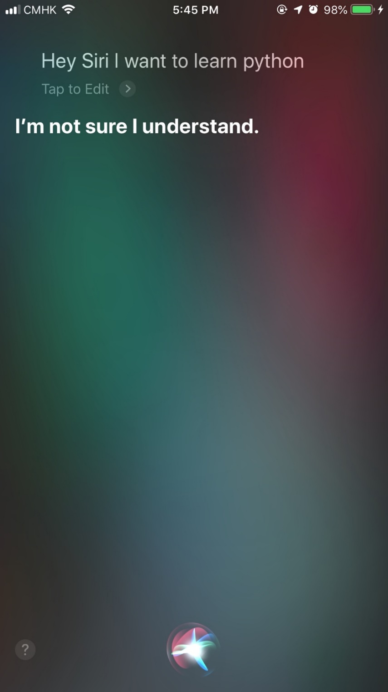
Natural language conversation requires a lot of commonsense knowledge
Interacting with human involves a lot of commonsense knowledge
Space
Time
Location
State
Causality
Color
Shape
Physical interaction
Theory of mind
Human interactions
…
Judy Kegl, The boundary between word knowledge and world knowledge, TINLAP3, 1987
Ernie Davis, Building AIs with Common Sense, Princeton Chapter of the ACM, May 16, 2019

Slide 4
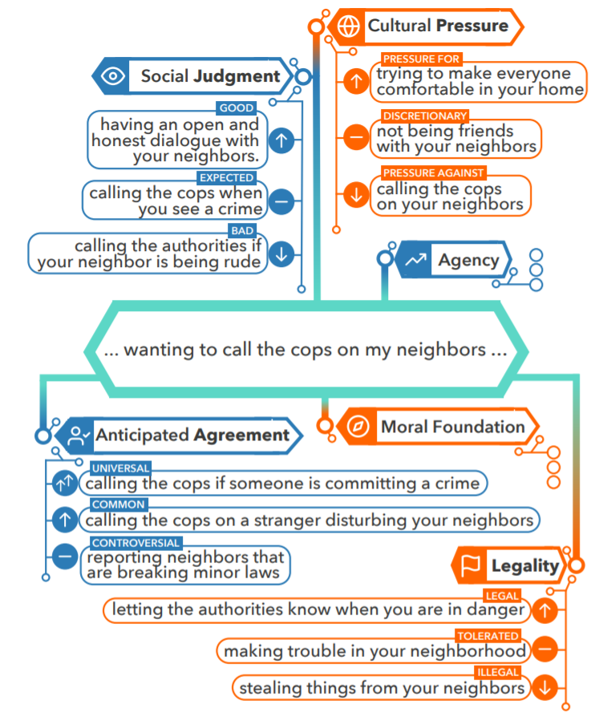
Social-Chemistry-101 (UW)
Understanding law-related documents needs social understanding
“段某某又打电话给糜某2问明其所在位置后,于当晚21时许携带空啤酒瓶,带领袁某(已判决)以及携带三、四十厘米长刀具的易某(已判决)等人来到三期宿舍对面的麻将馆找糜某2。糜某2接到段某某电话后,从麻将馆的厨房找来一把菜刀放在口袋里以备段某某来打架。段某某、袁某、易某等人找到糜某2后,段某某又与糜某2发生言语冲突,继而双方发生打架。糜某2被段某某持啤酒瓶、易某持刀致伤后逃脱,后被糜某1等人送至湖口县中医院进行治疗。”
Maxwell Forbes, Jena D. Hwang, Vered Shwartz, Maarten Sap, Yejin Choi: Social Chemistry 101: Learning to Reason about Social and Moral Norms. EMNLP (1) 2020: 653-670

Slide 5
Commonsense Knowledge is the Key
  How to define commonsense knowledge? (Liu & Singh, 2004)
    “While to the average person the term ‘commonsense’ is regarded as synonymous with ‘good judgement’, ”
    “in the AI community it is used in a technical sense to refer to the millions of basic facts and understandings possessed by most people.”
  “Such knowledge is typically omitted from social communications”, e.g.,
    If you forget someone’s birthday, they may be unhappy with you.
H Liu and P Singh, ConceptNet - a practical commonsense reasoning tool-kit, BTTJ, 2004

Slide 6
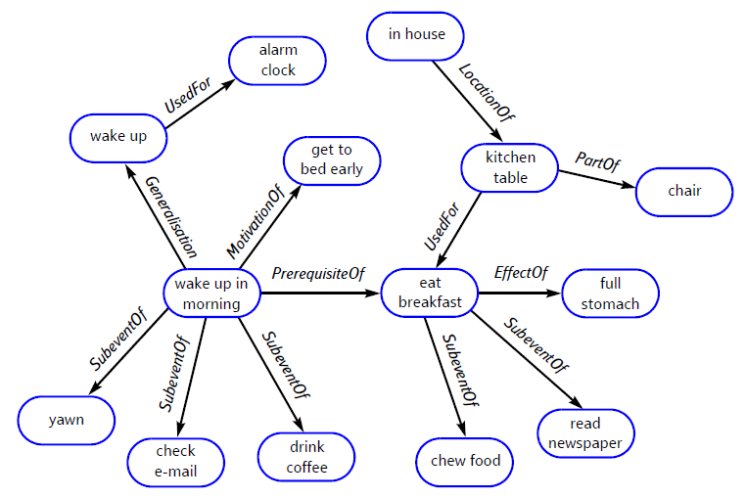
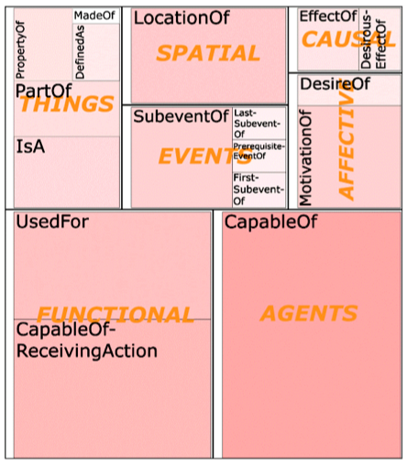
How to collect commonsense knowledge?
ConceptNet5 (Speer and Havasi, 2012)
  Core is from Open Mind Common Sense (OMCS) (Liu & Singh, 2004)
  Essentially a crowdsourcing based approach + text mining

Slide 7
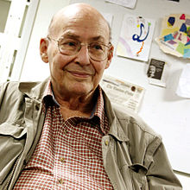
The Scale
“A founder of AI, Marvin Minsky, once estimated that ‘...commonsense is knowing maybe 30 or 60 million things about the world and having them represented so that when something happens, you can make analogies with others’.” (Liu & Singh, 2004)
ConceptNet
  2004: 1.6 million relations among 300,000 nodes
  2017: 21 million edges over 8 million nodes
    1.5 million nodes are English
Slides credit: Haixun Wang
Notes:
ConceptNet : is generated automatically from OMCS corpus (general public) about 4 years
WordNet, Cyc: is manually handcrafted by knowledge engineers (knowledge engineers at Cycorp) 20 years
ConceptNet :
Structure like WordNet, relationally rich like Cyc
(simple-to-use representation) (rich content)

Slide 8
What contribute to ConceptNet5.5
(21 million edges and over 8 million nodes)?
Facts acquired from Open Mind Common Sense (OMCS) (Singh 2002) and sister projects in other languages (Anacleto et al. 2006)
Information extracted from parsing Wiktionary, in multiple languages, with a custom parser (“Wikiparsec”)
“Games with a purpose” designed to collect common knowledge (von Ahn, Kedia, and Blum 2006) (Nakahara and Yamada 2011) (Kuo et al. 2009)
Open Multilingual WordNet (Bond and Foster 2013), a linked-data representation ofWordNet (Miller et al. 1998) and its parallel projects in multiple languages
JMDict (Breen 2004), a Japanese-multilingual dictionary
OpenCyc, a hierarchy of hypernyms provided by Cyc (Lenat and Guha 1989), a system that represents commonsense knowledge in predicate logic
A subset of DBPedia (Auer et al. 2007), a network of facts extracted from Wikipedia infoboxes
Most of them are entity-centric knowledge, there are only
116,097 edges among
74,989 nodes about
events
Speer, Chin, and Havasi, ConceptNet 5.5: An Open Multilingual Graph of General Knowledge. AAAI 2017.

Slide 9





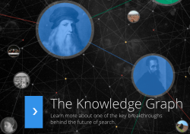



Most Existing KBs are Entity-centric
Many large-scale knowledge graphs about entities and their attributes (property-of) and relations (thousands of different predicates) have been developed
  Millions of entities and concepts
  Billions of relationships
NELL
Google Knowledge Graph (2012)
570 million entities and 18 billion facts

Slide 10
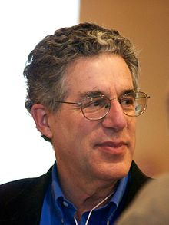
However,
Semantic meaning in our language can be described as ‘a finite set of mental primitives and a finite set of principles of mental combination (Jackendoff, 1990)’.
The primitive units of semantic meanings include
  Thing (or Object, Entity, Concept, Instance, etc.),
  Property,
  Place,
  Path,
  Amount,
  Activity,
  State,
  Event,
  etc.
  How to collect more knowledge about eventualities rather than entities and relations?
Eventuality
Ray Jackendoff. (Ed.). (1990). Semantic Structures. Cambridge, Massachusetts: MIT Press.

Slide 11
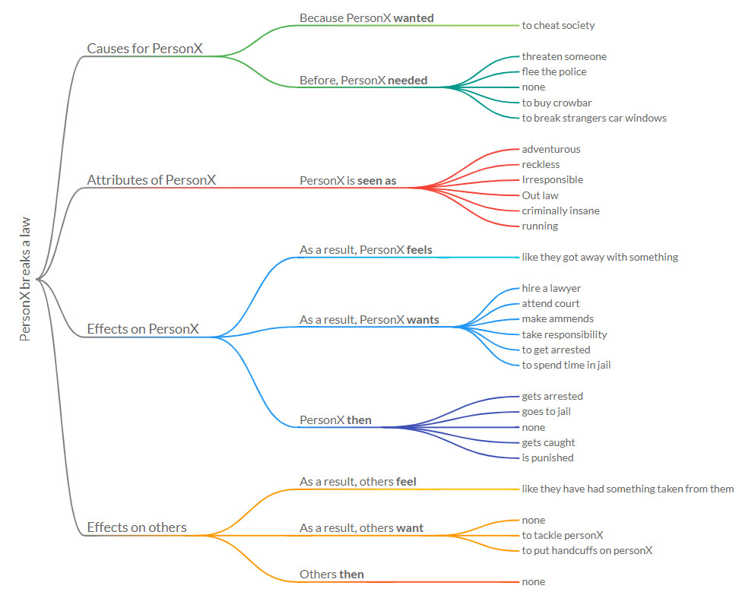
ATOMIC
Crowdsoursing 9 Types of IF-THEN relations
All personal entity information has been removed to reduce ambiguity
Arbitrary texts
Maarten Sap, Ronan LeBras, Emily Allaway, Chandra Bhagavatula, Nicholas Lourie, Hannah Rashkin, Brendan Roof, Noah A. Smith, Yejin Choi: ATOMIC: An Atlas of Machine Commonsense for If-Then Reasoning. AAAI, 2019.

Slide 12
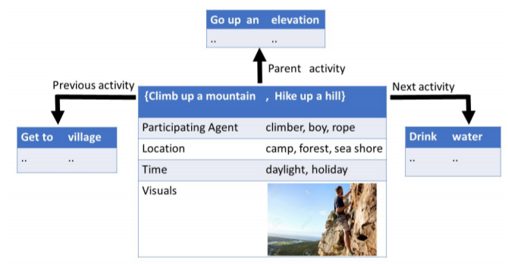
KnowlyWood
Perform information extraction from free text
  Mostly movie scripts and novel books
Four relations: previous, next, parent, similarity
Only verb+object
Niket Tandon, Gerard de Melo, Abir De, Gerhard Weikum: Knowlywood: Mining Activity Knowledge From Hollywood Narratives. CIKM 2015: 223-232

Slide 13
  How to define and scale up the commonsense knowledge acquisition and inference?

Slide 14
Outline
Motivation: NLP and commonsense knowledge
Consideration: selectional preference
New proposal: large-scale and higher-order selectional preference
Application on the Winograd Schema Challenge
Extensions

Slide 15
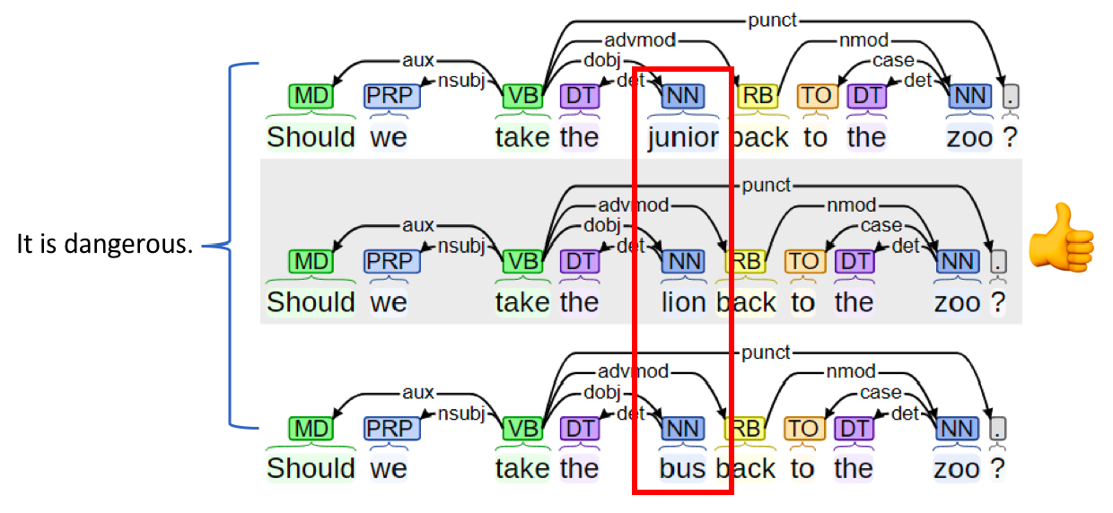
“Linguistic description – grammar = semantics”
The lower bound of a semantic theory (Katz and Fodor, 1963)
  Disambiguation needs both “the speaker's knowledge of his language and his knowledge about the world” (Katz and Fodor, 1963)
  Compare semantic meanings by fixing grammar
    Syntactically unambiguous
Principle #1
Katz, J. J., & Fodor, J. A. (1963). The structure of a semantic theory. Language, 39(2), 170–210.

Slide 16
Selectional Preference (SP)
Principle #2
  The need of language inference based on ‘partial information (in John MaCarthy’s phrase)’ (Wilks, 1975)
    The soldiers fired at the women, and we saw several of them fall.
    The needed partial information: hurt things tending to fall down
      “not invariably true”
      “tend to be of a very high degree of generality indeed”
  Selectional preference (Resnik, 1993)
    A relaxation of selectional restrictions (Katz and Fodor, 1963) and as syntactic features (Chomsky, 1965)
    Applied to isA hierarchy in WordNet and verb-object relations
(hurt, X) connection (X, fall)
Yorick Wilks. 1975. An intelligent analyzer and understander of English. Communications of the ACM, 18(5):264–274.
Katz, J. J., & Fodor, J. A. (1963). The structure of a semantic theory. Language, 39(2), 170–210.
Noam Chomsky. 1965. Aspects of the Theory of Syntax. MIT Press, Cambridge, MA.
Philip Resnik. 1993. Selection and information: A class-based approach to lexical relationships. Ph.D. thesis, University of Pennsylvania.

Slide 17
Outline
Motivation: NLP and commonsense knowledge
Consideration: selectional preference
New proposal: large-scale and higher-order selectional preference
Extensions

Slide 18
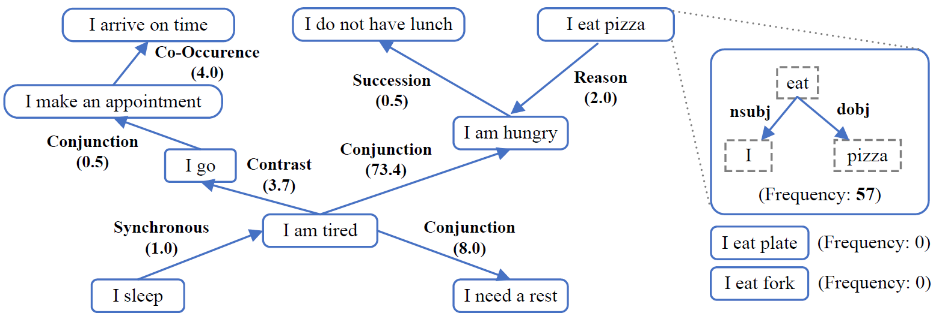
A New Eventuality Knowledge Graph: ASER
Activities, States, Events, and their Relations
Use verb-centric patterns from dependency parsing
  Principle #1: to compare semantics by fixing syntax (Katz and Fodor, 1963)
Maintain a set of key tags and a set of auxiliary tags
  Principle #2: to obtain frequent ‘partial information’ (Wilks, 1975)
A hybrid graph of
Each eventuality is a hyper-edge of words
Heterogeneous edges among eventualities

Slide 19
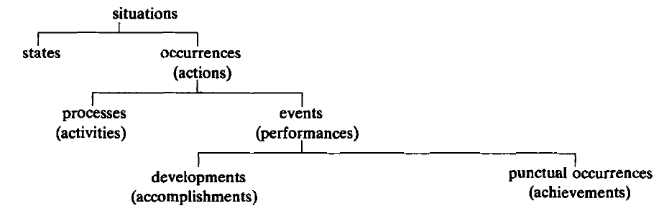
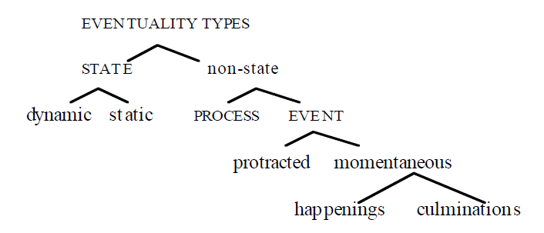
ASER
Activities, States, Events, and their Relations
Mourelatos’ taxonomy (1978)
Bach’s taxonomy (1986)
State: The air smells of jasmine.
Process: It’s snowing.
Development: The sun went down.
Punctual occurrence: The cable snapped. He blinked. The pebble hit the water.
Static states: be in New York, love (one's cat);
Dynamic states: sit, stand, drunk, present, sick;
Processes: walk, push a cart, sleep;
Protracted events: build (a cabin), eat a sandwich, polish a shoe, walk to Boston;
Culminations: take off; arrive, leave, depart;
Happenings: blink, flash, knock, kick, hit, pat, wink;
Alexander P. D. Mourelatos. Events, processes, and states. Linguistics and Philosophy, 2, 415-434. 1978.
Emmon Bach. The algebra of events. Linguistics and philosophy, 9 (1), 5-16. 1986.

Slide 20
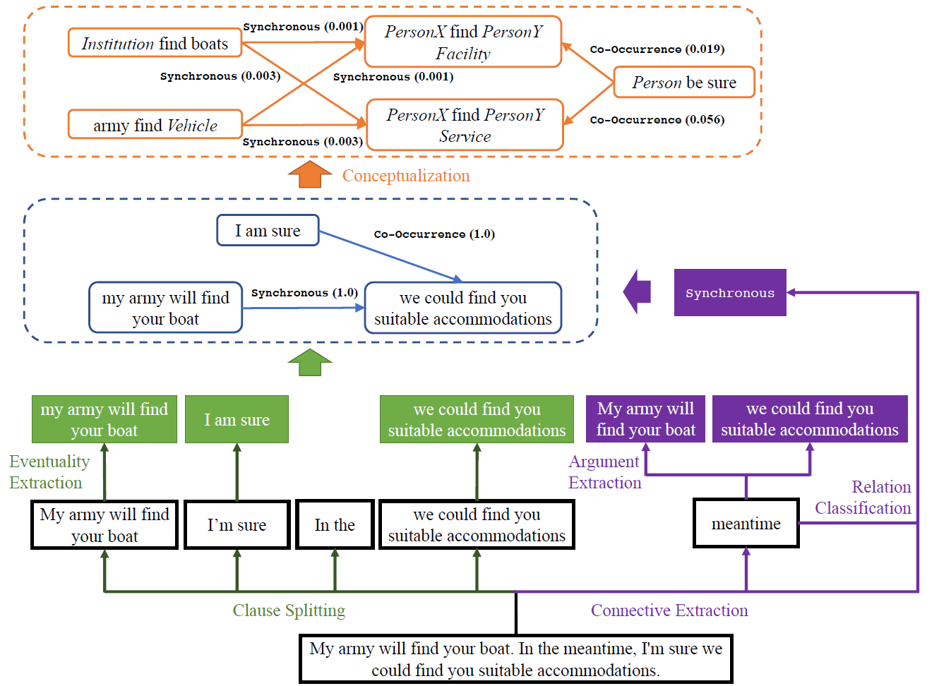
A Running Example
Conceptualization
Graph Construction
Relation Extraction
Eventuality Extraction
An input sentence

Slide 21
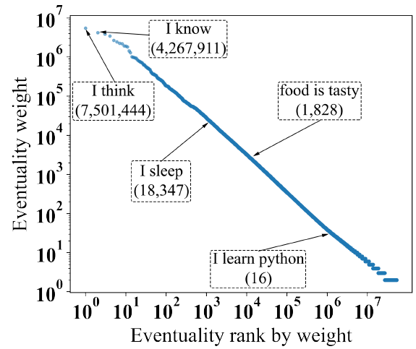
Eventualities
Pattern | Code | Example
n1-nsubj-v1 | s-v | `The dog barks'
n1-nsubj-v1-dobj-n2 | s-v-o | `I love you'
n1-nsubj-v1-xcomp-a | s-v-a | `He felt ill'
n1-nsubj-(v1-iobj-n2)-dobj-n3 | s-v-o-o | `You give me the book'
n1-nsubj-a1-cop-be | s-be-a | `The dog is cute'
n1-nsubj-v1-xcomp-a1-cop-be | s-v-be-a | `I want to be slim'
n1-nsubj-v1-xcomp-n2-cop-be | s-v-be-o | `I want to be a hero'
n1-nsubj-v1-xcomp-v2-dobj-n2 | s-v-v-o | `I want to eat the apple'
n1-nsubj-v1-xcomp-v2 | s-v-v | `I want to go'
(n1-nsubj-a1-cop-be)-nmod-n2-case-p1 | s-be-a-p-o | `It' cheap for the quality'
n1-nsubj-v1-nmod-n2-case-p1 | s-v-p-o | `He walks into the room'
(n1-nsubj-v1-dobj-n2)-nmod-n3-case-p1 | s-v-o-p-o | `He plays football with me'
n1-nsubjpass-v1 | spass-v | `The bill is paid'
n1-nsubjpass-v1-nmod-n2-case-p1 | spass-v-p-o | `The bill is paid by me'
Using patterns to collect partial information
Six relations are also kept but treated as auxiliary edges
  advmod,
  amod,
  nummod,
  aux,
  compound,
  neg

Slide 22
Eventuality Relations
14 relations taking from CoNLL shared task
  More frequent relations
Less ambiguous connectives
  ‘so that’ 31 times only in ‘Result’ relations
Some are ambiguous
  ‘while’: Conjunction 39 times, Contrast 111 times, Expectation 79 times, and Concession 85 times
Classifiers trained on Penn Discourse Treebank (PDTB) (Prasad et al., 2007)
Relation Type | Examples
Precedence | E1 before E2; E1 , then E2; E1 till E2; E1 until E2
Succession | E1 after E2; E1 once E2
Synchronous | E1, meanwhile E2; E1 meantime E2; E1, at the same time E2
Reason | E1, because E2
Result | E1, so E2; E1, thus E2; E1, therefore E2; E1, so that E2
Condition | E1, if E2; E1, as long as E2
Contrast | E1, but E2; E1, however E2; E1, by contrast E2; E1, in contrast E2; E1 , on the other hand, E2; E1, on the contrary, E2
Concession | E1, although E2
Conjunction | E1 and E2; E1, also E2
Instantiation | E1, for example E2; E1, for instance E2
Restatement | E1, in other words E2
Alternative | E1 or E2; E1, unless E2; E1, as an alternative E2; E1, otherwise E2
ChosenAlternative | E1, E2 instead
Exception | E1, except E2
Prasad, R., Miltsakaki, E., Dinesh, N., Lee, A., Joshi, A., Robaldo, L., & Webber, B. L. (2007). The penn discourse treebank 2.0 annotation manual.
Nianwen Xue, Hwee Tou Ng, Sameer Pradhan, Rashmi Prasad, Christopher Bryant, Attapol T. Rutherford. The CoNLL-2015 Shared Task on Shallow Discourse Parsing.

Slide 23
Scales of Verb Related Knowledge Graphs
300x larger
6000x larger

Slide 24
Partial Information Aggregation
    “hurt things tending to fall down”
    “stocks price may increase when a company acquires a start-up”
(hurt, X) connection (X, fall)
(company, acquire, start-up) result-in (stock, increase)

Slide 25
Normalization
Probability
He, she, I, Bob, …
PERSON
1.0
1996, 2020, 1949, …
YEAR
1.0
23, 20, 333, ….
DIGIT
1.0
www.google.com, …
URL
1.0

Slide 26


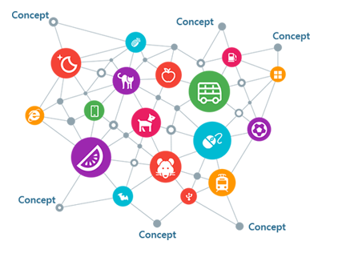
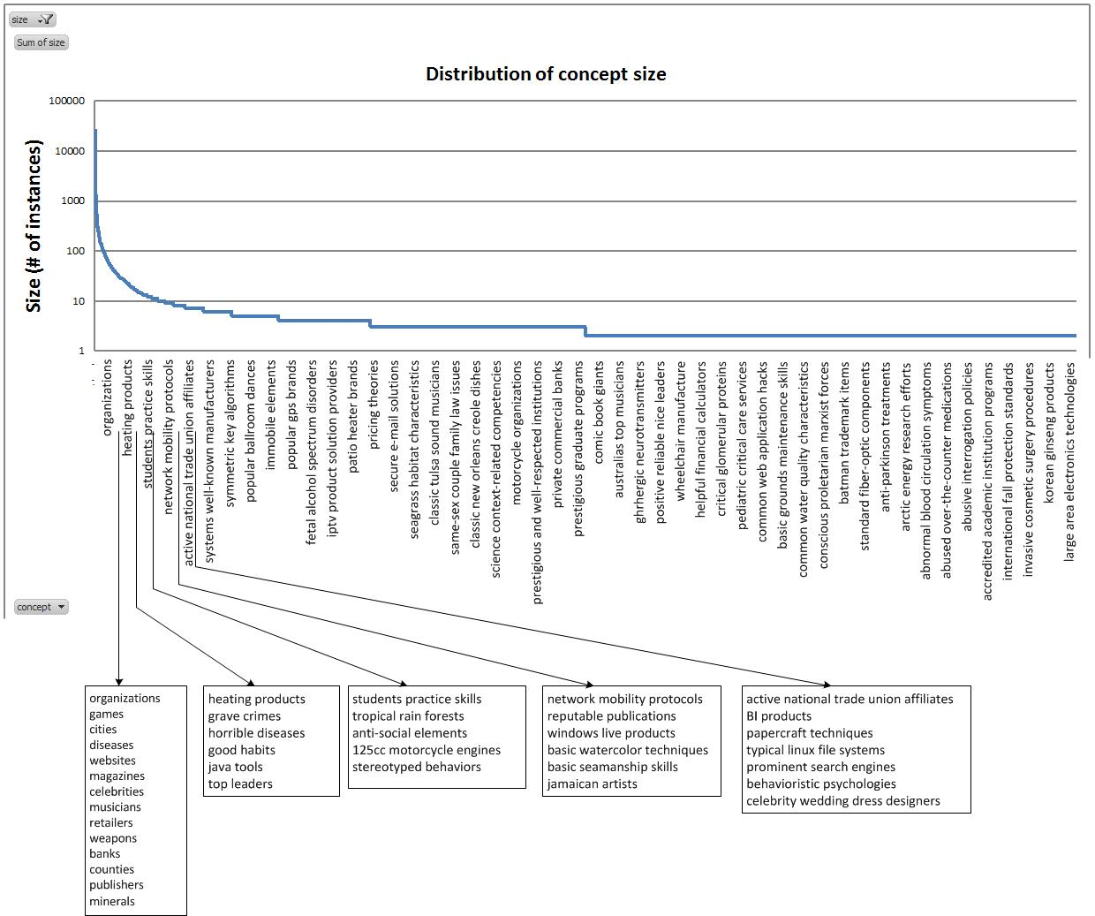
Conceptualization with
Basic watercolor techniques
2.7 million concepts
cities
Celebrity wedding dress designers
Concepts are the glue that holds our mental world together.
Gregory L. Murphy
NYU
Probase is a large, universal,
probabilistic knowledge base with an extremely large concept space
Data are available at https://concept.research.microsoft.com/
Wentao Wu, Hongsong Li, Haixun Wang, Kenny Qili Zhu: Probase: a probabilistic taxonomy for text understanding. SIGMOD Conference 2012: 481-492

Slide 27
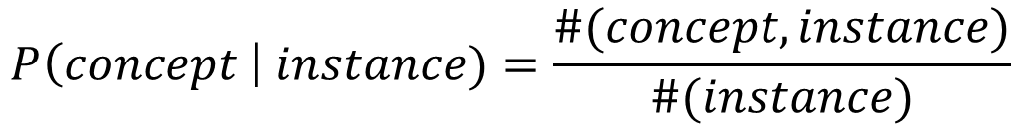
Conceptualization with
Typicality
$$P\left(concept \right| instance)=\frac{\#(concept, instance)}{\#(instance)}$$
Robin
Penguin
Data are available at https://concept.research.microsoft.com/
Wentao Wu, Hongsong Li, Haixun Wang, Kenny Qili Zhu: Probase: a probabilistic taxonomy for text understanding. SIGMOD Conference 2012: 481-492
Yangqiu Song, Haixun Wang, Zhongyuan Wang, Hongsong Li, Weizhu Chen: Short Text Conceptualization Using a Probabilistic Knowledgebase. IJCAI 2011: 2330-2336

Slide 28

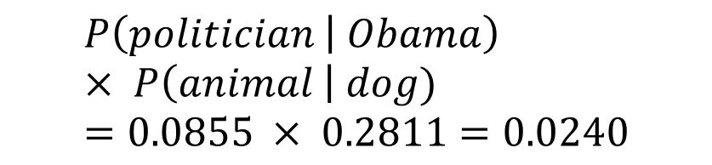
A Running Example
Obama
dog
(politician, 0.0855)
(democrat, 0.0560)
(liberal, 0.0560)
(animal, 0.2811)
(pet, 0.1377)
(domestic animal, 0.0525)
(Obama, have, dog)
$$\prod_{i=1}^{N}{P\left(C_{i, k} | E_{i}\right)}$$
(obama have animal, 0.2811)
(obama have pet, 0.1377)
(politician have dog, 0.0855)
(democrat have dog, 0.05604)
...
(politician have animal, 0.0240)
(democrat have animal, 0.01575)
...
$$P\left(politician | Obama\right) × P\left(animal \right| dog)=0.0855 × 0.2811=0.0240$$

Slide 29
(person, have, animal)
(positive-emotion, come)
……
……
ResultIn [freq=3]
0.281
0.087
He, have, a little dog
the happiness, come
……
……
ResultIn [freq=2]
0.333
0.125
I, have, my own horse
the exhilaration, come
0.222
……
You, will have, a duckling
……
P( | , ) = $0.281 × 3 ×0.087+0.333×2×0.125$
= $0.157$
ResultIn
(person, have, animal)
(positive-emotion, come)

Slide 30
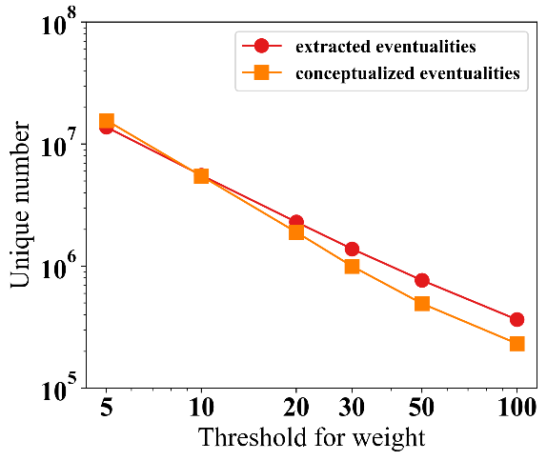
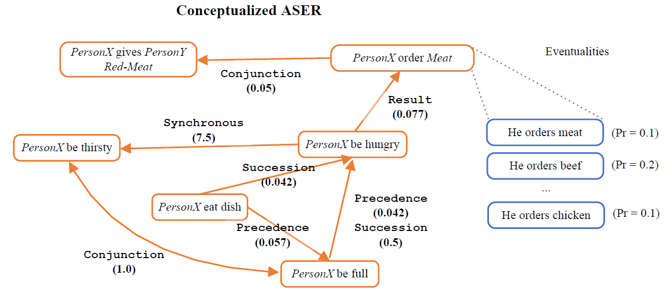
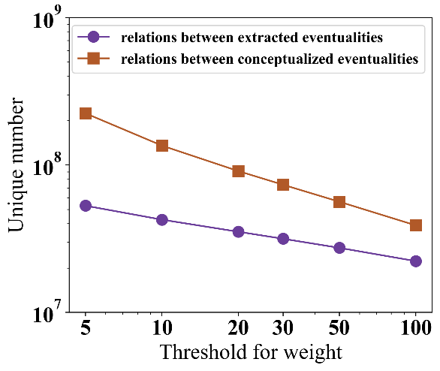
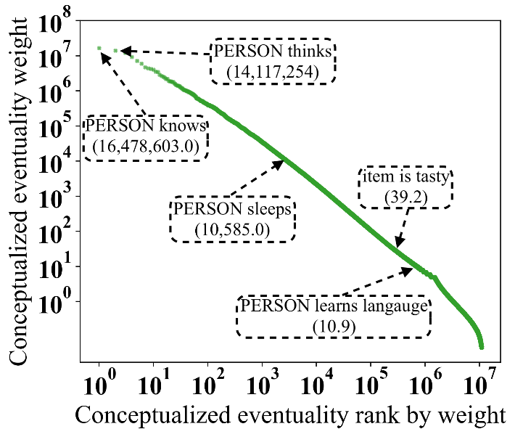
Conceptualization Results

Slide 31
ASER 2.0
1.0: Rule based extraction (14 Eventuality Patterns, Improved Version)
2.0: Discourse Parser (18 Eventuality Patterns + Wang and Lan 2015)
Conceptualization Core (threshold=5):
  Concepts: 15 millions (based on 14 millions eventualities, 1.X times)
  Concept Relations: 224 millions (based on 53 millions eventuality relations, 4.X times)
Data | #Unique Eventualities | #Unique Relations
Core | 34 millions | 15 millions
Full | 272 millions | 206 millions
Data | #Unique Eventualities | #Unique Relations
Core | 53 millions | 52 millions
Full | 439 millions | 649 millions
Jianxiang Wang and Man Lan. A Refined End-to-End Discourse Parser. CONLL Shared Task 2015.

Slide 32
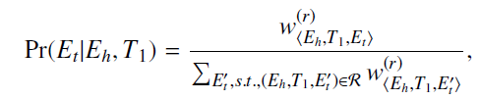
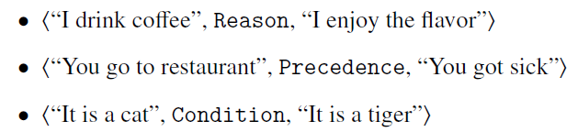
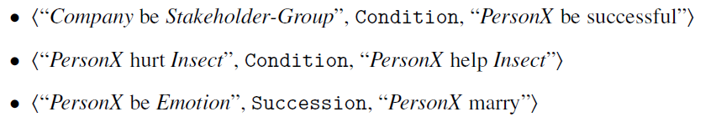
Graph Inference Examples
One hop relations
Eventualities
Concepts

Slide 33
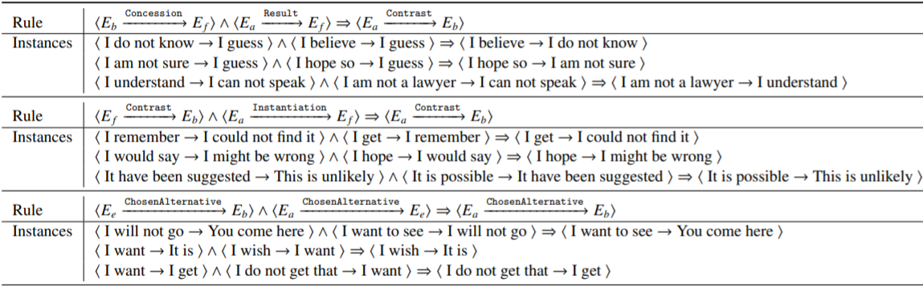
Rule Mining: Eventualities
Mine Rules using AIME+
Concession | E1, although E2
ChosenAlternative | E1, E2 instead

Slide 34
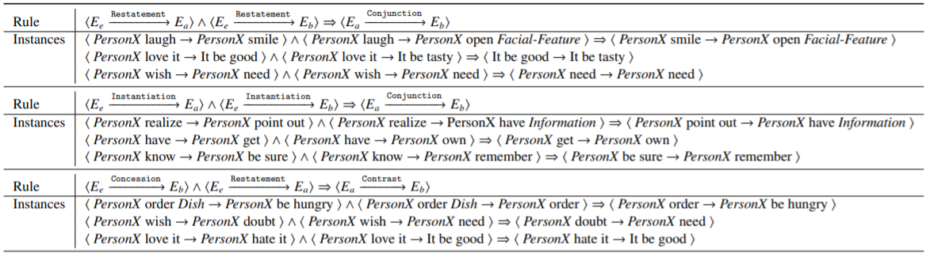
Rule Mining: Concepts
Mine Rules using AIME+
Instantiation | E1, for example E2; E1, for instance E2
Restatement | E1, in other words E2

Slide 35
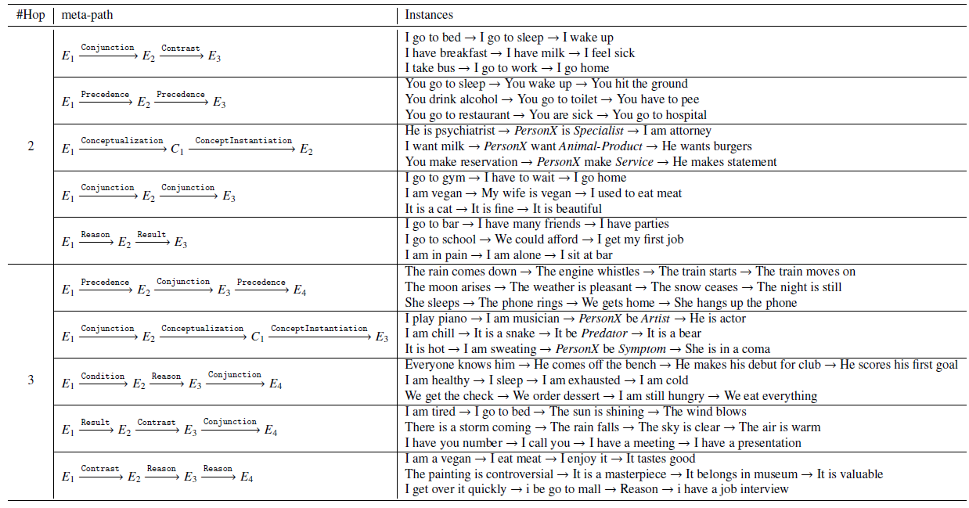
Meta-path Mining

Slide 36
Outline
Motivation: NLP and commonsense knowledge
Consideration: selectional preference
New proposal: large-scale and higher-order selectional preference
Extensions
  Transform to ConceptNet
  Transform to ATOMIC

Slide 37
ASER is Essentially a Knowledge Graph based on Linguistics
How is it transferrable from linguistic knowledge to existing definition of commonsense knowledge?
Dependency Relation
Discourse Relation

Slide 38
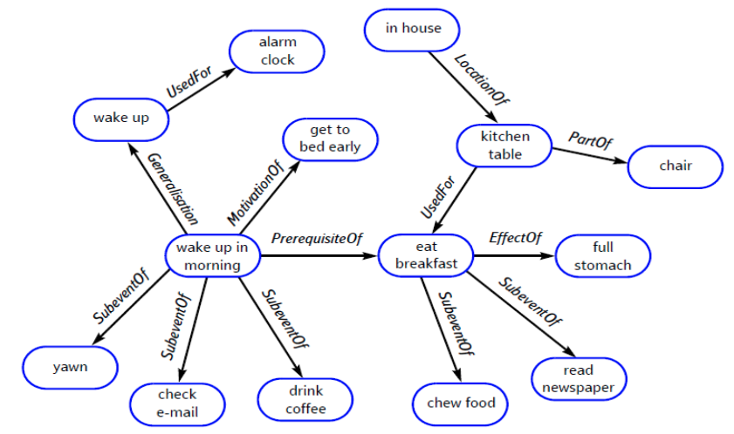
ConceptNet (Speer & Havasi, 2012)
Core is OMCS (Liu & Singh 2004)
Commonsense knowledge base
  Commonsense knowledge about noun-phrases, or entities.
Speer and Havasi. "Representing General Relational Knowledge in ConceptNet 5." LREC. 2012.

Slide 39
Revisit the Correlations of SP and OMCS
(sing, song) (dobj, 9.25)
(song, UsedFor, sing)
(phone, ring) (nsubj, 8.75)
(phone, CapableOf, ring)
(cold, water) (amod, 8.86)
(water, HasProperty, cold)
(create, new) (dobj_amod, 8.25)
(create idea, UsedFor, invent new things)
(hungry, eat) (nsubj_amod, 10.00)
(eat, MotivatedByGoal, are hungry)

Slide 40
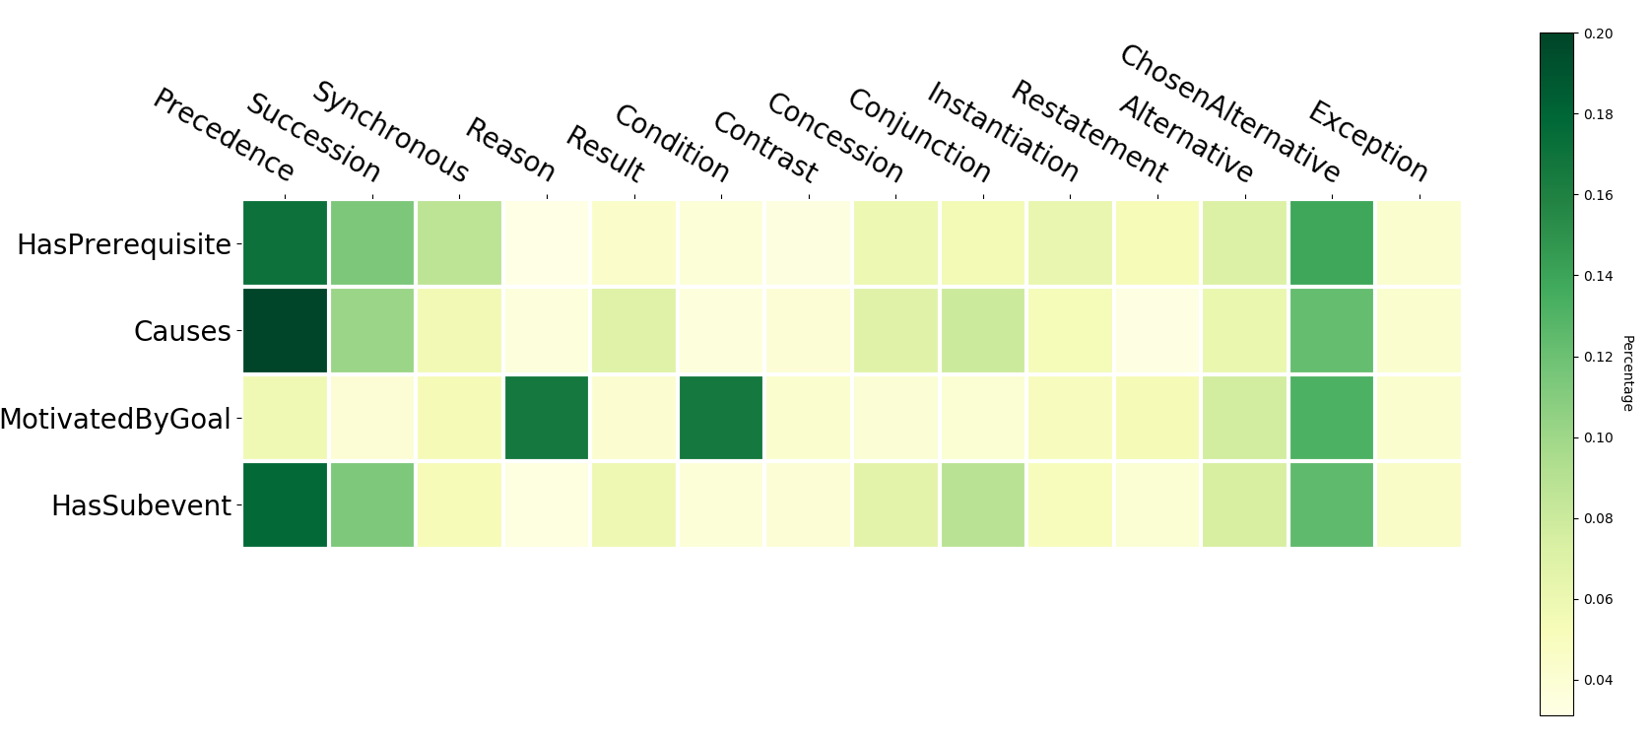
Revisit the Correlations of ASER and OMCS

Slide 41
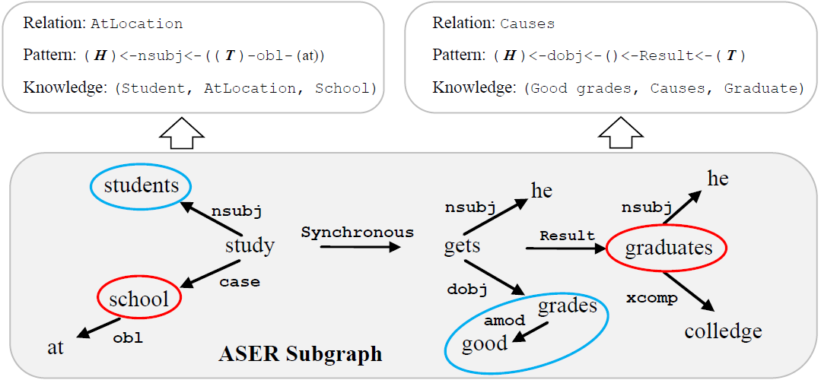
TransOMCS

Slide 42
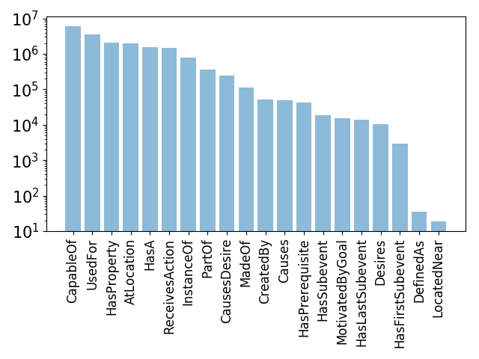
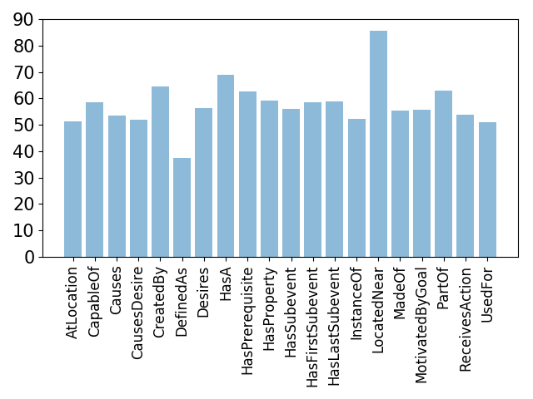
Distribution of Relations and Accuracy
~90x Larger (about 18M triplets) than OMCS, with >50% accuracy

Slide 43
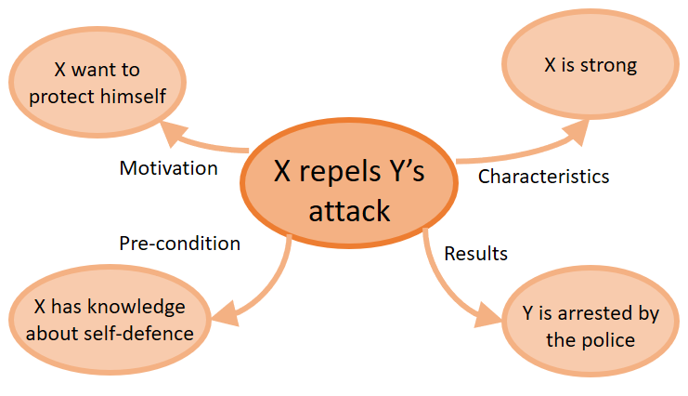
ATOMIC (Sap, Maarten, et al. 2019)
Everyday if-then commonsense knowledge
These are day-to-day knowledge that help us understand each other
  If a person X did something, human beings are able to inference:
    Motivation: Why person X did this.
    Pre-conditions: What enables X to do this.
    Characteristics: What are attributes of X.
    Result: What will affect X/others
Sap, Maarten, et al. “Atomic: An atlas of machine commonsense for if-then reasoning.”, AAAI 2019.

Slide 44
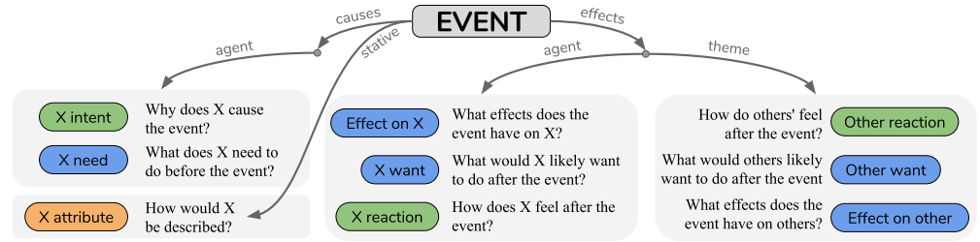
ATOMIC (Sap, Maarten, et al. 2019)
Define 4 categories of if-then relations:
  Causes-agent (Motivation & Pre-condition): xIntend, xNeed
  Stative (Characteristics): xAttr
  Effects-agent (Results on X): xWant, xReact, xEffect
  Effects-theme (Results on others): oWant, oReact, oEffect
Sap, Maarten, et al. “Atomic: An atlas of machine commonsense for if-then reasoning.”, AAAI 2019.

Slide 45
ATOMIC
Crowdsoursing 9 Types of IF-THEN relations
All personal entity information has been removed to reduce ambiguity
Arbitrary texts
Maarten Sap, Ronan LeBras, Emily Allaway, Chandra Bhagavatula, Nicholas Lourie, Hannah Rashkin, Brendan Roof, Noah A. Smith, Yejin Choi: ATOMIC: An Atlas of Machine Commonsense for If-Then Reasoning. AAAI, 2019.

Slide 46
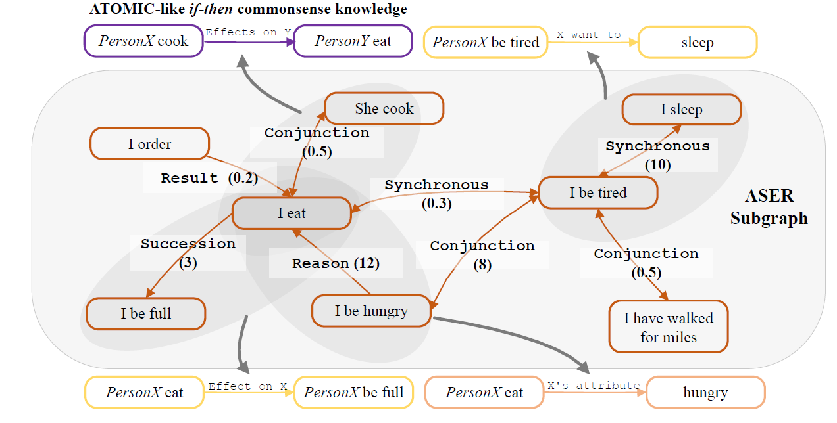
DISCOS: Transform to ATOMIC

Slide 47
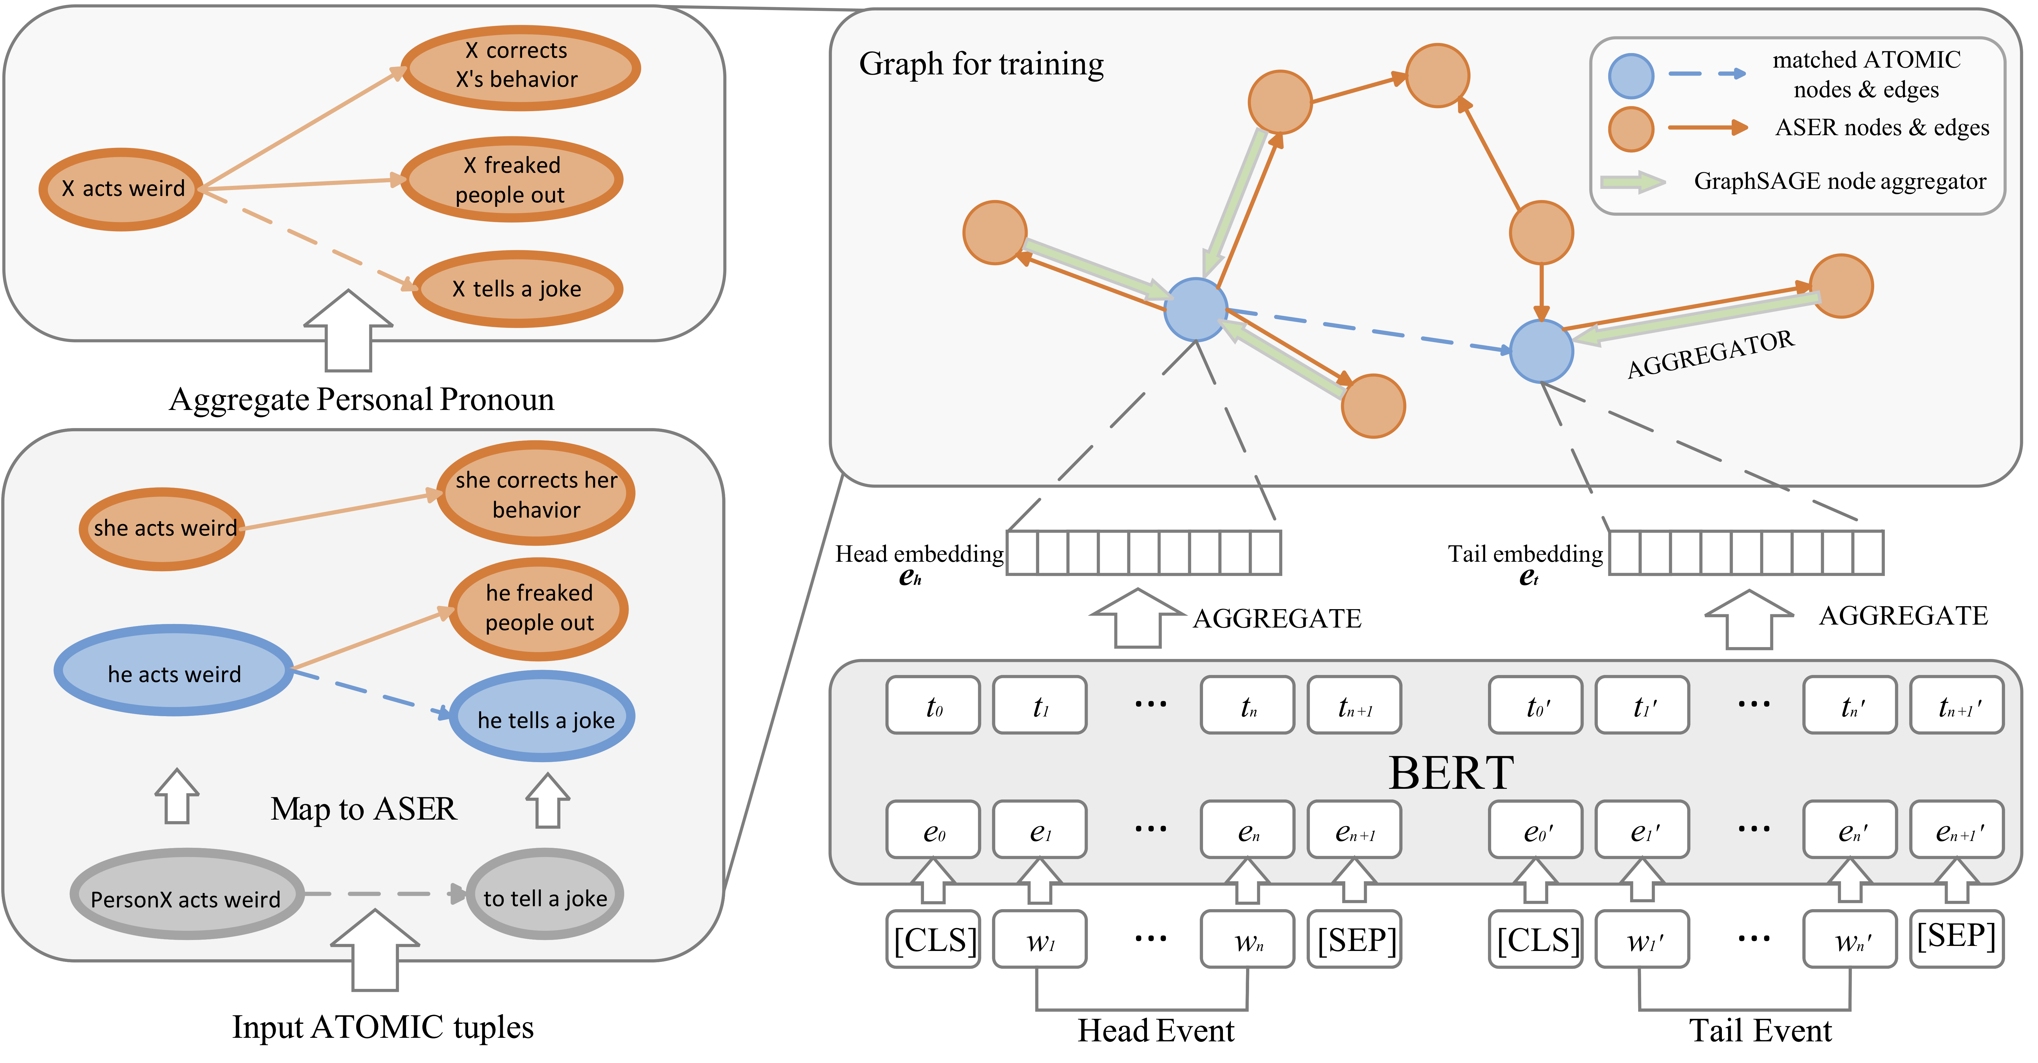
DISCOS Framework

Slide 48
DISCOS Result
Accuracy
Quality
Percentage of novel assertions
Novelty

Slide 49
Conclusions and Future Work
Thank you ☺
We extended the concept of selectional preference for commonsense knowledge acquisition
We have proven that ASER can be transferred to other commonsense knowledge graphs:
  OMCS/ConceptNet: TransOMCS (IJCAI 2020)
  ATOMIC: DISCOS (WWW 21)
We are building a commonsense knowledge population evaluation benchmark with Huawei
We plan to build neural logical reasoning framework based on ASER
Applications of ASER?
  Event detection and reasoning
  Other NLP tasks
    Legal AI
    …
Code and data
  https://github.com/HKUST-KnowComp/ASER
Project Homepage
  https://hkust-knowcomp.github.io/ASER/

Slide 50
Extraction Results
Extract examples from 11-billion tokens from Yelp, NYT, Wiki, Reddit, Subtitles, E-books
Evaluate about 200 examples in each pattern using Amazon Turk

Slide 51
Extraction Results
Left: number of relations and overall accuracy
Right: accuracy of each relations for the last iteration
Each point is annotated with 200 examples by Amazon Turk

