Slide 1
COMP5222 Advanced Machine Learning with Graphs
Querying the Knowledge Graphs 1
Instructor: Yangqiu Song
Slides credits: Zihao Wang

Slide 2
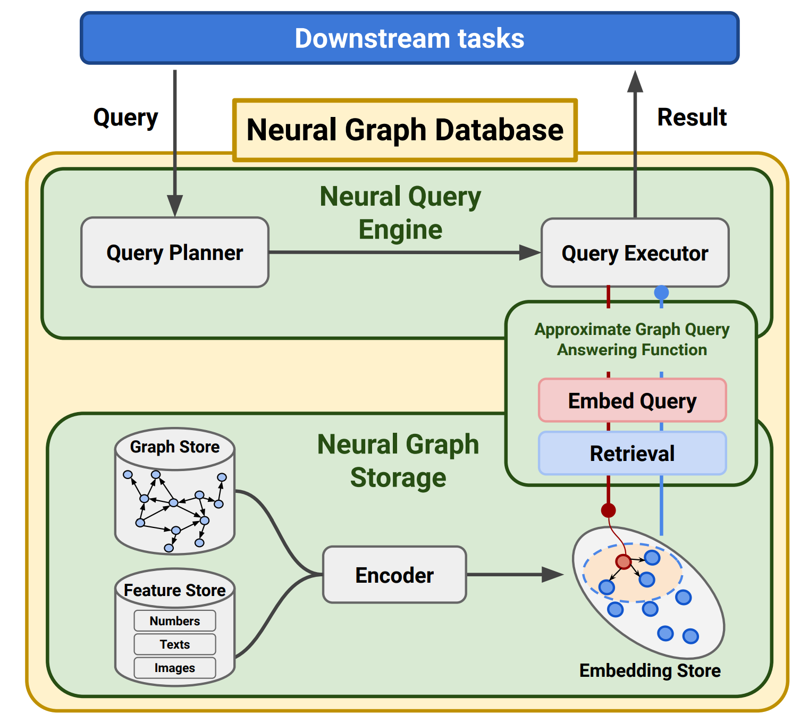
Neural Graph Databases
Figure credit: Neural Graph Reasoning: Complex Logical Query Answering Meets Graph Databases Hongyu Ren*, Mikhail Galkin*, Michael Cochez, Zhaocheng Zhu, Jure Leskovec
https://arxiv.org/abs/2303.14617

Slide 3
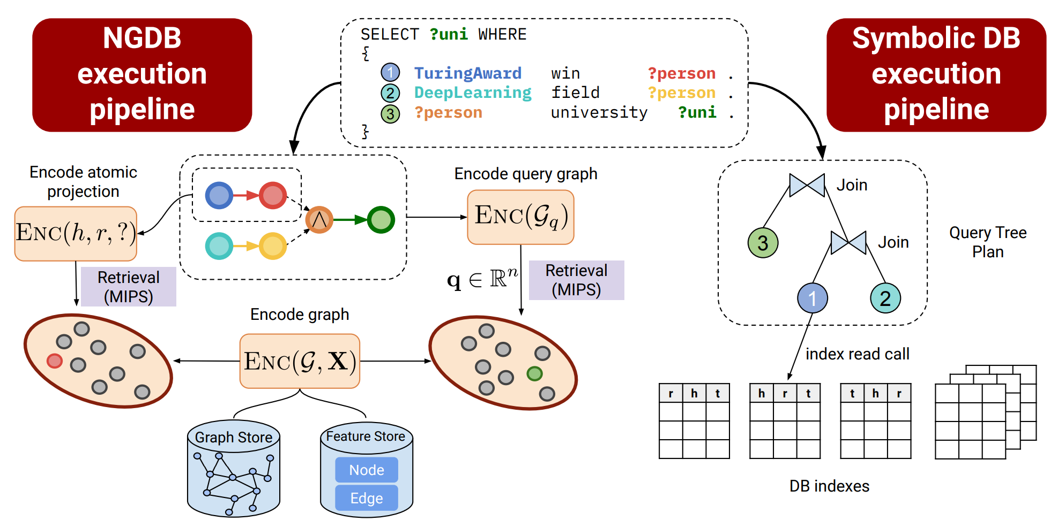
Neural Graph Databases
Figure credit: Neural Graph Reasoning: Complex Logical Query Answering Meets Graph Databases Hongyu Ren*, Mikhail Galkin*, Michael Cochez, Zhaocheng Zhu, Jure Leskovec
https://arxiv.org/abs/2303.14617

Slide 4
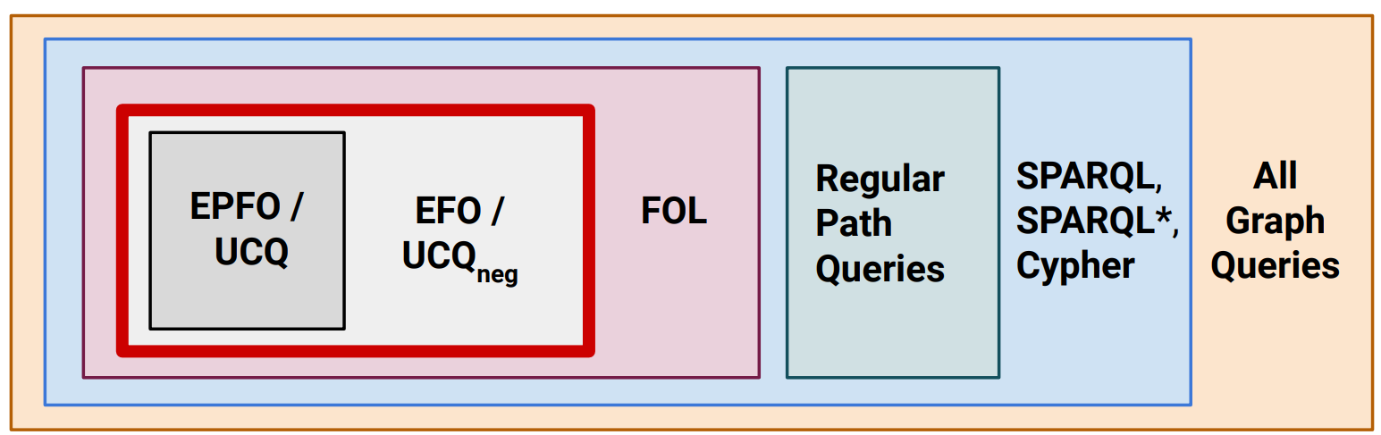
Neural Graph Databases
Figure credit: Neural Graph Reasoning: Complex Logical Query Answering Meets Graph Databases Hongyu Ren*, Mikhail Galkin*, Michael Cochez, Zhaocheng Zhu, Jure Leskovec
https://arxiv.org/abs/2303.14617

Slide 5
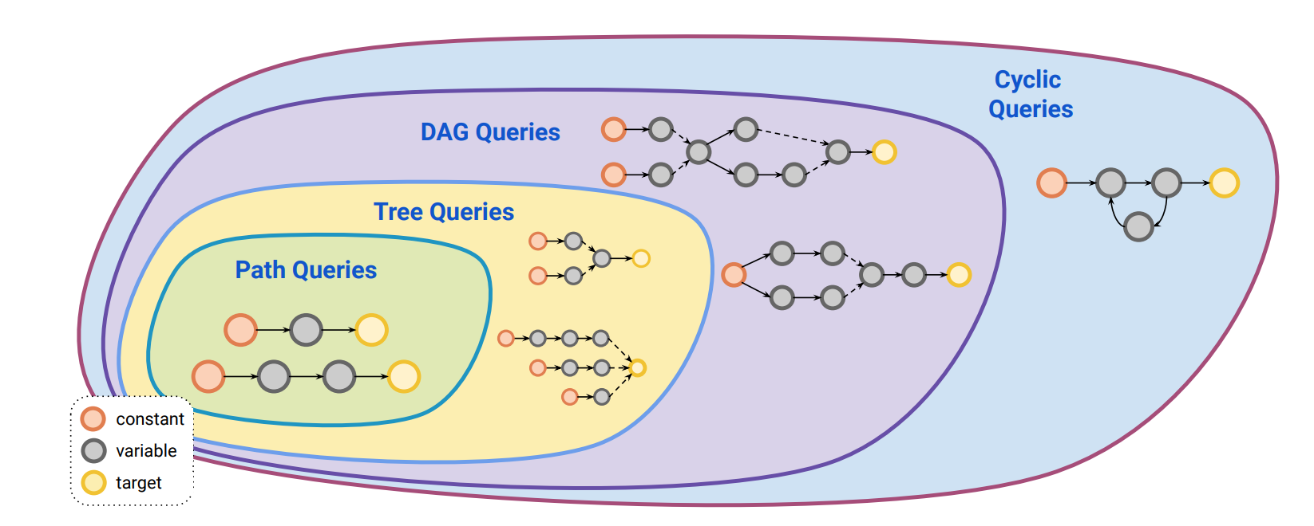
Neural Graph Databases
Figure credit: Neural Graph Reasoning: Complex Logical Query Answering Meets Graph Databases Hongyu Ren*, Mikhail Galkin*, Michael Cochez, Zhaocheng Zhu, Jure Leskovec
https://arxiv.org/abs/2303.14617

Slide 6
Table of content
First lecture:
Background
Problem definition and general strategy
Solutions for TFQs
Second lecture:
EFO queries and neural-symbolic solutions
Queries with rich semantics

Slide 7
1. Background
1.1 Logical query examples
1.2 Motivations and challenges for neuro-symbolic approach

Slide 8





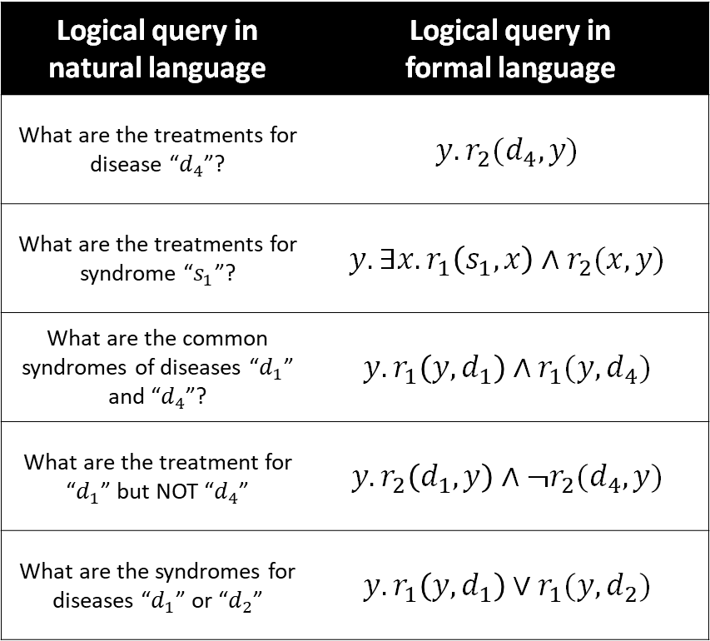









Background: Logical query examples
Logical query in natural language | Logical query in formal language
What are the treatments for disease “$d_{4}$”? | $$y.r_{2}(d_{4},y)$$
What are the treatments for syndrome “$s_{1}$”? | $$y.∃x.r_{1}\left(s_{1},x\right)∧r_{2}(x,y)$$
What are the common syndromes of diseases “$d_{1}$” and “$d_{4}$”? | $$y. r_{1}\left(y,d_{1}\right)∧r_{1}(y,d_{4})$$
What are the treatment for “$d_{1}$” but NOT “$d_{4}$” | $$y. r_{2}\left(d_{1},y\right)∧¬r_{2}(d_{4},y)$$
What are the syndromes for diseases “$d_{1}$” or “$d_{2}$” | $$y. r_{1}\left(y,d_{1}\right)∨r_{1}(y,d_{2})$$
Syndrome
Disease
Treatment
$$s_{1}$$
$$r_{1}$$
$$d_{1}$$
$$t_{1}$$
$$r_{2}$$
$$s_{2}$$
$$d_{2}$$
$$t_{2}$$
$$s_{3}$$
$$d_{3}$$
$$t_{3}$$
$$s_{4}$$
$$d_{4}$$
$$t_{4}$$
A simplified medical KG.
A more recent and complex one:
https://www.nature.com/articles/s41597-023-01960-3

Slide 9


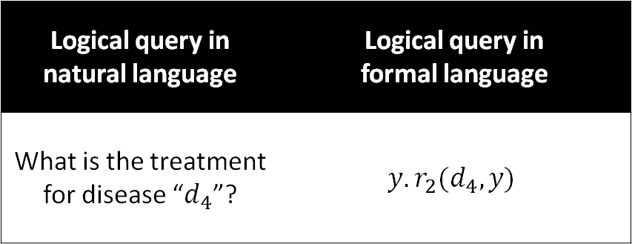
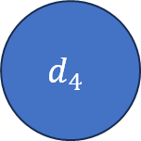

Background: Logical query examples
Logical query in natural language | Logical query in formal language
What is the treatment for disease “$d_{4}$”? | $$y.r_{2}(d_{4},y)$$
Syndrome
Disease
Treatment
$$s_{1}$$
$$r_{1}$$
$$d_{1}$$
$$t_{1}$$
$$r_{2}$$
$$s_{2}$$
$$d_{2}$$
$$t_{2}$$
A query graph representation of
One-hop query / Link prediction
$$s_{3}$$
$$d_{3}$$
$$t_{3}$$
$$d_{4}$$
$$r_{2}$$
$$y$$
$$s_{4}$$
$$d_{4}$$
$$t_{4}$$
Nodes in a query graph: entities and variables
Edges in a query graph: the logical predicate (with negation)
Traversal on the knowledge graph

Slide 10

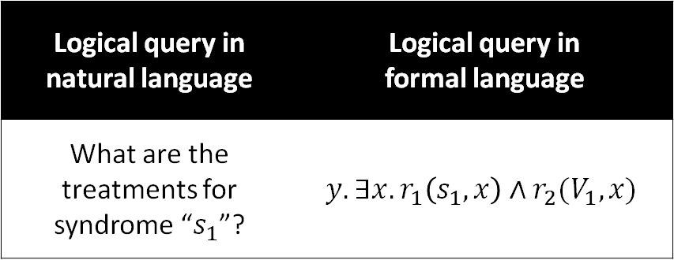

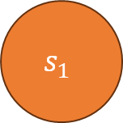
Background: Logical query examples
Logical query in natural language | Logical query in formal language
What are the treatments for syndrome “$s_{1}$”? | $$y.∃x.r_{1}\left(s_{1},x\right)∧r_{2}(V_{1},x)$$
Syndrome
Disease
Treatment
$$s_{1}$$
$$r_{1}$$
$$d_{1}$$
$$t_{1}$$
$$r_{2}$$
$$s_{2}$$
$$d_{2}$$
$$t_{2}$$
A query graph representation for
multi-hop query / path query
Missing edge
$$s_{3}$$
$$d_{3}$$
$$t_{3}$$
$$s_{1}$$
$$r_{1}$$
$$x$$
$$r_{2}$$
$$y$$
$$s_{4}$$
$$d_{4}$$
$$t_{4}$$
Nodes in a query graph: entities and variables
Edges in a query graph: the logical predicate (with negation)
Traversal on the knowledge graph

Slide 11

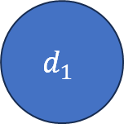
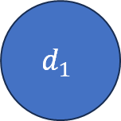


Background: Logical query examples
Logical query in natural language | Logical query in formal language
What is the common syndrome of diseases “$d_{1}$” and “$d_{4}$”? | $$y. r_{1}\left(y,d_{1}\right)∧r_{1}(y,d_{4})$$
Syndrome
Disease
Treatment
$$s_{1}$$
$$r_{1}$$
$$d_{1}$$
$$t_{1}$$
$$r_{2}$$
$$s_{2}$$
$$d_{2}$$
$$t_{2}$$
A query graph representation for
multi-constraint query
$$s_{3}$$
$$d_{3}$$
$$t_{3}$$
$$d_{1}$$
$$r_{1}$$
$$y$$
$$r_{1}$$
$$d_{1}$$
$$s_{4}$$
$$d_{4}$$
$$t_{4}$$
Nodes in a query graph: entities and variables
Edges in a query graph: the logical predicate (with negation)
Traversal on the knowledge graph

Slide 12

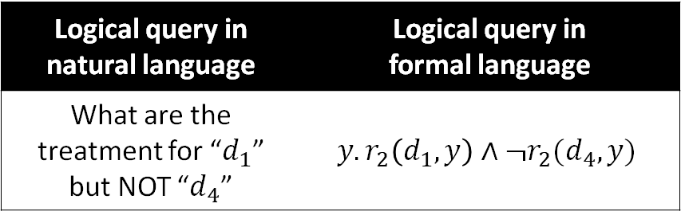

Background: Logical query examples
Logical query in natural language | Logical query in formal language
What are the treatment for “$d_{1}$” but NOT “$d_{4}$” | $$y. r_{2}\left(d_{1},y\right)∧¬r_{2}(d_{4},y)$$
Syndrome
Disease
Treatment
$$s_{1}$$
$$r_{1}$$
$$d_{1}$$
$$t_{1}$$
$$r_{2}$$
$$s_{2}$$
$$d_{2}$$
$$t_{2}$$
A query graph representation for
multi-constraint + logical negation query
$$s_{3}$$
$$d_{3}$$
$$t_{3}$$
$$d_{1}$$
$$r_{2}$$
$$y$$
$${¬r}_{2}$$
$$d_{4}$$
$$s_{4}$$
$$d_{4}$$
$$t_{4}$$
Nodes in a query graph: entities and variables
Edges in a query graph: the logical predicate (with negation)
Traversal on the knowledge graph

Slide 13
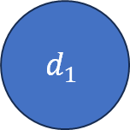
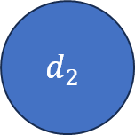
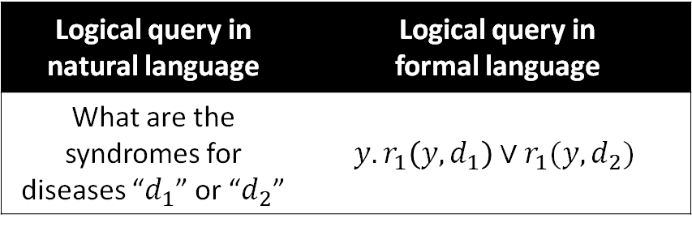


Background: Logical query examples
Logical query in natural language | Logical query in formal language
What are the syndromes for diseases “$d_{1}$” or “$d_{2}$” | $$y. r_{1}\left(y,d_{1}\right)∨r_{1}(y,d_{2})$$
Syndrome
Disease
Treatment
$$s_{1}$$
$$r_{1}$$
$$d_{1}$$
$$t_{1}$$
$$r_{2}$$
$$s_{2}$$
$$d_{2}$$
$$t_{2}$$
A query graph representation for
multi-constraint disjunctive query
$$s_{3}$$
$$d_{3}$$
$$t_{3}$$
$$d_{1}$$
$$r_{1}$$
$$y$$
$$y$$
$$r_{1}$$
$$d_{2}$$
$$s_{4}$$
$$d_{4}$$
$$t_{4}$$
Nodes in a query graph: entities and variables
Edges in a query graph: the logical predicate (with negation)
Simple graph CANNOT represent the disjunction operation. Two components for two parts
Traversal on the knowledge graph

Slide 14
Background: Summary
Questions for rigorous research:
How to define the semantics and syntax?
How to represent and answer a query?
Challenge for knowledge graph in general:
The graph is incomplete, traversal will fail!

Slide 15
Background: Summary
Semantics of queries
  Highly interpretable with logical conditions,
  Related to complex demands of knowledge.
Syntax of queries
  variables and entities,
  logical connectives:
    Conjunction
    Disjunction
    Negation
Representation
  A query graph
In the previous examples, the answers are identified by
  Symbolic traversal on the knowledge graph

Slide 16
2. Problem definition and general strategies
2.1 Notations and definitions
2.2 Two general strategies

Slide 17
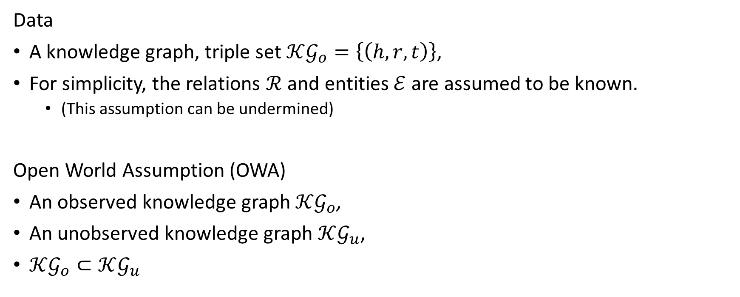
Problem definition and general strategies
Notations
Data
A knowledge graph, triple set $𝒦𝒢_{o}=\left\{\left(h,r,t\right)\right\}$,
For simplicity, the relations $ℛ$ and entities $ℰ$ are assumed to be known.
  (This assumption can be undermined)
Open World Assumption (OWA)
An observed knowledge graph $𝒦𝒢_{o}$,
An unobserved knowledge graph $𝒦𝒢_{u}$,
$𝒦𝒢_{o}⊂𝒦𝒢_{u}$

Slide 18
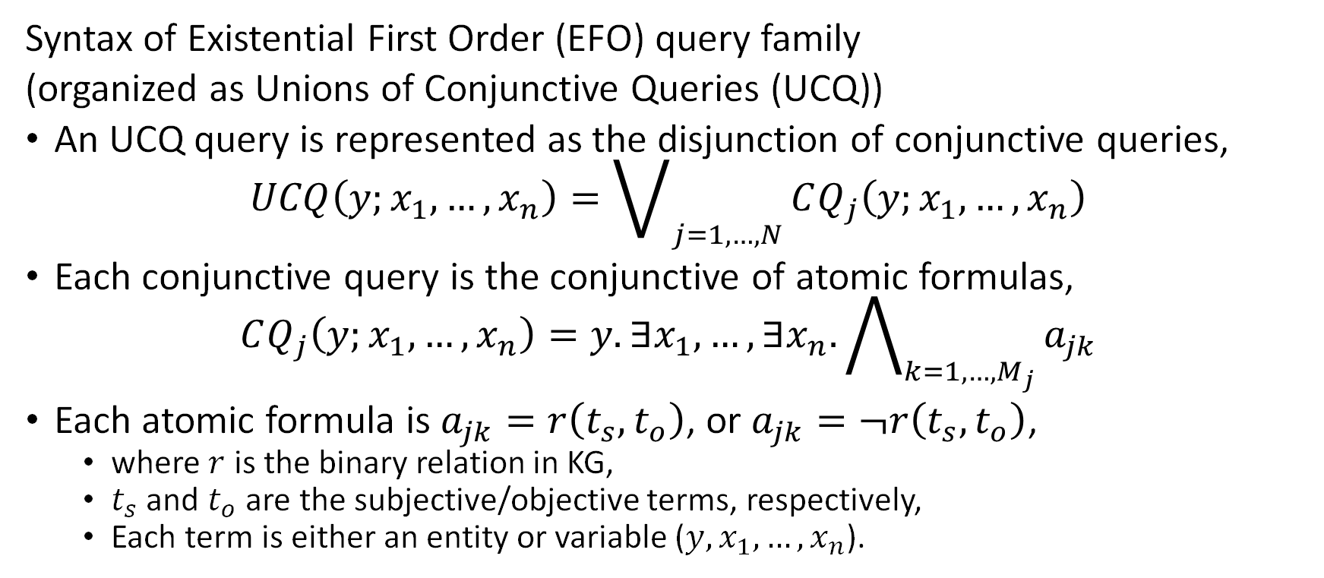
Problem definition and general strategies
Query syntax
Syntax of Existential First Order (EFO) query family
(organized as Unions of Conjunctive Queries (UCQ))
An UCQ query is represented as the disjunction of conjunctive queries,
$$UCQ\left(y;x_{1},…,x_{n}\right)=\bigvee_{j=1,…,N}{CQ_{j}\left(y;x_{1},…,x_{n}\right)}$$
Each conjunctive query is the conjunctive of atomic formulas,
$$CQ_{j}\left(y;x_{1},…,x_{n}\right)=y.∃x_{1},…,∃x_{n}.\bigwedge_{k=1, …,M_{j}}{a_{jk}}$$
Each atomic formula is $a_{jk}=r\left(t_{s},t_{o}\right)$, or $a_{jk}=¬r\left(t_{s},t_{o}\right)$,
  where $r$ is the binary relation in KG,
  $t_{s}$ and $t_{o}$ are the subjective/objective terms, respectively,
  Each term is either an entity or variable ($y,x_{1},…,x_{n}$).

Slide 19
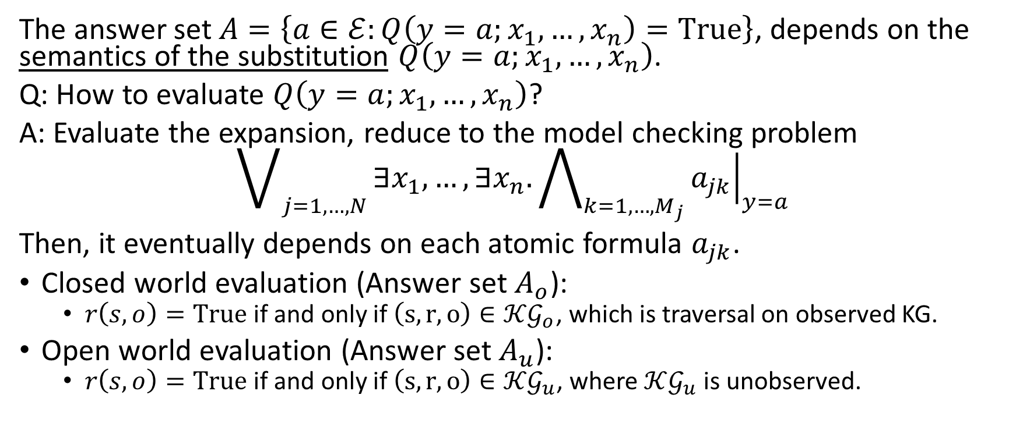
Problem definition and general strategies
Query semantics
The answer set $A=\left\{a∈ℰ:Q\left(y=a;x_{1},…,x_{n}\right)=True\right\}$, depends on the semantics of the substitution $Q\left(y=a;x_{1},…,x_{n}\right)$.
Q: How to evaluate $Q\left(y=a;x_{1},…,x_{n}\right)$?
A: Evaluate the expansion, reduce to the model checking problem
$$\bigvee_{j=1,…,N}{∃x_{1},…,∃x_{n}.\bigwedge_{k=1, …,M_{j}}{{\left.a_{jk}\right|}_{y=a}}}$$
Then, it eventually depends on each atomic formula $a_{jk}$.
Closed world evaluation (Answer set $A_{o}$):
  $r\left(s,o\right)=True$ if and only if $\left(s,r,o\right)∈𝒦𝒢_{o}$, which is traversal on observed KG.
Open world evaluation (Answer set $A_{u}$):
  $r\left(s,o\right)=True$ if and only if $\left(s,r,o\right)∈𝒦𝒢_{u}$, where $𝒦𝒢_{u}$ is unobserved.

Slide 20


Problem definition and general strategies
The challenge of the open world problem
Unobserved KG
$$A_{u}$$
?
How to break the
data incompleteness
Query
Observed KG
Graph Traversal
$$A_{o}$$

Slide 21
Problem definition and general strategies
Symbolic strategy: completion and search
Unobserved KG
Graph Traversal
$$A_{u}$$
KG Completion
Query
Observed KG
Graph Traversal
$$A_{o}$$

Slide 22
Problem definition and general strategies
Neural strategy: end-to-end training
Unobserved KG
$$A_{u}$$
Inference
Query
Neural Models
Training
Observed KG
Graph Traversal
$$A_{o}$$

Slide 23
3. Tree-Formed Queries (TFQ)
Reduction to computational graphs
The design space of neural models for TFQ

Slide 24







Tree-Formed Queries (TFQ)
We can interpretate logical queries in natural language
How can we compute logical queries?
  In general the symbolic methods are NP-complete.
What are simpler query families to handle?
  Convert the query answering process as set operations.
  Result in a computational tree.
$$V_{2}$$
$$r_{1}$$
$$r_{2}$$
$$V_{1}$$
$$V_{?}$$
$$s_{1}$$
$$r_{1}$$
$$V_{1}$$
$$r_{2}$$
$$V_{?}$$
$$V_{3}$$
$$r_{1}$$
$$r_{2}$$
A simple query graph
A complex query graph

Slide 25




Tree-Formed Queries (TFQ)
We begin with a working example
Tree-form query family contains the queries
that can be converted into the computational tree.
What is a computational tree? A working example
Natural Language: Find non-American directors whose movie won Golden Globes or Oscar?
Logical Formula: $q=V_{?}∃ V_{1}.(Won\left(V_{1},GoldenGlobes\right)∨Won(V_{1},Oscar))∧¬BornIn\left(V_{?},America\right)∧Direct(V_{?},V_{1})$
Set Operator Tree: $DirectorOf(WinnerOf\left(GoldenGlobes\right)∪WinnerOf\left(Oscar\right))∩BornIn{\left(America\right)}^{C}$
Set Operators
P
DirectorOf
set operations
GoldenGlobes
$$∪$$
set union
WinnerOf
$$∪$$
P
$$∩$$
set intersection
P
Oscar
Answer Set
$$C$$
set complement
BornIn
America
P
$$C$$
$$∩$$
P
set projection

Slide 26
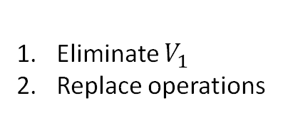
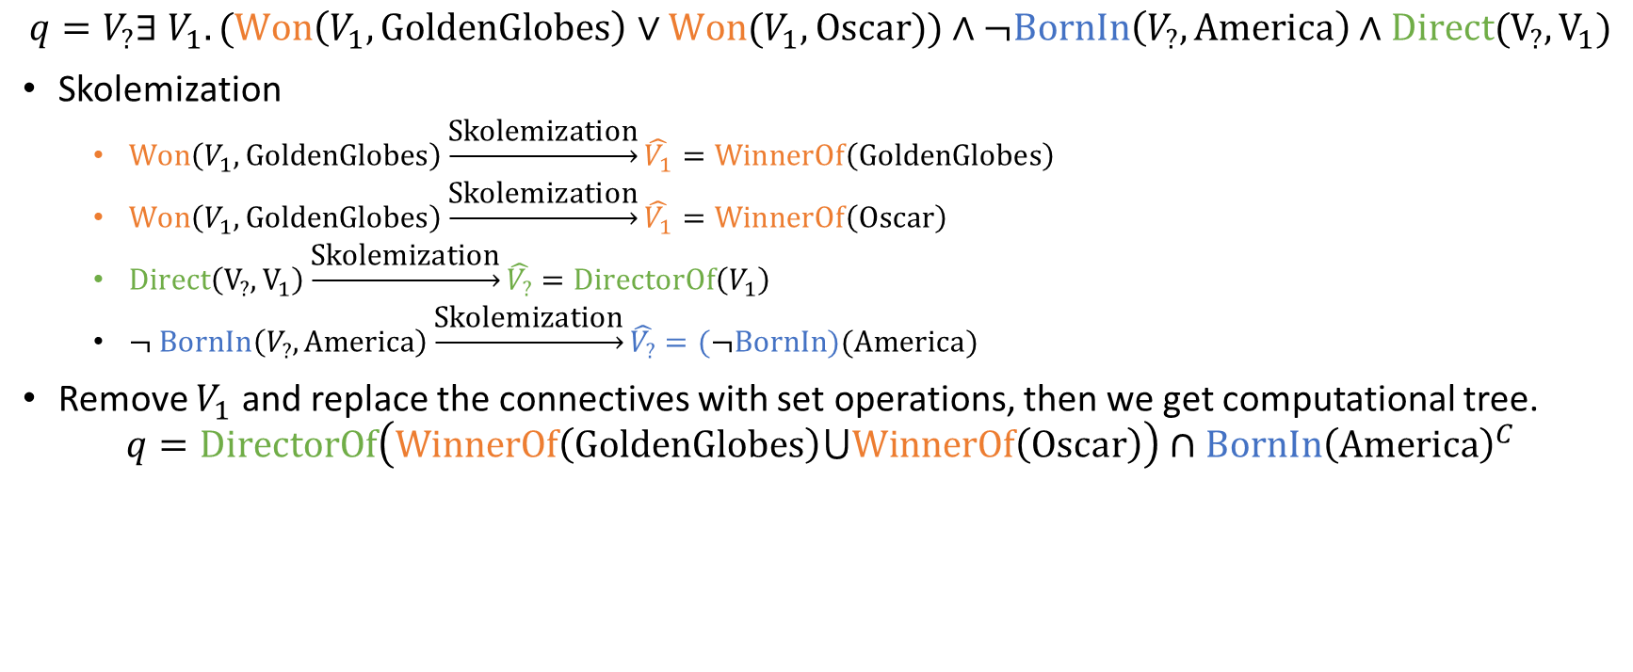
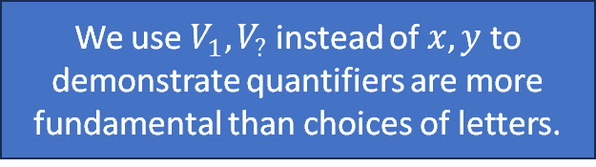

Tree-Formed Queries (TFQ)
A working example (1/4)
We use $V_{1},V_{?}$ instead of $x,y$ to demonstrate quantifiers are more fundamental than choices of letters.
$$q=V_{?}∃ V_{1}.(Won\left(V_{1},GoldenGlobes\right)∨Won(V_{1},Oscar))∧¬BornIn\left(V_{?},America\right)∧Direct(V_{?},V_{1})$$
Skolemization
  $Won\left(V_{1},GoldenGlobes\right)\underset{→}{\text{Skolemization}}\hat{V_{1}}=WinnerOf\left(GoldenGlobes\right)$
  $Won\left(V_{1},GoldenGlobes\right)\underset{→}{\text{Skolemization}}\hat{V_{1}}=WinnerOf\left(Oscar\right)$
  $Direct\left(V_{?},V_{1}\right)\underset{→}{\text{Skolemization}}\hat{V_{?}}=DirectorOf\left(V_{1}\right)$
  $¬ BornIn\left(V_{?},America\right)\underset{→}{\text{Skolemization}}\hat{V_{?}}=(¬BornIn)(America)$
Remove $V_{1}$ and replace the connectives with set operations, then we get computational tree.
$$q=DirectorOf\left(WinnerOf\left(GoldenGlobes\right)⋃WinnerOf\left(Oscar\right)\right)∩BornIn{\left(America\right)}^{C}$$
Skolemization:
One way to eliminate the quantified variables
GoldenGlobes
P
WinnerOf
$$∪$$
P
DirectorOf
Eliminate $V_{1}$
Replace operations
Oscar
P
BornIn
Answer Set
America
P
$$C$$
$$∩$$

Slide 27
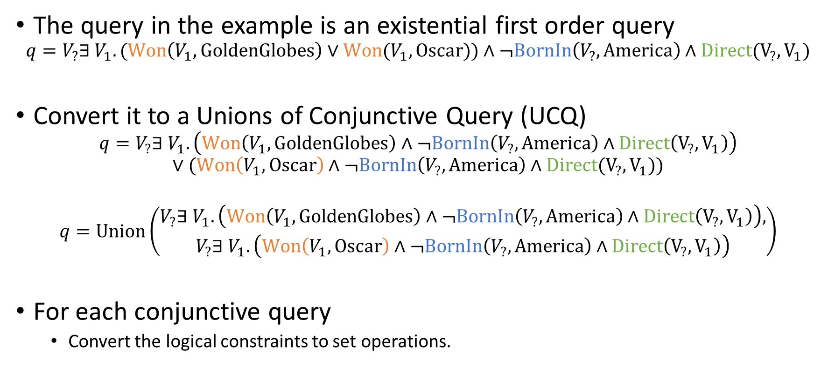
Tree-Formed Queries (TFQ)
A working example (2/4)
The query in the example is an existential first order query
$$q=V_{?}∃ V_{1}.(Won\left(V_{1},GoldenGlobes\right)∨Won(V_{1},Oscar))∧¬BornIn\left(V_{?},America\right)∧Direct(V_{?},V_{1})$$
Convert it to a Unions of Conjunctive Query (UCQ)
$$q=V_{?}∃ V_{1}.\left(Won\left(V_{1},GoldenGlobes\right)∧¬BornIn\left(V_{?},America\right)∧Direct\left(V_{?},V_{1}\right)\right)$$
$$∨(Won\left(V_{1},Oscar\right)∧¬BornIn\left(V_{?},America\right)∧Direct(V_{?},V_{1}))$$
$$q=Union\left(\begin{aligned}V_{?}∃ V_{1}.\left(Won\left(V_{1},GoldenGlobes\right)∧¬BornIn\left(V_{?},America\right)∧Direct\left(V_{?},V_{1}\right)\right), \\ V_{?}∃ V_{1}.\left(Won\left(V_{1},Oscar\right)∧¬BornIn\left(V_{?},America\right)∧Direct\left(V_{?},V_{1}\right)\right)\end{aligned}\right)$$
For each conjunctive query
  Convert the logical constraints to set operations.

Slide 28
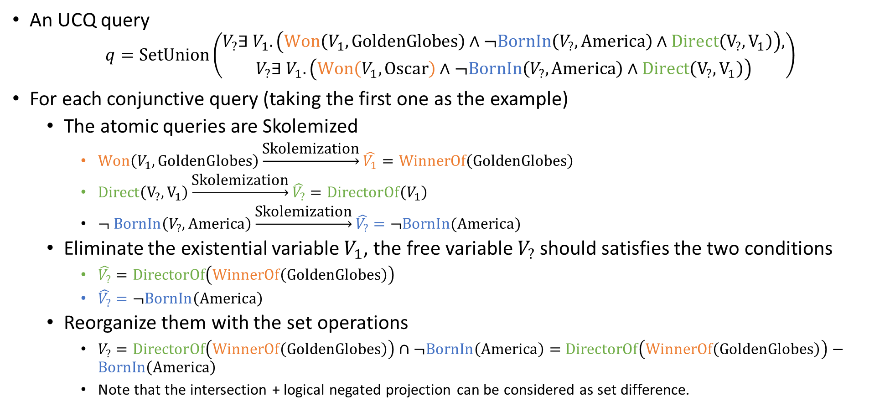
Solutions for TFQs
A working example (3/4)
An UCQ query
$$q=SetUnion\left(\begin{aligned}V_{?}∃ V_{1}.\left(Won\left(V_{1},GoldenGlobes\right)∧¬BornIn\left(V_{?},America\right)∧Direct\left(V_{?},V_{1}\right)\right), \\ V_{?}∃ V_{1}.\left(Won\left(V_{1},Oscar\right)∧¬BornIn\left(V_{?},America\right)∧Direct\left(V_{?},V_{1}\right)\right)\end{aligned}\right)$$
For each conjunctive query (taking the first one as the example)
  The atomic queries are Skolemized
    $Won\left(V_{1},GoldenGlobes\right)\underset{→}{\text{Skolemization}}\hat{V_{1}}=WinnerOf\left(GoldenGlobes\right)$
    $Direct\left(V_{?},V_{1}\right)\underset{→}{\text{Skolemization}}\hat{V_{?}}=DirectorOf\left(V_{1}\right)$
    $¬ BornIn\left(V_{?},America\right)\underset{→}{\text{Skolemization}}\hat{V_{?}}=¬BornIn(America)$
  Eliminate the existential variable $V_{1}$, the free variable $V_{?}$ should satisfies the two conditions
    $\hat{V_{?}}=DirectorOf\left(WinnerOf\left(GoldenGlobes\right)\right)$
    $\hat{V_{?}}=¬BornIn\left(America\right)$
  Reorganize them with the set operations
    $V_{?}=DirectorOf\left(WinnerOf\left(GoldenGlobes\right)\right)∩¬BornIn\left(America\right)=$ $DirectorOf\left(WinnerOf\left(GoldenGlobes\right)\right)−BornIn\left(America\right)$
    Note that the intersection + logical negated projection can be considered as set difference.

Slide 29





Solutions for TFQs
A working example (4/4)
For the first conjunctive query
$$V_{?}=DirectorOf\left(WinnerOf\left(GoldenGlobes\right)\right)−BornIn\left(America\right)$$
Similarly for the other conjunctive query
$$V_{?}=DirectorOf\left(WinnerOf\left(Oscar\right)\right)−BornIn\left(America\right)$$
Then the computational tree
WinnerOf
DirectorOf
Oscar
P
P
Answer Set
BornIn
$$∩$$
America
P
$$C$$
$$∪$$
$$∩$$
GoldenGlobes
P
P
WinnerOf
DirectorOf

Slide 30
Quick Summarization
What is a computational tree of a TFQ?
  A tree whose leaves are entities, intermediate nodes are set operators, and the root node is the answer set.
  The answer set can be computed by executing set operations following the bottom-up order.
One query can be represented with multiple equivalent computational trees
  For a logical query, there are many logical equivalent forms
  Each logical form yields one or more computational trees
Operators in trees can be different
  Intersection & complement = intersection & difference
  For UCQs, no need for “union” because we can collect answers from each CQ
Can UCQs always be converted to TFQs?
  It will be discussed in the next lecture

Slide 31
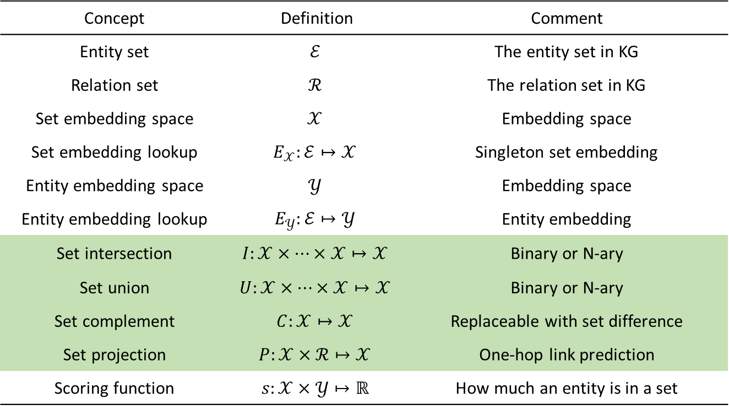
Solutions for TFQs
The design space of neural TFQ answering
Concept | Definition | Comment
Entity set | $$ℰ$$ | The entity set in KG
Relation set | $$ℛ$$ | The relation set in KG
Set embedding space | $$𝒳$$ | Embedding space
Set embedding lookup | $$E_{𝒳}:ℰ↦𝒳$$ | Singleton set embedding
Entity embedding space | $$𝒴$$ | Embedding space
Entity embedding lookup | $$E_{𝒴}:ℰ↦𝒴$$ | Entity embedding
Set intersection | $$I:𝒳×…×𝒳↦𝒳$$ | Binary or N-ary
Set union | $$U:𝒳×…×𝒳↦𝒳$$ | Binary or N-ary
Set complement | $$C:𝒳↦𝒳$$ | Replaceable with set difference
Set projection | $$P:𝒳×ℛ↦𝒳$$ | One-hop link prediction
Scoring function | $$s:𝒳×𝒴↦ℝ$$ | How much an entity is in a set
Converting to computational tree
makes it possible to model
set operations with neural
networks
Set Operators
$$∪$$
set union
set operations
$$∩$$
set intersection
$$C$$
set complement
P
set projection
Wang, Z., Yin, H., & Song, Y. (2021). Benchmarking the combinatorial generalizability of complex query answering on knowledge graphs. arXiv preprint arXiv:2109.08925.

Slide 32



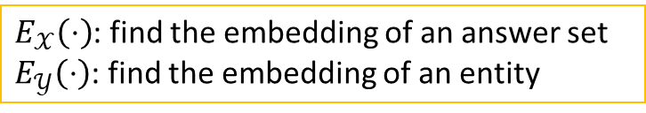







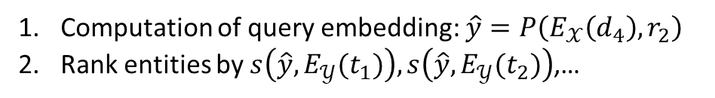


Solutions for TFQs
Neural TFQ intuition explained
Syndrome
Disease
Treatment
$$s_{1}$$
$$r_{1}$$
$$d_{1}$$
$$t_{1}$$
$$r_{2}$$
$$s_{2}$$
$$d_{2}$$
$$t_{2}$$
Logical query in natural language | Logical query in formal language
What is the treatment for disease “$d_{4}$”? | $$y.r_{2}(d_{4},y)$$
$$s_{3}$$
$$d_{3}$$
$$t_{3}$$
One-hop Set Projection
$$s_{4}$$
$$d_{4}$$
$$t_{4}$$
$$d_{4}$$
$$r_{2}$$
$$y$$
Traversal on the knowledge graph
The computational DAG
$$d_{4}$$
$$E_{𝒳}\left(d_{4}\right)$$
$$P\left( _,r_{2}\right)$$
$${E_{𝒴}(t}_{k})$$
$$t_{k}$$
Computation of query embedding: $\hat{y}=P\left(E_{𝒳}\left(d_{4}\right),r_{2}\right)$
Rank entities by $s\left(\hat{y},{E_{𝒴}(t}_{1})\right),s\left(\hat{y},{E_{𝒴}(t}_{2})\right)$,…
$E_{𝒳}\left(⋅\right)$: find the embedding of an answer set
$E_{𝒴}\left(⋅\right)$: find the embedding of an entity
Neural projection in embedding space

Slide 33

















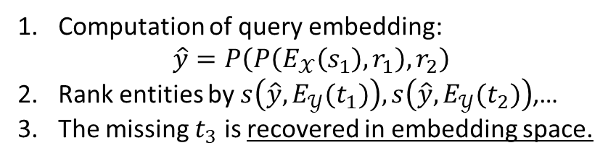




Solutions for TFQs
Neural TFQ intuition explained
Syndrome
Disease
Treatment
$$s_{1}$$
$$r_{1}$$
$$d_{1}$$
$$t_{1}$$
$$r_{2}$$
$$s_{2}$$
$$d_{2}$$
$$t_{2}$$
Logical query in natural language | Logical query in formal language
What are the treatments for syndrome “$s_{1}$”? | $$y.∃x.r_{1}\left(s_{1},x\right)∧r_{2}(x,y)$$
$$s_{3}$$
$$d_{3}$$
$$t_{3}$$
Multi-hop Set Projection
$$s_{4}$$
$$d_{4}$$
$$t_{4}$$
$$s_{1}$$
$$r_{1}$$
$$x$$
$$r_{2}$$
$$y$$
Traversal on the knowledge graph
The computational DAG
$$s_{1}$$
$$E_{𝒳}\left(s_{1}\right)$$
$$P\left( _,r_{1}\right)$$
$$P\left( _,r_{2}\right)$$
$${E_{𝒴}(t}_{k})$$
$$t_{k}$$
Computation of query embedding:
$\hat{y}=P\left(P\left(E_{𝒳}\left(s_{1}\right),r_{1}\right),r_{2}\right)$
Rank entities by $s\left(\hat{y},{E_{𝒴}(t}_{1})\right),s\left(\hat{y},{E_{𝒴}(t}_{2})\right)$,…
The missing $t_{3}$ is recovered in embedding space.
Multi-hop neural projection in embedding space

Slide 34

















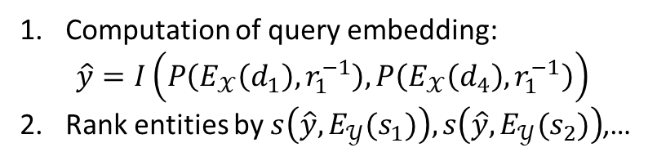
Solutions for TFQs
Neural TFQ intuition explained
Syndrome
Disease
Treatment
$$s_{1}$$
$$r_{1}$$
$$d_{1}$$
$$t_{1}$$
$$r_{2}$$
$$s_{2}$$
$$d_{2}$$
$$t_{2}$$
Logical query in natural language | Logical query in formal language
What is the common syndrome of diseases “$d_{1}$” and “$d_{4}$”? | $$V_{?}. r_{1}\left(V_{?},d_{1}\right)∧r_{1}(V_{?},d_{4})$$
$$s_{3}$$
$$d_{3}$$
$$t_{3}$$
Set Intersection
$$s_{4}$$
$$d_{4}$$
$$t_{4}$$
$$d_{1}$$
$$r_{1}$$
$$V_{?}$$
$$r_{1}$$
$$d_{1}$$
Traversal on the knowledge graph
The computational DAG
$$d_{1}$$
$$E_{𝒳}\left(d_{1}\right)$$
$$P\left( _,r_{1}^{−1}\right)$$
$$I\left( _,_\right)$$
$${E_{𝒴}(s}_{k})$$
$$s_{k}$$
Computation of query embedding:
$\hat{y}=I\left(P\left(E_{𝒳}\left(d_{1}\right),r_{1}^{−1}\right),P\left(E_{𝒳}\left(d_{4}\right),r_{1}^{−1}\right)\right)$
Rank entities by $s\left(\hat{y},{E_{𝒴}(s}_{1})\right),s\left(\hat{y},{E_{𝒴}(s}_{2})\right)$,…
$$d_{4}$$
$$E_{𝒳}\left(d_{4}\right)$$
$$P\left( _,r_{1}^{−1}\right)$$

Slide 35






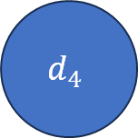


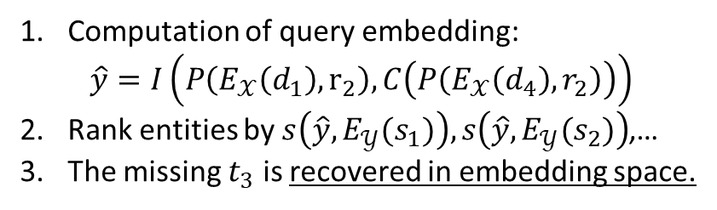





Solutions for TFQs
Neural TFQ intuition explained
Syndrome
Disease
Treatment
$$s_{1}$$
$$r_{1}$$
$$d_{1}$$
$$t_{1}$$
$$r_{2}$$
$$s_{2}$$
$$d_{2}$$
$$t_{2}$$
Logical query in natural language | Logical query in formal language
What are the treatment for “$d_{1}$” but NOT “$d_{4}$” | $$V_{?}. r_{2}\left(d_{1},V_{?}\right)∧¬r_{2}(d_{4},V_{?})$$
$$s_{3}$$
$$d_{3}$$
$$t_{3}$$
Set Intersection & Compliment
$$d_{1}$$
$$r_{2}$$
$$V_{?}$$
$${¬r}_{2}$$
$$d_{4}$$
$$s_{4}$$
$$d_{4}$$
$$t_{4}$$
Traversal on the knowledge graph
The computational DAG
Computation of query embedding:
$\hat{y}=I\left(P\left(E_{𝒳}\left(d_{1}\right),r_{2}\right),C\left(P\left(E_{𝒳}\left(d_{4}\right),r_{2}\right)\right)\right)$
Rank entities by $s\left(\hat{y},{E_{𝒴}(s}_{1})\right),s\left(\hat{y},{E_{𝒴}(s}_{2})\right)$,…
The missing $t_{3}$ is recovered in embedding space.
$$d_{1}$$
$$E_{𝒳}\left(d_{1}\right)$$
$$P\left( _,r_{2}\right)$$
$$I\left( _,_\right)$$
$${E_{𝒴}(t}_{k})$$
$$t_{k}$$
$$d_{4}$$
$$E_{𝒳}\left(d_{4}\right)$$
$$P\left( _,r_{2}\right)$$
$$C\left( _ \right)$$

Slide 36



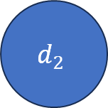




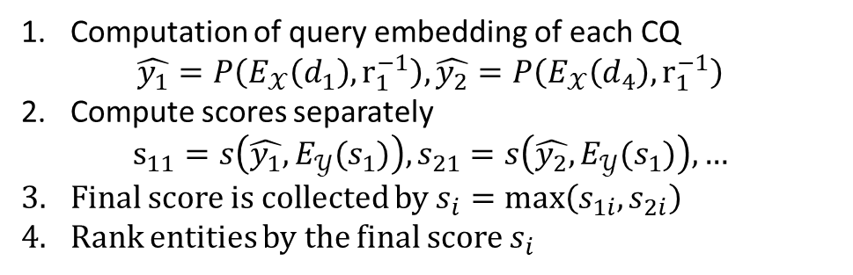





Background:
Logical query examples
Syndrome
Disease
Treatment
$$s_{1}$$
$$r_{1}$$
$$d_{1}$$
$$t_{1}$$
$$r_{2}$$
$$s_{2}$$
$$d_{2}$$
$$t_{2}$$
Logical query in natural language | Logical query in formal language
What are the syndromes for diseases “$d_{1}$” or “$d_{2}$” | $$y. r_{1}\left(y,d_{1}\right)∨r_{1}(y,d_{2})$$
$$s_{3}$$
$$d_{3}$$
$$t_{3}$$
UCQ
$$d_{1}$$
$$r_{1}$$
$$y$$
$$y$$
$$r_{1}$$
$$d_{2}$$
$$s_{4}$$
$$d_{4}$$
$$t_{4}$$
Traversal on the knowledge graph
The computational DAG
Computation of query embedding of each CQ
$\hat{y_{1}}=P\left(E_{𝒳}\left(d_{1}\right),r_{1}^{−1}\right),\hat{y_{2}}=P\left(E_{𝒳}\left(d_{4}\right),r_{1}^{−1}\right)$
Compute scores separately
$s_{11}=s\left(\hat{y_{1}},{E_{𝒴}(s}_{1})\right),s_{21}=s\left(\hat{y_{2}},{E_{𝒴}(s}_{1})\right),…$
Final score is collected by $s_{i}=max\left(s_{1i},s_{2i}\right)$
Rank entities by the final score $s_{i}$
$$d_{1}$$
$$E_{𝒳}\left(d_{1}\right)$$
$$P\left( _,r_{1}^{−1}\right)$$
$${E_{𝒴}(s}_{k})$$
$$s_{k}$$
$$d_{2}$$
$$E_{𝒳}\left(d_{2}\right)$$
$$P\left( _,r_{1}^{−1}\right)$$
$${E_{𝒴}(s}_{k})$$

Slide 37
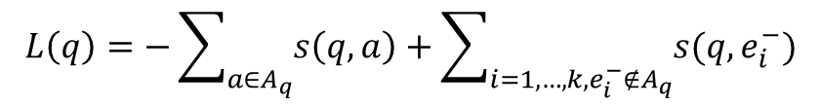
Summary of the design intuitions
Following the computational tree, forward passing of neural networks can simulate the graph traversal in the embedding space.
UCQ provides a way to handle disjunction. But there are also other ways.
The entire model is composed of several neutralized set operators and properly defined functions.
  We will introduce several concrete designs later.
The missing answers can be found because of the generalizability of neural models.
  We will explain how to train models with their designs
  But in general, it is negative sampling
$$L\left(q\right)=−\sum_{a∈A_{q}}{s\left(q, a\right)}+\sum_{i=1,…,k,e_{i}^{−}∉A_{q}}{s(q, e_{i}^{−})}$$

Slide 38
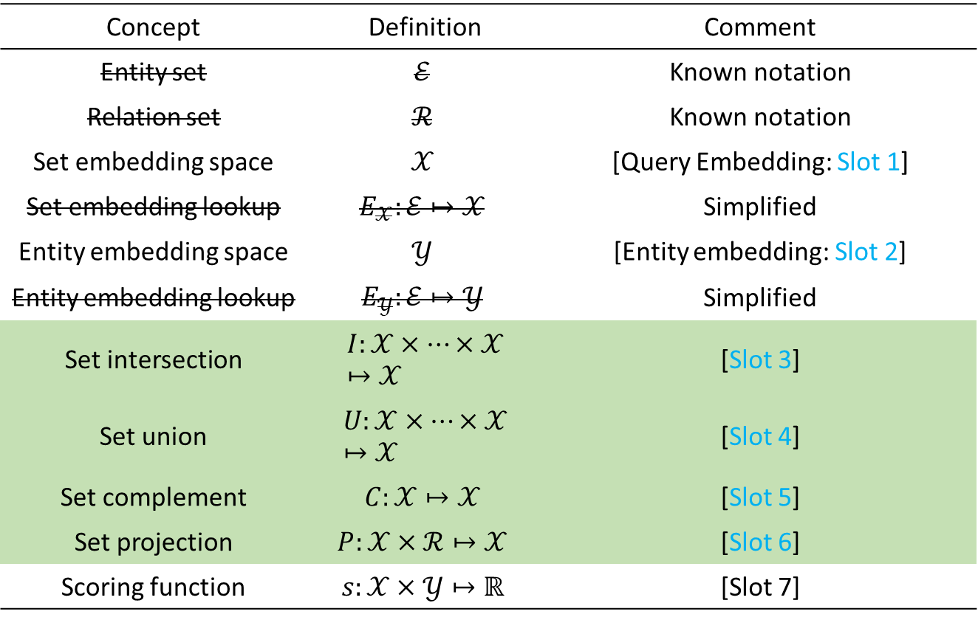
Solutions for TFQs
A unified template for neural TFQ models
Concept | Definition | Comment
Entity set | $$ℰ$$ | Known notation
Relation set | $$ℛ$$ | Known notation
Set embedding space | $$𝒳$$ | [Query Embedding: Slot 1]
Set embedding lookup | $$E_{𝒳}:ℰ↦𝒳$$ | Simplified
Entity embedding space | $$𝒴$$ | [Entity embedding: Slot 2]
Entity embedding lookup | $$E_{𝒴}:ℰ↦𝒴$$ | Simplified
Set intersection | $$I:𝒳×…×𝒳↦𝒳$$ | [Slot 3]
Set union | $$U:𝒳×…×𝒳↦𝒳$$ | [Slot 4]
Set complement | $$C:𝒳↦𝒳$$ | [Slot 5]
Set projection | $$P:𝒳×ℛ↦𝒳$$ | [Slot 6]
Scoring function | $$s:𝒳×𝒴↦ℝ$$ | [Slot 7]
Each method will be introduced by filling 7 slots

Slide 39
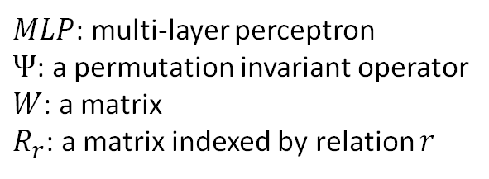
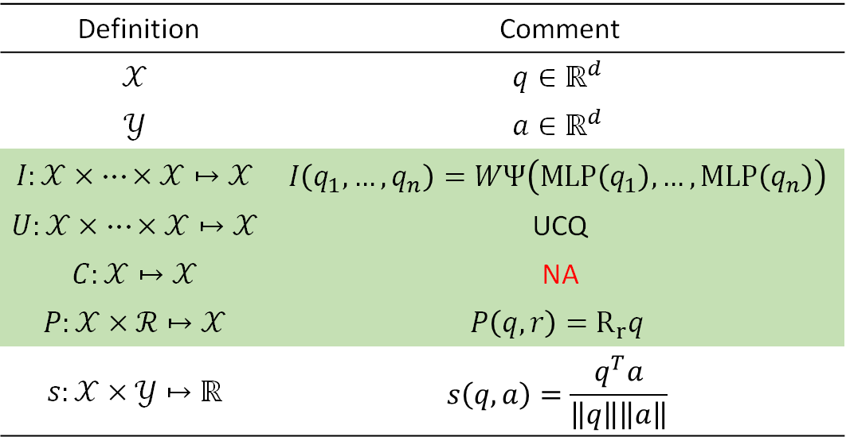
Solutions for TFQs
Vector embedding space: GQE
Definition | Comment
$$𝒳$$ | $$q∈ℝ^{d}$$
$$𝒴$$ | $${a∈ℝ}^{d}$$
$$I:𝒳×…×𝒳↦𝒳$$ | $$I\left(q_{1},…,q_{n}\right)=WΨ\left(MLP\left(q_{1}\right),…,MLP\left(q_{n}\right)\right)$$
$$U:𝒳×…×𝒳↦𝒳$$ | UCQ
$$C:𝒳↦𝒳$$ | NA
$$P:𝒳×ℛ↦𝒳$$ | $$P\left(q,r\right)=R_{r}q$$
$$s:𝒳×𝒴↦ℝ$$ | $$s\left(q,a\right)=\frac{q^{T}a}{\left\|q\right\|\left\|a\right\|}$$
$MLP$: multi-layer perceptron
$Ψ$: a permutation invariant operator
$W$: a matrix
$R_{r}$: a matrix indexed by relation $r$
Training objective $L\left(q\right)=max⁡(0, 1−s\left(q, a\right)+s(q,e_{−}))$
Hamilton, W., Bajaj, P., Zitnik, M., Jurafsky, D., & Leskovec, J. (2018). Embedding logical queries on knowledge graphs. Advances in neural information processing systems, 31.

Slide 40
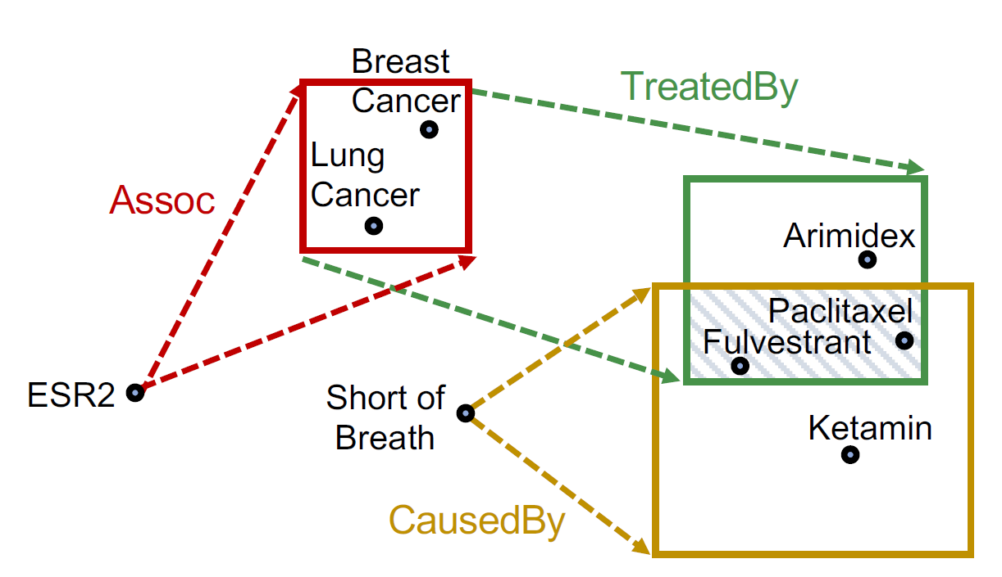
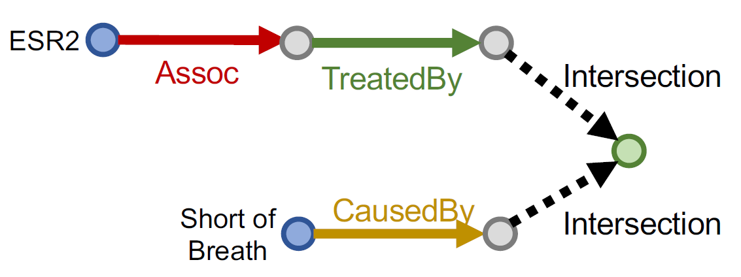
Solutions for TFQs
Geometric embedding space: Q2B (0/4)
Query Plan
Embedding Space
Slides credit: Jure Leskovec,

Slide 41
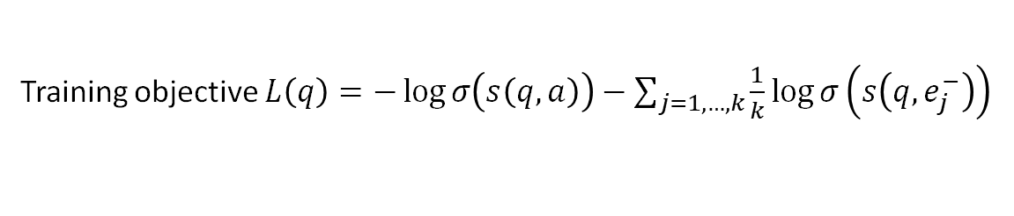
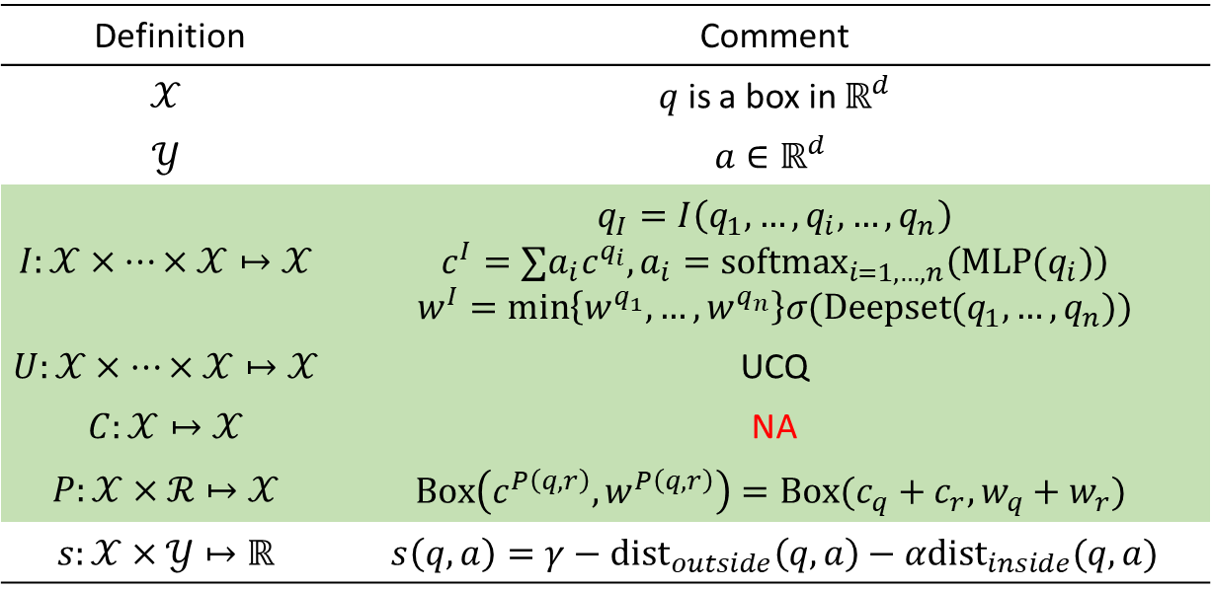
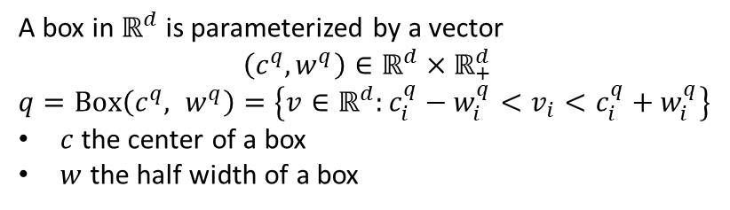
Solutions for TFQs
Geometric embedding space: Q2B (1/4)
Definition | Comment
$$𝒳$$ | $q$ is a box in $ℝ^{d}$
$$𝒴$$ | $${a∈ℝ}^{d}$$
$$I:𝒳×…×𝒳↦𝒳$$ | $$q_{I}=I\left(q_{1},…,q_{i},…,q_{n}\right)$$ $$c^{I}=∑a_{i}c^{q_{i}}, a_{i}={softmax}_{i=1,…,n}\left(MLP(q_{i})\right)$$ $$w^{I}=\min\left\{w^{q_{1}},…,w^{q_{n}}\right\}σ(Deepset(q_{1},…,q_{n}))$$
$$U:𝒳×…×𝒳↦𝒳$$ | UCQ
$$C:𝒳↦𝒳$$ | NA
$$P:𝒳×ℛ↦𝒳$$ | $$Box\left(c^{P\left(q,r\right)},w^{P\left(q,r\right)}\right)=Box(c_{q}+c_{r},w_{q}+w_{r})$$
$$s:𝒳×𝒴↦ℝ$$ | $$s\left(q,a\right)=γ−dist_{outside}\left(q,a\right)−αdist_{inside}(q,a)$$
A box in $ℝ^{d}$ is parameterized by a vector
$$\left(c^{q}, w^{q}\right)∈ℝ^{d}×ℝ_{+}^{d}$$
$q=Box\left(c^{q}, w^{q}\right)=\left\{v∈ℝ^{d}:c_{i}^{q}−w_{i}^{q}<v_{i}<c_{i}^{q}+w_{i}^{q}\right\}$
$c$ the center of a box
$w$ the half width of a box
Half width
center
Training objective $L\left(q\right)=−\log{σ\left(s\left(q,a\right)\right)−\sum_{j=1,…,k}{\frac{1}{k}\log{σ\left(s\left(q,e_{j}^{−}\right)\right)}}}$
Ren, H., Hu, W., & Leskovec, J. (2020). Query2box: Reasoning over knowledge graphs in vector space using box embeddings. arXiv preprint arXiv:2002.05969.

Slide 42
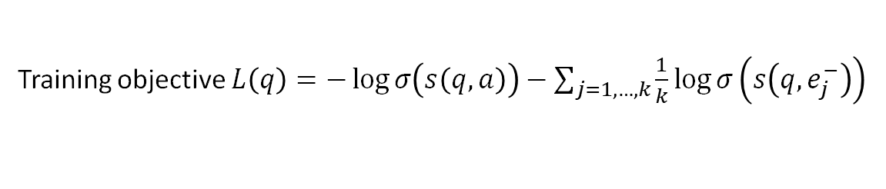
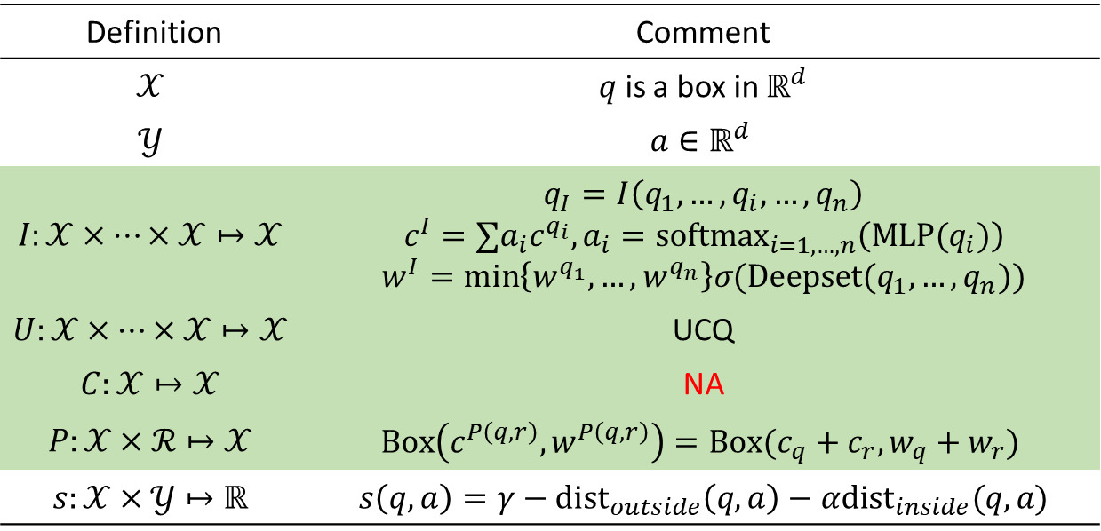



Solutions for TFQs
Geometric embedding space: Q2B (2/4)
Definition | Comment
$$𝒳$$ | $q$ is a box in $ℝ^{d}$
$$𝒴$$ | $${a∈ℝ}^{d}$$
$$I:𝒳×…×𝒳↦𝒳$$ | $$q_{I}=I\left(q_{1},…,q_{i},…,q_{n}\right)$$ $$c^{I}=∑a_{i}c^{q_{i}}, a_{i}={softmax}_{i=1,…,n}\left(MLP(q_{i})\right)$$ $$w^{I}=\min\left\{w^{q_{1}},…,w^{q_{n}}\right\}σ(Deepset(q_{1},…,q_{n}))$$
$$U:𝒳×…×𝒳↦𝒳$$ | UCQ
$$C:𝒳↦𝒳$$ | NA
$$P:𝒳×ℛ↦𝒳$$ | $$Box\left(c^{P\left(q,r\right)},w^{P\left(q,r\right)}\right)=Box(c_{q}+c_{r},w_{q}+w_{r})$$
$$s:𝒳×𝒴↦ℝ$$ | $$s\left(q,a\right)=γ−dist_{outside}\left(q,a\right)−αdist_{inside}(q,a)$$
The intuition for the intersection of multiple boxes
$$q_{1}=(c^{q_{1}},w^{q_{1}})$$
$$q_{I}=(c^{I},w^{I})$$
$$q_{2}=(c^{q_{2}},w^{q_{2}})$$
Training objective $L\left(q\right)=−\log{σ\left(s\left(q,a\right)\right)−\sum_{j=1,…,k}{\frac{1}{k}\log{σ\left(s\left(q,e_{j}^{−}\right)\right)}}}$
Ren, H., Hu, W., & Leskovec, J. (2020). Query2box: Reasoning over knowledge graphs in vector space using box embeddings. arXiv preprint arXiv:2002.05969.

Slide 43

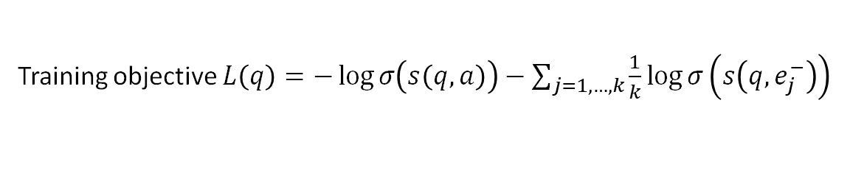


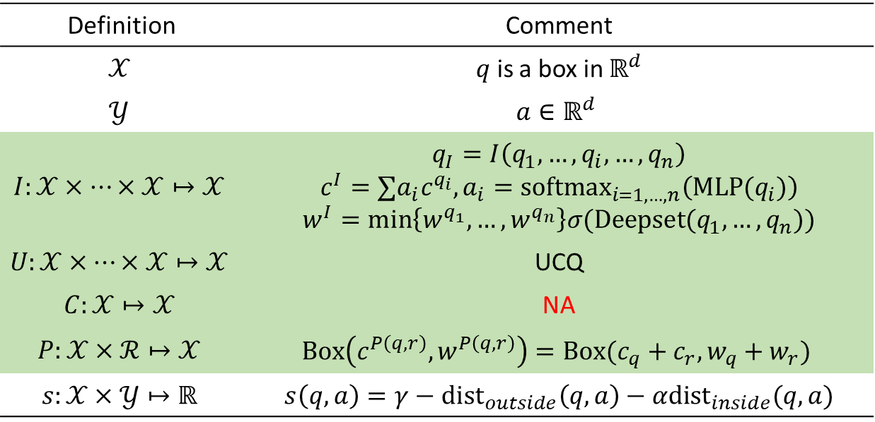






Solutions for TFQs
Geometric embedding space: Q2B (3/4)
Definition | Comment
$$𝒳$$ | $q$ is a box in $ℝ^{d}$
$$𝒴$$ | $${a∈ℝ}^{d}$$
$$I:𝒳×…×𝒳↦𝒳$$ | $$q_{I}=I\left(q_{1},…,q_{i},…,q_{n}\right)$$ $$c^{I}=∑a_{i}c^{q_{i}}, a_{i}={softmax}_{i=1,…,n}\left(MLP(q_{i})\right)$$ $$w^{I}=\min\left\{w^{q_{1}},…,w^{q_{n}}\right\}σ(Deepset(q_{1},…,q_{n}))$$
$$U:𝒳×…×𝒳↦𝒳$$ | UCQ
$$C:𝒳↦𝒳$$ | NA
$$P:𝒳×ℛ↦𝒳$$ | $$Box\left(c^{P\left(q,r\right)},w^{P\left(q,r\right)}\right)=Box(c_{q}+c_{r},w_{q}+w_{r})$$
$$s:𝒳×𝒴↦ℝ$$ | $$s\left(q,a\right)=γ−dist_{outside}\left(q,a\right)−αdist_{inside}(q,a)$$
The intuition for the scoring function
Outside distance and inside distance
$$c$$
$$dist_{inside}(q,a)$$
$$b$$
$$dist_{outside}\left(q,a\right)$$
$$a$$
$$c$$
$$dist_{inside}(q,a)$$
$$b$$
$$a$$
Training objective $L\left(q\right)=−\log{σ\left(s\left(q,a\right)\right)−\sum_{j=1,…,k}{\frac{1}{k}\log{σ\left(s\left(q,e_{j}^{−}\right)\right)}}}$
Ren, H., Hu, W., & Leskovec, J. (2020). Query2box: Reasoning over knowledge graphs in vector space using box embeddings. arXiv preprint arXiv:2002.05969.

Slide 44







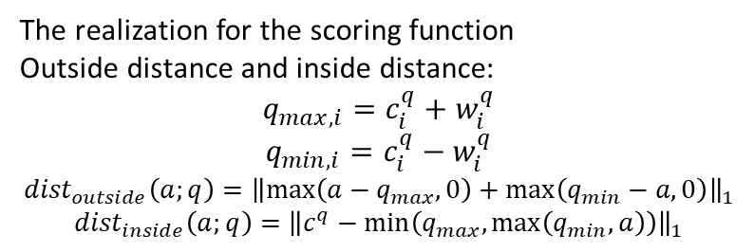

Solutions for TFQs
Geometric embedding space: Q2B (4/4)
Definition | Comment
$$𝒳$$ | $q$ is a box in $ℝ^{d}$
$$𝒴$$ | $${a∈ℝ}^{d}$$
$$I:𝒳×…×𝒳↦𝒳$$ | $$q_{I}=I\left(q_{1},…,q_{i},…,q_{n}\right)$$ $$c^{I}=∑a_{i}c^{q_{i}}, a_{i}={softmax}_{i=1,…,n}\left(MLP(q_{i})\right)$$ $$w^{I}=\min\left\{w^{q_{1}},…,w^{q_{n}}\right\}σ(Deepset(q_{1},…,q_{n}))$$
$$U:𝒳×…×𝒳↦𝒳$$ | UCQ
$$C:𝒳↦𝒳$$ | NA
$$P:𝒳×ℛ↦𝒳$$ | $$Box\left(c^{P\left(q,r\right)},w^{P\left(q,r\right)}\right)=Box(c_{q}+c_{r},w_{q}+w_{r})$$
$$s:𝒳×𝒴↦ℝ$$ | $$s\left(q,a\right)=γ−dist_{outside}\left(q,a\right)−αdist_{inside}(q,a)$$
The realization for the scoring function
Outside distance and inside distance:
$$q_{max,i}=c_{i}^{q}+w_{i}^{q}$$
$$q_{min,i}=c_{i}^{q}−w_{i}^{q}$$
$${dist}_{outside}\left(a;q\right)={\left\|\max\left(a−q_{max},0\right)+\max\left(q_{min}−a,0\right)\right\|}_{1}$$
$${dist}_{inside}\left(a;q\right)={\left\|c^{q}−\min\left(q_{max},\max\left(q_{min},a\right)\right)\right\|}_{1}$$
$$q_{max}$$
$$c$$
$$dist_{inside}(q,a)$$
$$b$$
$$q_{min}$$
$$dist_{outside}\left(q,a\right)$$
$$a$$
Training objective $L\left(q\right)=−\log{σ\left(s\left(q,a\right)\right)−\sum_{j=1,…,k}{\frac{1}{k}\log{σ\left(s\left(q,e_{j}^{−}\right)\right)}}}$
Ren, H., Hu, W., & Leskovec, J. (2020). Query2box: Reasoning over knowledge graphs in vector space using box embeddings. arXiv preprint arXiv:2002.05969.

Slide 45




Solutions for TFQs with set complement
Probability embedding space: BetaE
Q: How to model the set complement?
A: Use inductive bias of probability families
P.d.f. of Beta distribution $Beta\left(α,β\right)$
$$f\left(x;α,β\right)=\frac{Γ\left(α+β\right)}{Γ\left(α\right)Γ\left(β\right)}x^{α−1}{\left(1−x\right)}^{β−1}$$
where $Γ\left(x\right)$ is the Gamma function.
Set embedding: $d$ Beta distributions.
Definition | Comment
$$𝒳$$ | $$q=\left(α_{1}^{q},β_{1}^{q},…,α_{d}^{q},β_{d}^{q}\right)∈{\left[0,∞\right)}^{2d}$$
$$𝒴$$ | $${a∈[0,∞)}^{2d}$$
$$I:𝒳×…×𝒳↦𝒳$$ | $$I\left(q_{1},…,q_{i},…,q_{n}\right)=\sum_{i}{α_{i}q_{i}},$$ $$α_{i}=softmax\left(NN\left(q_{i}\right)\right)$$
$$U:𝒳×…×𝒳↦𝒳$$ | UCQ
$$C:𝒳↦𝒳$$ | $$C\left(q\right)=1/q$$
$$P:𝒳×ℛ↦𝒳$$ | $$P\left(q,r\right)={MLP}_{r}(q)$$
$$s:𝒳×𝒴↦ℝ$$ | $$s\left(q,a\right)=γ−\sum_{i=1,…,d}{KL\left(B\left(α_{i}^{q},β_{i}^{q}\right)|B\left(α_{i}^{a},β_{i}^{a}\right)\right)}$$
Training objective $L\left(q\right)=−\log{σ\left(s\left(q,a\right)\right)−\sum_{j=1,…,k}{\frac{1}{k}\log{σ\left(s\left(q,e_{j}^{−}\right)\right)}}}$
Ren, H., & Leskovec, J. (2020). Beta embeddings for multi-hop logical reasoning in knowledge graphs. Advances in Neural Information Processing Systems, 33, 19716-19726.

Slide 46

Solutions for TFQs with set union
Empirical sample embedding space: Q2P
$$q=V_{?} . ∃V:Win\left(TuringAward, V\right)$$
$$∧¬Citizen\left(Canada,V\right)∧Graduate(V, V_{?})$$
Turing
Award
Has Winner
Vector Embeddings
Graduate
Intersection
Has Citizen
Complement
Canada
Box Embeddings
Computation Graph
Embedding Space
The multi-hop logical operations make the query answers diversified
The answers embeddings are scattered in the embedding space
Particle Embeddings
𝑃𝑎𝑟𝑡𝑖𝑐𝑙𝑒 𝑒𝑚𝑏𝑒𝑑𝑑𝑖𝑛𝑔𝑠 𝑤𝑖𝑡ℎ 𝐾 𝑣𝑒𝑐𝑡𝑜𝑟𝑠:$P_{i}$ = [$p_{i}^{(1)}$, $p_{i}^{(2)},p_{i}^{(3)}, …,p_{i}^{(K)}$]
Bai, J., Wang, Z., Zhang, H., & Song, Y. (2022). Query2Particles: Knowledge graph reasoning with particle embeddings. arXiv preprint arXiv:2204.12847.

Slide 47














Solutions for TFQs with set union
Empirical sample embedding space: Q2P
$$f_{P}(∙,e_{l})$$
$$P_{i}^{(2)}$$
$$P_{i}^{(3)}$$
$$P_{i+1}$$
$$P_{i}^{(1)}$$
$$P_{i}$$
$$f_{I}$$
$$P_{i+1}$$
Relational Projection
Intersection
$$P_{i+1}$$
$$P_{i}^{(1)}$$
$$P_{i}^{(2)}$$
$$f_{C}$$
$$P_{i+1}$$
$$P_{i}$$
Complement
Union
47
Bai, J., Wang, Z., Zhang, H., & Song, Y. (2022). Query2Particles: Knowledge graph reasoning with particle embeddings. arXiv preprint arXiv:2204.12847.

Slide 48



Solutions for TFQs with set union
Empirical sample embedding space: Q2P
Definition | Comment
$$𝒳$$ | Multiple particles in $ℝ^{d}$
$$𝒴$$ | $$ℝ^{d}$$
$$I:𝒳×…×𝒳↦𝒳$$ | $A_{i}$= self-attn($P_{i}$) $P_{i+1}$ = MLP($A_{i}$)
$$U:𝒳×…×𝒳↦𝒳$$ | Merge Particles
$$C:𝒳↦𝒳$$ | $$A_{i} \text{= }\text{self}\text{−}\text{attn}\text{(}P_{i}\text{)}$$ $$P_{i+1}\text{ = }\text{MLP}\text{(}A_{i}\text{)}$$
$$P:𝒳×ℛ↦𝒳$$ | $A_{i}$ = (1 - $Z$) ${⊙P}_{i}$ + $Z⊙T$ $$P\left(q,r\right)=\text{self}\text{−}\text{attn}\text{(}A_{i}\text{)}$$
$$s:𝒳×𝒴↦ℝ$$ | $$s\left(q,a\right)=\max_{k=1,2,3,…,K}{<p_{T}^{(k)}, a> }$$
Gated Transition for customizing the directions of transitions for each vector in particles:
$A_{i}$ = (1 - $Z$) ${⊙P}_{i}$ + $Z⊙T$
  Here $Z$ is the update gate, and $T$ is transition for each particles. They are computed from $P_{i}$ and the relation embedding $e_{l}$ for relation $l$
Training objective $L\left(q\right)=−\log{\frac{e^{s\left(q, a\right)}}{\sum_{v∈ℰ}{e^{s(q,v)}}}}$
Bai, J., Wang, Z., Zhang, H., & Song, Y. (2022). Query2Particles: Knowledge graph reasoning with particle embeddings. arXiv preprint arXiv:2204.12847.

Slide 49


Solutions for TFQs with fuzzy logic
Fuzzy logic embedding space (1/4)
Designing set operators is tricky. Can we make it more theoretical?
Trying to incorporate it with fuzzy logic $t$-norm.
A t-norm is a function T: [0, 1] × [0, 1] → [0, 1]
Consider conjunction query $\left(q_{1}∧q_{2}\right)\left(y;x_{1},…\right)$
  Consider the fuzzy Truth Value $TV[\left(q_{1}∧q_{2}\right)\left(y=a\right)]$
  $$TV\left[\left(q_{1}∧q_{2}\right)\left(y=a\right)\right]=TV\left[q_{1}\left(y=a\right)∧q_{2}\left(y=a\right)\right]$$
  Introduce $t$-norm $⊤$, then,
  $$TV\left[q_{1}\left(y=a\right)∧q_{2}\left(y=a\right)\right]=TV\left[q_{1}\left(y=a\right)\right]⊤TV[q_{2}\left(y=a\right)]$$
Also, for disjunction and negation,
  $TV\left[q_{1}\left(y=a\right)∨q_{2}\left(y=a\right)\right]=TV\left[q_{1}\left(y=a\right)\right]⊥TV\left[q_{2}\left(y=a\right)\right]$
  $TV\left[¬q_{1}\left(y=a\right)\right]=1−TV\left[q_{1}\left(y=a\right)\right]$
We consider Godel $t$-norm in this lecture
$a ⊤ b=\min{(a,b)}$
$a⊥b=\max\left(a,b\right)$

Slide 50

Solutions for TFQs with fuzzy logic
Fuzzy logic embedding space (2/4)
A matrix $M_{q,a}=TV\left(q\left(y=a\right)\right)$ records everything we need.
where $q$ is an arbitrary query and $a$ is an entity.
$$s\left(q,a\right)=M_{q,a}$$
The range of $q$ looks infinitely large, but what really matters is
  Finite positive atomic queries, so that only finite rows should be recorded $M^{atomic}$.
  $t$-norm computation (introduced in previous page) generates infinite rows.
We can of course consider the low rank decomposition of $M^{atomic}$.
$$M_{q,a}^{atomic}≈{\vec{q}}^{T}\vec{a}$$
${\vec{q}}^{T}∈ℝ^{d}$ is the query embedding of an atomic query $q(y)=r(e,y)$.
Any atomic query can be written as $q\left(y\right)=r\left(e,y\right)$ by allowing reverse relation.

Slide 51

Solutions for TFQs with fuzzy logic
Fuzzy logic embedding space (3/4)
Low rank (rank $d$) decomposition of $M^{atomic}$
$$M_{q,a}^{atomic}≈{\vec{q}}^{T}\vec{a}$$
  $\vec{q}$ is the query embedding
  $\vec{a}$ is the entity embedding
If we further assume that
  $\vec{q}∈{\left[0,1\right]}^{d}$,$\vec{a}∈{\left[0,1\right]}^{d}$
  $t$-norm is linear, for convenience we consider Godel $t$-norm
Let $q_{1},q_{2}$ be atomic query, then
$$M_{q_{1}∧q_{2},a}={\vec{q_{1}∧q_{2}}}^{T}\vec{a}=M_{q_{1},a}⊤M_{q_{2},a}=\min\left(M_{q_{1},a},M_{q_{2},a}\right)=\min\left({\vec{q_{1}}}^{T}\vec{a}, {\vec{q_{2}}}^{T}\vec{a}\right)=\min{({\vec{q_{1}}}^{T}, {\vec{q_{2}}}^{T})\vec{a}}$$
Conclusion:
$$\vec{q_{1}∧q_{2}}=min\left(\vec{q_{1}},\vec{q_{2}}\right)=\vec{q_{1}}⊤\vec{q_{2}}$$

Slide 52


Solutions for TFQs with fuzzy logic
Fuzzy logic embedding space (4/4)
We omit $\vec{q}$ as $q$.
$$q_{1}∧q_{2}=q_{1}⊤q_{2}$$
Similarly
$$q_{1}∨q_{2}=q_{1}⊥q_{2}$$
$$¬q=1−q$$
Then we parameterize atomic query $q_{atomic}=r(q_{in},y)$ as ${MLP}_{r}(q_{in})$, we see the projection is
$$P\left(q_{in},r\right)={MLP}_{r}(q_{in})$$
Then we get the FuzzQE
Definition | Comment
$$𝒳$$ | $$q∈{\left[0,1\right]}^{d}$$
$$𝒴$$ | $${a∈\left[0,1\right]}^{d}$$
$$I:𝒳×…×𝒳↦𝒳$$ | $$I\left(q_{1},…,q_{i},…,q_{n}\right)=q_{1}⊤…⊤q_{n}$$
$$U:𝒳×…×𝒳↦𝒳$$ | $$U\left(q_{1},…,q_{i},…,q_{n}\right)=q_{1}⊥…⊥q_{n}$$
$$C:𝒳↦𝒳$$ | $$C\left(q\right)=1−q$$
$$P:𝒳×ℛ↦𝒳$$ | $$P\left(q,r\right)={MLP}_{r}(q)$$
$$s:𝒳×𝒴↦ℝ$$ | $$s\left(q,a\right)=q^{T}a$$
Chen, X., Hu, Z., & Sun, Y. (2022, June). Fuzzy logic based logical query answering on knowledge graphs. In Proceedings of the AAAI Conference on Artificial Intelligence (Vol. 36, No. 4, pp. 3939-3948).

Slide 53
Summary so far
An overview of the problem + a detailed discussion about TFQ
  Definition
  Set operator parameterization
    In vector, geometric region, probability distribution, empirical samples, …
    Heuristics for projection, intersection, negation, and union.
    Fuzzy logic motivated methods.
Questions
  How far is TFQ away from EFO1?
  Methods beyond simulating set operators?

