Slide 1
Complex Query Answering on Neural Knowledge Graphs with Rich Semantics
Yangqiu Song
Department of CSE, HKUST
Slides Credit: Jiaxin Bai and Zihao Wang

Slide 2
Knowledge Graphs
Large-scale knowledge graphs about entities and their attributes (property-of) and relations (thousands of different predicates)
Developed since Google released its knowledge graph in 2012
Millions of entities and concepts
Billions of relationships
NELL
Google Knowledge Graph (2012)
570 million entities and 18 billion facts

Slide 3
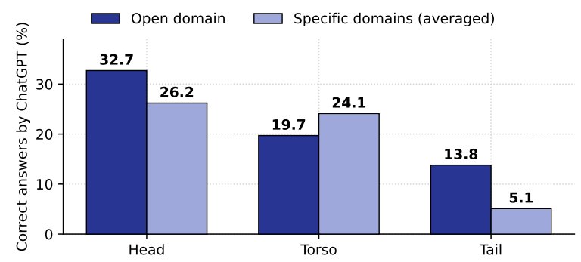
Why is it still Important?
Large language models (LLMs) tend to better memorize head (popular, more frequent) knowledge
Figure credit: Sun et al., 2023
Haoran Li*, Dadi Guo*, Wei Fan, Mingshi Xu, Jie Huang, Fanpu Meng, Yangqiu Song. Multi-step Jailbreaking Privacy Attacks on ChatGPT. EMNLP (Findings), 2023.
Kai Sun, Yifan Ethan Xu, Hanwen Zha, Yue Liu, Xin Luna Dong. Head-to-Tail: How knowledgeable are Large Language Models? A.K.A. Will LLMs replace knowledge graphs? In arXiv2023.

Slide 4
Entity/Facts as Memories
Figure credit: Verga et al., 2021
Pat Verga, Haitian Sun, Livio Baldini Soares, William W. Cohen: Adaptable and Interpretable Neural Memory Over Symbolic Knowledge. NAACL-HLT 2021: 3678-3691

Slide 5
What is Missing?
Retrieval Augmented Generation (RAG)
Knowledge Bases
Embedding
Large Language Models (LLMs)
Vector Databases
Triple may not be enough

Slide 6
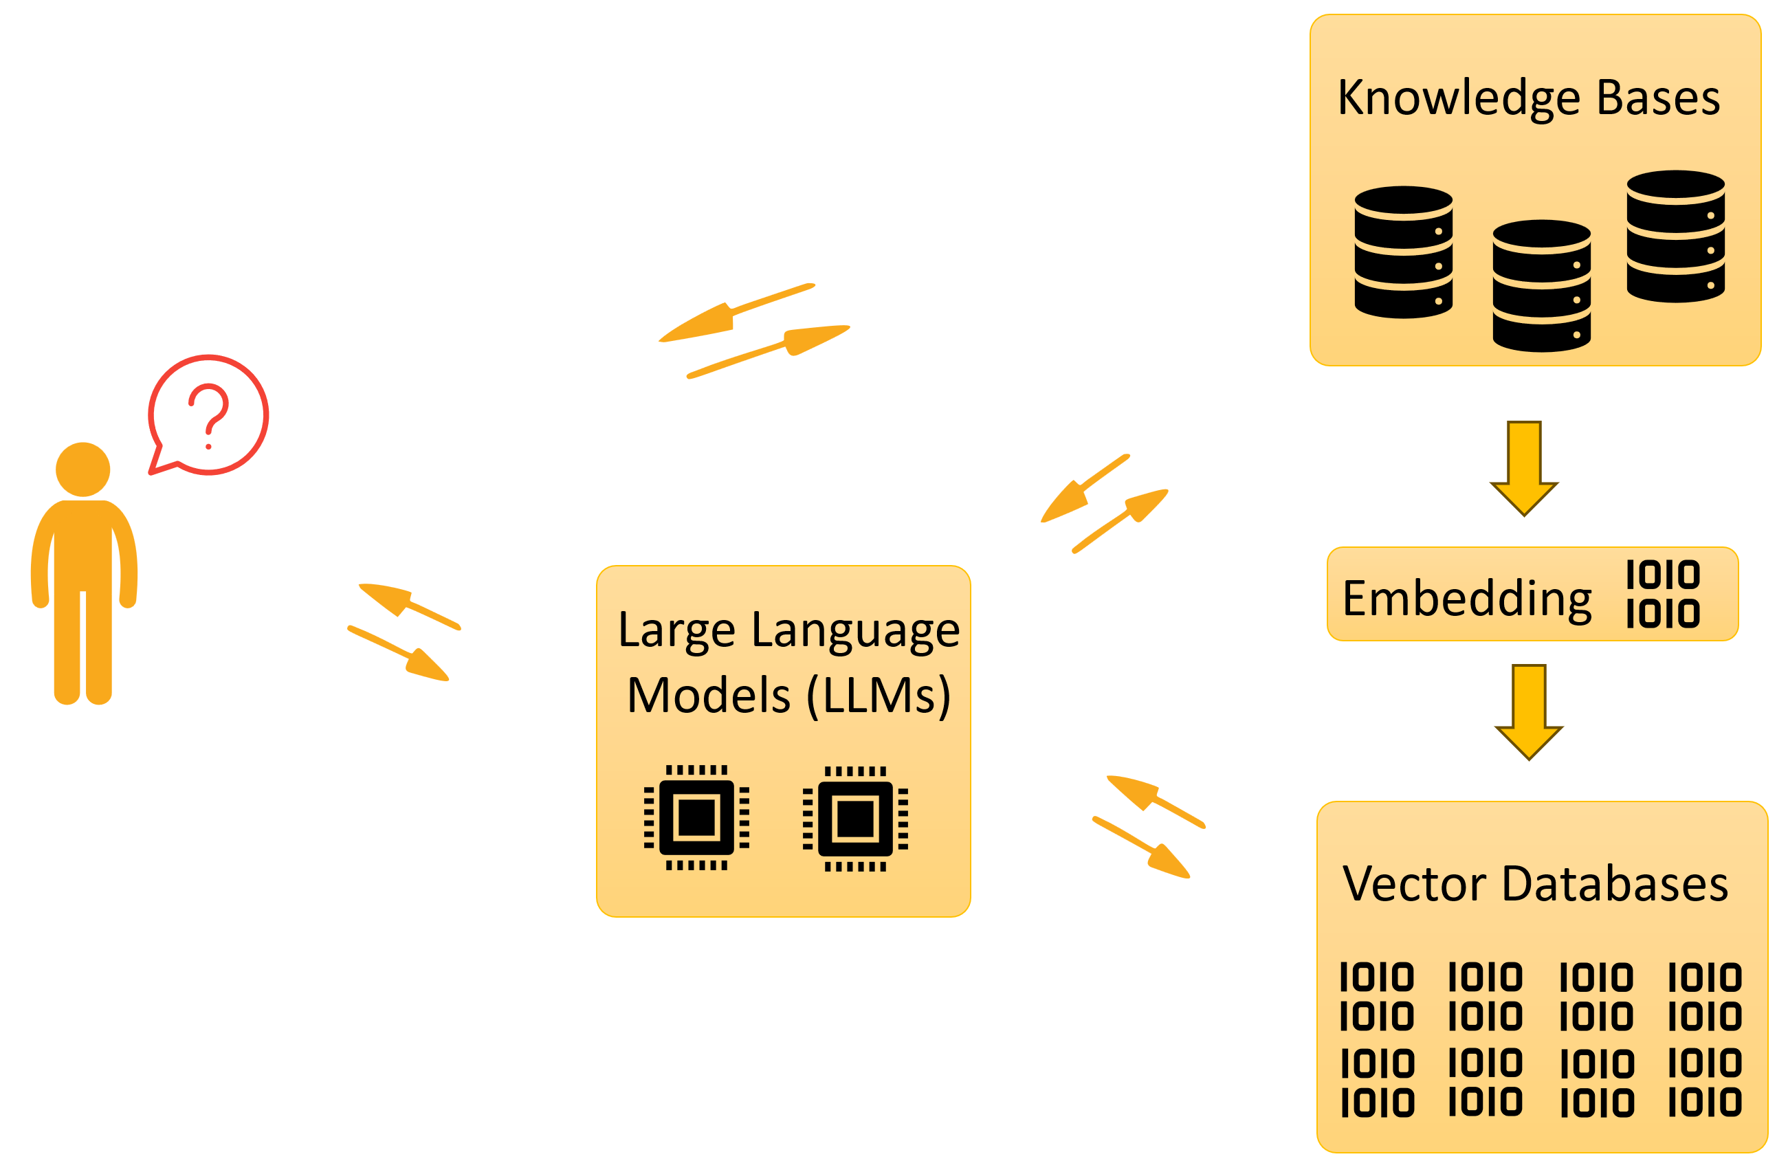
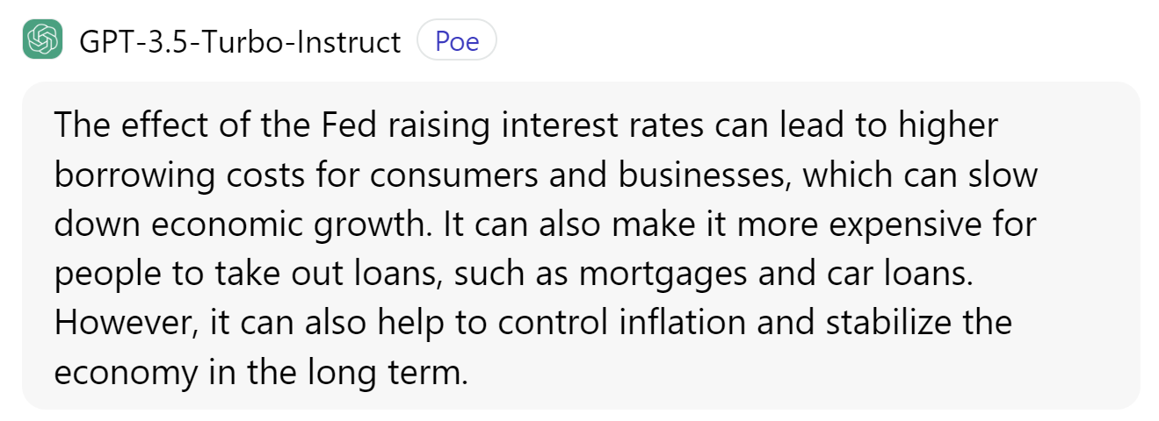
Retrieval Augmented Generation
Q: What is the effect of the Fed raising the interest rate?
https://en.wikipedia.org/wiki/Monetary_policy_of_the_United_States
The Federal Reserve's main monetary policy instrument is its Federal funds rate target. By adjusting this target, the Fed affects a wide range of market interest rates and in turn indirectly affects stock prices, wealth and currency exchange rates. …
https://en.wikipedia.org/wiki/Federal_funds_rate
Interbank borrowing is essentially a way for banks to quickly raise money. …
Raising the federal funds rate will dissuade banks from taking out such inter-bank loans, which in turn will make cash that much harder to procure.
…
…
…

Slide 7
Retrieval Augmented Generation (Cont’d)
Q: What is the effect of the Fed raising the interest rate?
Embedding
Embedding
…
…
…
$p\left(a_{t} | a_{t−1},…,a_{1},q,c_{1},…,c_{M}\right)$ or
$$\sum_{c}{p\left(a | q,c\right)p(c|q)}$$
Kelvin Guu, Kenton Lee, Zora Tung, Panupong Pasupat, Ming-Wei Chang: Retrieval Augmented Language Model Pre-Training. ICML 2020

Slide 8
What is the effect of the Fed raising the interest rate to more than 6% while China dropping the rate to less than 2% and OPEC reduces oil production by 1 million barrels a day, and the consequence of this effect?
While I cannot provide real-time information as my knowledge cutoff is in January 2022, I can offer a general analysis based on economic principles up to that point.
1. **Fed Raising Interest Rates to More Than 6%:**
- **Effect:** Increasing interest rates by the Federal Reserve is typically done to curb inflation. Higher interest rates can lead to reduced borrowing and spending, which may slow down economic growth but can help control inflationary pressures.
- **Consequence:** Higher interest rates can lead to increased costs for businesses and consumers, potentially slowing down investment and spending. It might also impact the housing market as mortgage rates increase.
2. **China Dropping Interest Rates to Less Than 2%:**
- **Effect:** Lowering interest rates is often a move to stimulate economic activity. It encourages borrowing and spending, which can boost investment and consumption.
- **Consequence:** Lower interest rates can stimulate economic growth, but it may also lead to concerns about excessive debt and asset bubbles. It can impact currency values and trade relationships as well.
3. **OPEC Reducing Oil Production by 1 Million Barrels a Day:**
- **Effect:** A reduction in oil production by OPEC can influence global oil prices. Lower production can potentially lead to higher oil prices, impacting industries and consumers dependent on oil and energy.
- **Consequence:** Higher oil prices can result in increased costs for businesses and consumers, potentially leading to inflationary pressures. It can also impact industries like transportation and manufacturing.
**Overall Consequences:**
- **Global Economic Impact:** The combination of these actions by major economic players can have widespread global economic implications. Shifts in interest rates and oil prices can influence investment, trade balances, and inflationary pressures across countries.
- **Currency Markets:** Changes in interest rates and oil prices can affect currency values. A divergence in monetary policies between the U.S. and China, for example, might lead to fluctuations in exchange rates.
- **Inflation and Economic Growth:** The overall impact on inflation and economic growth will depend on the magnitude and speed of these changes. The coordinated actions of these major players can have complex and interconnected effects on the global economy.
It's important to note that the actual outcomes can be influenced by a multitude of factors, including the overall health of the global economy, geopolitical events, and other economic policies in place at the time. For the most current and accurate information, it's recommended to refer to recent economic data and expert analyses.

Slide 9
Retrieval Augmented Generation (Cont’d)
 | Texts | Embeddings
Match | Exact match | Semantic match
Search space | Sparse vectors | Dense vectors
In-context learning | Symbolic | Neural

Slide 10
Retrieval Augmented Generation (Cont’d)
What is the effect of the Fed raising the interest rate?
What is the effect of the Fed raising the interest rate while China dropping the rate?
What is the effect of the Fed raising the interest rate while China dropping the rate and OPEC+ reduces oil production?
What is the effect of the Fed raising the interest rate while China dropping the rate and OPEC+ reduces oil production, and the consequence of this effect?
What is the effect of the Fed raising the interest rate to more than 6% while China dropping the rate to less than 2% and OPEC+ reduces oil production by 1 million barrels a day, and the consequence of this effect?

Slide 11
Retrieval Augmented Generation (Cont’d)
What is the effect of the Fed raising the interest rate to more than 6% while China dropping the rate to less than 2% and OPEC+ reduces oil production by 1 million barrels a day, and the consequence of this effect?
Fed raising interest rate to > 6%
???
effect
???
China dropping interest rate to < 2%
effect
Join
???
consequence
???
…
…
…
effect
Search
OPEC+ reducing oil production by 1M B/D
???
Search

Slide 12
Retrieval Augmented Generation (Cont’d)
What is the effect of the Fed raising the interest rate to more than 6% while China dropping the rate to less than 2% and OPEC+ reduces oil production by 1 million barrels a day, and the consequence of this effect?
Fed raising interest rate to > 6%
Embedding
effect
China dropping interest rate to < 2%
Embedding
effect
Join
Embedding
Join
consequence
effect
OPEC+ reducing oil production by 1M B/D
Embedding
Embedding
$$p\left(y_{t} | y_{t−1},…,y_{1},q,c_{1},…,c_{M}\right)$$

Slide 13
More Generally
Traditional NoSQL or Graph databases
Semantic match of strings
Can we support complex queries such as join, intersection, counting, etc., on top of that?
Doc 1
…
…
Doc 2
…
…
Doc K
…
…
…
…
…
…
…
…
Embedding
Large Language Models (LLMs)

Slide 14
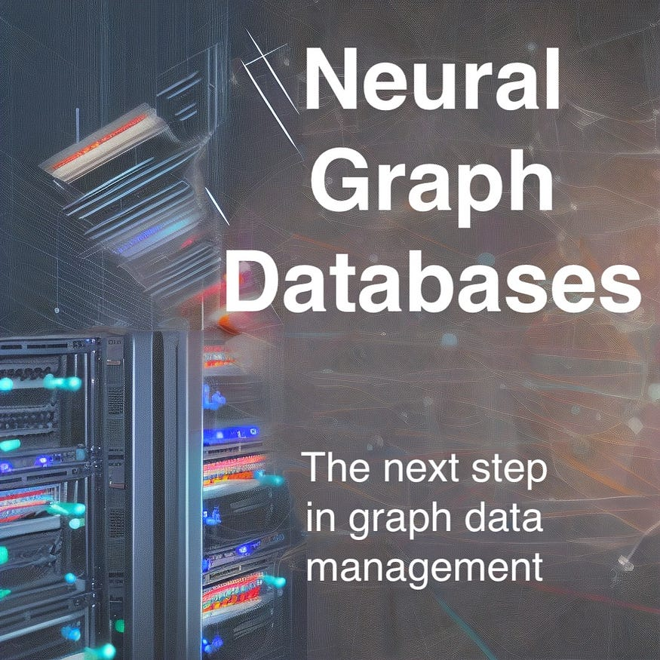
Neural Graph Databases
Graph structure + vector storage
Leveraging the power of LLMs for textual data
Query executor to support complex queries
Query encoder is trainable
Inductive method to be robust with insertion, deletion, and modification
Fuzzy semantic search
Generalizable to incomplete data
Figure taken from: https://towardsdatascience.com/neural-graph-databases-cc35c9e1d04f

Slide 15
Complex Queries on Neuralized Knowledge Graphs
A working example: Tree-Formed Queries (TFQ):
Tree-form query family contains the queries that can be converted into the computational tree
Natural Language: Find non-American directors whose movie won Golden Globes or Oscar?
Logical Formula: $q=V_{?}∃ V_{1}.(Won\left(V_{1},GoldenGlobes\right)∨Won(V_{1},Oscar))∧¬BornIn\left(V_{?},America\right)∧Direct(V_{?},V_{1})$
Set Operator Tree: $DirectorOf(WinnerOf\left(GoldenGlobes\right)∪WinnerOf\left(Oscar\right))∩BornIn{\left(America\right)}^{C}$
Set Operators
GoldenGlobes
P
DirectorOf
set operations
$$∪$$
set union
WinnerOf
$$∪$$
P
$$∩$$
set intersection
Oscar
P
Answer Set
$$C$$
set complement
BornIn
America
P
$$C$$
$$∩$$
P
set projection
Example from: Zihao Wang, Weizhi Fei, Hang Yin, Yangqiu Song, Ginny Y Wong, and Simon See . Wasserstein-Fisher-Rao Embedding: Logical Query Embeddings with Local Comparison and Global Transport In Findings of ACL 2023

Slide 16
The Design Space of Neural TFQ Answering
Concept | Definition | Comment
Entity set | $$ℰ$$ | The entity set in KG
Relation set | $$ℛ$$ | The relation set in KG
Set embedding space | $$𝒳$$ | Embedding space
Set embedding lookup | $$E_{𝒳}:ℰ↦𝒳$$ | Singleton set embedding
Entity embedding space | $$𝒴$$ | Embedding space
Entity embedding lookup | $$E_{𝒴}:ℰ↦𝒴$$ | Entity embedding
Set intersection | $$I:𝒳×…×𝒳↦𝒳$$ | Binary or N-ary
Set union | $$U:𝒳×…×𝒳↦𝒳$$ | Binary or N-ary
Set complement | $$C:𝒳↦𝒳$$ | Replaceable with set difference
Set projection | $$P:𝒳×ℛ↦𝒳$$ | One-hop link prediction
Scoring function | $$s:𝒳×𝒴↦ℝ$$ | How much an entity is in a set
Converting to computational tree
makes it possible to model
set operations with neural
networks
Set Operators
$$∪$$
set union
set operations
$$∩$$
set intersection
$$C$$
set complement
P
set projection
Wang, Z., Yin, H., & Song, Y. (2021). Benchmarking the combinatorial generalizability of complex query answering on knowledge graphs. arXiv preprint arXiv:2109.08925.

Slide 17
The Design Space of Neural TFQ Answering
Concept | Definition | Comment
Entity set | $$ℰ$$ | Known notation
Relation set | $$ℛ$$ | Known notation
Set embedding space | $$𝒳$$ | [Query Embedding: Slot 1]
Set embedding lookup | $$E_{𝒳}:ℰ↦𝒳$$ | Simplified
Entity embedding space | $$𝒴$$ | [Entity embedding: Slot 2]
Entity embedding lookup | $$E_{𝒴}:ℰ↦𝒴$$ | Simplified
Set intersection | $$I:𝒳×…×𝒳↦𝒳$$ | [Slot 3]
Set union | $$U:𝒳×…×𝒳↦𝒳$$ | [Slot 4]
Set complement | $$C:𝒳↦𝒳$$ | [Slot 5]
Set projection | $$P:𝒳×ℛ↦𝒳$$ | [Slot 6]
Scoring function | $$s:𝒳×𝒴↦ℝ$$ | [Slot 7]
Each method will be introduced by filling 7 slots

Slide 18
Embedding Space and Set Representations
$$q=V_{?} . ∃V:Win\left(TuringAward, V\right) ∧¬Citizen\left(Canada,V\right)∧Graduate(V, V_{?})$$
GQE
Turing
Award
Has Winner
Vector Embeddings
Graduate
Query2Box
Has Citizen
Complement
Intersection
Canada
Box Embeddings
Computation Graph
Embedding Space
Query2Particle
The multi-hop logical operations make the query answers diversified
The answers embeddings are set(s) scattered in the embedding space
Particle Embeddings
William L. Hamilton, Payal Bajaj, Marinka Zitnik, Dan Jurafsky, Jure Leskovec. Embedding Logical Queries on Knowledge Graphs. NeurIPS 2018.
Hongyu Ren, Weihua Hu, Jure Leskovec. Query2box: Reasoning over Knowledge Graphs in Vector Space using Box Embeddings. ICLR 2020.
Example from: Jiaxin Bai, Zihao Wang, Hongming Zhang, Yangqiu Song: Query2Particles: Knowledge Graph Reasoning with Particle Embeddings. NAACL-HLT (Findings) 2022.

Slide 19
What’s Still Missing to Support RAG?
What is the effect of the Fed raising the interest rate to more than 6% while China dropping the rate to less than 2% and OPEC+ reduces oil production by 1 million barrels a day, and the consequence of this effect?
The understanding of numbers/attributes
The understanding of discourse (temporal, causal, etc.) relations
Fed raising interest rate to > 6%
Embedding
effect
China dropping interest rate to < 2%
Embedding
effect
Join
Embedding
Join
consequence
effect
OPEC+ reducing oil production by 1M B/D
Embedding
Embedding
$$p\left(y_{t} | y_{t−1},…,y_{1},q,c_{1},…,c_{M}\right)$$

Slide 20
This Talk
Neural KG CQA on Entities and Numerical Values
Neural KG CQA on Eventuality Knowledge Graphs

Slide 21
Numerical Complex Query Answering
Category
Complex Queries
Interpretations
Numerical CQA
Find the Turing award winners
that
is born before
the year of
1927.
Numerical CQA
Find the states in US that have
a
higher latitudes
than Beijing.
Numerical CQA
Find the states in US that have a
twice smaller population
than
California?

Slide 22
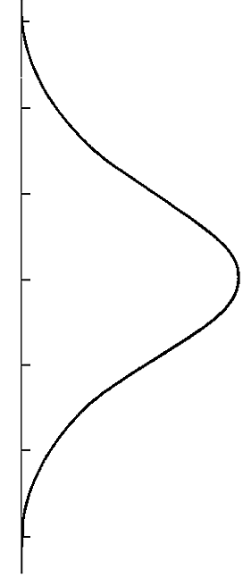
Number Reasoning Network
Find the cities that have a higher latitudes than Japanese cities.
q$=V_{?} . ∃{V_{1}, X}_{1},X_{2}:\underline{\text{HasLatitude}}\left(V_{?},X_{2}\right) ∧\underline{GreaterThan}\left(X_{2},X_{1}\right)∧\underline{HasLatitude}\left(V_{1},X_{1}\right)∧ LocatedIn\left(V_{1}, Japan\right)$
$$HasCity$$
$$HasLatitude$$
$$GreaterThan$$
$HasLatitide$⁻¹
$$Japan$$
$$Target$$
50°
50°
$$Tokyo$$
40°
40°
$$Kyoto$$
30°
30°
$$Japan$$
20°
20°
$$Osaka$$
(1) Relational
Projection
(2) Attribute
Projection
(3) Numerical
Projection
(4) Reverse
Attribute Projection
Jiaxin Bai, Chen Luo, Zheng Li, Qingyu Yin, Bing Yin, Yangqiu Song: Knowledge Graph Reasoning over Entities and Numerical Values. KDD 2023: 57-68

Slide 23
Number Reasoning Network
Relational Projection (rp):
Query Embedding → Entity Set
(2) Attribute Projection (ap):
Query/Set Embedding → Value Distribution
(3) Numerical Projection (np):
Value Distribution → Value Distribution
(4) Reverse Attribute Projection (rap):
Value Distribution → Query Embedding
50°
50°
$$Tokyo$$
40°
40°
$$Kyoto$$
30°
30°
$$Osaka$$
20°
20°
(1) Relational
Projection
(2) Attribute
Projection
(3) Numerical
Projection
(4) Reverse
Attribute Projection

Slide 24
Number Reasoning Network
(1) Relational Projection:
Adopted from the backbones:
GQE, Query2Box, Query2Particles.
(2) (3) (4) Other Projections: Gated Transitions
Linear projection
$$p_{i}= W_{p}^{p}q^{i}+ b_{p}^{p}$$
$$z_{i}= {{σ (W}_{z}^{p}e}_{a}+U_{z}^{p}p_{i} + b_{z}^{p})$$
$$r_{i}= {{σ (W}_{r}^{p}e}_{a}+U_{r}^{p}p_{i} + b_{r}^{p})$$
$$t_{i}= {{φ (W}_{h}^{p}e}_{a}+U_{h}^{p}{(r}_{i} ⨀ p_{i}) + b_{h}^{p})$$
$θ_{i+1}=(1−z_{i})$ $⨀$ $p_{i}$ + $z_{i} ⨀$ $t_{i}$
MLP
Gate selection
50°
50°
$$Tokyo$$
40°
40°
$$Kyoto$$
30°
30°
$$Osaka$$
20°
20°
(1) Relational
Projection
(2) Attribute
Projection
(3) Numerical
Projection
(4) Reverse
Attribute Projection

Slide 25
Number Reasoning Network
Entity embeddings:
Adopted from the backbones:
GQE, Query2Box, Query2Particles.
Input number embeddings
DICE
Sinusoidal
$${ψ(v)}_{d}= \left\{\begin{aligned}\sin{\frac{v}{v^{d/D}},} d ≡0 (mod 2) \\ \cos{\frac{v}{v^{{(d−1)}/D}}}, d ≡1 (mod 2)\end{aligned}\right.$$
$${ψ(v)}_{d}= \left\{\begin{aligned}\sin^{d−1}{(α)\cos{(α)}} \\ \sin^{D}{(α)}\end{aligned}\right.$$
50°
50°
$$Tokyo$$
40°
40°
$$Kyoto$$
30°
30°
$$Osaka$$
20°
20°
(1) Relational
Projection
(2) Attribute
Projection
(3) Numerical
Projection
(4) Reverse
Attribute Projection
Dhanasekar Sundararaman, Shijing Si, Vivek Subramanian, Guoyin Wang, Devamanyu Hazarika, and Lawrence Carin. 2020. Methods for Numeracy-Preserving Word Embeddings. In EMNLP. 4742–4753
Ashish Vaswani, Noam Shazeer, Niki Parmar, Jakob Uszkoreit, Llion Jones, Aidan N. Gomez, Lukasz Kaiser, and Illia Polosukhin. 2017. Attention is All you Need. NeurIPS 2017

Slide 26
Number Reasoning Network
Logic Operators on Entities, adopted from the backbones:
GQE, Query2Box, Query2Particles.
Logic Operator on Value Distribution:
Intersection and Union: DeepSet
Relational Projection (rp)
Attribute Projection (ap)
Numerical Projection (np)
Reverse Attribute Projection (rap)
$$a_{i}={Attn( W_{q}θ_{i}^{T},W_{k}θ_{i}^{T},W_{v}θ_{i}^{T}) }^{T}$$
$$θ_{i+1} =MLP(a_{i})$$
rap
rp
np
rap
nv
e
nv
nv
e
e
1p
2p
2i
pi
e
rp
e
rp
u
ap
rap
ap
np
e
nv
e
nv
2u
ip
3i
up
e
nv
e
rp
e
ap
…
Manzil Zaheer, Satwik Kottur, Siamak Ravanbakhsh, Barnabás Póczos, Ruslan Salakhutdinov, Alexander J. Smola: Deep Sets. NIPS 2017: 3391-3401

Slide 27
Number Embeddings and Learning Objective
Use maximize a posteriori probability (MAP) estimation to derive an objective function for type-aware reasoning.
$v$ is the positive answer value.
$t$ is the type of this value like date, length, size etc.
$θ_{I}$ is the distribution parameters in the last step.
$ψ\left(v\right)$ is number embeddings
$${\hat{θ }}_{I}\left(v, t\right)= \underset{θ_{I}}{arg max}{f\left(θ_{I} | v, t\right) }$$
$\underset{θ_{I}}{=arg max}f\left(ψ\left(v\right) | θ_{I}, t\right)g\left(θ_{I} | t\right)$ (Bayes’ Rule; Remove the denominator: a constant in argmax)
$\underset{θ_{I}}{=arg min}−\log{f\left(ψ\left(v\right) | θ_{I}\right)}− \log{g\left(θ_{I} | t\right)}$ (Conditional Independent of $v$ and t on $θ_{I}$)
happenedOnDate
createdOnDate
latitude
longitude
person.height_mt
date_of_death
date_of_birth
film_release_date
org.date_founded
location.date_founded
Set the parameteration as: $f\left(ψ\left(v\right) | θ_{I}\right)$ = $p_{θ_{I}}\left( ψ\left(v\right)\right)$ and $g\left(θ_{I} | t\right)$ = $φ_{t}(θ_{I})$
$L_{A}= \frac{1}{M}\sum_{j=1}^{M}{(− \log{p_{θ_{I}^{(j)}} \left( ψ\left(v^{\left(j\right)}\right)\right) − \log{φ_{t^{\left(j\right)}}(θ_{I}^{(j)})}})}$
Jiaxin Bai, Chen Luo, Zheng Li, Qingyu Yin, Bing Yin, Yangqiu Song: Knowledge Graph Reasoning over Entities and Numerical Values. KDD 2023: 57-68

Slide 28
Number Embeddings and Learning Objective
End-to-end training by Joint optimization of two losses:
$L_{A}= \frac{1}{M}\sum_{j=1}^{M}{(− \log{p_{θ_{I}^{(j)}} \left( ψ\left(v^{\left(j\right)}\right)\right) − \log{φ_{t^{\left(j\right)}}(θ_{I}^{(j)})}})}$
The likelihood of the value $v^{\left(j\right)}$ sampled from distribution of $θ_{I}^{(j)}$
The likelihood of the distribution parameter $θ_{I}^{(j)} is of type{ t}^{\left(j\right)}$
$$L_{E}=−\frac{1}{N} \sum_{j=1}^{N}{\log{p(q_{I}^{\left(j\right)}, v^{(j)})}}$$
The likelihood of the entity $v^{\left(j\right)}$ is the answer of the query encoding $q_{I}^{\left(j\right)}.$
$j$ is means the $j$-th sample, and $I$means the last step of distribution parameter encoding.

Slide 29
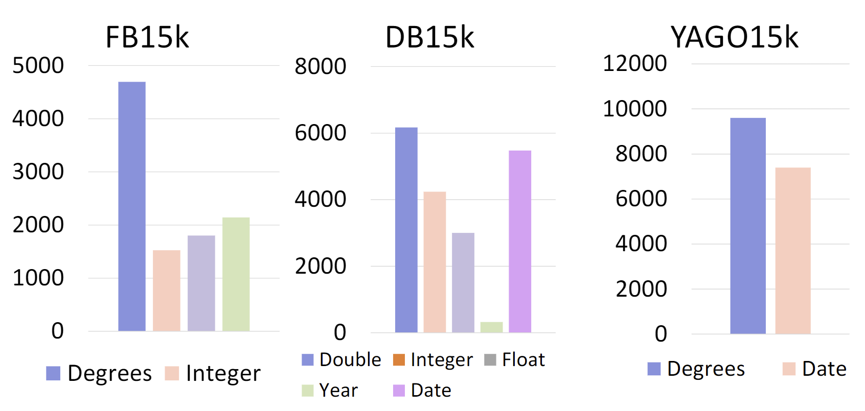
Sampling Data
General Query Types:
u
Numerical Values Types on Different KGs:
1p
2p
2u
up
2i
ip
3i
pi
Number related query types:
rap
np
rap
rp
np
rap
nv
nv
nv
e
nv
nv
e
nv
e
e
e
rp
e
ap
e
rp
e
rp
rap
rp
ap
rap
ap
np
nv
e
e
nv
e
nv
e
e
e
nv
e
rp
e
rp
e
rp
e
ap
…
…

Slide 30
Data Statistics
Graphs | Data Split | #Nodes | #Rel. | # Attr. | #Rel. Edges | #Attr. Edges | #Rev. Attr. Edges | #Num. Edges | #Edges
FB15K | Training | 25,106 | 1,345 | 15 | 947,540 | 20,248 | 20,248 | 27,020 | 1,015,056
 | Validation | 26,108 | 1,345 | 15 | 1,065,982 | 22,779 | 22,779 | 27,376 | 1,138,916
 | Testing | 27,144 | 1,345 | 15 | 1,184,426 | 25,311 | 25,311 | 27,389 | 1,262,437
DB15K | Training | 31,980 | 279 | 30 | 145,262 | 33,131 | 33,131 | 25,495 | 237,019
 | Validation | 34,191 | 279 | 30 | 161,978 | 37,269 | 37,269 | 25,596 | 262,112
 | Testing | 36,358 | 279 | 30 | 178,394 | 41,411 | 41,411 | 25,680 | 286,896
YAGO15K | Training | 32,112 | 32 | 7 | 196,616 | 21,732 | 21,732 | 26,616 | 266,696
 | Validation | 33,078 | 32 | 7 | 221,194 | 22,748 | 22,748 | 26,627 | 293,317
 | Testing | 33,610 | 32 | 7 | 245,772 | 23,520 | 23,520 | 26,631 | 319,443

Slide 31
Data Statistics
Graphs | Data Split | 1p | 2p | 2i | 3i | pi | ip | 2u | up | All
FB15K | Training | 304,633 | 138,192 | 226,729 | 288,874 | 260,057 | 233,834 | 284,301 | 284,931 | 2,021,551
 | Validation | 8,271 | 15,860 | 23,359 | 28,836 | 25,081 | 22,930 | 29,187 | 29,210 | 182,734
 | Testing | 7,969 | 15,431 | 23,346 | 28,865 | 24,810 | 22,232 | 29,212 | 29,274 | 181,139
DB15K | Training | 124,851 | 99,698 | 140,427 | 190,413 | 171,353 | 163,687 | 190,364 | 194,244 | 1,275,037
 | Validation | 3,529 | 10,388 | 9,792 | 13,817 | 14,594 | 16,651 | 19,512 | 19,792 | 108,075
 | Testing | 3,387 | 10,047 | 9,914 | 14,603 | 14,642 | 15,897 | 19,504 | 19,773 | 107,767
YAGO15K | Training | 84,014 | 76,238 | 136,282 | 183,850 | 162,712 | 145,994 | 183,963 | 183,459 | 1,156,512
 | Validation | 2,833 | 7,986 | 10,757 | 16,884 | 13,485 | 13,899 | 18,444 | 19,105 | 103,393
 | Testing | 2,713 | 7,949 | 10,935 | 17,171 | 13,481 | 13,526 | 18,433 | 18,997 | 103,205

Slide 32
Main Results on Three KGs
Query Encoding | Attribute | Hit@1 | Hit@3 | Hit@10 | MRR
GQE | Baseline | 10.33 | 18.19 | 27.91 | 16.29
 | NRN + DICE | 11.03 | 19.18 | 29.01 | 17.15
 | NRN + Sinusoidal | 11.14 | 19.39 | 29.23 | 17.31
Q2P | Baseline | 10.22 | 17.35 | 26.61 | 15.81
 | NRN + DICE | 11.86 | 19.70 | 29.46 | 17.84
 | NRN + Sinusoidal | 12.25 | 20.16 | 29.96 | 18.28
Q2B | Baseline | 11.81 | 20.93 | 31.19 | 18.41
 | NRN + DICE | 12.52 | 22.09 | 32.34 | 19.34
 | NRN + Sinusoidal | 12.75 | 22.22 | 32.46 | 19.51

Slide 33
This Talk
Neural KG CQA on Entities and Numerical Values
Neural KG CQA on Eventuality Knowledge Graphs

Slide 34
CQA on Eventuality Knowledge Graph
Complex query on eventuality graphs are different from the entity-relation graph
Whether and when the eventualities occur are important
Queries
Type
Interpretations
Entity
Find the substances that interact with the
proteins associated with Alzheimer’s and
Mad cow disease.
Eventuality
Food
is bad before
PersonX
add soy sauce.
What is the reason for food being bad?
Eventuality
Instead
of buying an umbrella,
PersonX
go
home.
What happened before
PersonX
go
home?
Jiaxin Bai, Xin Liu, Weiqi Wang, Chen Luo, Yangqiu Song: Complex Query Answering on Eventuality Knowledge Graph with Implicit Logical Constraints. NeurIPS, 2023

Slide 35
ASER (Activities, States, Events, and their Relations)
Principle 1: Comparing semantic meanings by fixing grammar (Katz and Fodor, 1963)
Principle 2: The need of language inference based on ‘partial information’ (Wilks, 1975)
https://github.com/HKUST-KnowComp/ASER
Hongming Zhang, Xin Liu, Haojie Pan, Yangqiu Song, Cane Wing-Ki Leung: ASER: A Large-scale Eventuality Knowledge Graph. WWW 2020: 201-211
Katz, J. J., & Fodor, J. A. (1963). The structure of a semantic theory. Language, 39(2), 170–210.
Yorick Wilks. 1975. An intelligent analyzer and understander of English. Communications of the ACM, 18(5):264–274.

Slide 36
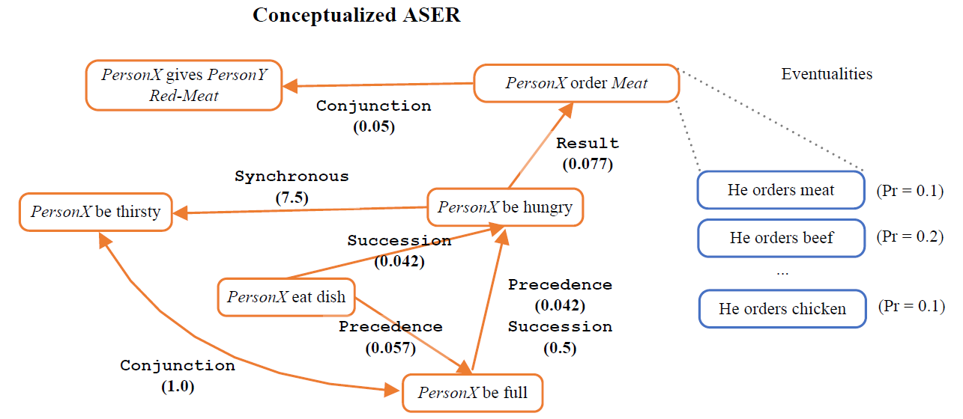
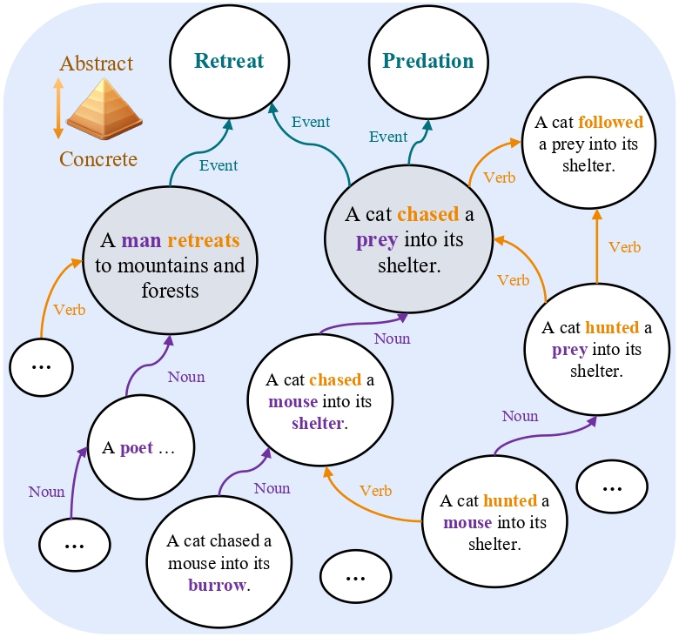
Conceptualization and Normalization
https://github.com/HKUST-KnowComp/ASER
Hongming Zhang, Xin Liu, Haojie Pan, Haowen Ke, Jiefu Ou, Tianqing Fang, Yangqiu Song: ASER: Towards large-scale commonsense knowledge acquisition via higher-order selectional preference over eventualities. Artif. Intell. 309: 103740 (2022)
https://github.com/HKUST-KnowComp/AbsPyramid
Zhaowei Wang, Haochen Shi, Weiqi Wang, Tianqing Fang, Hongming Zhang, Sehyun Choi, Xin Liu, Yangqiu Song: AbsPyramid: Benchmarking the Abstraction Ability of Language Models with a Unified Entailment Graph. CoRR abs/2311.09174 (2023)

Slide 37
Discourse Relations and Implicit Constraints
PersonX did not eat anything because PersonX was full
Reason($\text{PersonX}$ did not eat anything, $\text{PersonX}$ was full)
Occurrence Constraint
$η\text{(}\text{PersonX} \text{did} \text{not} \text{eat} \text{anything}\text{)}∧η\text{(}\text{PersonX} \text{was} \text{full}\text{)}$ ^
∧ 𝜂($\text{PersonX} \text{did} \text{not} \text{eat} \text{anything}$) $←\text{η}\text{(}\text{PersonX} \text{was} \text{full}$)
Temporal Constraints
$τ$($\text{PersonX}$ did not eat anything) $≻τ$($\text{PersonX}$ was full)
$η(A)$ = 1 if and only if it occurs
$τ$($A$)$≻$𝜏($B$) : A happens after B

Slide 38
Discourse Relations and Implicit Constraints
Food is bad before PersonX add soy sauce
Precedence(Food is bad, PersonX adds soy sauce)
Occurrence Constraint
$$η\text{(}\text{Food} \text{is} \text{bad}\text{) }∧η\text{(}\text{PersonX} \text{adds} \text{soy} \text{sauce}\text{)}$$
Temporal Constraints
$τ$(Food is bad) $≺τ$(PersonX adds soy sauce)
$τ$($A$) $≺$𝜏($B$) : A happens before B
$η(A)$ = 1 if and only if it occurs

Slide 39
Discourse Relations and Implicit Constraints
Instead of buying an umbrella, PersonX go home
$\text{ChosenAlternative}$($\text{PersonX}$ go home, $\text{PersonX}$ buy an umbrella)
Occurrence Constraint
$$η\left(\text{PersonX} \text{go} \text{home}\right)∧¬ η\left(\text{PersonX} \text{buy} \text{an} \text{umbrella}\right)$$
$η(A)$ = 1 if and only if it occurs

Slide 40
Logical Constraints behind Discourse Relations
Discourse Relations | Semantics | Implicit Constraints
 |  | Occurrence Constraints | Temporal Constraints
Precedence(A, B) | A occurs before B. | 𝜂(A) ∧ 𝜂(B) | $τ$(A) $≺$𝜏(B)
Succession(A, B) | A occurs after B happens. | 𝜂(A) ∧ 𝜂(B) | 𝜏(A) $≻$ 𝜏(B)
Synchronous(A, B) | A occurs at the same time as B. | 𝜂(A) ∧ 𝜂(B) | 𝜏(A) = 𝜏(B)
Reason(A, B) | A occurs because B. | 𝜂(A) ∧ 𝜂(B) ∧ (𝜂(A) $←$ 𝜂(B)) | 𝜏 (A) $≻$ 𝜏 (B)
Result(A, B) | A occurs as a result B. | 𝜂(A) ∧ 𝜂(B) ∧ (𝜂(A) $→$ 𝜂(B)) | 𝜏 (A) $≺$ 𝜏 (B)
Condition(A, B) | If B occurs, A. | 𝜂(A) $→$ 𝜂(B) | 𝜏 (A) $≻$ 𝜏 (B)
Concession(A, B) | B occurs, although A. | 𝜂(A) ∧ 𝜂(B) | -
Constrast(A, B) | B occurs, but A. | 𝜂(A) ∧ 𝜂(B) | -
Conjunction(A, B) | A and B both occur. | 𝜂(A) ∧ 𝜂(B) | -
Instantiation(A, B) | B is a more detailed description of A. | 𝜂(A) ∧ 𝜂(B) | -
Restatement(A, B) | A restates the semantics of B. | 𝜂(A) $↔$ 𝜂(B) | -
Alternative(A, B) | A and B are alternative situations. | 𝜂(A) $∨$ 𝜂(B) | -
ChosenAlternative(A, B) | Instead of B occurs, A. | 𝜂(A) ∧ $¬$ 𝜂(B) | -
Exception(A, B) | A, except B. | $¬$ 𝜂(A) ∧ 𝜂(B) ∧ ($¬$ 𝜂(B) $→$ 𝜂(A) ) | -
$τ$($A$) $≺$𝜏($B$) : A happens before B, $η(A)$ = 1 if and only if it occurs

Slide 41
Implicit Temporal Logical Constraints
Consider the differences between the following questions:
Question 1: What is the reason of food being bad?
PersonX added soy sauce is a plausible answer.
Question 2: Food is ready bad before PersonX adds soy sauce. What is the reason of food being bad?
Adding soy sauce is not a plausible answer. Because adding soy sauce happens after food being bad,
Because of this, it cannot be the reason of it. (Causality implies temporal relation)
$τ$($A$) $≺$𝜏($B$) : A happens before B
$η(A)$ = 1 if and only if it occurs
Food is bad before PersonX add soy sauce. What is the reason for food being bad?
Query:
q = V? . Precedence(Food is bad, PersonX adds soy sauce)$∧$Reason(Food is bad, V?)
$$η\text{(}\text{Food} \text{is} \text{bad}\text{)}∧η\left(\text{V}\text{?}\right)∧\left(η\left(\text{V}\text{?}\right)→η\left(\text{Food} \text{is} \text{bad}\right)\right)∧ τ\left(\text{Food} \text{is} \text{bad}\right) ≻τ\left(\text{V}\text{?}\right)$$
$η$(Food is bad) $∧η$(PersonX adds soy sauce)$∧τ$(Food is bad) $≺τ$(PersonX adds soy sauce)
Constraints:
$$∧$$
$$η\text{(}\text{Food} \text{is} \text{bad}\text{) }∧η\text{(}\text{PersonX} \text{adds} \text{soy} \text{sauce}\text{)}∧$$
$$η\text{(}\text{Food} \text{is} \text{bad}\text{)}∧η\left(\text{V}\text{?}\right)∧(η\left(\text{V}\text{?}\right)→η\left(\text{Food} \text{is} \text{bad}\right))$$
Occurrence:
Temporal :
$τ$(Food is bad) $≺τ$(PersonX adds soy sauce) $∧τ\left(\text{Food} \text{is} \text{bad}\right) ≻τ\left(\text{V}\text{?}\right)$

Slide 42
Implicit Occurrence Logical Constraints
$τ$($A$) $≺$𝜏($B$) : A happens before B
$η(A)$ = 1 if and only if it occurs
Consider the differences between the following questions:
Question 1: What happened before I go home?
Buying umbrella is a plausible answer.
Question 2: Instead of buying an umbrella, I go home. What happed before I go home?
Buying umbrella is not a plausible answer. Because the instead-of relation implicitly suggests it did not happen.
Instead of buying an umbrella, PersonX go home. What happened before PersonX go home?
Query:
q$\text{=} V_{?} .\text{Precedence}\left(\text{V}\text{?}\text{, }\text{PersonX} \text{go} \text{home} \right) ∧$
$$\text{ChosenAlternative}\left(\text{PersonX} \text{go} \text{home}\text{,}\text{PersonX} \text{buy} \text{an} \text{umbrella} \right)$$
Constraints:
$τ\left(\text{V}\text{?}\right) ≺τ\left(\text{PersonX} \text{go} \text{home}\right)∧η\left(\text{V}\text{?}\right)∧η\left(\text{PersonX} \text{go} \text{home}\right)$ $∧$
$$η\left(\text{PersonX} \text{go} \text{home}\right)∧¬ η\left(\text{PersonX} \text{buy} \text{an} \text{umbrella}\right)$$
Occurrence:
$η\left(\text{V}\text{?}\right)∧η\left(\text{PersonX} \text{go} \text{home}\right)∧¬ η\left(\text{PersonX} \text{buy} \text{an} \text{umbrella}\right)$
Temporal :
$$τ\left(\text{V}\text{?}\right)≺τ\left(\text{PersonX} \text{go} \text{home}\right)$$

Slide 43
Logical Query with Implicit Constraints
Question: Food is bad before PersonY adds soy sauce. Instead of adding vinegar, PersonY adds ketchup.
PersonX complains after V. PersonX leaves the restaurant after V. The reason V is V’?. What is V’?
Query on Graph: q = V? . $∃$ V: Succession(PersonX complains, V) $∧$ Succession(PersonX leaves restaurant, V) $∧$ Reason(V, V?) $∧$ Precedence(Food is bad, $\text{PersonY}$ adds soy sauce) $∧$ ChosenAlternative($\text{PersonY}$ adds ketchup, $\text{PersonY}$ adds vinegar)
Eventuality Knowledge Graph:
Computational Atomics:
Succession
Reason
Succession
Without context and its constraints:
4 answers
PersonX complains
Service
is bad
Staff is new
PersonX complains
Reason
Succession
V
V?
Reason
PersonY adds ketchup
Reason
PersonX leaves restaurant
Answer: V? $∈\{\text{Staff} \text{is} \text{new}\text{, }\text{PersonY} \text{adds} \text{ketchup}\text{, }$
$$\text{PersonY} \text{adds} \text{soy} \text{sauce}\text{,} \text{PersonY} \text{adds} \text{vinega}r\}$$
Succession
ChosenAlternative
Precedence
Informational Atomics:
PersonX leaves restaurant
Food is bad
PersonY adds
soy sauce
Precedence
ChosenAlternative
Reason
With Implicit Constraints:
Only 2 answers
Food is bad
PersonY adds
soy sauce
PersonY adds ketchup
PersonY adds vinegar
PersonY adds
vinegar
Answer: V? $∈\{\text{Staff} \text{is} \text{new}\text{,}\text{PersonY} \text{adds} \text{ketchup}\}$

Slide 44
Query Encoding with Constraint Memory
Computational Graph
(3)
Constraint Memory
V?
Key
Value
(2)
Reason
Food is bad
Precedence
PersonY
adds soy sauce
Intersection
(1)
PersonY
adds ketchup
PersonY
adds vinegar
ChosenAlter.
Succession
Succession
PersonX
complains
PersonX leaves
restaurant
…
…
…
(1) $s_{i,m }= <q_{i}, c_{h}^{(m)}>$
Computes the relevance of query embedding to the head of the memory key at position $m$.
(2) $v_{i}= \sum_{m=1}^{M}{s_{i,m} (c_{r}^{\left(m\right)}+c_{t}^{(m)})}$
Computes the aggregated memory values across $M$ memory cells with the importance weighted by relevance scores.
(3) $q_{i}=q_{i}+MLP\left(v_{i}\right)$
Computes the query embedding with memory values with the help of a MLP layer.
Jiaxin Bai, Xin Liu, Weiqi Wang, Chen Luo, Yangqiu Song: Complex Query Answering on Eventuality Knowledge Graph with Implicit Logical Constraints. NeurIPS, 2023

Slide 45
Complex Eventuality Queries on ASER
Data Split | Types | Query with Occurrence Constraints |  |  | Query with Temporal Constraints
 |  | #Queries | #Answers | #Contr. Answers | #Queries | #Answers | # Contr. Answers
Train Queries | 6 | 58,797 | 4.74 | 1.44 | 18,033 | 4.37 | 1.09
Validation Queries | 15 | 22,320 | 7.20 | 1.63 | 19,637 | 8.85 | 1.41
Test Queries | 15 | 24,466 | 7.93 | 1.68 | 20,788 | 10.88 | 1.46
The tables shows the types and number queries;
The number of answers on ASER;
The number of logically contradictory answers.

Slide 46
The MEQE Combined with Various QE methods
Models | Occurrence Constraints |  |  | Temporal Constraints |  |  | Average
 | Hit@1 | Hit@3 | MRR | Hit@1 | Hit@3 | MRR | Hit@1 | Hit@3 | MRR
GQE | 8.92 | 14.21 | 13.09 | 9.09 | 14.03 | 12.94 | 9.12 | 14.12 | 13.02
+ MEQE | 10.20 | 15.54 | 14.31 | 10.70 | 15.67 | 14.50 | 10.45 | 15.60 | 14.41
Q2P | 14.14 | 19.97 | 18.84 | 14.48 | 19.69 | 18.68 | 14.31 | 19.83 | 18.76
+ MEQE | 15.15 | 20.67 | 19.38 | 16.06 | 20.82 | 19.74 | 15.61 | 20.74 | 19.56
Nerual MLP | 13.03 | 19.21 | 17.75 | 13.45 | 19.06 | 17.68 | 13.24 | 19.14 | 17.71
+ MEQE | 15.26 | 20.69 | 19.32 | 15.91 | 20.63 | 19.47 | 15.58 | 20.66 | 19.40
FuzzQE | 11.68 | 18.64 | 17.07 | 11.68 | 17.97 | 16.53 | 11.68 | 18.31 | 16.80
+ MEQE | 14.76 | 21.12 | 19.45 | 15.31 | 21.01 | 19.49 | 15.03 | 21.06 | 19.47

Slide 47
Conclusions
Complex query answering on neural knowledge graphs/bases has great potential to support retrieval augmented generation (RAG)
Two things are missing
Number and attribute understanding
Discourse relation modeling for logical queries
We implemented models that can handle numbers and discourse relations

Slide 48
Future Work
Incorporating complex query answering into retrieval augmented generation
Exploring more strategies for complex query answering with rich semantics to handle Open World Problems

Slide 49
The Challenge of the Open World Problem
Unobserved KG
$$A_{u}$$
?
How to break the
data incompleteness
Query
Observed KG
Graph Traversal
$$A_{o}$$

Slide 50
Neural strategy: End-to-end Training
Unobserved KG
$$A_{u}$$
Inference
Query
Neural Models
Training
Observed KG
Graph Traversal
$$A_{o}$$

Slide 51
Symbolic Strategy: Completion and Search
Unobserved KG
Graph Traversal
$$A_{u}$$
KG Completion/
Population
Query
Observed KG
Graph Traversal
$$A_{o}$$

Slide 52
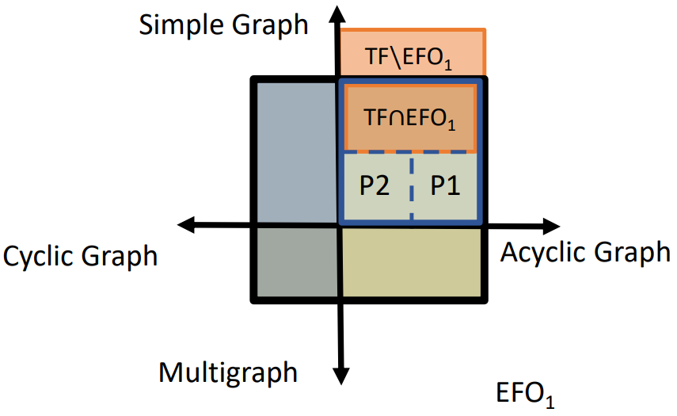
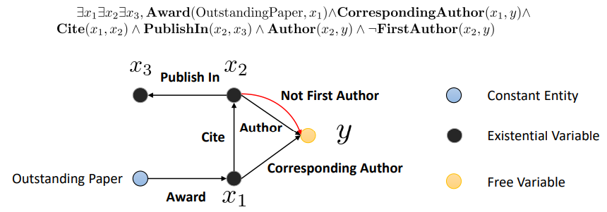
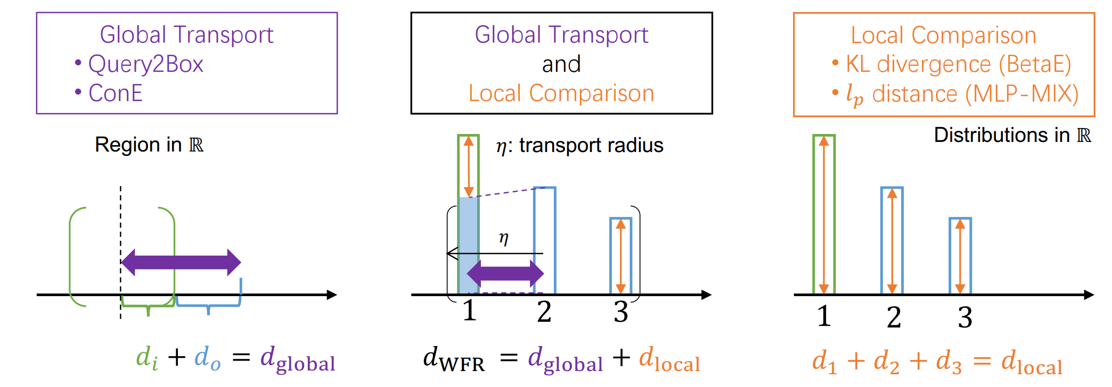
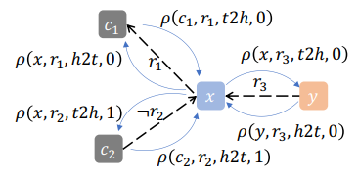
Other Works on CQA
Benchmarking EFO-1 (Existential First-Order Queries with Single Free Variable)
EFO-1 queries with cycles
EFO-K more than one variables
NeurIPS’21
ICLR’24
Arxiv’23
Data
Models
Query encoder with OT
Learning in the inference step as a GNN (one-hop logical inference based MPNN)
Sequence encoder of queries
ACL Findings’23
ICLR’23
TMLR’23
Jiaxin Bai*, Tianshi Zheng*, Yangqiu Song. Sequential Query Encoding For Complex Query Answering on Knowledge Graphs. Transactions of Machine Learning Research. 2023
Zihao Wang, Yangqiu Song, Ginny Y. Wong, and Simon See. Logical Message Passing Networks with One-hop Inference on Atomic Formulas. In The Eleventh International Conference on Learning Representations, ICLR 2023
Zihao Wang, Weizhi Fei, Hang Yin, Yangqiu Song, Ginny Y Wong, and Simon See . Wasserstein-Fisher-Rao Embedding: Logical Query Embeddings with Local Comparison and Global Transport In Findings of ACL 2023
Hang Yin, Zihao Wang, and Yangqiu Song. EFO_k-CQA: Towards Knowledge Graph Complex Query Answering beyond Set Operation. Arxiv 2023
Hang Yin, Zihao Wang, and Yangqiu Song. Rethinking Existential First Order Queries and their Inference on Knowledge Graphs. Arxiv 2023
Zihao Wang, Hang Yin, and Yangqiu Song. Benchmarking the Combinatorial Generalizability of Complex Query Answering on Knowledge Graphs. In NeurIPS Datasets and Benchmarks Track, 2021

Slide 53
Thank you for your attention ☺

