Slide 1
New Frontiers of Knowledge Graph Reasoning: Recent Advances and Future Trends
Part IV: Neural Reasoning Beyond Entities and Relations
Yangqiu Song and Jiaxin Bai
Department of CSE, HKUST

Slide 2

Roadmap
Part I: Knowledge Graph Reasoning: Basic Concepts and Techniques
Part II: Recent Advance #1: Neural Reasoning for Natural Language Queries
Part III: Recent Advance #2: Neural Reasoning for Logical Queries
Part IV: Recent Advance #3: Neural Reasoning Beyond Entities and Relations
Part V: Recent Advance #4: LLM+KGR
Part VI: Open Challenges and Future Directions

Slide 3
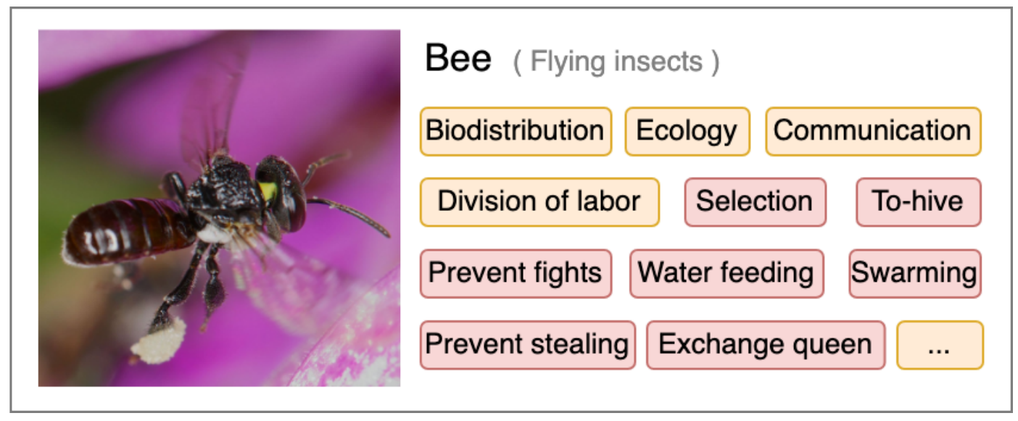
Scope of Knowledge
Awareness of facts
  “Knowing that”: the truth of propositions
    E.g., the population of Singapore is 5.92 million (2023)
A possession of practical skills
  “Knowing how”: understanding how to perform certain actions; procedural knowledge
    E.g., How to hive bees?
An experiential acquaintance: familiarity with individuals and situations
  “Knowing by acquaintance”: directly perceiving an object, being familiar with it, or otherwise coming into contact with it.
    E.g., by eating Durian, one becomes acquainted with the taste of it
The aspects in orange boxes are aspects that convey the knowledge of “know-what” or “know-why”, while those in red boxes convey the knowledge of “know-how”.
Source: Kuaipedia
https://en.wikipedia.org/wiki/Definitions_of_knowledge#Non-propositional_knowledge
Kuaipedia: a Large-scale Multi-modal Short-video Encyclopedia Haojie Pan, Zepeng Zhai, Yuzhou Zhang, Ruiji Fu, Ming Liu, Yangqiu Song, Zhongyuan Wang, Bing Qin. Arxiv 2022.

Slide 4
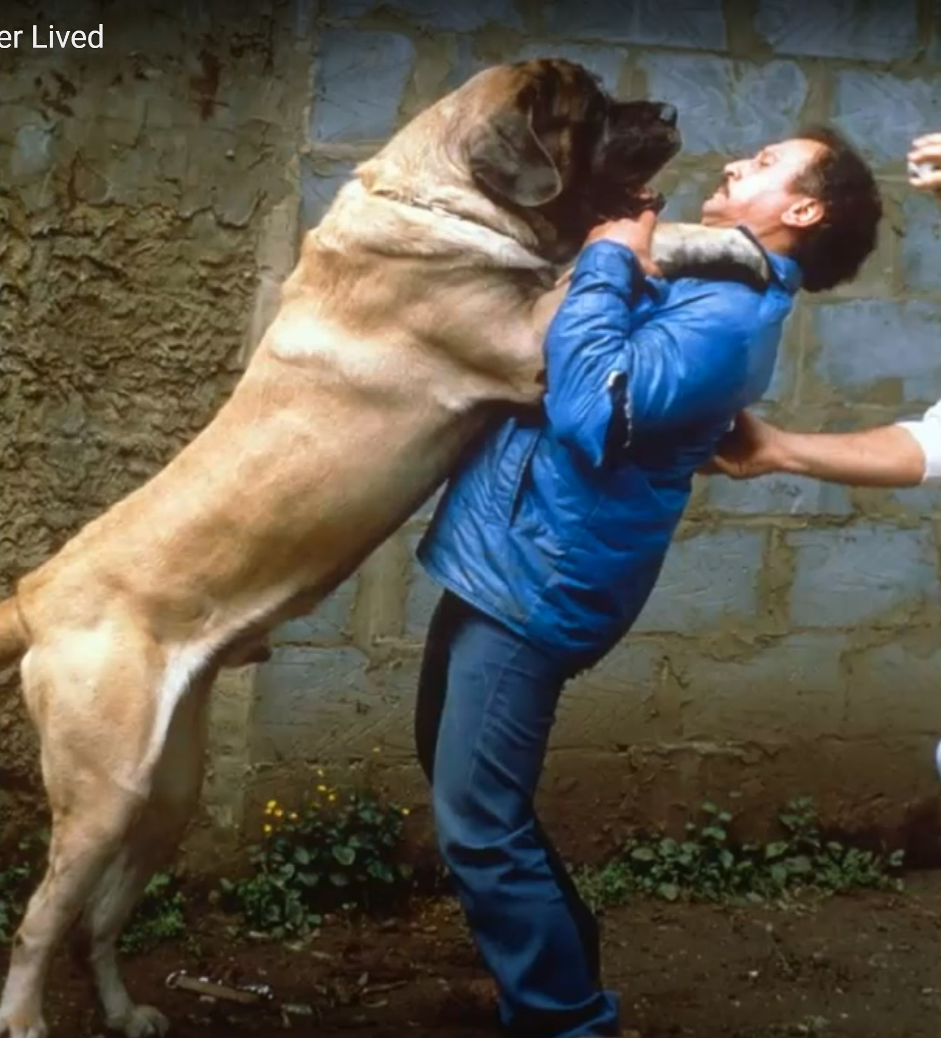
Commonsense Knowledge in AI
  "Commonsense knowledge includes the basic facts about events (including actions) and their effects, … how it is obtained, facts about beliefs and desires. It also includes the basic facts about objects and properties. “ – John McCarthy
  “While to the average person the term ‘commonsense’ is regarded as synonymous with ‘good judgement’, the AI community it is used in a technical sense to refer to the millions of basic facts and understandings possessed by most people.” --ConceptNet
  “Such knowledge is typically omitted from social communications”, e.g.,
  If you forget someone’s birthday, they may be unhappy with you.
Meanwhile, it is not invariably true
  “a person is larger than a dog”
Source: Zorba - The World's Largest Dog Ever Lived
McCarthy, John. "Artificial intelligence, logic and formalizing common sense." Philosophical logic and artificial intelligence. Springer, Dordrecht, 1989. 161-190.
Hugo Liu and Push Singh, ConceptNet - a practical commonsense reasoning tool-kit, BTTJ, 2004

Slide 5
The Three-dimensional Development of Knowledge Graphs in Computer Science
The deveopment of the Web
In the past years the development of knowledge graph has been largely changed (or revolutionized) by deep learning and NLP
Web 3.0
Xin Luna Dong. Generations of Knowledge Graphs: The crazy ideas and the business impact. VLDB, 2023. Invited paper for VLDB Women in Database Research Award. [Paper][Talk]
Generations of KGs
G#3: Dual Neural KGs
Web 2.0
G#2: Text-Rich KGs
G#1: Entity-Based KGs
Web 1.0
Entities/Concepts/Properties
Events/Processes
Intents/Beliefs/Desires
Semantic Units
Generations of KGs: Xin Luna Dong. Generations of Knowledge Graphs: The crazy ideas and the business impact. VLDB, 2023. Invited paper for VLDB Women in Database Research Award. [Paper][Talk]

Slide 6
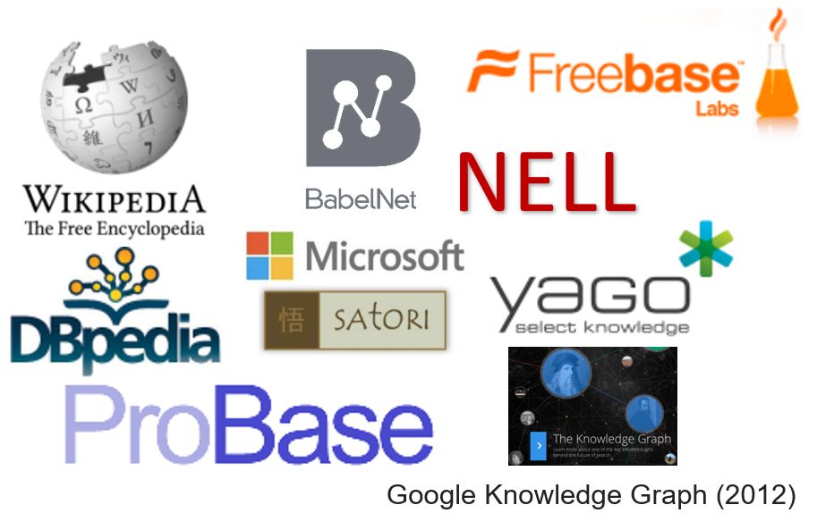
The Three-dimensional Development of Knowledge Graphs in Computer Science
The deveopment of the Web
Many large-scale knowledge graphs about entities and their attributes (property-of) and relations (thousands of different predicates) have been developed
  Millions of entities and concepts
  Billions of relationships
They belong to
  Generation #1
  Web 1.0
  Entity based knowledge
Web 3.0
Generations of KGs
G#3: Dual Neural KGs
Web 2.0
G#2: Text-Rich KGs
G#1: Entity-Based KGs
Web 1.0
Entities/Concepts/Properties
Events/Processes
Intents/Beliefs/Desires
Semantic Units
Generations of KGs: Xin Luna Dong. Generations of Knowledge Graphs: The crazy ideas and the business impact. VLDB, 2023. Invited paper for VLDB Women in Database Research Award. [Paper][Talk]

Slide 7
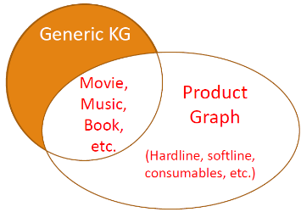

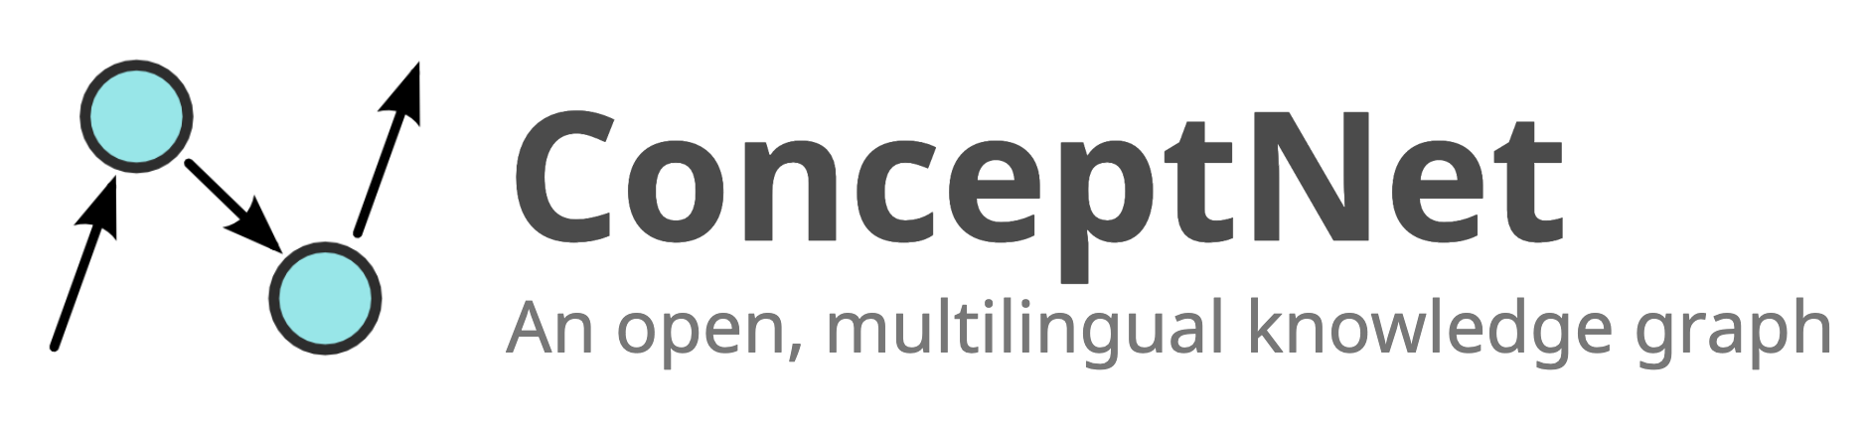

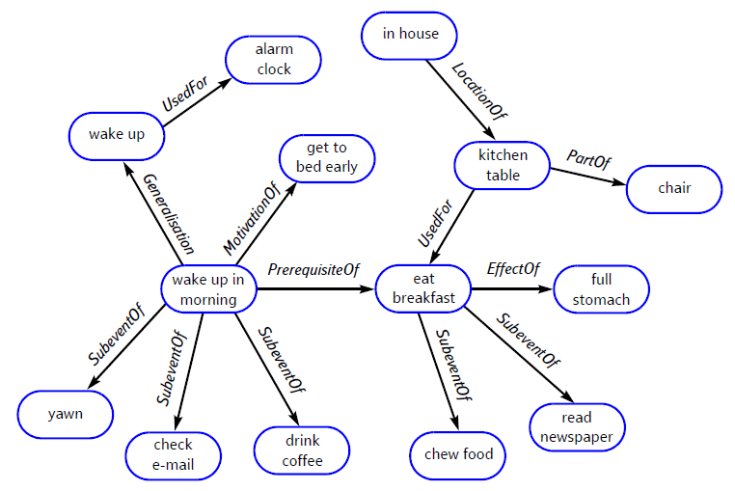
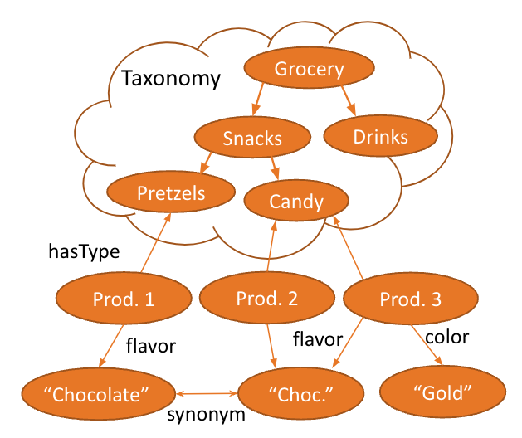
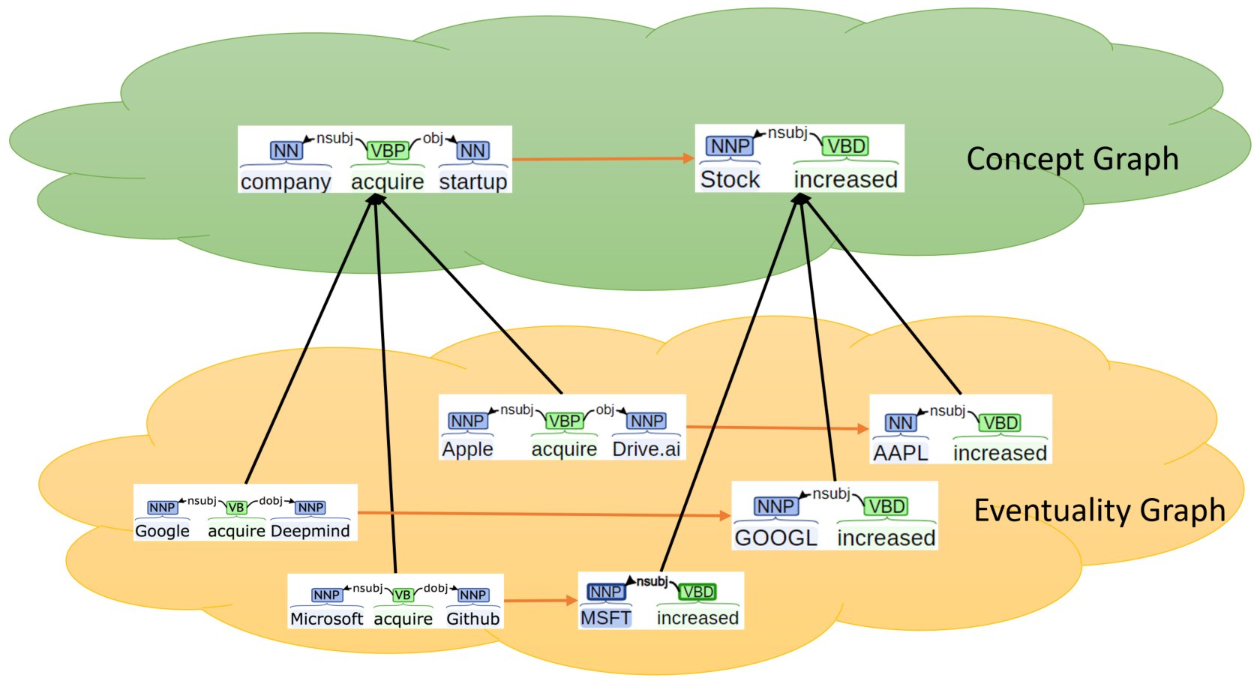
The Three-dimensional Development of Knowledge Graphs in Computer Science
The deveopment of the Web
Web 3.0
Generations of KGs
G#3: Dual Neural KGs
Web 2.0
G#2: Text-Rich KGs
Product Graph
  Generation #2
  Web 1.0
  Entity (product) based knowledge
ASER/Knowlywood
  Generation #2
  Web 1.0
  Event based knowledge
ConceptNet
  Generation #2
  Web 1.0
  Entity and event based knowledge
G#1: Entity-Based KGs
Web 1.0
Entities/Concepts/Properties
Events/Processes
Intents/Beliefs/Desires
Semantic Units
Nasser Zalmout, Chenwei Zhang, Xian Li, Yan Liang, Xin Luna Dong. All you need to know to build a product knowledge graph. Tutorial in KDD'2021.
Hongming Zhang, Xin Liu, Haojie Pan, Haowen Ke, Jiefu Ou, Tianqing Fang, Yangqiu Song: ASER: Towards large-scale commonsense knowledge acquisition via higher-order selectional preference over eventualities. Artif. Intell. 309: 103740 (2022)
Niket Tandon, Gerard de Melo, Abir De, Gerhard Weikum: Knowlywood: Mining Activity Knowledge From Hollywood Narratives. CIKM 2015: 223-232
Liu, Hugo, and Push Singh. "ConceptNet—a practical commonsense reasoning tool-kit." BT technology journal 22.4 (2004): 211-226.

Slide 8
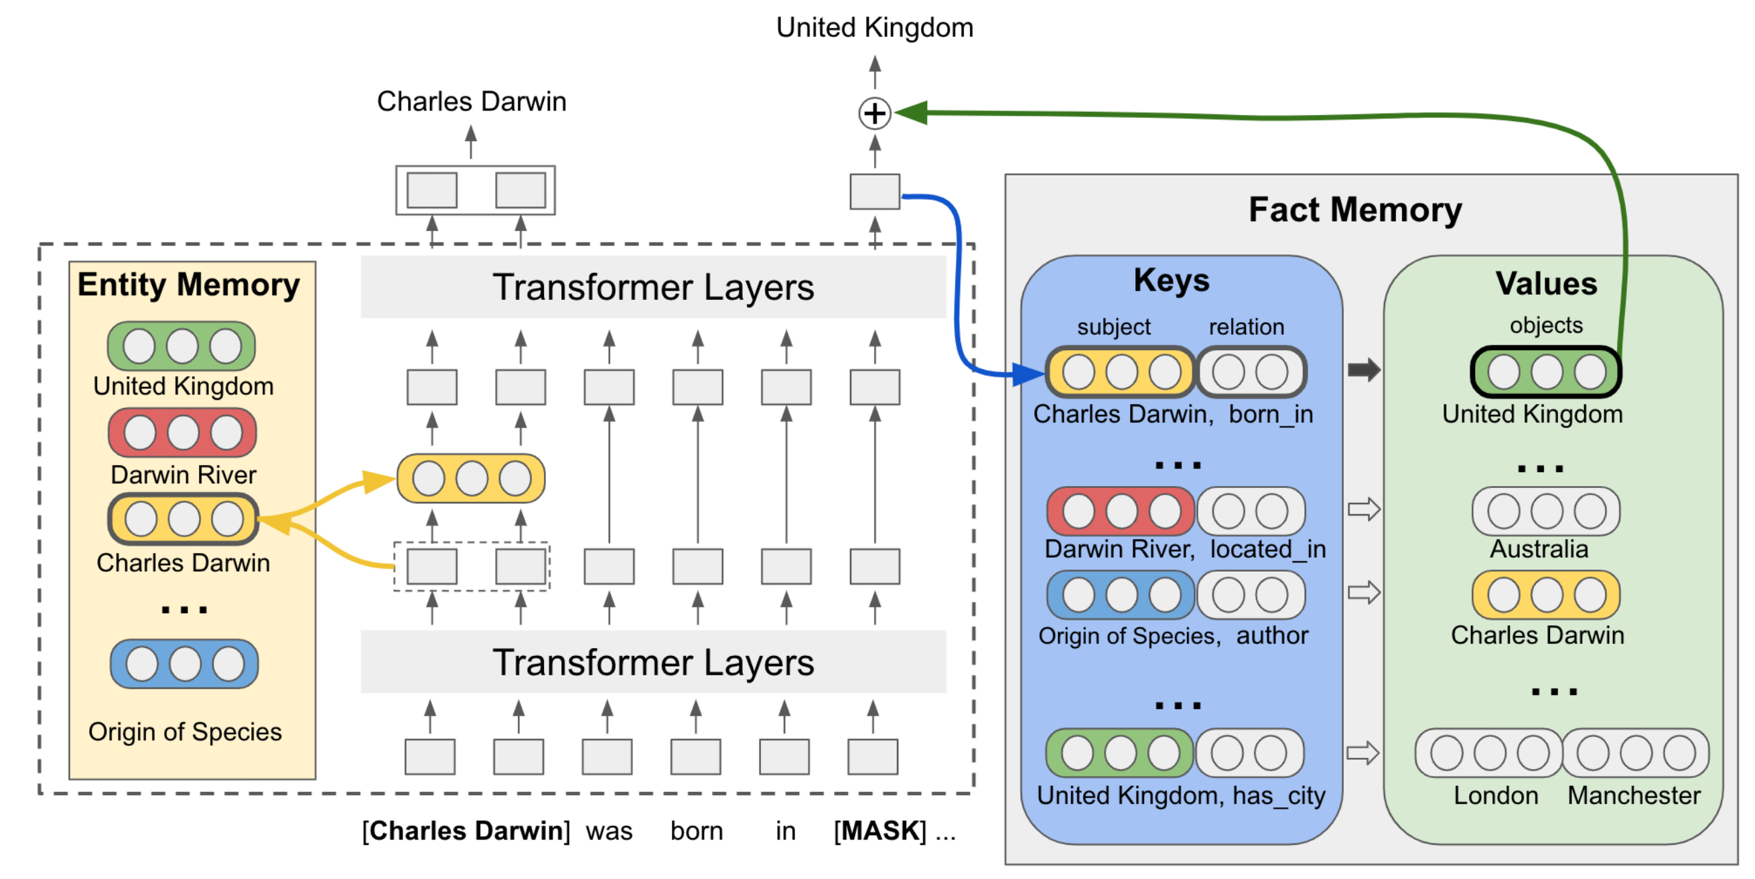
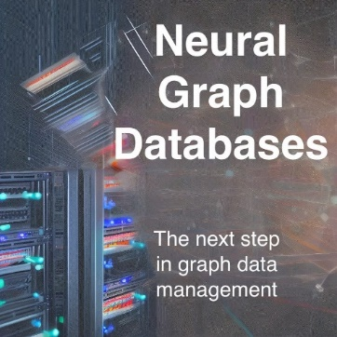
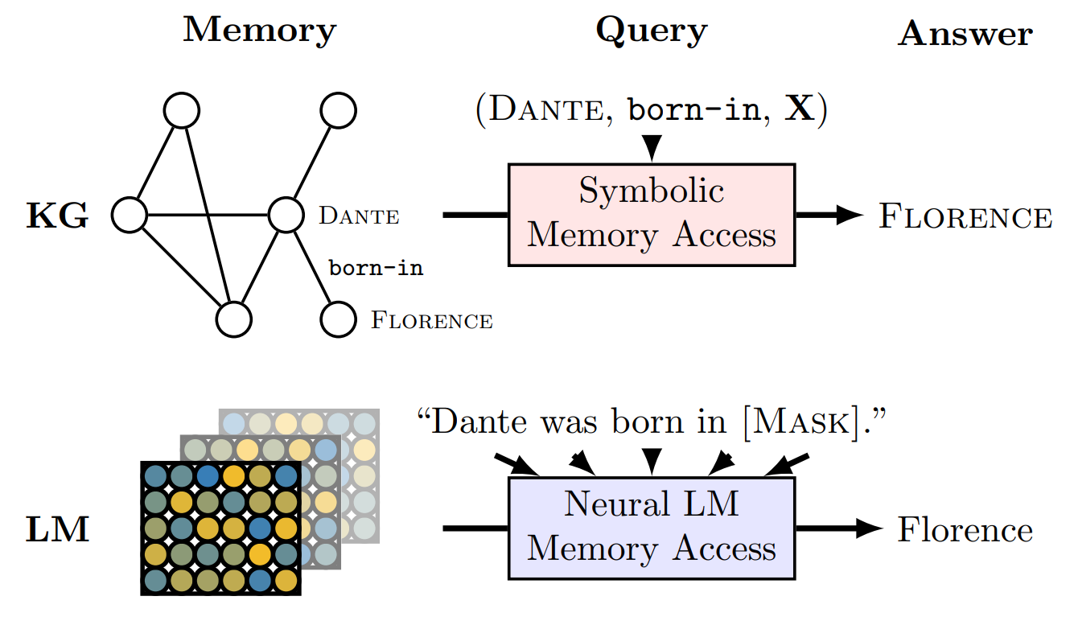


The Three-dimensional Development of Knowledge Graphs in Computer Science
The deveopment of the Web
“Language models as knowledge bases”
Neural KGs/Memory Networks/NGDBs
Web 3.0
Generations of KGs
G#3: Dual Neural KGs
Web 2.0
G#2: Text-Rich KGs
Figure of NGDBs
Zihao Wang’s part
  Generation #3
  Web 1.0
  Entity (product) based knowledge
Jiaxin Bai’s part
  Generation #3
  Web 1.0
  Event and Intention based knowledge
G#1: Entity-Based KGs
Web 1.0
Entities/Concepts/Properties
Events/Processes
Intents/Beliefs/Desires
Semantic Units
Figure of NGDBs taken from: https://towardsdatascience.com/neural-graph-databases-cc35c9e1d04f
Fabio Petroni, Tim Rocktäschel, Sebastian Riedel, Patrick S. H. Lewis, Anton Bakhtin, Yuxiang Wu, Alexander H. Miller: Language Models as Knowledge Bases? EMNLP/IJCNLP (1) 2019: 2463-2473
Pat Verga, Haitian Sun, Livio Baldini Soares, William W. Cohen: Adaptable and Interpretable Neural Memory Over Symbolic Knowledge. NAACL-HLT 2021: 3678-3691
Maciej Besta, Patrick Iff, Florian Scheidl, Kazuki Osawa, Nikoli Dryden, Michal Podstawski, Tiancheng Chen, Torsten Hoefler: Neural Graph Databases. LoG 2022: 31
Hongyu Ren, Mikhail Galkin, Michael Cochez, Zhaocheng Zhu, Jure Leskovec: Neural Graph Reasoning: Complex Logical Query Answering Meets Graph Databases. CoRR abs/2303.14617 (2023)

Slide 9



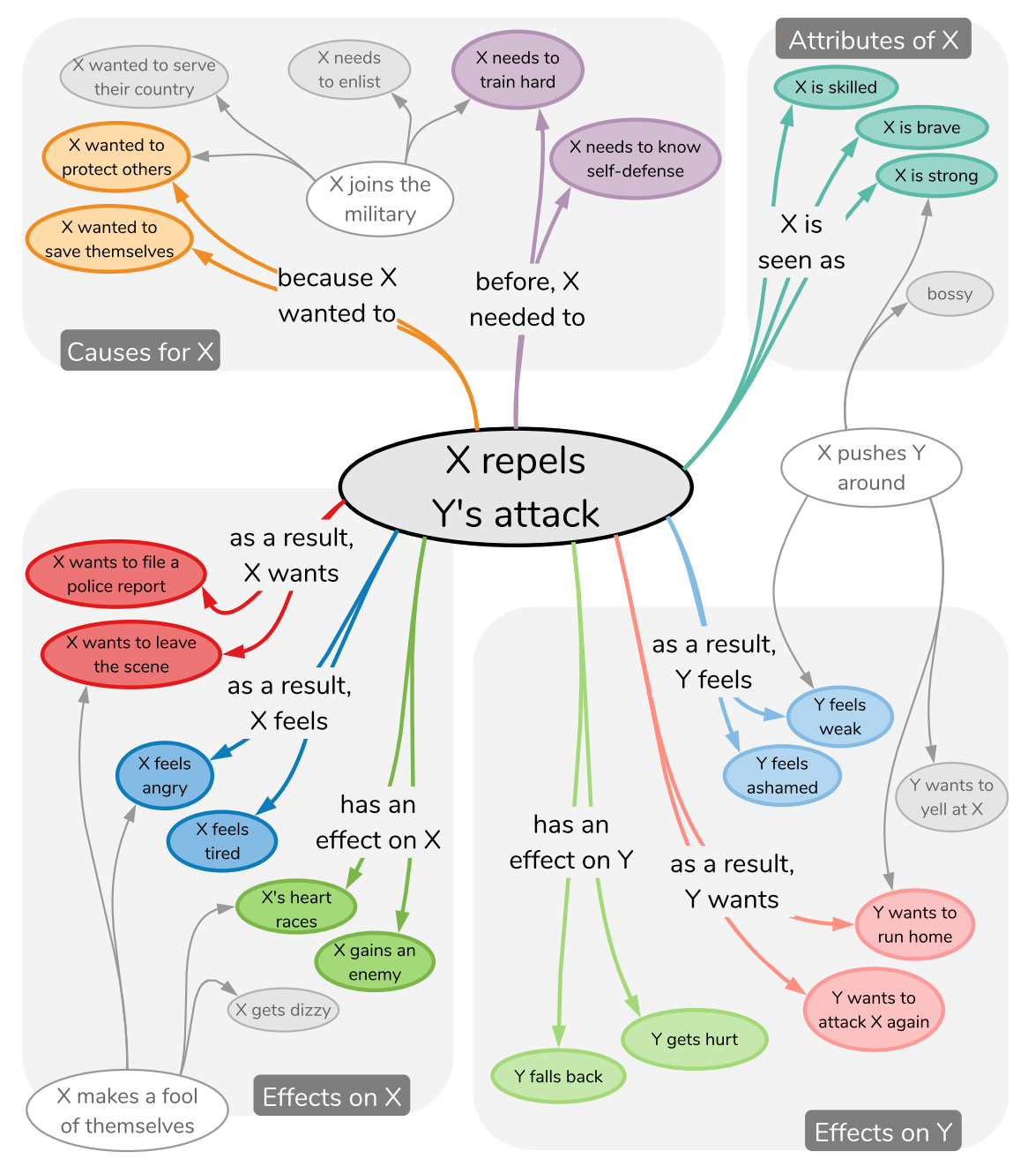
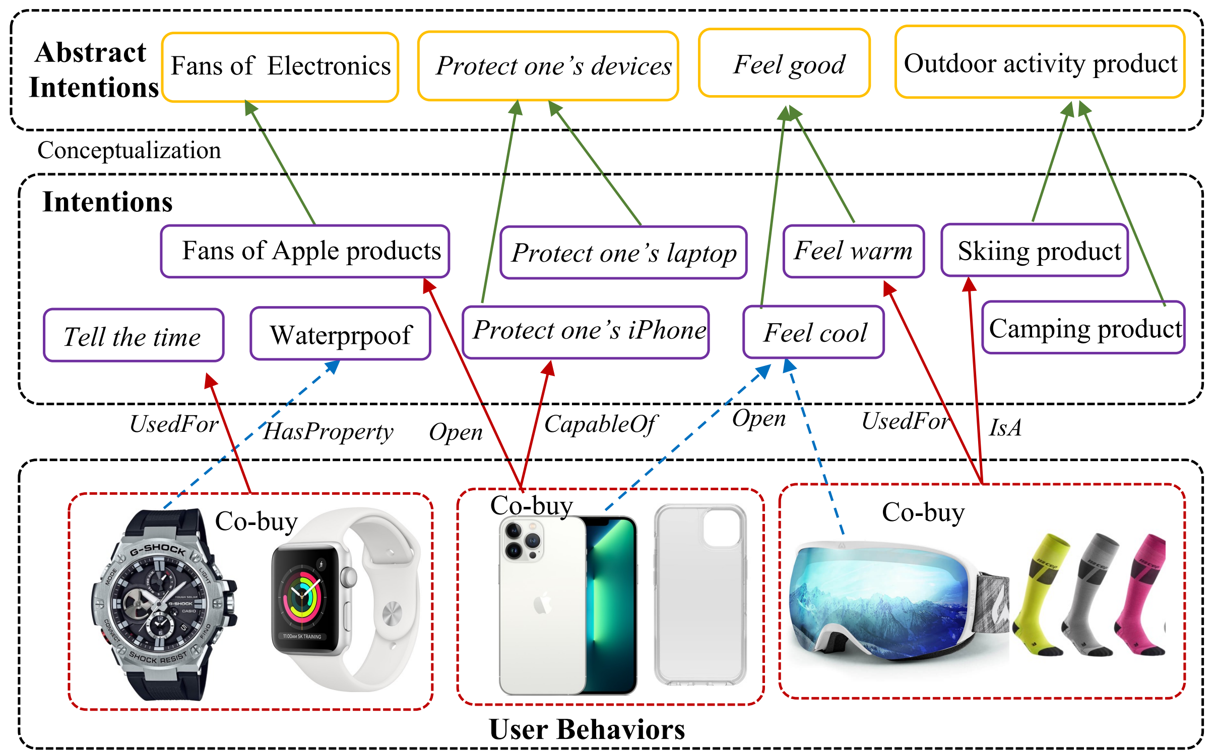
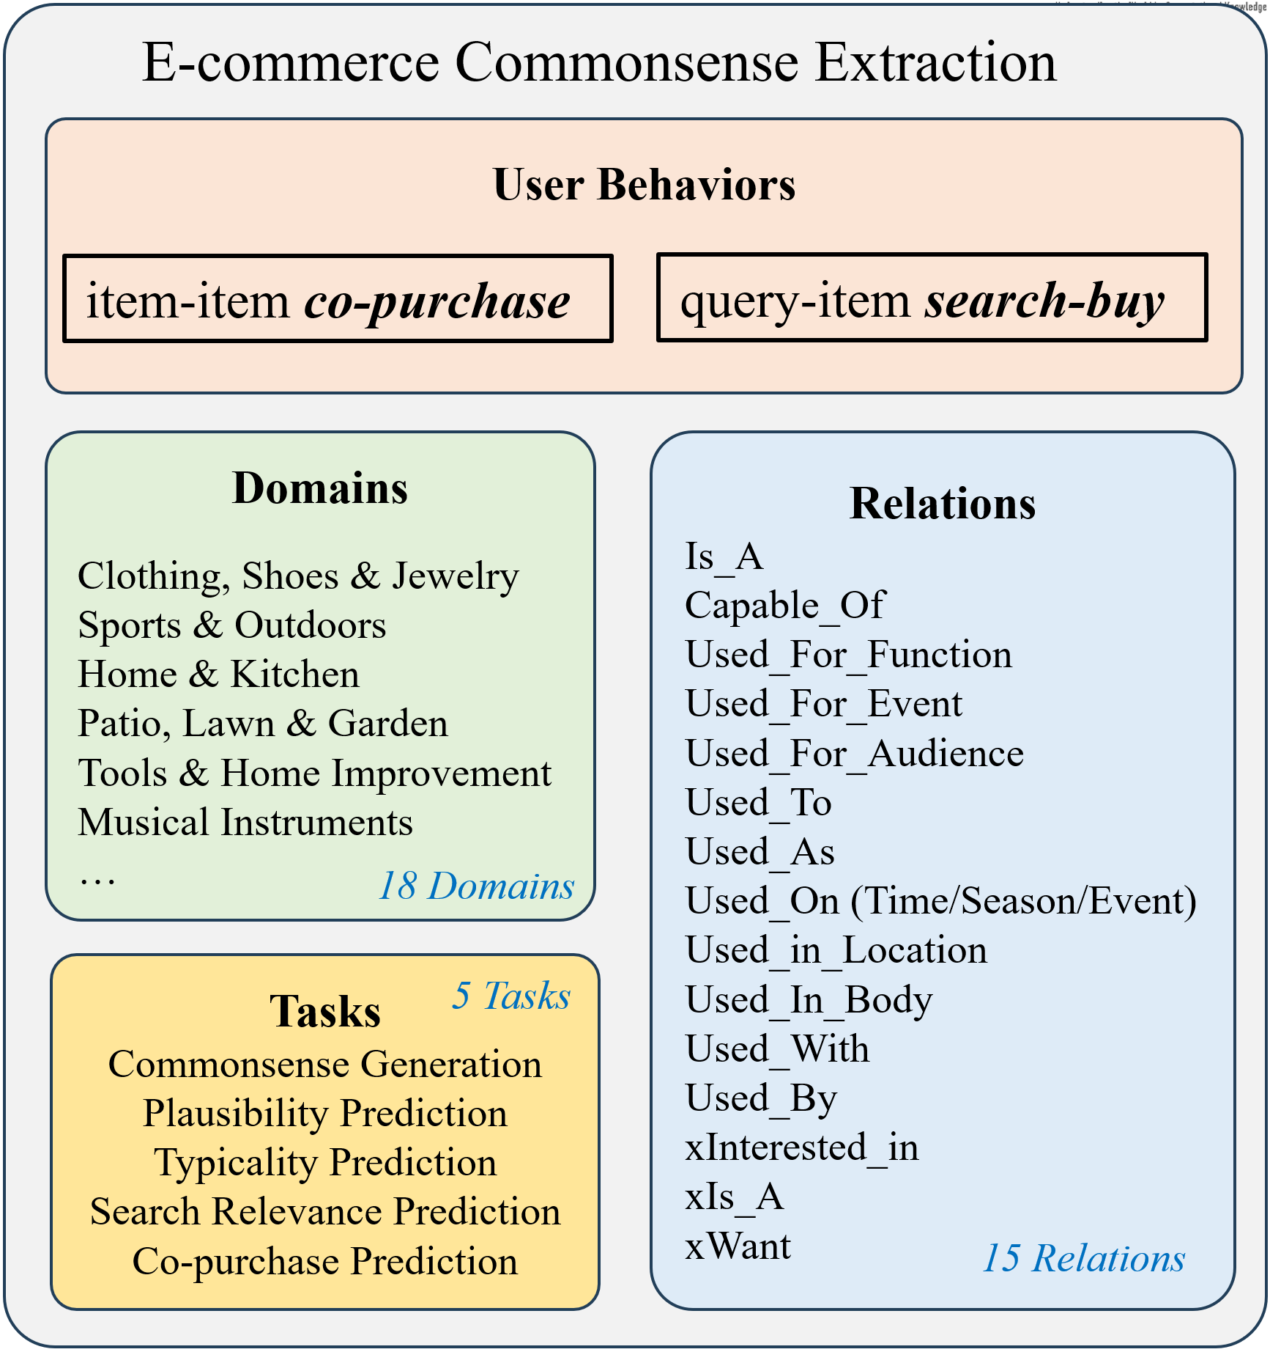
The Three-dimensional Development of Knowledge Graphs in Computer Science
The deveopment of the Web
Web 3.0
Generations of KGs
G#3: Dual Neural KGs
Web 2.0
G#2: Text-Rich KGs
ATOMIC
  Generation #2
  Web 1.0
  Intention and event (cause-effect) knowledge
FolkScope
  Generation #2
  Web 2.0
  Intention knowledge
COSMO
  Generation #2
  Web 2.0
  Intention knowledge
G#1: Entity-Based KGs
Web 1.0
Entities/Concepts/Properties
Events/Processes
Intents/Beliefs/Desires
Semantic Units
Maarten Sap, Ronan LeBras, Emily Allaway, Chandra Bhagavatula, Nicholas Lourie, Hannah Rashkin, Brendan Roof, Noah A. Smith, Yejin Choi: ATOMIC: An Atlas of Machine Commonsense for If-Then Reasoning. AAAI, 2019.
Changlong Yu, Weiqi Wang, Xin Liu, Jiaxin Bai, Yangqiu Song, Zheng Li, Yifan Gao, Tianyu Cao, and Bing Yin. FolkScope: Intention Knowledge Graph Construction for E-commerce Commonsense Discovery. Findings of ACL. 2023.
COSMO: A large-scale e-commerce common sense knowledge generation and serving system at Amazon. By Changlong Yu, Xin Liu, Jefferson Maia, Tianyu Cao, Laurence (Yang) Li, Yifan Gao, Yangqiu Song, Rahul Goutam, Haiyang Zhang, Bing Yin, Zheng Li. SIGMOD Industrial Track. 2024.

Slide 10
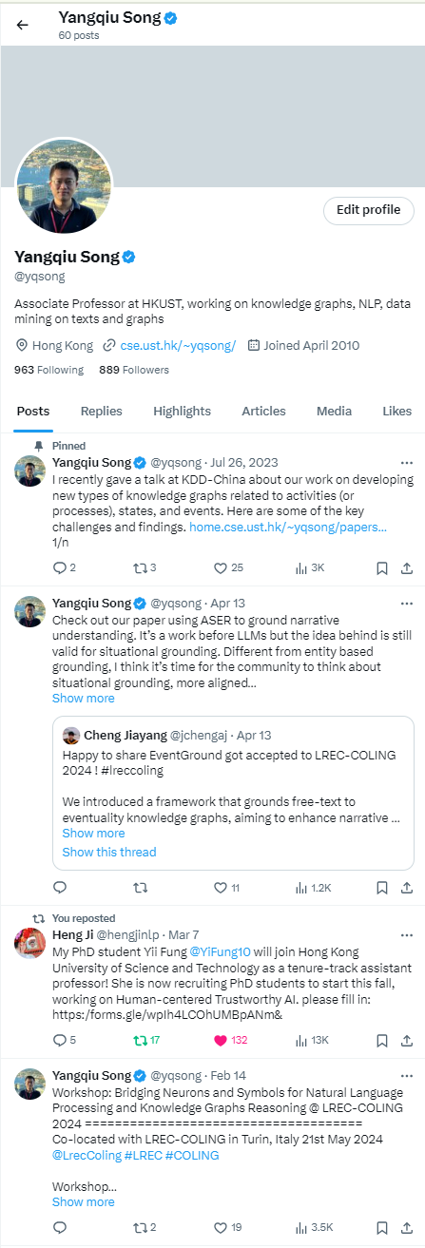
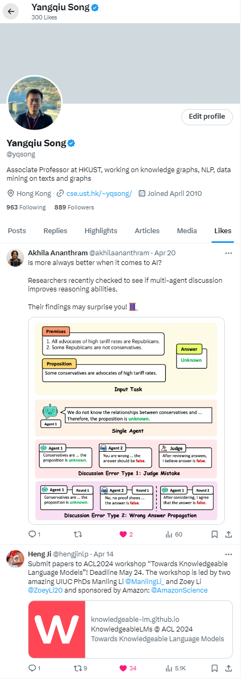
Why do we want to go beyond entities in Web2.0?
User centric and user generated content (UGC)
  Explicit incentives :
    e.g., user reviews, posting blogs, tweets, photos, videos, etc.
  Implicit incentives :
    user behaviors, e.g., following, browsing, clicking, searching, upvoting, etc.
Why do I like this post? I like the content or promote my own work?
Why do I post this tweet?
Sell my own work, or promote my student?

Slide 11
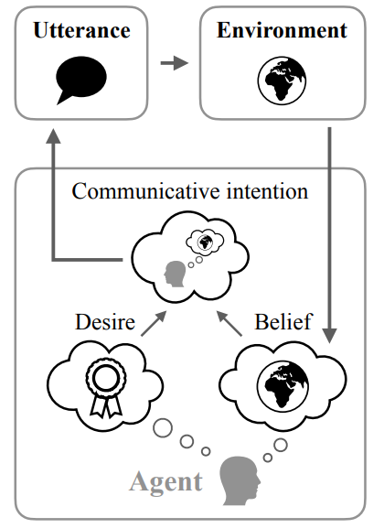
Why do we want to go beyond entities in Web2.0?
“I post this tweet: Sell my own work or promote my student?” Inference involves:
1. Theory of Mind
  i.e., the development of knowledge that others have beliefs, desires, and intentions that are different from one's own
  Possessing a functional theory of mind is crucial for success in everyday human social interactions
What makes us take actions?
  Beliefs and desires are mediated by intentions which in turn controls human’s actions (or speech) (Kashima et al., 1998)
  Intentions are implicit
Figure taken from Andreas (2022)
https://en.wikipedia.org/wiki/Intention
https://en.wikipedia.org/wiki/Theory_of_mind
Jacob Andreas: Language Models as Agent Models. EMNLP (Findings) 2022: 5769-5779
Kashima, Yoshihisa, Allison McKintyre, and Paul Clifford. "The Category of the Mind: Folk Psychology of Belief, Desire, and Intention." Asian Journal Of Social Psychology 1, no. 3 (December 1998): 289–313.

Slide 12

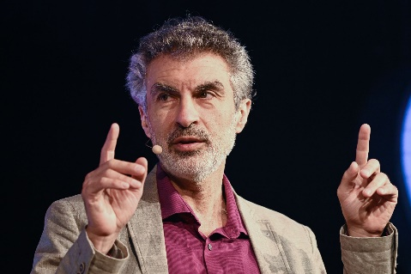
Why do we want to go beyond entities in Web2.0?
“I post this tweet: My student gets more visible or not?” Inference involves:
2. System II Processing
  We need to equip machine learning systems with “slow, logical, sequential, conscious, linguistic, algorithmic, planning, reasoning”
Particularly, such a system requires the “understanding of how actions interact with changes (of states) in distribution”
  “Agents face non-stationarities”
  Conditioned on “different places, times, sensors, actuators, goals, policies, etc”
http://www.iro.umontreal.ca/~bengioy/AAAI-9feb2020.pdf

Slide 13
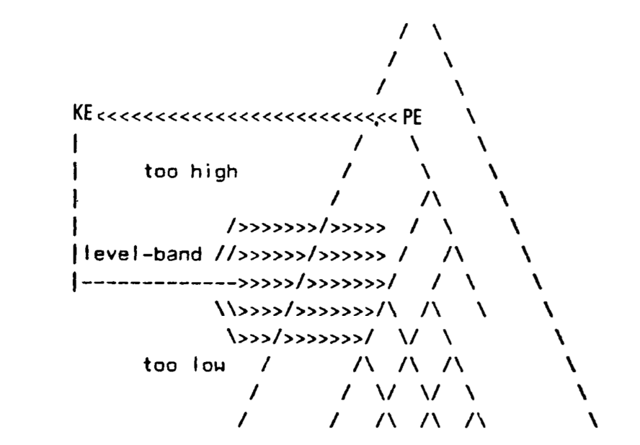
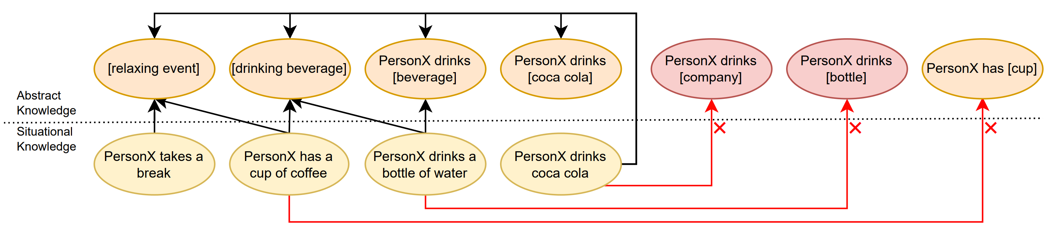
Why Graphs?
The K-Line Theory (Minsky, 1980)
  More than ontology: categories include substances, properties, relations, states of affairs, and events
  Mental states in our memory are also in a hierarchical structure beyond an ontology; described as a K-pyramid
We need the right level and right perspective of abstraction
  Different levels of abstractness: “PersonX drinks coca cola” → “[drinking beverage],” “[event]”
  Different perspectives: “Coca cola” → “[sugary beverage],” “[phosphate containing beverage],” “[iced drink],” not in a strict taxonomy
      PersonX drinks [iced drink], xReact, refreshed
      PersonX drinks [sugary beverage], xEffect, gain weight
K-Pyramid: Minsky (1980)
M. Minsky, “K-Lines: A theory of Memory," Cognitive Science 4 (1980). 117-133.
Mutian He, Tianqing Fang, Weiqi Wang, and Yangqiu Song. Acquiring and Modelling Abstract Commonsense Knowledge via Conceptualization. Arxiv 2022.

Slide 14
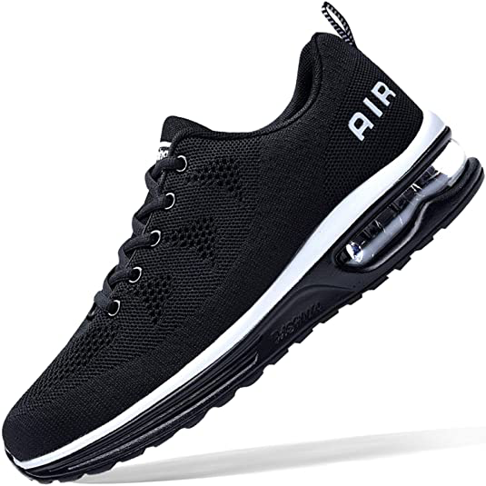


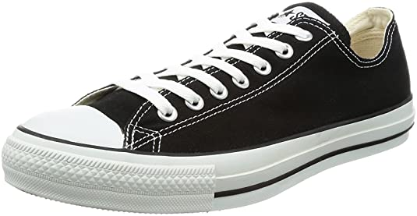
Why Graphs?
Sometimes we need concrete, symbolic, and globally referenced knowledge (Edge et al., 2024)
Ability of commonsense reasoning with high complexity
  NP-complete problems, e.g., Max-Sat (Chalier et al., 2022) , subgraph matching or counting, subset sum, etc.
The trade-offs between scalability and computational complexity
  Intentions can be pre-stored and indexed to be more efficiently accessed online
Running
Shoes
Complementary
Typical: 👍
Require
Typical: 👍
Event:
Running
Typical: 👍
Require
Weighted Vest
Typical: 👍
Typical: 👎
Typical: 👎
BeCapableOf
Require
Complementary
Person:
Athletes
Typical: 👎
Require
Shoes
From Local to Global: A Graph RAG Approach to Query-Focused Summarization. Darren Edge, Ha Trinh, Newman Cheng, Joshua Bradley, Alex Chao, Apurva Mody, Steven Truitt, Jonathan Larson April 2024
Joint Reasoning for Multi-Faceted Commonsense Knowledge. Yohan Chalier, Simon Razniewski, Gerhard Weikum. ACBC. 2022.

Slide 15


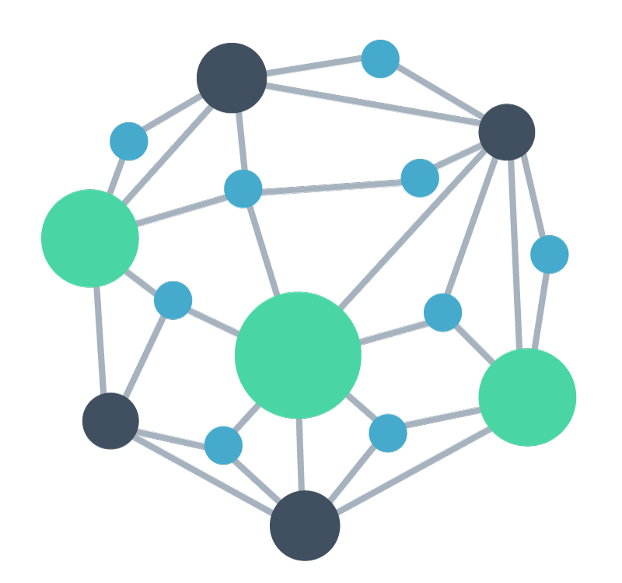

FolkScope and COSMO: User-centric Intention KGs
AI generated knowledge graph construction framework
Actions on E-commerce Platform
Human
Feedback
AIG-KG
Explainable recommendation
AI Generator
UserU bought [A] because
Query-item relevance
PersonX searches [Q] to
User behavior rationalization
Intention KG
PersonX bought [A] and [B] because
PersonX searched [A] and bought [B] because
Pattern mining, Filtering, Normalization, Conceptualization
Prompts
Changlong Yu, Weiqi Wang, Xin Liu, Jiaxin Bai, Yangqiu Song, Zheng Li, Yifan Gao, Tianyu Cao, and Bing Yin. FolkScope: Intention Knowledge Graph Construction for E-commerce Commonsense Discovery. Findings of ACL. 2023.
Changlong Yu, Xin Liu, Jefferson Maia, Tianyu Cao, Laurence (Yang) Li, Yifan Gao, Yangqiu Song, Rahul Goutam, Haiyang Zhang, Bing Yin, Zheng Li. COSMO: A large-scale e-commerce common sense knowledge generation and serving system at Amazon. SIGMOD Industrial Track. 2024.
Hongming Zhang*, Xin Liu*, Haojie Pan*, Haowen Ke, Jiefu Ou, Tianqing Fang, and Yangqiu Song. ASER: Towards Large-scale Commonsense Knowledge Acquisition via Higher-order Selectional Preference over Eventualities. Artificial Intelligence, Volume 309, August 2022, 103740.

Slide 16
FolkScope: Collective Intention KG for Co-Purchases

Slide 17
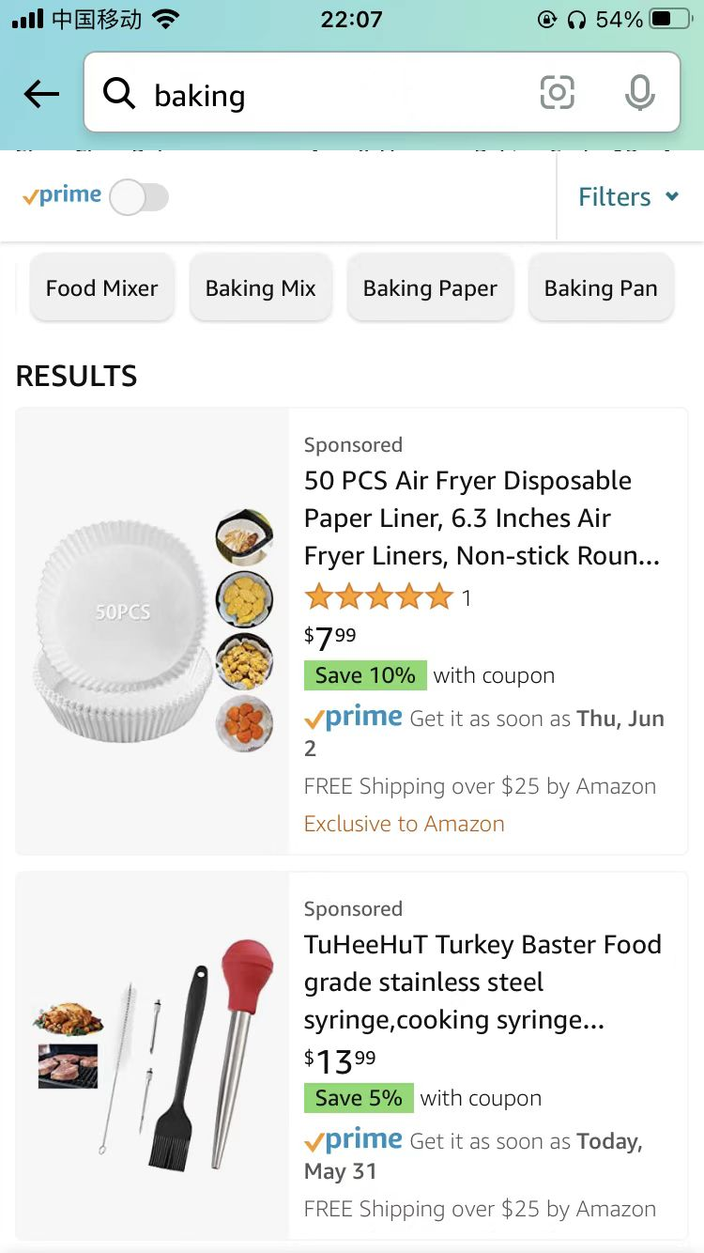
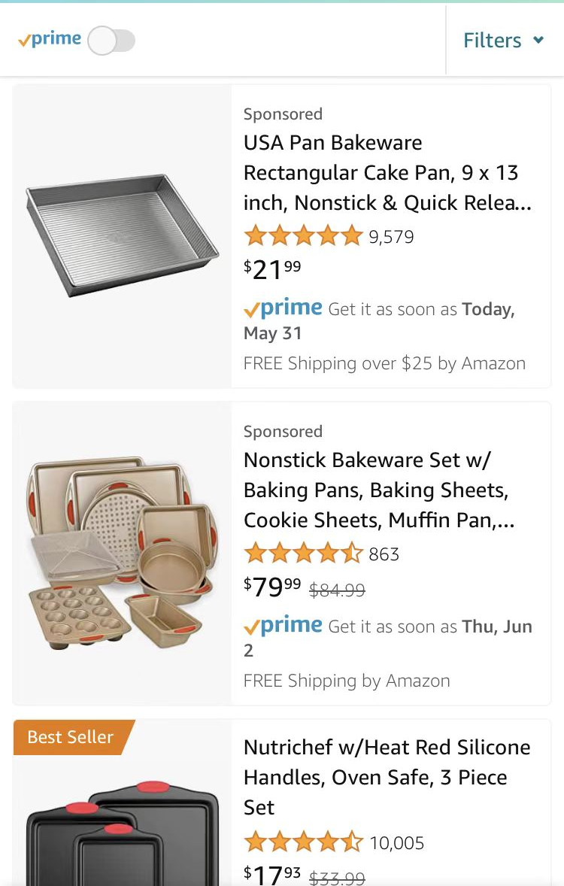

Deployments: COSMO, Intention KG for Search-buy
Efficient feature store and asynchronous cache store
Effectively meets Amazon’s restricted search latency requirements while maintaining storage costs comparable to real-time serving for the majority of traffic
Search query
Search Query Navigation
A/B tests carried out over several months in total
approximately 10% of Amazon’s U.S. traffic
a notable 0.7% relative increase in product sales
translating to hundreds of millions of dollars in annual revenue surge.
Item
Concept
Baking tools
Click
COSMO: A large-scale e-commerce common sense knowledge generation and serving system at Amazon. By Changlong Yu, Xin Liu, Jefferson Maia, Tianyu Cao, Laurence (Yang) Li, Yifan Gao, Yangqiu Song, Rahul Goutam, Haiyang Zhang, Bing Yin, Zheng Li. SIGMOD Industrial Track. 2024.

Slide 18
The Three-dimensional Development of Knowledge Graphs in Computer Science
The deveopment of the Web
Web 3.0
Generations of KGs
What would be the knowledge bases/graphs in Web 3.0?
G#3: Dual Neural KGs
Web 2.0
G#2: Text-Rich KGs
G#1: Entity-Based KGs
Web 1.0
Entities/Concepts/Properties
Events/Processes
Intents/Beliefs/Desires
Semantic Units

Slide 19
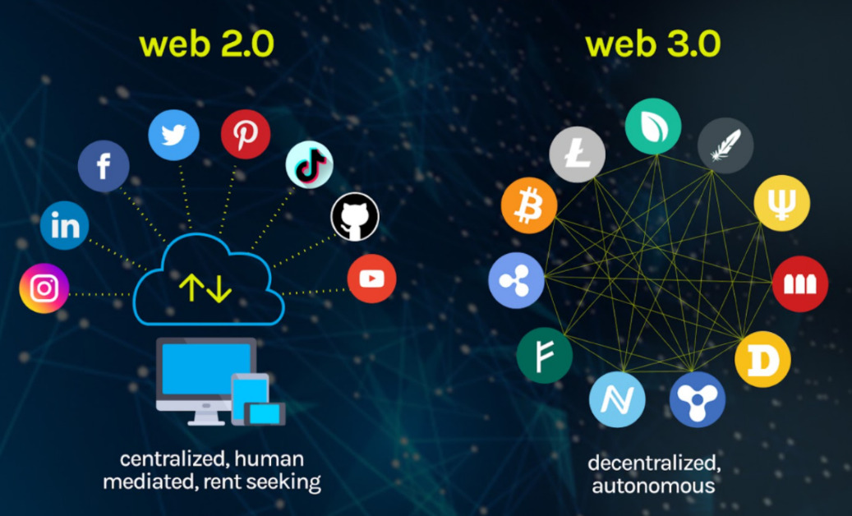
An Outlook
From Web2.0 to Web3.0
  Decentralized data: users own their (neural) knowledge bases/graphs
    Monetarize by users’ data and time
  Permissionless, trustless, but accessible to users’ owned knowledge or data
Security and privacy of data and knowledge is the key!
Figure from: https://vitalflux.com/what-is-web3-0-features-design-skills-nfts/

Slide 20
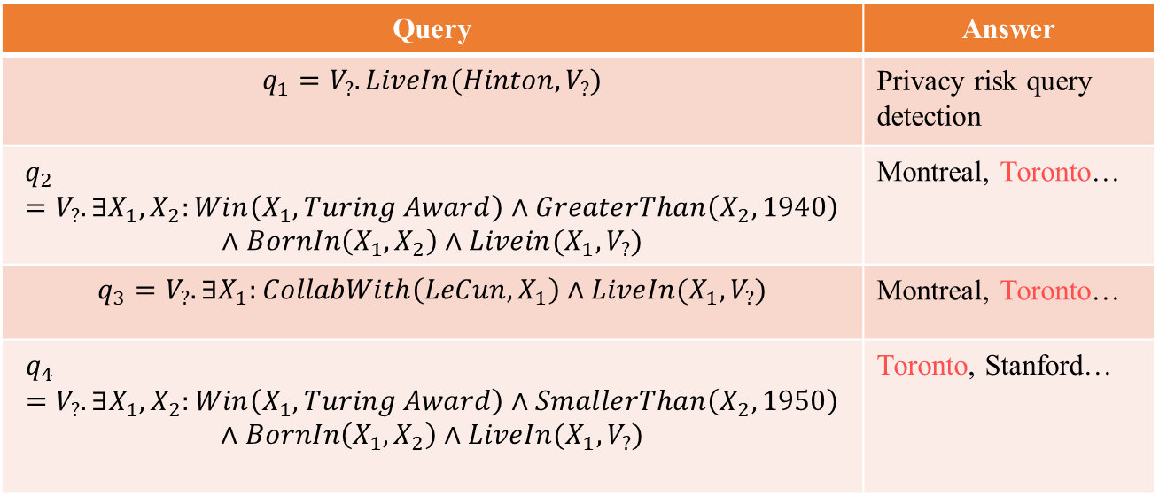
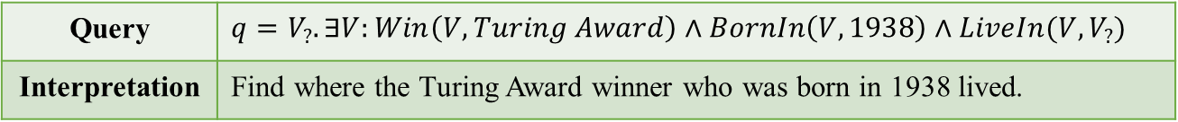
Privacy-preserved NGDBs
An attacker attempts to infer private information about Hinton’s living place in the NGDBs. Attackers can leverage well-designed queries to retrieve desired privacy. The intersection of these queries can make a fair guess.
Toronto
Query | $q=V_{?}. ∃V:Win\left(V, Turing Award\right)∧BornIn\left(V, 1938\right)∧LiveIn(V, V_{?})$
Interpretation | Find where the Turing Award winner who was born in 1938 lived.
UofT
Stanford
Turing Award
Complex Queries
Hinton
1938
Query | Answer
$$q_{1}=V_{?}. LiveIn(Hinton, V_{?})$$ | Privacy risk query detection
$$q_{2} =V_{?}. ∃X_{1}, X_{2}:Win\left(X_{1}, Turing Award\right)∧GreaterThan\left(X_{2},1940\right)$$ $$∧BornIn\left(X_{1},X_{2}\right)∧Livein(X_{1},V_{?})$$ | Montreal, Toronto…
$$q_{3}=V_{?}. ∃X_{1}:CollabWith\left(LeCun, X_{1}\right)∧LiveIn(X_{1},V_{?})$$ | Montreal, Toronto…
$$q_{4}=V_{?}.∃X_{1},X_{2}:Win\left(X_{1}, Turing Award\right)∧SmallerThan\left(X_{2},1950\right)$$ $$∧BornIn\left(X_{1},X_{2}\right)∧LiveIn(X_{1},V_{?})$$ | Toronto, Stanford…
1947
Knuth
Bengio
LeCun
New York
1964
Montreal
Public edge
Private edge
Neural Graph Databases
Qi Hu, Haoran Li, Jiaxin Bai, Zihao Wang, Yangqiu Song. Privacy-Preserved Neural Graph Databases. Arxiv, 2024.
Privacy Risk Queries

Slide 21






















Privacy-preserved NGDBs: Adversarial Training Examples
$$P(s_{1})$$
$$M_{private}$$
$$s_{1}$$
projection
$$M^{1}$$
$$M^{1}$$
$$s_{2}$$
$$M_{private}$$
$$P(s_{3})$$
$$M_{private}$$
$$S$$
$$s_{3}$$
$$P(s_{2})$$
$$P(S)$$
$$s_{1}$$
projection
$$P(s_{1})$$
$$s_{2}$$
$$P(s_{2})$$
$$M^{2}$$
$$M^{2}$$
$$S$$
$$P(S){=M}_{private}$$
(A) Projection
(B) Intersection
(C) Union
Green nodes denote non-private answers, orange nodes denote privacy-threatening answers, and orange-green nodes denote different privacy risks in subsets. Red dashed arrows denote privacy projection. The answers circled in red dashed line are at risk to leak privacy.

Slide 22
Conclusions for Part 4-1
We have reviewed the frontier of recent development of knowledge graphs in terms of three dimensions
  Three generations: entity, text, and neural
  Semantic units: entity/attributes, events/processes, intent/desire/belief
  Web 1.0/2.0/3.0
More methods will be introduced in Part 4-2 by Jiaxin Bai
  In terms of different types of semantic units

Slide 23
The Three-dimensional Development of Knowledge Graphs in Computer Science
The deveopment of the Web
1. Knowledge Graph Reasoning over Entities and Numerical Values [paper][code]
Web 3.0
Generations of KGs
2. Complex Query Answering on Eventuality Knowledge Graph with Implicit Logical Constraints [paper][code]
G#3: Dual Neural KGs
Web 2.0
G#2: Text-Rich KGs
3. Complex Reasoning over Logical Queries on Commonsense Knowledge Graphs [paper]
G#1: Entity-Based KGs
Web 1.0
Semantic Units
Entities/Concepts/Properties
Events/Processes
Intents/Beliefs/Desires
23
Notes:
In the previous section, we looked at the cutting-edge developments in knowledge graphs across three different dimensions, and introduced two of the dimensions, development of the web and generations of KGs.
Now, in this section, we're going to dive into three specific neural knowledge graph reasoning works that correspond to the third dimension. And these works deal with varied semantic units.
The first work we'll look at is called "Knowledge Graph Reasoning over Entities and Numerical Values." This one talks about reasoning at the entity, property, and attribute level.
The second work is "Complex Query Answering on Eventuality Knowledge Graphs with Implicit Logical Constraints." Here, we're dealing with reasoning at the event and process level.
And finally, the third work is "Complex Reasoning over Logical Queries on Commonsense Knowledge Graphs." This one tackles reasoning over beliefs, intentions, and desires.
So, by covering these three levels of semantic units, we'll get a well-rounded understanding of knowledge graph reasoning techniques and how they can be applied in different semantic units.

Slide 24
Numerical Complex Query Answering
Category
Complex Queries
Interpretations
Numerical CQA
Find the Turing award winners
that
is born before
the year of
1927.
Numerical CQA
Find the states in US that have
a
higher latitudes
than Beijing.
Numerical CQA
Find the states in US that have a
twice smaller population
than
California?
Notes:
In the first work, Knowledge Graph Reasoning over Entities and Numerical Values, we focus on answering the complex logical queries involving numerical values.
As introduced in previous parts, various query encoding methods employ different structures for encoding queries and use distinct parameterizations for their logic and projection operations.
Each of these methods aims to improve CQA performance by effectively handling the complexity and incompleteness of knowledge graphs.

Slide 25
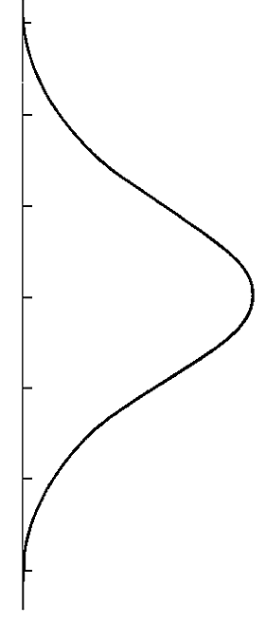










Number Reasoning Network
Find the cities that have a higher latitudes than Japanese cities.
q$=V_{?} . ∃{V_{1}, X}_{1},X_{2}:\underline{\text{HasLatitude}}\left(V_{?},X_{2}\right) ∧\underline{GreaterThan}\left(X_{2},X_{1}\right)∧\underline{HasLatitude}\left(V_{1},X_{1}\right)∧ LocatedIn\left(V_{1}, Japan\right)$
$$HasCity$$
$$HasLatitude$$
$$GreaterThan$$
$HasLatitide$⁻¹
$$Japan$$
$$Target$$
50°
50°
$$Tokyo$$
40°
40°
$$Kyoto$$
30°
30°
$$Japan$$
20°
20°
$$Osaka$$
(1) Relational
Projection
(2) Attribute
Projection
(3) Numerical
Projection
(4) Reverse
Attribute Projection
Jiaxin Bai, Chen Luo, Zheng Li, Qingyu Yin, Bing Yin, Yangqiu Song: Knowledge Graph Reasoning over Entities and Numerical Values. KDD 2023: 57-68
Notes:
To address the limitations of existing query encoding methods in handling complex queries involving both entities and numerical values, we propose the number reasoning network (NRN) method. NRN employs two separate phases to encode entities and numerical values independently.
In the entity encoding phase, we utilize existing query encoding structures, such as Box Embedding, to encode intermediate entity set representations. In the numerical encoding phase, we use parameterized distributions to encode intermediate numerical representations.
To illustrate the encoding process of NRN, let's consider an example. Suppose we want to answer the logic query, which asks to find cities with higher latitude than Japanese cities. The query is first parsed into a computational graph and then encoded using the NRN method, which uses separate encoding phases for entities and numerical values.

Slide 26



Number Reasoning Network
Relational Projection (rp):
Query Embedding → Entity Set
(2) Attribute Projection (ap):
Query Embedding → Value Distribution
(3) Numerical Projection (np):
Value Distribution → Value Distribution
(4) Reverse Attribute Projection (rap):
Value Distribution → Query Embedding
50°
50°
$$Tokyo$$
40°
40°
$$Kyoto$$
30°
30°
$$Osaka$$
20°
20°
(1) Relational
Projection
(2) Attribute
Projection
(3) Numerical
Projection
(4) Reverse
Attribute Projection
Notes:
We go through this example step-by-step.
First, the entity embedding of the anchor entity "Japan" is obtained, and a relational projection is used to compute the representation of "cities in Japan" as part of the entity phase.
Then, the numerical value distribution indicating the "latitude values of cities in Japan" are computed using an attribute projection.
The NRN method then compute the distribution of latitude values that are greater than the previous results, using a numerical projection of "GreaterThan."
The resulting distribution is then used in a reverse attribute projection to find cities with latitude values that satisfy the query's conditions, and the encoding process switches back to the entity phase.

Slide 27
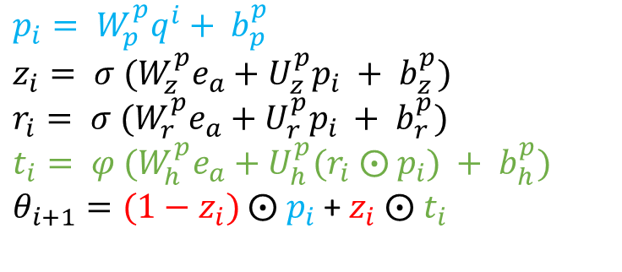
Number Reasoning Network
(1) Relational Projection:
Adopted from the backbones:
GQE, Query2Box, Query2Particles.
(2) (3) (4) Other Projections: Gated Transitions
Linear projection
$$p_{i}= W_{p}^{p}q^{i}+ b_{p}^{p}$$
$$z_{i}= {{σ (W}_{z}^{p}e}_{a}+U_{z}^{p}p_{i} + b_{z}^{p})$$
$$r_{i}= {{σ (W}_{r}^{p}e}_{a}+U_{r}^{p}p_{i} + b_{r}^{p})$$
$$t_{i}= {{φ (W}_{h}^{p}e}_{a}+U_{h}^{p}{(r}_{i} ⨀ p_{i}) + b_{h}^{p})$$
$θ_{i+1}=(1−z_{i})$ $⨀$ $p_{i}$ + $z_{i} ⨀$ $t_{i}$
MLP
Gate selection
50°
50°
$$Tokyo$$
40°
40°
$$Kyoto$$
30°
30°
$$Osaka$$
20°
20°
(1) Relational
Projection
(2) Attribute
Projection
(3) Numerical
Projection
(4) Reverse
Attribute Projection
Notes:
To handle logical operations for entities such as intersection and union, we utilize established query encoding methods as the backbones in the number reasoning network. Specifically, we also use the three different encoding structures - GQE, Q2B, and Q2P - in the implementation.
For the intersection and union of value distributions, suppose we have N attribute variables, and their concatenation is θi. These variables are inputs for intersection operations. The intersection and union are expressed as a deep-set function. To implement this deep-set function, we use an attention layer followed by an MLP layer.

Slide 28
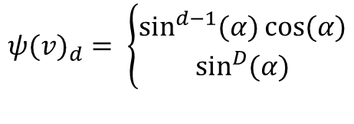
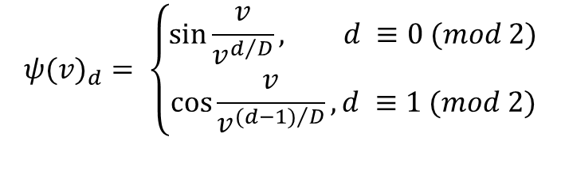
Number Reasoning Network
Entity embeddings:
Adopted from the backbones:
GQE, Query2Box, Query2Particles.
Input number embeddings
DICE
Sinusoidal
$${ψ(v)}_{d}= \left\{\begin{aligned}\sin{\frac{v}{v^{d/D}},} d ≡0 (mod 2) \\ \cos{\frac{v}{v^{{(d−1)}/D}}}, d ≡1 (mod 2)\end{aligned}\right.$$
$${ψ(v)}_{d}= \left\{\begin{aligned}\sin^{d−1}{(α)\cos{(α)}} \\ \sin^{D}{(α)}\end{aligned}\right.$$
50°
50°
$$Tokyo$$
40°
40°
$$Kyoto$$
30°
30°
$$Osaka$$
20°
20°
(1) Relational
Projection
(2) Attribute
Projection
(3) Numerical
Projection
(4) Reverse
Attribute Projection
Dhanasekar Sundararaman, Shijing Si, Vivek Subramanian, Guoyin Wang, Devamanyu Hazarika, and Lawrence Carin. 2020. Methods for Numeracy-Preserving Word Embeddings. In EMNLP. 4742–4753
Ashish Vaswani, Noam Shazeer, Niki Parmar, Jakob Uszkoreit, Llion Jones, Aidan N. Gomez, Lukasz Kaiser, and Illia Polosukhin. 2017. Attention is All you Need. NeurIPS 2017
Notes:
To compute NRN query embeddings, we need to use numerical embeddings to project the attribute values from R to RD to obtain numerical embeddings for NRN. We use two deterministic numerical encodings - DICE and Sinusoidal encoding of value.
DICE is a deterministic independent-of-corpus word embedding of numbers. The Sinusoidal encoding of value was first proposed for encoding token position in the transformer model, but we have found it to be effective in encoding numerical values as well. This function works well in our setting, and its input values do not necessarily have to be integers.

Slide 29
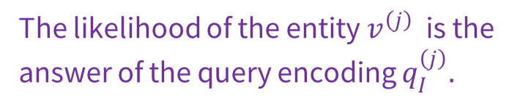
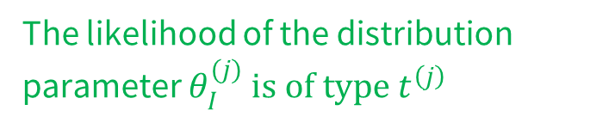
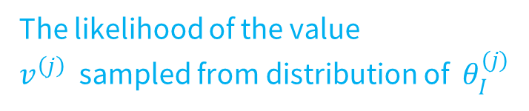
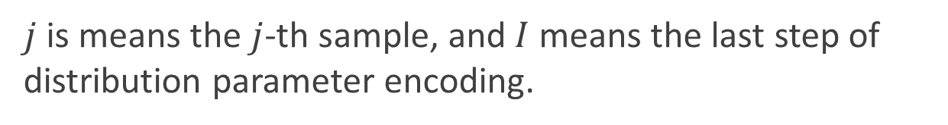
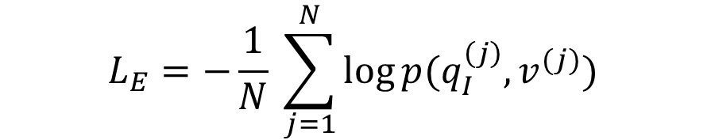
Number Embeddings and Learning Objective
End-to-end training by Joint optimization of two losses:
$L_{A}= \frac{1}{M}\sum_{j=1}^{M}{(− \log{p_{θ_{I}^{(j)}} \left( ψ\left(v^{\left(j\right)}\right)\right) − \log{φ_{t^{\left(j\right)}}(θ_{I}^{(j)})}})}$
The likelihood of the value $v^{\left(j\right)}$ sampled from distribution of $θ_{I}^{(j)}$
The likelihood of the distribution parameter $θ_{I}^{(j)} is of type{ t}^{\left(j\right)}$
$$L_{E}=−\frac{1}{N} \sum_{j=1}^{N}{\log{p(q_{I}^{\left(j\right)}, v^{(j)})}}$$
The likelihood of the entity $v^{\left(j\right)}$ is the answer of the query encoding $q_{I}^{\left(j\right)}.$
$j$ is means the $j$-th sample, and $I$means the last step of distribution parameter encoding.
Notes:
During the learning process, we use joint optimization of two losses.
The first loss is over the numerical distribution, where we use the first term to describe the probability of v in the distribution of Θ, and the second term describes the probability of distribution Θ being of type T.
The second loss is for minimizing the distribution differences of the predicted entities and answer entities over the entity space. By jointly optimizing these two losses, we can effectively train the NRN model to handle complex queries involving both entities and numerical values.

Slide 30
The Three-dimensional Development of Knowledge Graphs in Computer Science
The deveopment of the Web
1. Knowledge Graph Reasoning over Entities and Numerical Values [paper][code]
Web 3.0
Generations of KGs
2. Complex Query Answering on Eventuality Knowledge Graph with Implicit Logical Constraints [paper][code]
G#3: Dual Neural KGs
Web 2.0
G#2: Text-Rich KGs
G#1: Entity-Based KGs
Web 1.0
Semantic Units
Entities/Concepts/Properties
Events/Processes
Intents/Beliefs/Desires
30
Notes:
In the second work, we introduce Complex Query Answering on Eventuality Knowledge Graph with Implicit Logical Constraints. This work discuss how to conduct logical reasoning over knowledge graphs describing event and processes.

Slide 31

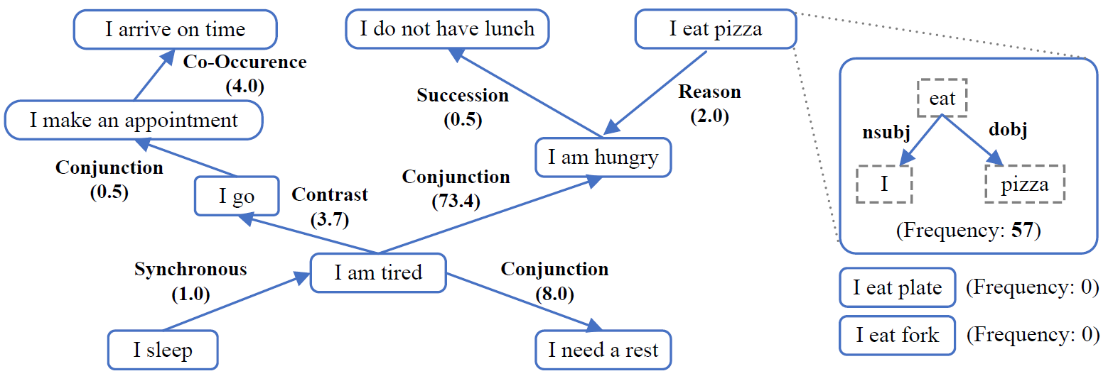
ASER (Activities, States, Events, and their Relations)
Principle 1: Comparing semantic meanings by fixing grammar (Katz and Fodor, 1963)
Principle 2: The need of language inference based on ‘partial information’ (Wilks, 1975)
https://github.com/HKUST-KnowComp/ASER
Hongming Zhang, Xin Liu, Haojie Pan, Yangqiu Song, Cane Wing-Ki Leung: ASER: A Large-scale Eventuality Knowledge Graph. WWW 2020: 201-211
Katz, J. J., & Fodor, J. A. (1963). The structure of a semantic theory. Language, 39(2), 170–210.
Yorick Wilks. 1975. An intelligent analyzer and understander of English. Communications of the ACM, 18(5):264–274.
Notes:
In the work of eventuality reasoning, we use ASER as our KG dataset.
The ASER KG is constructed for describing the relations between activities, states, and events. It is built by the syntactic and semantic parsers following the principle of Comparing semantic meanings by fixing grammar and The need of language inference based on ‘partial information’ .

Slide 32
CQA on Eventuality Knowledge Graph
Complex query on eventuality graphs are different from the entity-relation graph
Whether and when the eventualities occur are important
Queries
Type
Interpretations
Entity
Find the substances that interact with the
proteins associated with Alzheimer’s and
Mad cow disease.
Eventuality
Food
is bad before
PersonX
add soy sauce.
What is the reason for food being bad?
Eventuality
Instead
of buying an umbrella,
PersonX
go
home.
What happened before
PersonX
go
home?
Jiaxin Bai, Xin Liu, Weiqi Wang, Chen Luo, Yangqiu Song: Complex Query Answering on Eventuality Knowledge Graph with Implicit Logical Constraints. NeurIPS, 2023
Notes:
Complex query on eventuality graphs are different from the entity-relation graph
This is because whether and when the eventualities occur are important in the reasoning processes.
For example, in an event-centric KG, suppose we know food is bad before person add soy sauce, if we ask the question what is the reason for food being bad, then adding soy sauce cannot be the reason. Because something happens later cannot be the reason of something happens earlier.
For another example, suppose we know instead of buying an umbrella, personX go home, then we if we ask what happened before person go home, then buying an umbrella should not be an answer because it does not happened.

Slide 33
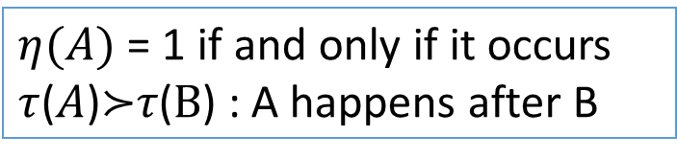
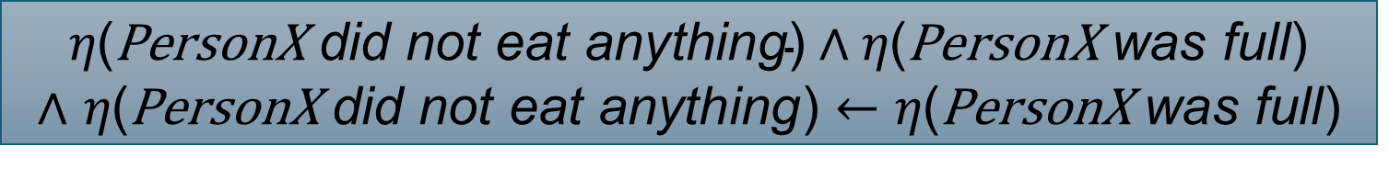
Discourse Relations and Implicit Constraints
PersonX did not eat anything because PersonX was full
Reason($\text{PersonX}$ did not eat anything, $\text{PersonX}$ was full)
Occurrence Constraint
$η\text{(}\text{PersonX} \text{did} \text{not} \text{eat} \text{anything}\text{)}∧η\text{(}\text{PersonX} \text{was} \text{full}\text{)}$
∧ 𝜂($\text{PersonX} \text{did} \text{not} \text{eat} \text{anything}$) $←\text{η}\text{(}\text{PersonX} \text{was} \text{full}$)
Temporal Constraints
$τ$($\text{PersonX}$ did not eat anything) $≻τ$($\text{PersonX}$ was full)
$η(A)$ = 1 if and only if it occurs
$τ$($A$)$≻$𝜏($B$) : A happens after B
Notes:
How can we describe the such constraints over the occurrence of events and temporal order of events?
Use logical expressions derived from discourse relations!
We use \ita to denote whether an event happens, and \tau to denote the temporal order of event.
Then we can derive the following expressions. $\text{PersonX} \text{did} \text{not} \text{eat} \text{anything}$ and $\text{PersonX} \text{was} \text{full}$ both happens and $\text{PersonX} \text{was} \text{full}$ causes $\text{PersonX} \text{did} \text{not} \text{eat} \text{anything}$. Meanwhile, we know $\text{PersonX}$ did not eat anything happens after $\text{PersonX} \text{was} \text{full}$.

Slide 34
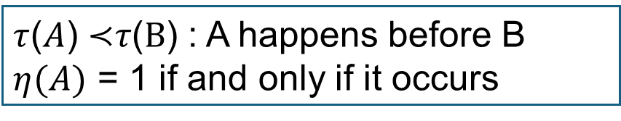
Discourse Relations and Implicit Constraints
Food is bad before PersonX add soy sauce
Precedence(Food is bad, PersonX adds soy sauce)
Occurrence Constraint
$$η\text{(}\text{Food} \text{is} \text{bad}\text{) }∧η\text{(}\text{PersonX} \text{adds} \text{soy} \text{sauce}\text{)}$$
Temporal Constraints
$τ$(Food is bad) $≺τ$(PersonX adds soy sauce)
$τ$($A$) $≺$𝜏($B$) : A happens before B
$η(A)$ = 1 if and only if it occurs
Notes:
Here is an example of temporal relations, which means Food is bad before PersonX add soy sauce

Slide 35
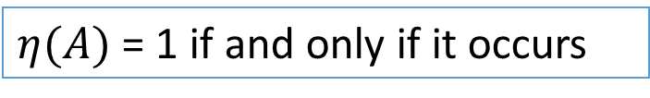
Discourse Relations and Implicit Constraints
Instead of buying an umbrella, PersonX go home
$\text{ChosenAlternative}$(buying an umbrella, $\text{PersonX}$ go home)
Occurrence Constraint
$$η\left(\text{PersonX} \text{go} \text{home}\right)∧¬ η\left(\text{PersonX} \text{buy} \text{an} \text{umbrella}\right)$$
$η(A)$ = 1 if and only if it occurs
Notes:
Here is a example of occurrence constraints, which means $\text{PersonX}$ go home happens and buying an umbrella does not happens.

Slide 36
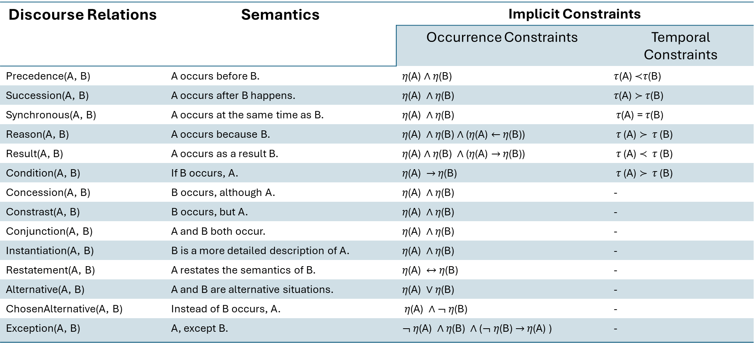
Logical Constraints behind Discourse Relations
Discourse Relations | Semantics | Implicit Constraints
 |  | Occurrence Constraints | Temporal Constraints
Precedence(A, B) | A occurs before B. | 𝜂(A) ∧ 𝜂(B) | $τ$(A) $≺$𝜏(B)
Succession(A, B) | A occurs after B happens. | 𝜂(A) ∧ 𝜂(B) | 𝜏(A) $≻$ 𝜏(B)
Synchronous(A, B) | A occurs at the same time as B. | 𝜂(A) ∧ 𝜂(B) | 𝜏(A) = 𝜏(B)
Reason(A, B) | A occurs because B. | 𝜂(A) ∧ 𝜂(B) ∧ (𝜂(A) $←$ 𝜂(B)) | 𝜏 (A) $≻$ 𝜏 (B)
Result(A, B) | A occurs as a result B. | 𝜂(A) ∧ 𝜂(B) ∧ (𝜂(A) $→$ 𝜂(B)) | 𝜏 (A) $≺$ 𝜏 (B)
Condition(A, B) | If B occurs, A. | 𝜂(A) $→$ 𝜂(B) | 𝜏 (A) $≻$ 𝜏 (B)
Concession(A, B) | B occurs, although A. | 𝜂(A) ∧ 𝜂(B) | -
Constrast(A, B) | B occurs, but A. | 𝜂(A) ∧ 𝜂(B) | -
Conjunction(A, B) | A and B both occur. | 𝜂(A) ∧ 𝜂(B) | -
Instantiation(A, B) | B is a more detailed description of A. | 𝜂(A) ∧ 𝜂(B) | -
Restatement(A, B) | A restates the semantics of B. | 𝜂(A) $↔$ 𝜂(B) | -
Alternative(A, B) | A and B are alternative situations. | 𝜂(A) $∨$ 𝜂(B) | -
ChosenAlternative(A, B) | Instead of B occurs, A. | 𝜂(A) ∧ $¬$ 𝜂(B) | -
Exception(A, B) | A, except B. | $¬$ 𝜂(A) ∧ 𝜂(B) ∧ ($¬$ 𝜂(B) $→$ 𝜂(A) ) | -
$τ$($A$) $≺$𝜏($B$) : A happens before B, $η(A)$ = 1 if and only if it occurs
Notes:
Here is the table of logical constraints behind the discourse relations.

Slide 37

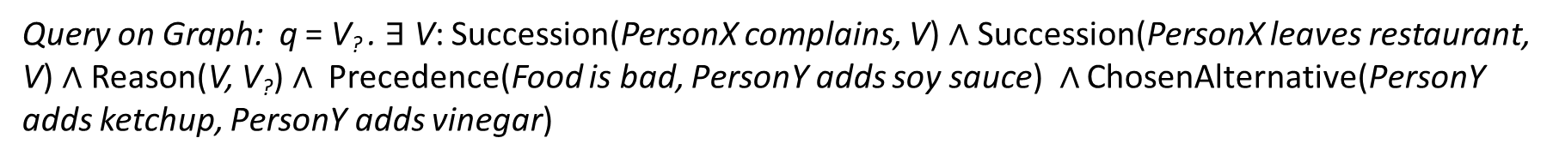
Logical Query with Implicit Constraints
Question: Food is bad before PersonY adds soy sauce. Instead of adding vinegar, PersonY adds ketchup.
PersonX complains after V. PersonX leaves the restaurant after V. The reason V is V’?. What is V’?
Query on Graph: q = V? . $∃$ V: Succession(PersonX complains, V) $∧$ Succession(PersonX leaves restaurant, V) $∧$ Reason(V, V?) $∧$ Precedence(Food is bad, $\text{PersonY}$ adds soy sauce) $∧$ ChosenAlternative($\text{PersonY}$ adds ketchup, $\text{PersonY}$ adds vinegar)
Eventuality Knowledge Graph:
Computational Atomics:
Succession
Reason
Succession
Without context and its constraints:
4 answers
PersonX complains
Service
is bad
Staff is new
PersonX complains
Reason
Succession
V
V?
Reason
PersonY adds ketchup
Reason
PersonX leaves restaurant
Answer: V? $∈\{\text{Staff} \text{is} \text{new}\text{, }\text{PersonY} \text{adds} \text{ketchup}\text{, }$
$$\text{PersonY} \text{adds} \text{soy} \text{sauce}\text{,} \text{PersonY} \text{adds} \text{vinega}r\}$$
Succession
ChosenAlternative
Precedence
Informational Atomics:
PersonX leaves restaurant
Food is bad
PersonY adds
soy sauce
Precedence
ChosenAlternative
Reason
With Implicit Constraints:
Only 2 answers
Food is bad
PersonY adds
soy sauce
PersonY adds ketchup
PersonY adds vinegar
PersonY adds
vinegar
Answer: V? $∈\{\text{Staff} \text{is} \text{new}\text{,}\text{PersonY} \text{adds} \text{ketchup}\}$

Slide 38
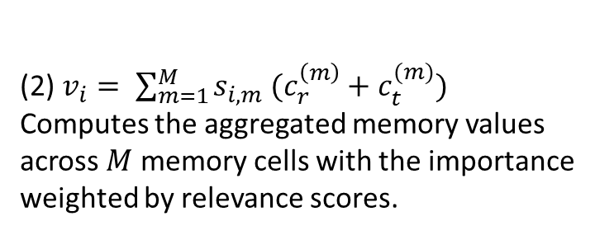
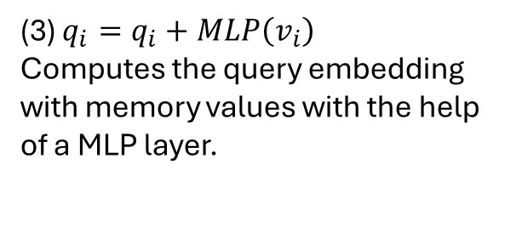
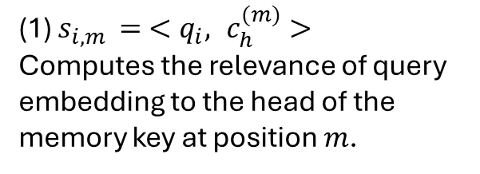
Query Encoding with Constraint Memory
Computational Graph
(3)
Constraint Memory
V?
Key
Value
(2)
Reason
Food is bad
Precedence
PersonY
adds soy sauce
Intersection
(1)
PersonY
adds ketchup
PersonY
adds vinegar
ChosenAlter.
Succession
Succession
PersonX
complains
PersonX leaves
restaurant
…
…
…
(1) $s_{i,m }= <q_{i}, c_{h}^{(m)}>$
Computes the relevance of query embedding to the head of the memory key at position $m$.
(2) $v_{i}= \sum_{m=1}^{M}{s_{i,m} (c_{r}^{\left(m\right)}+c_{t}^{(m)})}$
Computes the aggregated memory values across $M$ memory cells with the importance weighted by relevance scores.
(3) $q_{i}=q_{i}+MLP\left(v_{i}\right)$
Computes the query embedding with memory values with the help of a MLP layer.
Jiaxin Bai, Xin Liu, Weiqi Wang, Chen Luo, Yangqiu Song: Complex Query Answering on Eventuality Knowledge Graph with Implicit Logical Constraints. NeurIPS, 2023
Notes:
To address the logical constraints within the process of answering complex logical queries, we propose the query encoding method with constraint memory. For each encoding process of computation graph of a complex query, we first Computes the relevance of query embedding to the head of the memory key at position $m, then$Computes the aggregated memory values across $M$ memory cells with the importance weighted by relevance scores. And finally, we add back the constraints values from the constraint memory with memory values with the help of a MLP layer.

Slide 39
The Three-dimensional Development of Knowledge Graphs in Computer Science
The deveopment of the Web
1. Knowledge Graph Reasoning over Entities and Numerical Values [paper][code]
Web 3.0
Generations of KGs
2. Complex Query Answering on Eventuality Knowledge Graph with Implicit Logical Constraints [paper][code]
G#3: Dual Neural KGs
Web 2.0
G#2: Text-Rich KGs
3. Complex Reasoning over Logical Queries on Commonsense Knowledge Graphs [paper]
G#1: Entity-Based KGs
Web 1.0
Semantic Units
Entities/Concepts/Properties
Events/Processes
Intents/Beliefs/Desires
39
Notes:
the third work is "Complex Reasoning over Logical Queries on Commonsense Knowledge Graphs." This one tackles reasoning over beliefs, intentions, and desires with a emphasis on commonsense knowledge.

Slide 40
Moving towards intention based commonsense complex question answering
Reasoning on real-world text and narratives requires complex reasoning over multiple events, and inferring implicit context.
drink a glass of ice cold water
cause
X moves to a new place
Air pollution
cause
Lung Cancer
cause
effect
Smoking
X makes new friends
Getting coronary artery disease
cause
It was a hot and sunny day, but John feels much better!
Diabetes
X throws a party
Obesity
…
Abduction
Common cause
multi-hop effects
Tianqing Fang, Zeming Chen, Yangqiu Song, Antoine Bosselut. Complex Reasoning over Logical Queries on Commonsense Knowledge Graphs. Arxiv 2024.
Notes:
Specifically, We targets on intention based commonsense complex question answering.
Reasoning on real-world text and narratives requires complex reasoning over multiple events, and inferring implicit context.
We are interested in studying the abduction of events/processes, common cause, and multi-hop effects.
For abduction, here are some examples: It was a hot and sunny day, but John feels much better! This is very likely because he drink a glass of ice water. And this process is a type of abductive reasoning.
For common cause, smoking is a common cause of lung cancer and getting Getting coronary artery disease.
Moving to a new places causes making new friend and further causes throwing a party, and this is multi-hop effects.

Slide 41


Complex Commonsense Reasoning
Sampling conjunctive logical queries over existing CSKG
$q\left[V_{?}\right]=V_{?}:$xIntent$\left(X goes sky diving , V_{?}\right)$
$$∧\text{xWant} (X gets tired of it, V_{?})$$
(the intention of PersonX)
xIntent
PersonX goes skydiving
Sampling synthetic query at scale
Perform verbalization to make the query in natural language
Define reasoning (question) based on the relations.
find new things to do
PersonX gets tired of it
xWant
(then PersonX wants to)
Verbalization
🤖️
LLM-added
context
PersonX is living a boring life.
Base CSKG: ATOMIC2020
Rule-based
discourse
After getting tired of it
PersonX goes skydiving
Question:
What’s both the intention of PersonX going skydiving
and what X wants to do after PersonX getting tired of it?
Answer:
find new things to do
Tianqing Fang, Zeming Chen, Yangqiu Song, Antoine Bosselut. Complex Reasoning over Logical Queries on Commonsense Knowledge Graphs. Arxiv 2024.
Notes:
To systematically measure different MLP models to conduct complex commonsense reasoning, we propose a method of generating such complex commonsense queries.
We sample conjunctive logical queries and their from commonsense KG, then we use LLM to verbalize the queries and answers as natural language questions answering pairs.

Slide 42
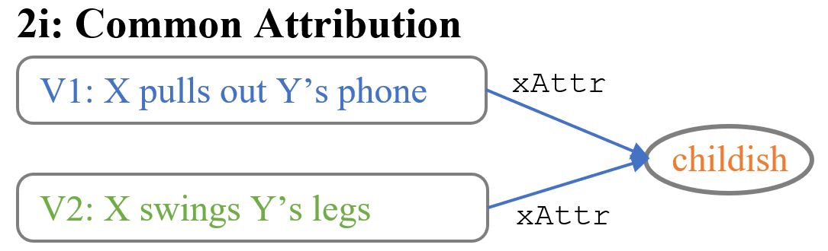
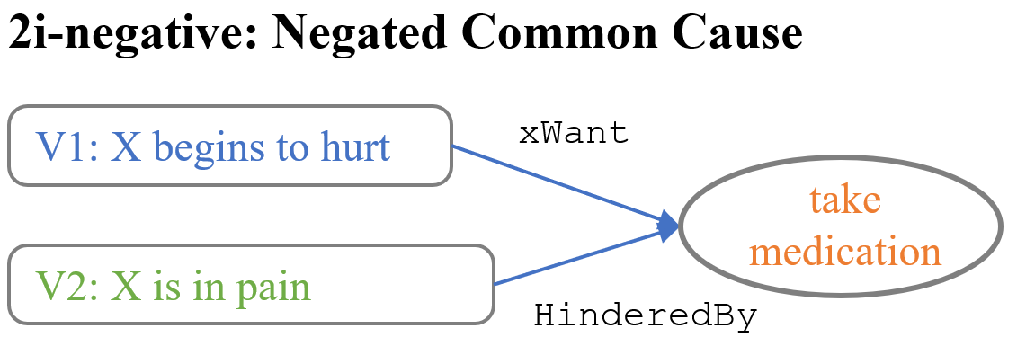
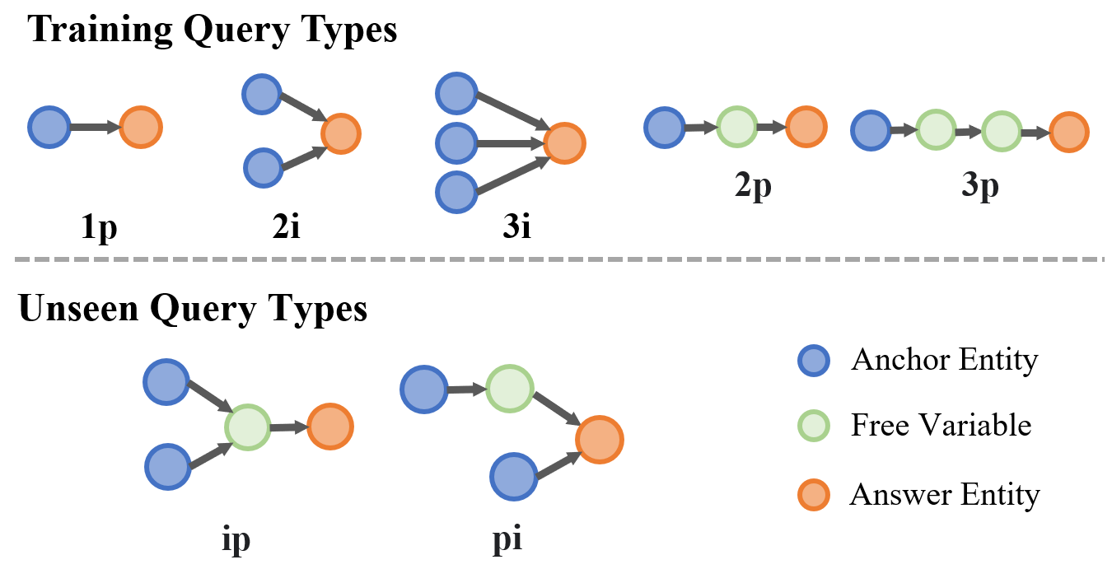


Conjunctive Logical Queries
Similar to CQA problems
Tianqing Fang, Zeming Chen, Yangqiu Song, Antoine Bosselut. Complex Reasoning over Logical Queries on Commonsense Knowledge Graphs. Arxiv 2024.
Notes:
Similar to CQA problems, we sample 5 types of training queries, and hold out 2 types of queries and out of distribution evaluation types.
Here are some examples like commonse attribution, negated commosen sense, second order effects, and multi-hop conjunctive query.

Slide 43
Benchmarking
Multiple-Choice QA:
  Negative sampling: 2 are randomly sampled across CSKB, 2 are randomly sampled across one-hop answers (hard negative).
  An additional “No answers are correct option”
Generative complex commonsense reasoning
  53 annotators
  Fleiss Kappa: 0.445; IAA: 78%
  All disagreements are fixed by experts
#Train | 790k
#Eval (annotated) | 1,317
%wrong verbalization | 4.5%
%sampled answers that are plausible | 52.1%
%sampled negatives that are plausible | 23.5%
Tianqing Fang, Zeming Chen, Yangqiu Song, Antoine Bosselut. Complex Reasoning over Logical Queries on Commonsense Knowledge Graphs. Arxiv 2024.
Notes:
After using LLM to verbalize the logical queries on commonsense KGs, we use the question answering pairs to further construct a mutple-choice QA benchmark. For negative samples, 2 are randomly sampled across CSKB, 2 are randomly sampled across one-hop answers (hard negative). Meanwhile we provide No answers are correct option.
We hire 53 annotators to annotate, their fleiss kappa is 0.445 and IAA of 78%. All disagreements are fixed by experts.

Slide 44

LLMs Still Fall Short on This Task
GPT: 37.74%~57.40%
Open LLMs: 33.64%~60.97%
Finetuned: 62.79%~63.78%
Tianqing Fang, Zeming Chen, Yangqiu Song, Antoine Bosselut. Complex Reasoning over Logical Queries on Commonsense Knowledge Graphs. Arxiv 2024.
Notes:
Here is the performance of the complex commonsense dataset. GPT is able to achieve 37%~57%, open LLM achieves 33%~60%. The fine-tuned pre-trained LMs can achieves 62~63 in this benchmark.

Slide 45
The Three-dimensional Development of Knowledge Graphs in Computer Science
The deveopment of the Web
1. Knowledge Graph Reasoning over Entities and Numerical Values [paper][code]
Web 3.0
Generations of KGs
2. Complex Query Answering on Eventuality Knowledge Graph with Implicit Logical Constraints [paper][code]
G#3: Dual Neural KGs
Web 2.0
G#2: Text-Rich KGs
3. Complex Reasoning over Logical Queries on Commonsense Knowledge Graphs [paper]
G#1: Entity-Based KGs
Web 1.0
Semantic Units
Entities/Concepts/Properties
Events/Processes
Intents/Beliefs/Desires
45
Notes:
Then we have covered all three types of semantic units on this horizontal axis with three different works in knowledge graph reasoning.

Slide 46
Conclusions for Part 4-2
We have reviewed the frontier of recent development of knowledge graphs in terms methods of different demantic units:
  Entity/attributes
  Events/processes
  Intent/desire/belief
More recent advances in KG reasoning combined with LLMs will be introduced in Part 5 by Lihui Liu
Notes:
That is all of this part. Thank you!

