Slide 1
Privacy-Preserved Neural Graph Databases
Yangqiu Song
Department of CSE, HKUST
Slides Credit: Qi Hu

Slide 2
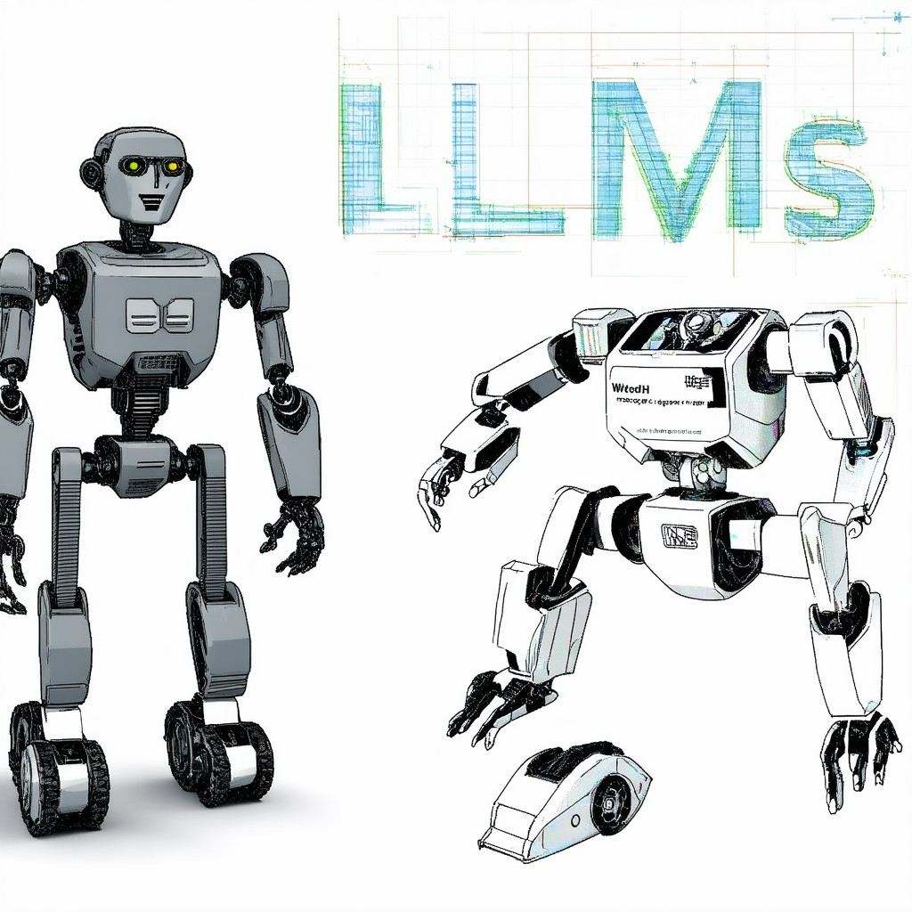
Our Research in the Era of LLMs
LLMs have “killed” many research directions
What do we do? IMHO,
The challenges that LLMs still face
The existing/new applications that LLMs enable
Image generated by Stable Diffusion v3 Medium - by fal.ai

Slide 3
Challenges
Factuality hallucination emphasizes the discrepancy between generated content and verifiable real-world facts, typically manifesting as factual inconsistency or fabrication
Specific domain knowledge/Long-tail knowledge
Huang L, Yu W, Ma W, Zhong W, Feng Z, Wang H, Chen Q, Peng W, Feng X, Qin B, Liu T. A survey on hallucination in large language models: Principles, taxonomy, challenges, and open questions. arXiv preprint arXiv:2311.05232. 2023 Nov 9.
Kai Sun, Yifan Ethan Xu, Hanwen Zha, Yue Liu, Xin Luna Dong. Head-to-Tail: How knowledgeable are Large Language Models? A.K.A. Will LLMs replace knowledge graphs? In arXiv2023. ​

Slide 4
New Applications
LLMs provides interactive natural language interface to many things
Self-driving cars
Excel spread sheets
Local databases
Etc.
LLMs provides much better representation for free texts to enable
Semantic search in text-rich databases
Search engines
Etc.

Slide 5
Retrieval Augmented Generation (RAG)
1. Retrieval: Fetches relevant documents from a large dataset.
2. Augmentation: Uses retrieved documents to provide context.
Knowledge Bases
3. Generation: Generates responses based on both the input and retrieved context.
Partially solved some LLMs’ challenges such as factuality hallucination
Embedding
Enabled by LLMs to have a better fuzzy semantic search when there is an open-world assumption
Retrieved information may not be accurate
Large Language Models (LLMs)
Vector Databases
What is RAG: Understanding Retrieval-Augmented Generation - Qdrant

Slide 6
From Vector DBs to Neural Graph DBs
Why Graphs?
Sometimes we need globally and structural referenced knowledge
Ability of reasoning with high complexity
NP-complete problems, e.g., Max-Sat (Chalier et al., 2022) , subgraph matching or counting, subset sum, etc.
The trade-offs between scalability and computational complexity
Leverage both neural and symbolic reasoning power
Doc 1
…
…
Doc 2
…
…
Doc K
…
…
…
…
…
…
…
…
Embedding
Large Language Models (LLMs)

Slide 7
Graph Query
Limitation: Missing knowledge results in incomplete answer set.
Complex Graph Queries (Figure taken from Ren et al)
Ren H, Galkin M, Cochez M, Zhu Z, Leskovec J. Neural graph reasoning: Complex logical query answering meets graph databases. arXiv preprint arXiv:2303.14617. 2023 Mar 26.

Slide 8
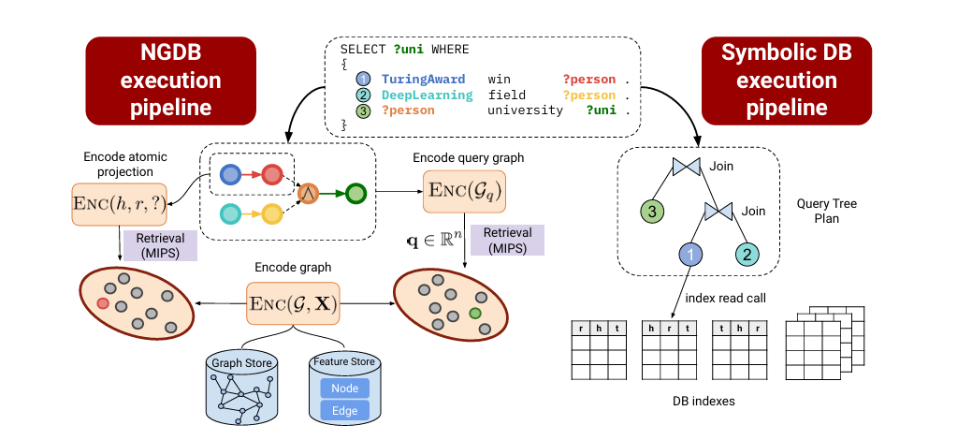
Neural Graph Databases (NGDBs)
Neural Graph Storage: employ graph store and feature store to obtain latent representations in the embedding store.
Neural Query Engine: derive the computation graph of the query and execute in the latent space.
Neural Graph Databases (Figure taken from Ren et al)
Ren H, Galkin M, Cochez M, Zhu Z, Leskovec J. Neural graph reasoning: Complex logical query answering meets graph databases. arXiv preprint arXiv:2303.14617. 2023 Mar 26.

Slide 9
Complex Queries on Neuralized Knowledge Graphs
A working example: Tree-Formed Queries (TFQ):
Tree-form query family contains the queries that can be converted into the computational tree
Natural Language: Find non-American directors whose movie won Golden Globes or Oscar?
Logical Formula: $q=V_{?}∃ V_{1}.(Won\left(V_{1},GoldenGlobes\right)∨Won(V_{1},Oscar))∧¬BornIn\left(V_{?},America\right)∧Direct(V_{?},V_{1})$
Set Operator Tree: $DirectorOf(WinnerOf\left(GoldenGlobes\right)∪WinnerOf\left(Oscar\right))∩BornIn{\left(America\right)}^{C}$
Set Operators
GoldenGlobes
P
DirectorOf
set operations
$$∪$$
set union
WinnerOf
$$∪$$
P
$$∩$$
set intersection
Oscar
P
Answer Set
$$C$$
set complement
BornIn
America
P
$$C$$
$$∩$$
P
set projection
Example from: Zihao Wang, Weizhi Fei, Hang Yin, Yangqiu Song, Ginny Y Wong, and Simon See . Wasserstein-Fisher-Rao Embedding: Logical Query Embeddings with Local Comparison and Global Transport In Findings of ACL 2023

Slide 10
Embedding Space and Set Representations
$$q=V_{?} . ∃V:Win\left(TuringAward, V\right) ∧¬Citizen\left(Canada,V\right)∧Graduate(V, V_{?})$$
GQE
Turing
Award
Has Winner
Vector Embeddings
Graduate
Query2Box
Has Citizen
Complement
Intersection
Canada
Box Embeddings
Computation Graph
Embedding Space
Query2Particle
The multi-hop logical operations make the query answers diversified
The answers embeddings are set(s) scattered in the embedding space
Particle Embeddings
William L. Hamilton, Payal Bajaj, Marinka Zitnik, Dan Jurafsky, Jure Leskovec. Embedding Logical Queries on Knowledge Graphs. NeurIPS 2018.
Hongyu Ren, Weihua Hu, Jure Leskovec. Query2box: Reasoning over Knowledge Graphs in Vector Space using Box Embeddings. ICLR 2020.
Example from: Jiaxin Bai, Zihao Wang, Hongming Zhang, Yangqiu Song: Query2Particles: Knowledge Graph Reasoning with Particle Embeddings. NAACL-HLT (Findings) 2022.

Slide 11
Privacy Issues in NGDBs
An attacker attempts to infer private information about Hinton’s living place in the NGDBs. Attackers can leverage well-designed queries to retrieve desired privacy. The intersection of these queries can make a fair guess.
Query | $q=V_{?}. ∃V:Win\left(V, Turing Award\right)∧BornIn\left(V, 1938\right)∧LiveIn(V, V_{?})$
Interpretation | Find where the Turing Award winner who was born in 1938 lived.
Embedding
Toronto
UofT
Stanford
Embedding Storage
Turing Award
Complex Queries
Hinton
Query | Answer
$$q_{1}=V_{?}. LiveIn(Hinton, V_{?})$$ | Privacy risk query detection
$$q_{2} =V_{?}. ∃X_{1}, X_{2}:Win\left(X_{1}, Turing Award\right)∧GreaterThan\left(X_{2},1940\right)$$ $$∧BornIn\left(X_{1},X_{2}\right)∧Livein(X_{1},V_{?})$$ | Montreal, Toronto…
$$q_{3}=V_{?}. ∃X_{1}:CollabWith\left(LeCun, X_{1}\right)∧LiveIn(X_{1},V_{?})$$ | Montreal, Toronto…
$$q_{4}=V_{?}.∃X_{1},X_{2}:Win\left(X_{1}, Turing Award\right)∧SmallerThan\left(X_{2},1950\right)$$ $$∧BornIn\left(X_{1},X_{2}\right)∧LiveIn(X_{1},V_{?})$$ | Toronto, Stanford…
1947
1938
Knuth
Bengio
query
LeCun
New York
Montreal
1964
Public edge
Query Engine
Private edge
Neural Graph Databases
Privacy Risk Queries

Slide 12
Privacy-preserved NGDBs: Adversarial Training Examples
$$P(s_{1})$$
$$M_{private}$$
$$s_{1}$$
$$M^{1}$$
$$M^{1}$$
projection
$$M_{private}$$
$$s_{2}$$
$$M_{private}$$
$$P(s_{3})$$
$$S$$
$$s_{3}$$
$$P(s_{2})$$
$$P(S)$$
$$s_{1}$$
projection
$$P(s_{1})$$
$$M^{2}$$
$$M^{2}$$
$$s_{2}$$
$$P(s_{2})$$
Orange-green is a privacy-threatening answer in intersection but not in union
$$S$$
$$P(S){=M}_{private}$$
(A) Projection
(B) Intersection
(C) Union
Green nodes denote non-private answers, orange nodes denote privacy-threatening answers, and orange-green nodes denote different privacy risks in subsets. Red dashed arrows denote privacy projection. The answers circled in red dashed line are at risk to leak privacy.
Privacy-Preserved Neural Graph Databases. Qi Hu, Haoran Li, Jiaxin Bai, Zihao Wang, Yangqiu Song. KDD 2024.

Slide 13
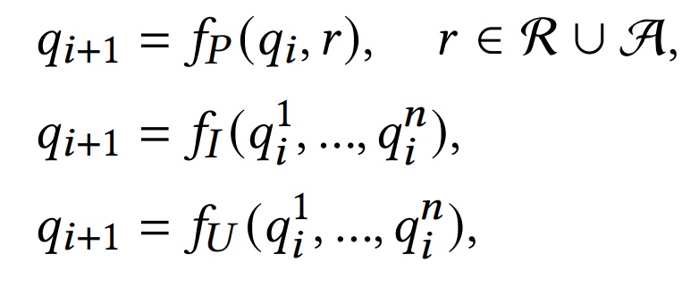
Privacy-preserved NGDBs: Adversarial Training Examples
Query Encoding:
The query encoding procedure can be decomposed to sub-queries and finally to atomic queries.
Learning Objective:
The original objective for public queries; increase the likelihood
The privacy protection objective is to obfuscate private atomic queries; decrease the likelihood

Slide 14
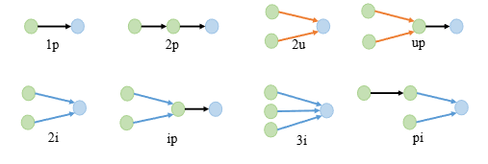
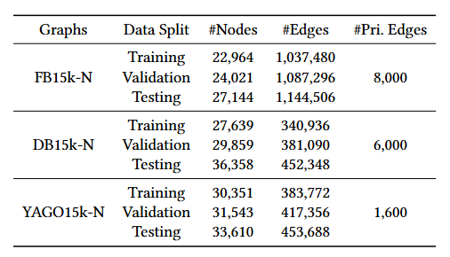
Privacy-preserved NGDBs: Experiments
Multi-relational knowledge graphs with numerical attributes
Attribute value projections can be the same as traditional relation projection if the values themselves are entities, e.g., locations
Attributes and their values are more aligned with real-world privacy considerations
Attribute values are vulnerable to be attacked as we can use group queries to attack individual’s information, which has been widely used as an illustration in differential privacy
Query Type
$$V_{?}. ∃X_{1}, X_{2}:Win\left(X_{1}, Turing Award\right)∧GreaterThan\left(X_{2},1940\right)$$
$$∧BornIn\left(X_{1},X_{2}\right)∧Livein(X_{1},V_{?})$$

Slide 15
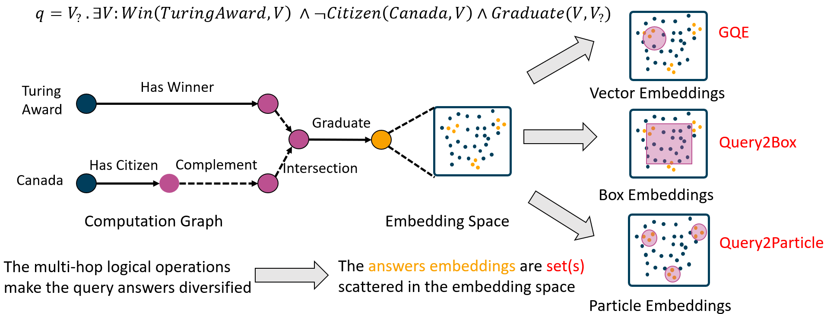
Privacy-preserved NGDBs: Experiments
Three commonly used query encoding methods
The protection methods hurt the retrieval quality on public sets, but to make fair comparison, we tune the parameter to get similar performance
P-NGDB’s retrieval performance on private sets drops more significantly denotes better privacy protection

Slide 16
Privacy-preserved NGDBs: Experiments
Better
There is a tradeoff between retrieval performance and privacy protection.
Better
We can select suitable privacy coefficients $β$ according to the task.
Dataset Construction
Stronger protection

Slide 17
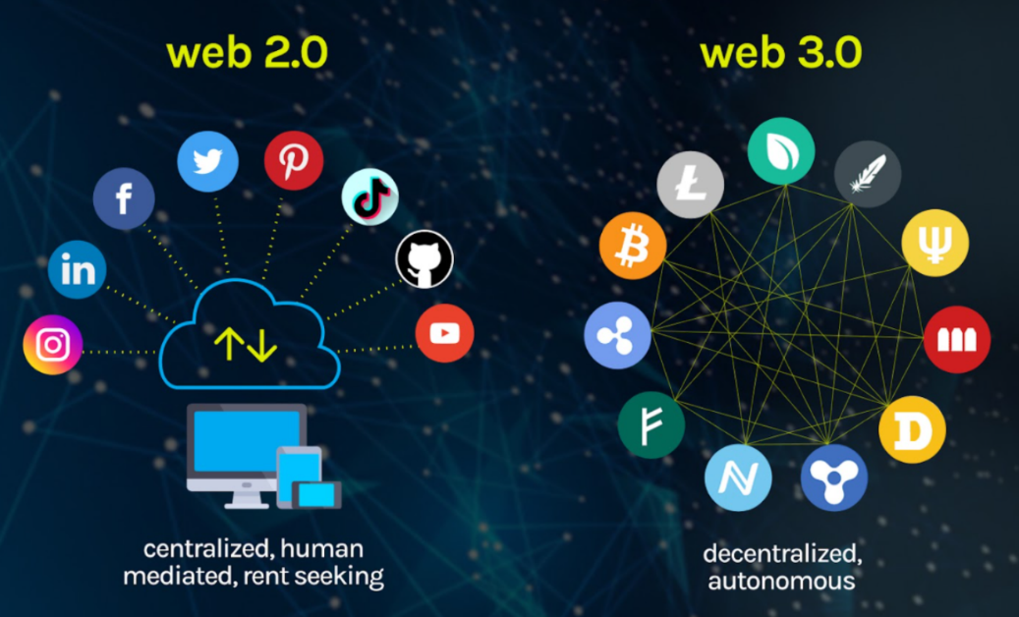
An Outlook
From Web2.0 to Web3.0
Decentralized data: users own their (neural) knowledge bases/graphs
Monetarize by users’ data and time
Permissionless, trustless, but accessible to users’ owned knowledge or data
Security and privacy of data and knowledge is the key!
Figure from: https://vitalflux.com/what-is-web3-0-features-design-skills-nfts/

Slide 18
Knowledge Sharing
interaction
Disease
Side Effect
Gene
Symptom
carriedBy
has
treat
has
Patient
infect
use
Microbe
Patient
Drug
Drug
has
has
contain
cause
Disease
Disease
Compound
similarTo
KG 1 from a gene engineering company
KG 2 from a hospital
KG 3 from a pharmaceutical company

Slide 19
Knowledge Sharing
Each party has its private part of data, which cannot be disclosed to others
Patient information
Drag chemical compound
Personal gene expressions
Even if privacy is not a concern, they would not expose their knowledge to other companies except they can also benefit from others
Existing drug repurposing failure cases

Slide 20
Types of Queries for Knowledge Sharing
Knowledge Graph-1
Nobel Prize
Schrödinger
Nobel Prize
Physics
Plank
Query | $q=V_{?}. ∃V:Win\left(V, Nobel Prize\right)∧BornIn\left(V, Germany\right)∧Study(V, V_{?})$
Interpretation | Find what research topics which Nobel Prize winner who was born in Germany studied.
Collaboration
Win
Study
Bohr
Nomination
Einstein
Einstein
Knowledge Graph-2
Academic
Einstein
BornIn
Knowledge Graph-3
Social
Germany
May be solved by previous work
FedCQA: Answering Complex Queries on Multi-Source Knowledge Graphs via Federated Learning Qi Hu, Weifeng Jiang, Haoran Li, Zihao Wang, Jiaxin Bai, Qianren Mao, Yangqiu Song, Lixin Fan, Jianxin Li. Arxiv, 2024.

Slide 21
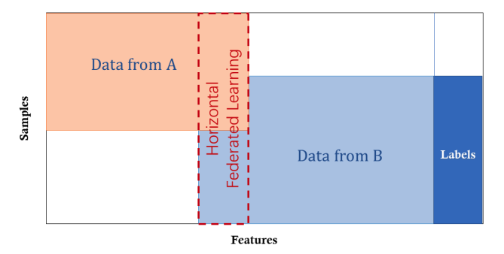
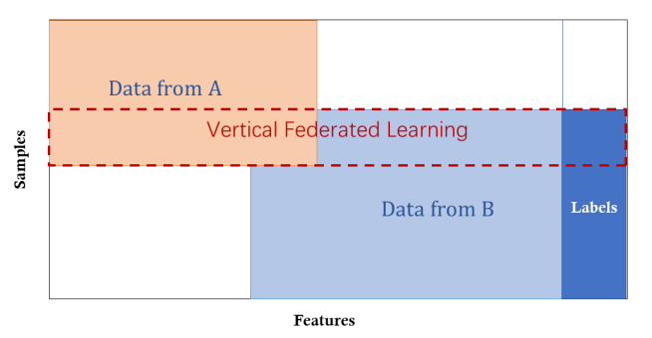
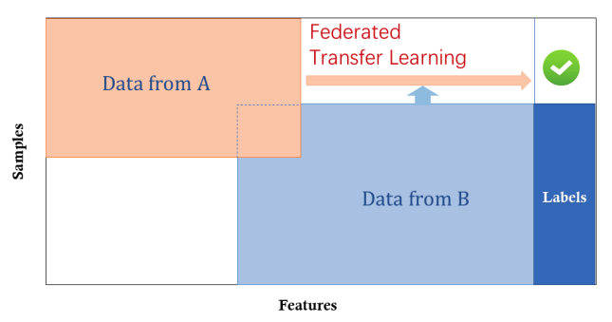
Federated Graph Machine Learning
Horizontal federated learning
Node embeddings should be aligned
Very unlikely
Vertical federated learning
Nodes should be partially aligned
Possible but sometimes unlikely
Aligned nodes are in different embedding space but features are not complementary
Federated transfer learning
Nodes and their embeddings are aligned
Possible
Nodes and their embeddings are not aligned
Likely
Figure credit: WeBank Tutorial, Chapter 1 - Introduction to Federated Learning. https://www.fedai.org/

Slide 22
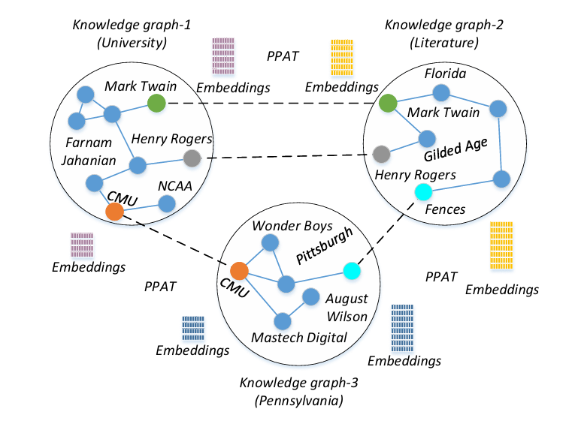
Existing methods: Federated Knowledge Graph Embedding
Learning a low-dimensional representation of a knowledge graph's entities and relations while preserving their semantic meaning.
Limitation: Only focus on one-hop relations and cannot support complex queries on the learned graph systems.
Federated Knowledge Graph Embedding (Figure taken from Peng et al)
Hao Peng, Haoran Li, Yangqiu Song, Vincent Zheng, and Jianxin Li. 2021. Differentially private federated knowledge graphs embedding. In CIKM 2021.

Slide 23
Federated NGDBs – Training
Secured
Aggregation
Like FedAvg
Encryption
Local Update
Local update is the same as traditional CQA
Standard homomorphic encryption (HE)
﻿The blue line denotes the training process, and the green line denotes the retrieval process.
FedCQA: Answering Complex Queries on Multi-Source Knowledge Graphs via Federated Learning. Qi Hu, Weifeng Jiang, Haoran Li, Zihao Wang, Jiaxin Bai, Qianren Mao, Yangqiu Song, Lixin Fan, Jianxin Li. Arxiv 2024.

Slide 24
Federated NGDBs – Inference (Queries)
Query encoding done by clients (along the green lines)
Query Enocding
Score Computation
Ranking all answers on the server
Query Decomposition
Distribute complex queries to different clients
﻿The blue line denotes the training process, and the green line denotes the retrieval process.
FedCQA: Answering Complex Queries on Multi-Source Knowledge Graphs via Federated Learning. Qi Hu, Weifeng Jiang, Haoran Li, Zihao Wang, Jiaxin Bai, Qianren Mao, Yangqiu Song, Lixin Fan, Jianxin Li. Arxiv 2024.

Slide 25
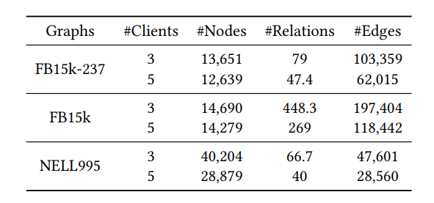
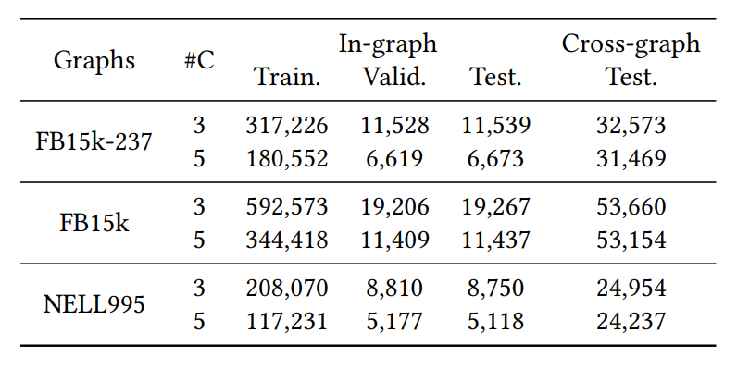
Federated NGDBs - Experiments
Split according relations
Sampled in-graph queries
Evaluation
Statistics of Knowledge Graphs
Statistics of Sampled Queries

Slide 26
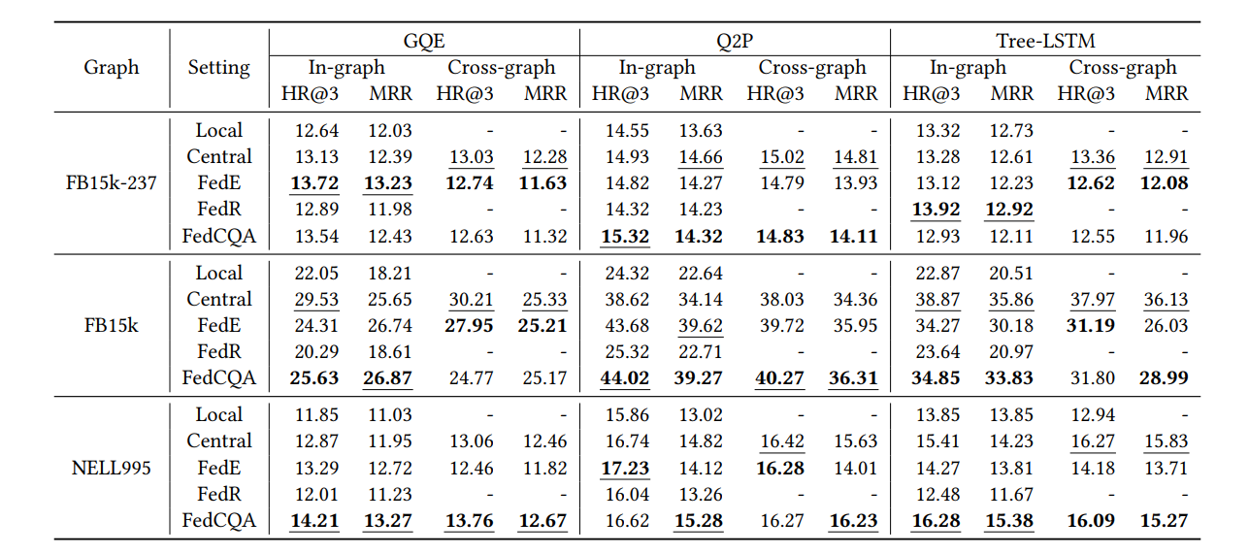
Federated NGDBs - Experiments
We evaluate the performance change on in- & cross- graph queries
Our FedCQA perform well on all datasets well maintaining good properties of both FedE and FedR
FedE performs well but has to share embeddings to the server
FedR secured entities for local clients but cannot support cross-graph queries
Table: The retrieval performance of distributed knowledge graph complex query answering models when there are 3 clients

Slide 27
Federated NGDBs – More Clients
Improve performance on both in- & cross-graph queries.
Table: The retrieval performance of distributed knowledge graph complex query answering models when there are 5 clients

Slide 28
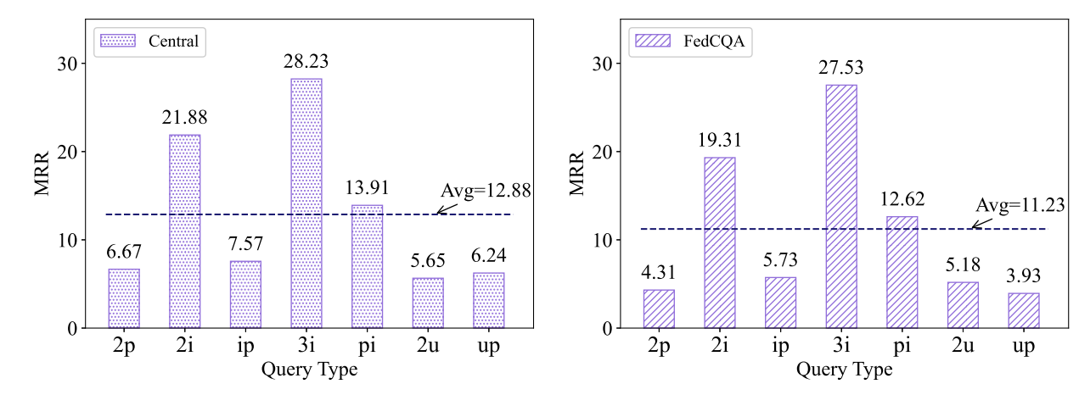
Federated NGDBs – Compared with Central Training
Different query types, the retrieval performance close to central training.
Central
FedCQA
Only evaluated on cross-graph queries

Slide 29
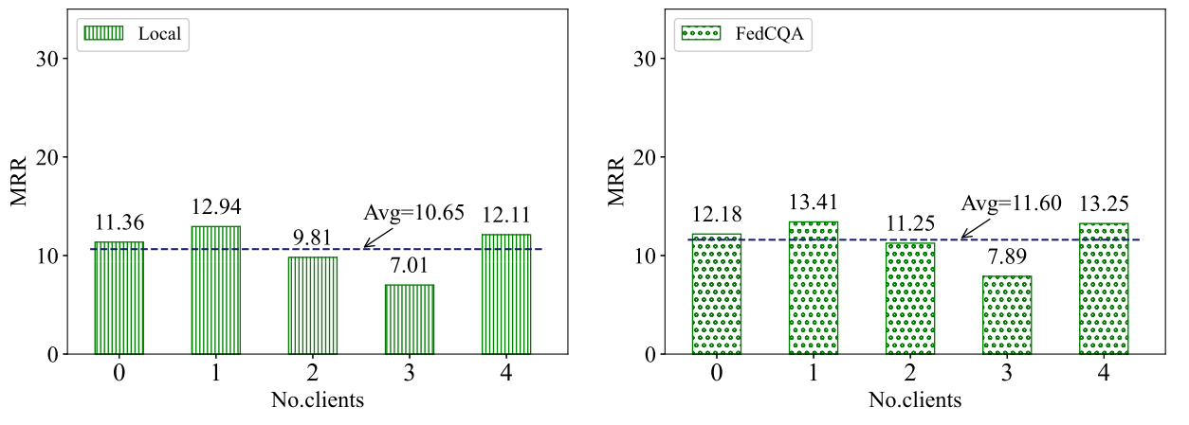
Federated NGDBs – Compared with Local Training
For clients, all participants can benefit from FedCQA training.
Local
FedCQA
Only evaluated on in-graph queries

Slide 30
Federated NGDBs – More Results
Table: Communication Rounds.
For convergence speed, FedCQA is slower than FedE but faster than FedR
Table: More Clients (10), in MRR
Table: Overlapped relations, in MRR
For more clients, our FedCQA is still useful
When there are relations overlapped, our FedCQA is still useful

Slide 31
Conclusions
The combination of LLMs and KGs (or NGDBs) is a promising direction
Retrieval augmented generation
Co-training
NGDBs brings better retrieval performance (for open-world assumptions) while introducing novel privacy risks
Privacy in NGDBs needs further explored
Inherent Privacy: we proposed privacy preserved NGDBs
Distributed Learning: we proposed federated NGDBs

Slide 32
Thank you for your attention ☺

