Slide 1
USTM17 Linux Network Administration
Lesson 1: Course Outline
Peter CHUNG (cspeter@cse.ust.hk)

Slide 2
Introduction
Linux Network Administration (Course code: USTM17)
A compulsory module for CPEG/COMP/EEIC
It is a one-week industrial training module
Recognized by HKIE for Scheme A training exemption
Course materials: http://home.cse.ust.hk/~cspeter/ustm17/

Slide 3
Rules and Regulations (for online teaching)
Lecture classes with the instructor via Zoom
09:00 am – 12:00 noon (with breaks)
Cover materials related to the lab exercises
Have some live demonstrations by using a virtual machine
Lunch break and Lab Exercises
12:00 noon – 2pm
Complete the assigned lab exercises
Live demonstration with the TA via Zoom
Starts at 2pm, there are live demonstration sessions with the TA
You need to register your time slot (around 5 minutes for each slot)
The TAs will check whether you have successfully finished the tasks

Slide 4
How to Retake USTM17?
Students who miss
ONE morning session or
ONE afternoon session
needs to retake the whole course
There is no sick leave
You may need to retake the whole course if you are sick for one session
It is important to attend both sessions
TA will take attendance in the afternoon
If you don’t attend the morning session, you may not be able to know how to complete the lab exercises

Slide 5
USTM17 - Pre-requisites
You MUST complete USTM16 - Linux Systems Administration
If you have not completed USTM16
You don’t need to take USTM17 now
Your work won’t be counted
Please contact ITC ( egitc@ust.hk ) directly if you have further questions about the industrial training classes

Slide 6
USTM17 - Lesson Plan
Lesson | Topic | Training Day
1 | Course outline | 1
2 | Introduction to Linux Networking | 1
3 | TCP/IP Networking Concepts | 1
4 | TCP/IP Networking Tools | 1
5 | Domain Name Service (DNS) | 2
6 | Directory Service (LDAP) | 2
7 | Network File System (NFS) | 2
8 | Firewall | 3
9 | Miscellaneous topics | 3
10 | Administrate a Remote Machine | 3

Slide 7
USTM17 - Tentative Schedule
Day 1 (Lesson 1-4)
Lab Exercises: Networking related exercises
TA will randomly pick 1-2 exercise and ask you to have a live demonstration
TA will check that all Day 1 exercises are completed
Day 2 (Lesson 5-6)
Lab Exercises: DNS (Domain Name Service) + LDAP (Directory Service)
TA will pick DNS/LDAP exercise and ask you to have a live demonstration
TA will check that all Day 2 exercises are completed
Day 3 (Lesson 7-10)
Lab Exercises: NFS + Firewall + Miscellaneous topics + Administrate a Remote Machine
TA will randomly pick some exercises and ask you to have a live demonstration
TA will check that all exercises are completed
You should present your complete work to the TA
Day4 (Buffer Day)
It is useful for emergency (e.g., typhoon for 1 day)

Slide 8
Online Industrial Training
We are going to use a web-based virtual machine to conduct the training

Slide 9
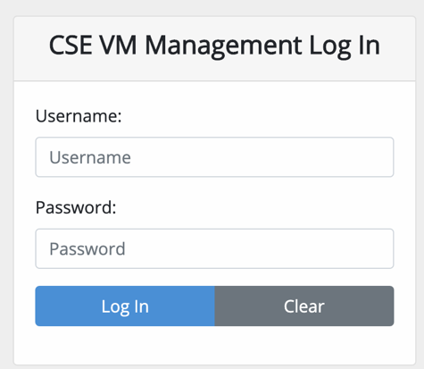
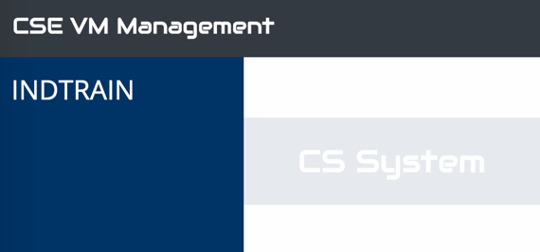
The Training Platform
https://cloud.cse.ust.hk/vmapp/
Enter your CSE username and password (Note: not your ITSC account)
Account activation (if you don’t have a CSE account): https://cssystem.cse.ust.hk/UGuides/activation.html
Click this menu item to start
Click Log In after entering your CSE username and password

Slide 10
VM Creation Schedule
The CS System team said that the creation will be very slow if we create VMs at the same time
I will try to coordinate the VM creation schedule via Zoom
Surname (i.e. Family name) starts with | Setup time
A to E | 2 minutes
F to J | 2 minutes
K to O | 2 minutes
P to T | 2 minutes
U to Z | 2 minutes

Slide 11
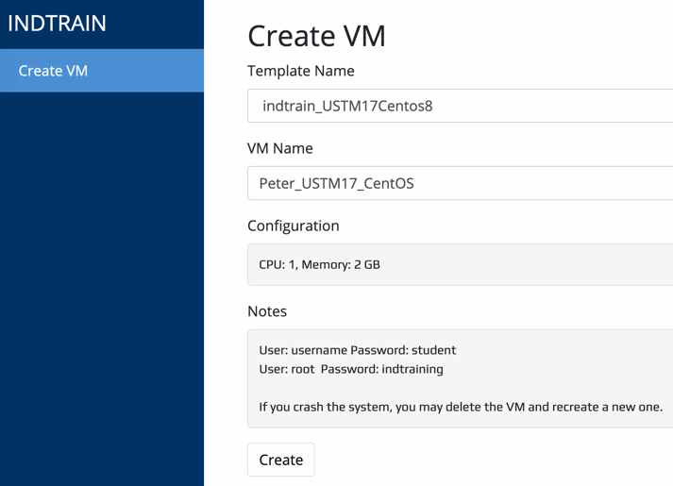
Creating a Linux virtual machine
In USTM-17, we are going to use a Linux virtual machine (VM) – indtrain_USTM17CentOS8
DON’T choose the wrong VM. Otherwise, you cannot complete the exercises
(Step 2)
Select the correct VM template
(Step 1)
Click Create VM button
(Step 3)
Give a VM machine name
(Step 4)
Write down the login information of the VM
(Step 5) Click Create

Slide 12
Terms and Conditions
Read the terms and conditions carefully
You are responsible for all the activities you are going to do on your own VM!
Check agree to the Terms and Conditions
Click Create

Slide 13
Starting the virtual machine inside a web browser
(Step 1)
Click the VM you created
(Step 3) Click Open VM console to start the VM
(Step 2) Click the Power On button

Slide 14
CentOS 8 (Teacher’s machine)
Demo
GNOME desktop is installed using CentOS 8 package manager: dnf
Linux distribution is flexible in a way that you can install any missing components by yourself (e.g. GUI Desktop)
The desktop installation is usually not necessary for server installation, but it is easier for teaching

Slide 15
CentOS 8 (Student’s machine)
We have a professional system for students
Most Linux server distribution don’t bundle with any GUI support
For students, you can ONLY use command lines for the entire USTM17 course! If you are smart, you can install your own GUI

Slide 16
First thing you should do…
Type in the root as username and password indtraining
Please note that no *** will be shown when typing the password
Press enter, your login is successful! – No GUI will be shown

Slide 17
How to check your CentOS version?
Command: cat /etc/centos-release
CentOS version 8.2.2004 was released on 2020-06-15

Slide 18
Two user accounts
A root user account
User: root
Password: indtraining
Root can do anything
Like a CEO in a company
Root ignores all permissions
Run any command (e.g. rm –rf * to delete everything)
Use root account with great cautions
A normal user account
User: username
Password: student
You cannot do many things
Like a junior staff in a company
Access control by permission bits on the files and directories
Run a limited number of commands
Sometimes, we may need to use su or sudo to temporarily switch to an administrator

Slide 19
Files and directories in Linux
Demo
Files in Linux may not have file extension
Example: hello may be a bmp file, a text file, or even an executable file
Example: hello.mp4 may be a text file in Linux
Directories
Start from a root directory (/)
We don’t have drive letter in Linux (C:\, D:\)
Example: /etc/hosts
Start from the root directory
Go inside the folder named etc
There is a file named hosts

Slide 20
Command line editors
Demo
nano
Recommended for beginners
Commands:
Arrow keys: Navigate the editor
Ctrl+X: exit nano
Ctrl+O: write output
Ctrl+K: (multiple times), each time it cut one line
Ctrl+U: Paste the copied lines from Ctrl+K
vi or vim
Recommended for power users
Commands:
ESC+i: Enter insert mode
ESC+dd: delete a line of text
ESC+4y: copy 4 lines
ESC+p: paste lines
ESC+wq!: exit and save
ESC+q!: exit but not save

Slide 21
Useful system commands
Demo
cd [directory name]
enter to the directory
cd ..
move up one directory
Ctrl+C
stop a process
Don’t press Ctrl+Z, it means other things!
pwd
Print the current working directory
rm
Remove files

Slide 22
Any questions so far?

