Slide 1
USTM17 Linux Network Administration
Lesson 2: Introduction to Linux Networking
Peter CHUNG (cspeter@cse.ust.hk)

Slide 2
Introduction to Networking
Network
A collection of hosts that communicate with each other (wired or wireless)
Hosts are often computers, but may also be other devices such as
an intelligent printer
a cell phone
a scanner
or even a smart toilet

Slide 3
What are Network Protocols?
Protocols ≈ Human languages
Communication among hosts
Network protocols
HTTP, FTP, SMTP, IMAP, POP3, TCP, UDP….

Slide 4
Types of networks
TCP/IP networks
The most popular protocol suite on both Local Area Networks (LANs) and Wide Area Networks (WANs)
Other types of networks
UUCP
to transport news and mail over dialup telephone connections
IPX
used in the Novell Netware environment
They are less common nowadays

Slide 5
History of TCP/IP Networks
A research project funded by the United States Defense Advanced Research Projects Agency (DARPA) in 1969
Converted into an operational one in 1975
In 1983, the new protocol suite TCP/IP was adopted as a standard, and all hosts on the network were required to use it

Slide 6
Applications related to TCP/IP networks
Applications we learned in this course
Domain Name System (DNS)
Directory Services – We will use OpenLDAP
Network File System (NFS)
Firewall
Other applications we may not be able to cover in this course
Web Server
FTP Server
SMTP mail server

Slide 7
Ethernet
The most common type of LAN hardware is known as Ethernet
Net transfer rate (in Mega bits per second: Mbps)
Examples: 10Mbps, 100Mbps, 1,000Mbps, 1Gbps, 10Gbps….

Slide 8
Other types of hardware
They are not commonly used nowadays
Fiber Distributed Data Interface (FDDI)
Was considered an attractive campus backbone technology in the early to mid 1990s
Full speed equal to 100Mbps and the maximum cable length can be up to 200km, which is much flexible than Thicknet and Thinnet
Now, it is obsolete by fast Ethernet
IBM’s Token Ring network
An older and quickly disappearing technology

Slide 9
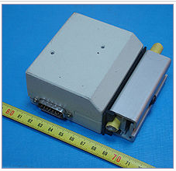
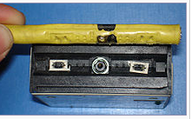
Thick Ethernet (10-Base5)
Use coaxial cable
Drill a small hole into the cable and attach a transceiver using a vampire tap
Features:
Transfer rate: 10Mbps
Cable can run for a maximum 500 meters
Adding hosts to the thick Ethernet do not need to bring down the network

Slide 10
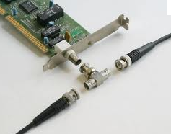
Thin Ethernet (10-Base2)
Use coaxial cable
Differing in diameter
It uses T-shaped “BNC” connector
Features
Transfer rate: 10Mbps
Cable can run for at most 200 meters
Have to cut the cable to insert the connector, need to disrupt the network

Slide 11
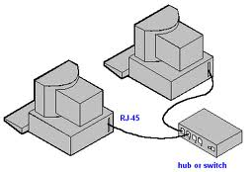
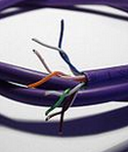
Twisted Pair Ethernet (10-BaseT)
Unlike Thinknet and Thinnet, T refers to twisted pair cable
A cable consists of a pair of copper wires
Features
A hub/switch is required to act as an interconnection point
Hosts can be added without disrupting the network

Slide 12
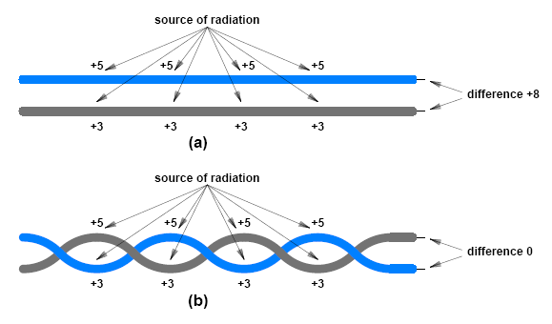
Why we need to twist the pair of wires?
Twisting two wires makes them less susceptible to electrical noise than leaving them parallel
12
Notes:
12

Slide 13
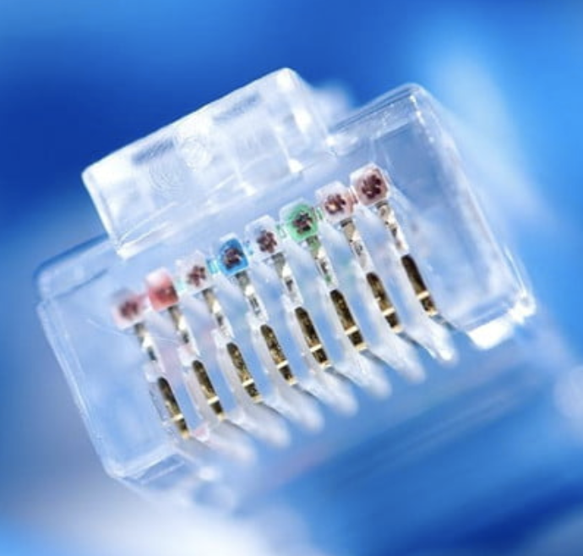
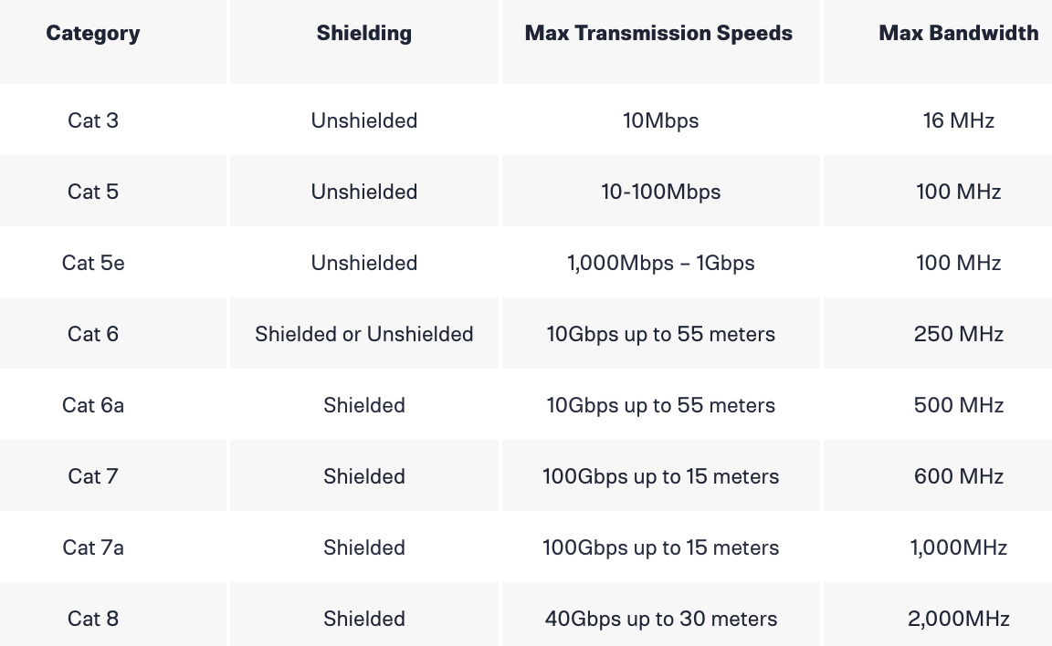
Modern Ethernet Cables
When you are shopping for cables
you may notice the names are “Cat-5,” “Cat-7a,” or something similar
Both Cat 3 and Cat 5 Ethernet cables are obsolete
A general rule of thumb is that higher numbers represent faster speeds and higher frequencies
Shielding cables are covered with a layer of grounded foil that helps prevent electromagnetic interference
Common categories of Cables

Slide 14
Repeaters, bridges and routers
Ethernet has a limited cable length
To extend the coverage of a Ethernet, several hardware components are designed
Repeaters
Copy signals between two or more LAN segments so that all segments will act as if one single LAN
Bridges and Routers
Smarter devices which are able to analyze and decide whether to forward the network packets
Bridges are used inside the same subnet, while routers are used between subnets

Slide 15
Network Interface Card (NIC)
A network interface card (NIC) is required to connect a modern Ethernet
A 6-byte (48-bits) unique hardware address is hardcoded in the NIC firmware
It is named as MAC address
MAC address format
Uses hexadecimal notation
aa:bb:cc:dd:ee:ff

Slide 16
A simple campus network
Two Ethernets (Maths Dept and Physics Dept),
both of them are connected to the campus backbone

Slide 17
The Internet Protocol (IP)
In the previous example, two professors
One from the Math Dept, one from the Physics Dept
They would like to communicate to each other
They are connected, but they are in two different LAN segments
How can they communicate to each other?
Routing and Internet Protocol
Routing
Directing datagrams to a remote host
Internet Protocols (IP)
Defines how to communicate among different connected hosts, even they are not in the same LAN segment

Slide 18
IP addressing
Each host is assigned a unique 32-bit number within the same network
IP address
A hardware independent address
Example:
192.168.1.100
We will talk more about IP addresses in the next lesson

Slide 19
Dot decimal notation (for IPv4)
Why using dot decimal notation for IP addresses?
Dot decimal notation is used to represent this 32-bit number. For example:
Binary notation: many zeros and ones! (Hard to read and write!)
Hexadecimal notation: 0x954C0C04 (Hard)
Decimal notation: 2504788996 (Hard)
Dot decimal notation: 149.76.12.4 (Easy)

Slide 20
Hostname resolution
Mapping a hostname into an IP address
Reasons
Human can understand numbers, but they are not good at memorizing numbers
Example: 185.199.108.153
However, it is very hard to memorize these numbers and then type the numbers to a web browser
For names, it is easier to remember (e.g. hkpeterpeter.github.com)
Example of hostname resolution
hkpeterpeter.github.com ⬄ 185.199.108.153

Slide 21
Address resolution
Mapping a hardware independent IP address into a hardware dependent MAC address
The MAC address is hardcoded in the firmware of the network interface card (NIC)
Example of address resolution
185.199.108.153 ⬄ AD:5C:99:77:66:99

Slide 22
TCP and UDP
Role of Internet Protocol (IP)
Sending datagram from one host to a remote host using their IP addresses
Several problems may appear during the transmission (e.g. packet loss, out-of-the-order packets)
Transport Layer Protocols
Provides extra features on top of the IP
Transmission Control Protocol (TCP)
User Datagram Protocol (UDP)

Slide 23
TCP and UDP
TCP
Provides a reliable service on top of the IP
Ports are introduced to distinguish between different processes (e.g. web server, FTP server) in the same machine
IP addresses and ports are used to establish a connection
It provides an illustration of a simple connection between two processes on your machine and the remote machine
UDP
It also uses IP addresses and ports
Doesn’t require us to establish a connection
Not designed to deal with datagram loss, the datagram loss is handled by the application

Slide 24
What are Ports?
Ports may be viewed as attachment points for network connection
To communicate, both the server side and the client side are required to have a port
Server
Attaches itself to a port and waits for the clients indefinitely
Server ports are usually well-known (e.g. port 80 is usually a web server)
Client
Usually allocates a random port on a local machine and connects to the server port on the remote machine

Slide 25
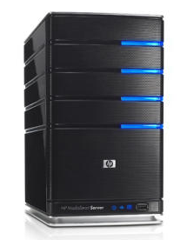
What are Ports?
IP: 192.168.1.100
Port: 80 (fixed)
Webpage access
Port: 21 (fixed)
Port: 26308 (random)
FTP session
Port: 26309 (random)
IP: 192.168.1.133

Slide 26
Common port numbers and port number assignment
Common port numbers
FTP data (port 20)
FTP control message (port 21)
SSH (port 22)
SMTP (port 25)
DNS (port 53)
HTTP (port 80)
HTTPS (port 443)
Remote Desktop Protocol (port 3389)
Port number assignment
Governed by Internet Engineering Task Force (IETF)
Linux to store port number assignment
/etc/services

Slide 27
TCP ports and UDP ports
Both TCP and UDP connection reply on ports
These two port numbers do not conflict to each other
TCP port 80 is different from UDP port 80
In most case, TCP port and UDP port will be assigned to the same service
Some outdated exceptions exist
rlogin (TCP port 513)
rwho (UDP port 513)

Slide 28
Any questions so far?

