Slide 1
USTM17 Linux Network Administration
Lesson 7: Network File System (NFS)
Peter CHUNG (cspeter@cse.ust.hk)

Slide 2
The Network File System (NFS)
A file system controls how data is stored and retrieved
Network File System (NFS) allows you accessing files on remote hosts
The file access provides an identical way as accessing local files
Files access is completely transparent to client and works across a variety of server and host architectures
Advantages
Data consuming large amounts of disk space can be kept on a single machine
Example:
A local machine may only have 100GB of hard disk space
Multiple TBs of NFS drives cannot mounted

Slide 3
Mounting a NFS volumn
The mounting of NFS volumes resembles regular file systems
The mount command is using the following syntax:
mount -t nfs remote_host:remote_dir local_dir options
remote_host refers to the hostname of the remote machine
An IP address can be used to replace the remote hostname
remote_dir refers to the directory of the remote machine
local_dir refers to the directory of the local machine
options refers to some optional parameters

Slide 4
Verify the NFS server is Running
Demo
Checking the NFS server status:
systemctl status nfs-server
If NFS server is not running, we need to start the NFS server (in the next slide)
Some error messages will be shown if the NFS server is not running

Slide 5
Starting the NFS server
Demo
The following command starts the NFS server
systemctl start nfs-server
You can double-check the NFS server status again
Some messages will be shown if the NFS server is active

Slide 6
Mounting a NFS volume
Demo
A client mount a directory from a remote host on a local directory is the same as it does on a physical device
The mount command has a special type nfs dedicated to mount a NFS directory
Example:
mount the /home directory from host itc100 to /users on the current machine
mount -t nfs itc100:/home /users

Slide 7
Mount NFS volume in boot time
Demo
Edit /etc/fstab entry to mount a NFS volume in boot time
Example:
Mount the /home folder of itc100 to the /mnt/home100 of the local machine
Add a line to /etc/fstab
# volume mount point type options (this is a comment line)
itc100:/home /mnt/home100 nfs timeo=14,intr
Extra options can be added
e.g. timeout – mounting is aborted if the timeout is expired

Slide 8
Extra options for the NFS
Increase block size to 8 kilobytes to obtain better performance by issuing the command
Example:
mount itc100:/home /home –o rsize=8192,wsize=8192
The option part is exactly ONE word, and it is not separated by any whitespace character

Slide 9
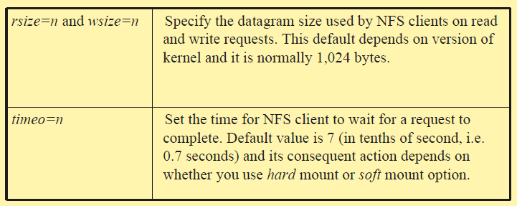
Summary of the extra options

Slide 10
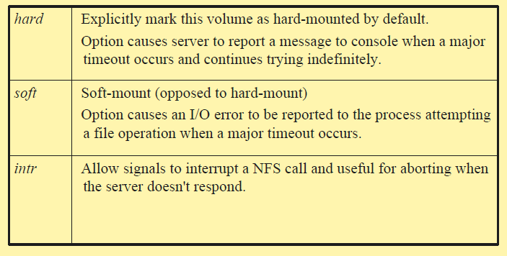
Summary of the extra options

Slide 11
Hard-mount V.S. Soft-mount
hard-mount
Volumes will retry an operation until the server becomes available
Make sure the computer waits until it can re-establish connection with your NFS server
Suitable for critical data
Example: Mounting drives that are useful during the system boot
soft-mount
Generate an I/O error for the calling process whenever a major timeout occurs
Non-critical data may use soft-mount
Example: Mounting data drives

Slide 12
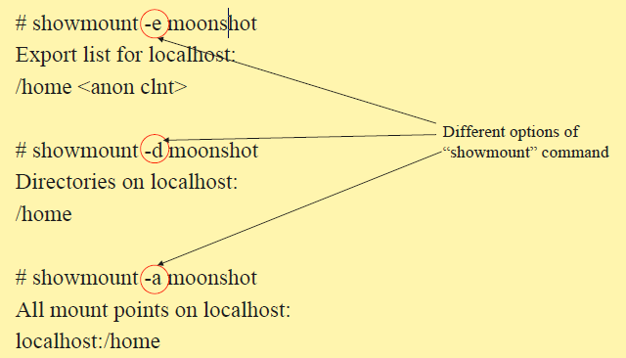
showmount command
Demo
Before running showmount, make sure that NFS server is active
This information can be displayed using showmount

Slide 13
Notes on using NFS
If both client and server associate with the same user and group names with these numerical IDs, they are sharing uid/gid space
i.e. using a directory service (e.g. LDAP) to distribute passwd information to all hosts on your network
If IDs on different hosts do not match
mapping daemon can be used to work around the difference

Slide 14
Exports File
Configure NFS server
what filesystems should make available for mounting
provide various parameters that control the access clients will have to the filesystem.
NFS server determines the type of access that can be mapped to the server's files.
/etc/exports file lists the file systems that the server will make available for its clients to mount and use

Slide 15
Export File: Example
Demo
A sample exports file (Granting NFS access rights to other machines):
# /etc/exports file for itc100 (this is a comment line)
/home itc101(rw) itc102 (rw)
/usr/bin itc101(ro) itc102 (ro)
/ itc101(rw, no_root_squash)
/home/ftp (ro)
If no hostname is given (e.g. /home/ftp directory), any host
matches and can mount the directory

Slide 16
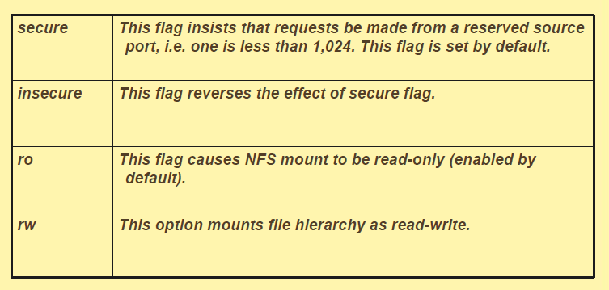
Settings on the export file

Slide 17
Root squash
Root is a super user
It ignores ALL permissions settings
It is dangerous to use with NFS
Default (root_squash)
root users will be down-graded to “nobody” when access a NFS volume

Slide 18
No root squash
Giving no_root_squash
Trust the root user in another machine
Example (itc100)
/ itc101(rw, no_root_squash)
itc101 will still have root permission to access itc100 root directory through NFS

Slide 19
Export and Restart the NFS server
Edit the /etc/exports
Run exportfs command
Restart the NFS server
Using the command: systemctl restart nfs-server

Slide 20
Any questions so far?

