Slide 1
USTM17 Linux Network Administration
Lesson 10: Administrate a
Remote Machine
Peter CHUNG (cspeter@cse.ust.hk)

Slide 2
Why Remote Login?
As a CSE student, you may need to remote login to a CS Linux Lab machine …
Maybe due to the course assignment requirements (e.g., you MUST test your assignments in a CS Linux Lab machine)
Your laptop may be too outdated (e.g., Macbook Air >5 years old)
Some commercial libraries/tools that may only be available in a remote machine (e.g., MatLab)
As a network administrator, you may need to remote login:
Fix problems in a remote machine, without physically visit the computer
Fix problems in a machine that is currently in another country, or a virtual machine that is now running in the cloud

Slide 3
Server Setup

Slide 4
Record down the IPv4 Address
Use the ip addr command
check the previous training slides if you forget the details

Slide 5
What is GNU Screen?
GNU screen is a screen manager that multiplexes a physical terminal between several processes, typically interactive shells
This software is very powerful and have many possible use cases
In the following experiment,
We would like to simulate that a remote login session is being terminated accidentally, and we are going to use GNU screen to restore the session
This use case is very useful
For example, imagine that you are going to run AI training which is expected to finish in 3 days. Most likely, you want to keep the session active, even the SSH connection is closed for some network issues

Slide 6
Fixing errors in dnf on CentOS 8 VM
The official CentOS 8 support is recently expired. The dnf software repositories are temporarily moved to a new destination. Run the following commands before running the dnf command:
sed -i -e "s|mirrorlist=|#mirrorlist=|g" /etc/yum.repos.d/CentOS-*
sed -i -e "s|#baseurl=http://mirror.centos.org|baseurl=http://vault.centos.org|g" /etc/yum.repos.d/CentOS-*

Slide 7
Install GNU Screen
Commands:
The first command is to install an addition software repository EPEL (Extra Packages for Enterprise Linux) for the dnf package manager
The second command is to install a software called GNU Screen
dnf install epel-release -y
dnf install screen -y

Slide 8
Remote Login from the Client Side
Use your own desktop/laptop to connect to a remote virtual machine
Note: You need to use the ip addr command to check the IP address of the remote machine

Slide 9
Getting Started (in Windows)
Enter the IPv4 address of a remote machine
Use SSH Secure Shell client or Putty
Host Name: you can direct type in
ITSC username (e.g. root)
Port Number: 22
root
is the username of our remote virtual machines

Slide 10
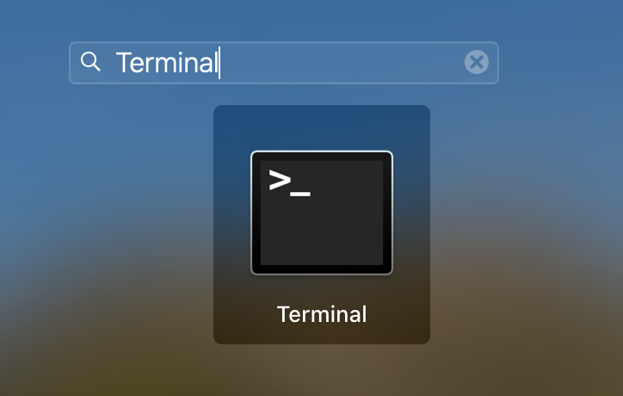
Getting Started (in Mac/Linux)
In Mac, open Terminal and then type in the ssh command
ssh root@[ipv4_address_of_vm]
In Linux, there should be a similar terminal software (e.g. Konsole, GNOME terminal)
Note: You need to check the IP address of your own remote virtual machine

Slide 11
Check the screen software
The following command can check the screen software installation:

Slide 12
List out all screen sessions
By default, there are no attached/detached screen sessions
We are going to create a new screen session in the next slide

Slide 13
Creating a new screen session
Type in the following command to start a new screen session:
Note: You need to type in a capital letter S
You can nothing noticeable happens, we are going to verify the result in the next step

Slide 14
List out all screen sessions again
Type in the same command to list out all screen sessions again

Slide 15
Experiment: Using nano to edit something…
DON’T save the file.
Close the Terminal App (in Mac) or putty (in Windows) to disconnect with the remote machine
Re-connect to the remote machine again

Slide 16
List out all screen sessions again
Type in the same command to list out all screen sessions again
Now, you can see that the ustm17_session is still there, but detached

Slide 17
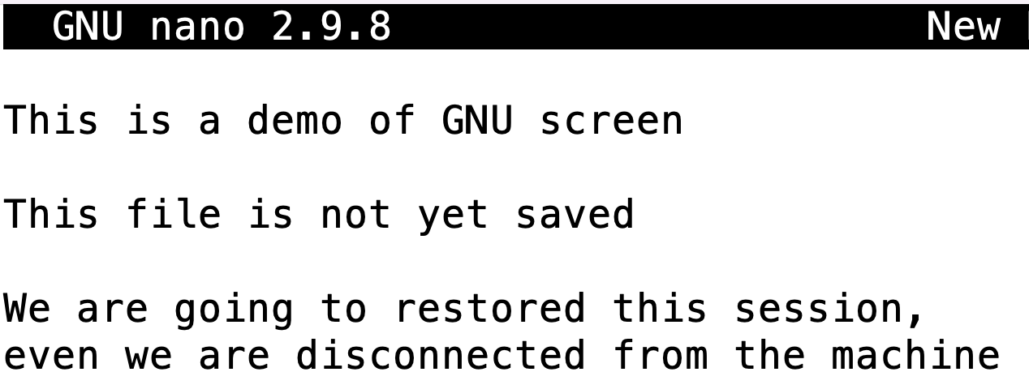
Resume the detached session
Expected result:
The interactive session is now restored!!

Slide 18
Any questions so far?

