Slide 1
Trajectory Simplification: On Minimizing the Direction-based Error
Cheng Long, Hong Kong University of Science and Technology
Raymond Chi-Wing Wong, Hong Kong University of Science and Technology
H. V. Jagadish, University of Michigan

Slide 2
Trajectory
Trajectory
p₃
p₁₀
p₈
10 positions
p₇
p₉
p₄
9 segments
p₁
p₂
p₅
p₆

Slide 3
Trajectory
Raw trajectory data is usually very large
For an example,
10,000 taxis
Sampling rate: 5s
$≈1.7×{10}^{8}$ positions per day!!
Trajectory Simplification
Drop some positions
Issue 1: Storing all sampled positions incurs a very high space cost
As a result, only a portion of the positions is kept
Issue 2: Query processing big trajectory data incurs high time cost

Slide 4
Trajectory Simplification
Trajectory Simplification:
Drop some positions
Trajectory
p₃
p₁₀
p₈
p₇
Suppose p₂, p₄, p₅, p₇, p₈, p₉ are dropped
p₉
p₄
p₁
p₂
p₅
p₆
Trajectory
6 positions to be dropped

Slide 5
Trajectory Simplification
Trajectory Simplification:
Drop some positions
Which positions should be dropped?
Depending which positions to be dropped, it returns different simplified trajectories
Our Idea:
Drop the positions such that the “direction information” of the original trajectory is preserved
Direction-Preserving Trajectory Simplification (DPTS)

Slide 6
Q1: What Is “Direction Information”?
p₃
p₁₀
p₈
Trajectory
p₇
p₉
p₄
p₁
p₂
p₅
p₆
Direction information

Slide 7
Why To Preserve “Direction Information”?
Applications That Use “Direction Information”
Map Matching
Trajectory Mining
Trajectory Query Processing
Trajectory Clustering
Trajectory Classification
Trajectory Outlier Detection
Brakatsoulas et al. VLDB’05
Brakatsoulas et al. IDEAS’ 04, Pelekis et al. TIME’07
Lee et al. SIGMOD’07, Hung et al. VLDBJ’11
Lee et al. VLDB’08
Lee et al. ICDE’08

Slide 8
Trajectory Clustering
Trajectory Clustering
Lee et al. SIGMOD’07, Hung et al. VLDBJ’11
Trajectory Clustering:
Partition a set of trajectories into several clusters such that
trajectories in the same cluster are similar
trajectories in different clusters are dissimilar
Cluster 1
Cluster 2
T₁
T₂
T₃
T₄
T₁ and T₂ are similar
T₃ and T₄ are similar

Slide 9
How To Preserve “Direction Information”?
Direction-based Error Measurement
Error of T’ = the max of its segment’s error
p₃
p₃
p₁₀
p₈
p₇
p₉
p₄
p₁
p₂
p₅
p₆
p₆
Error of segment p₁-p₃
$$π/2$$
Error of segment p₃-p₆
$$π/2$$
Error of segment p₆-p₁₀
$$π/2$$
$$π$$
$$π$$
$$π$$
$$0$$
$$0$$
$$0$$
$$3π/2$$
$$3π/2$$
$$3π/2$$

Slide 10
How To Preserve “Direction Information”?
Problem (Min-Error):
Given:
A trajectory T;
An integer W;
Goal: A simplified trajectory T’ of T such that
the number of positions in T’ is at most W, and
the error of T’ is the smallest
We have a storage budget
We want to protect the direction information as much as possible

Slide 11
How To Preserve “Direction Information”?
Exact Algorithms
ApproximateAlgorithm
Algorithms For Min-Error
DP
Error-Search
Span-Search
Time: O(W n³)
Space: O(n²)
Time: O(C n² log n)
Space: O(n²)
Time: O(n log² n)
Space: O(n)
2-factor approximation

Slide 12
DP: A Sub-Problem Optimality Property
Problem Instance 1:
Trajectory: p₁-p₂-…-p₁₀
Budget: 4
p₁-p₃-p₆-p₁₀ is the optimal solution for Problem Instance 1
p₃
p₁₀
p₈
Sub-problem of Problem Instance 1
Could be verified by contradiction
p₇
p₉
p₄
p₁
p₂
p₅
p₆
Problem Instance 2:
Trajectory: p₁-p₂-…-p₆
Budget: 3
p₁-p₃-p₆ is the optimal solution for Problem Instance 2

Slide 13
Error-Search: A Rough Idea
Problem (Min-Error):
Given:
A trajectory T;
An integer W;
Goal: A simplified trajectory T’ of T such that
the number of positions in T’ is at most W, and
the error of T’ is the smallest
Goal:
a feasible simplification with the smallest error
Feasible simplification:
A simplified trajectory with at most W positions
Multiple simplifications share the same error
All possible “feasible simplifications”:
p₁-p₄-p₇-p₁₀
P₁-p₄-p₆-p₁₀
p₁-p₃-p₆-p₁₀
…
Corresponding Errors (in radians):
1.305
1.305
0.785
…
O(n²) possible segments in a simplified trajectory
p₃
p₁₀
p₈
p₇
p₉
p₄
p₁
p₂
p₅
p₆
Size: O( n^{W})
Size: bounded by O( n²)

Slide 14
Span-Search: The Main Idea
The “span” of a simplified trajectory
Span of T’ = the max of its sub-trajectories’ span
p₃
p₃
p₁₀
p₈
p₇
p₉
p₄
p₁
p₂
p₅
p₆
p₆
Span of
p₁-p₂-p₃
$$π/2$$
Span of
p₃-p₄-p₅-p₆
$$π/2$$
Span of
p₆-p₇-p₈-p₉-p₁₀
$$π/2$$
$$π$$
$$π$$
$$π$$
$$0$$
$$0$$
$$0$$
$$3π/2$$
$$3π/2$$
$$3π/2$$

Slide 15
Span-Search: The Main Idea
A Property:
A simplified trajectory has its span at most twice its error
A trajectory
Span-Search
A simplified trajectory with smallest span
Analysis of Span-Search:
Span-Search is a 2-factor approximation
O(n log²n) time
O(n) space

Slide 16
Experiments: Settings
 | # of trajectories | Total # of positions | Average # of positions / trajectory
Geolife | 18K | 25M | 1K
T-Drive | 10K | 18M | 2K
Datasets:
Geolife and T-Drive
Algorithms
Exact: DP and Error-Search
Approximate: Span-Search
Experiments
DPTS vs. Wavelet Transformation
Performance Studies
Compared with Douglas-Peucker

Slide 17
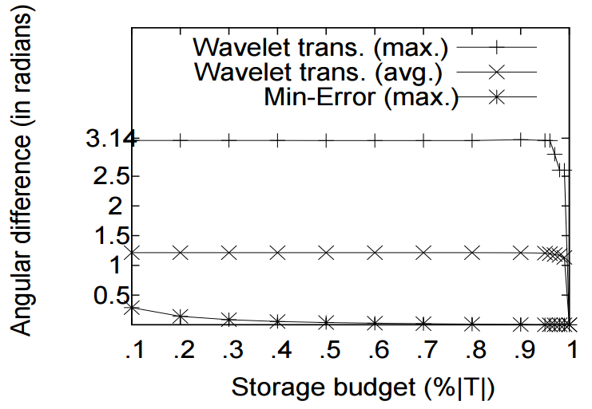
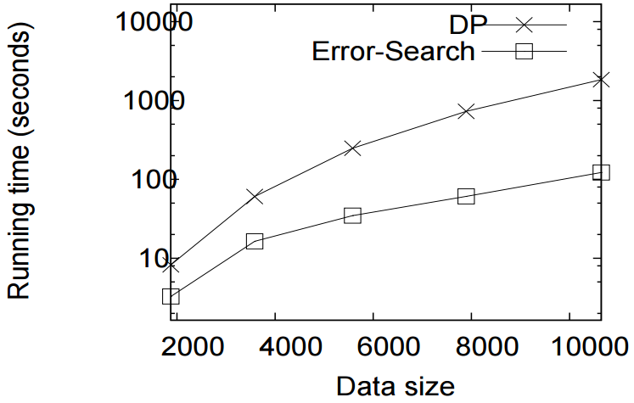
Experiments: Results
Error
Running time
Budget W (in terms of %)
# of positions in the trajectory

Slide 18
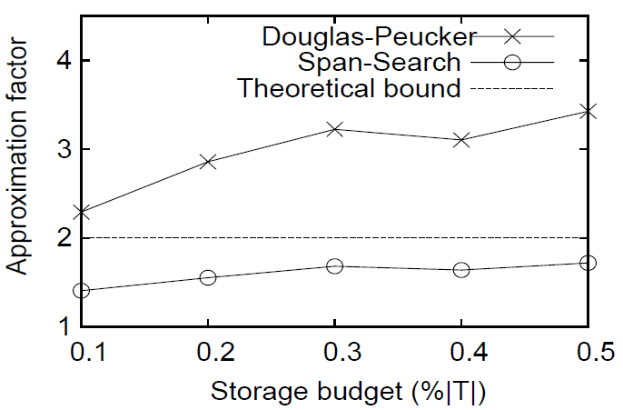
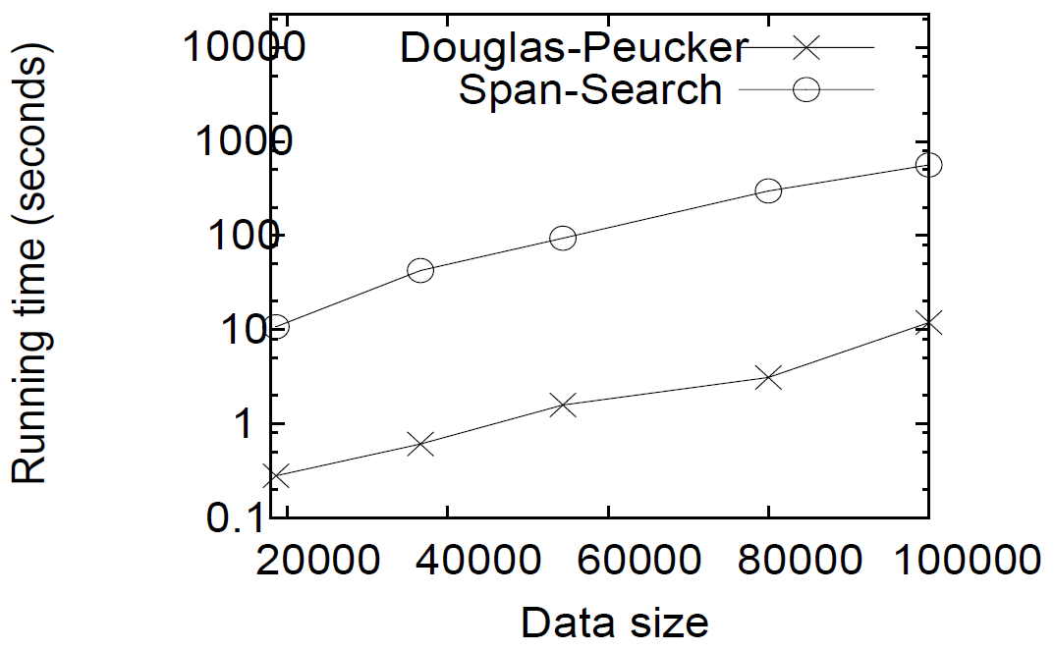
Experiments: Results
Appro. factor
Run. time
Budget W
Budget W

