Slide 1
Learning on Probabilistic Labels
Peng Peng, Raymond Chi-wing Wong, Philip S. Yu
CSE, HKUST

Slide 2
Introduction
Binary Classification:
Deterministic label: 0 or 1.
Probabilistic Label: a real number $f∈[0,1]$.
We aims at learning a classifier based on a training dataset with probabilistic labels.
0
0
0.3
0
1
1
0
0.7
0.2
0
0.6
0
0.4
0.1
1
0.8
1
0
0.7
0.4
1
0
0.2
0.6
1
1
1
1
0
0.9
0.6
0.3

Slide 3
Introduction
There are many applications where the instances are labeled with fractional scores.
An instance is labeled with multiple labelers and there are disagreements among these labelers.
The domain expert cannot give a deterministic label for an instance.
The instances themselves are uncertain with a deterministic label.

Slide 4
Contributions
We propose a way to learn from a dataset with probabilistic labels.
We prove theoretically that compared with learning from deterministic labels, learning from probabilistic labels leads to a faster rate of convergence (i.e., error bound).
We give an extensive experimental studies on our proposed method.
Significance of our work: our result shows that probabilistic datasets can enhance the performance of many existing learning algorithms if used properly. Besides, a lot of recent studies can use our error bound for their error analysis.
“Proper Losses for Learning from Partial Labels” (NIPS 2012)
“Estimating Labels from Label Proportions” (JMLR 2009)
“SVM Classifier Estimation from Group Probabilities” (ICML 2010)

Slide 5
Methodologies
Tsybakov Noise Condition:
$η\left(x\right)=Pr⁡(Y=1|X=x)$, i.e., the probability that the instance $x$ is labeled with $1$.
$η\left(x\right)∈[0,1]$.
This noise condition describes the relationship between the data density and the distance from a sampled data point to the decision boundary.

Slide 6
Methodologies
Tsybakov noise:
The density of the points becomes smaller when the points are close to the decision boundary (i.e., $η(x)$ is close to $\frac{1}{2}$).
$$Pr⁡(E\left[\left|η\left(x\right)−\frac{1}{2}\right|\right]<0.3)$$
$$Pr⁡(E\left[\left|η\left(x\right)−\frac{1}{2}\right|\right]<0.4)$$
1
1
$$Volume<c⋅{0.3}^{γ}$$
$$Volume<c⋅{0.4}^{γ}$$
0.2
0.5
0.8
$$η\left(x\right)$$
0.1
0
0.9
1
$$η\left(x\right)$$
0
1
0.5
When $t=0.3$
When $t=0.4$

Slide 7
Methodologies
Tsybakov noise:
Given a random instance $x$, the probability that $E[\left|η\left(x\right)−\frac{1}{2}\right|]$ is less than 0.3 is less than $c⋅{0.3}^{γ}$;
When $c$ is larger, the probability is higher so the data is more noisy;
when $γ$ is larger, the probability is smaller so the data is less noisy.

Slide 8
Methodologies
Gaussian Process Regression (GPR)
We regard the problem of learning from probabilistic labels as a regression problem.
Strategies:
1. Estimate $\hat{η}(⋅)$ by using the method of Gaussian Process Regression.
2. Given an instance $x$, the classifier $h\left(x\right)=I_{\hat{η}\left(x\right)≥0.5}$. That is, if $\hat{η}(x)$ is at least 0.5, we predict 1; otherwise, we predict 0.

Slide 9
Theoretical Results
Error bound: Let $E(h)$be the excess error of the classifier $h$, which is the difference between the expected error of $h$ and the expected error of $h^{∗}$, where $h^{∗}$ is the optimal classifier achieving the minimum expected error.
The error bound achieved by our result: $\tilde{O}(n^{−\frac{γ+2}{4}})$
Best-known error bound in the realizability setting: $\tilde{O}(n^{−1})$
Best-known error bound in the non-realizability setting: $\tilde{O}(n^{−\frac{1}{2}})$
Best-known error bound under the Tsybakov noise condition: $\tilde{O}(n^{−\frac{γ+1}{γ+2}})$

Slide 10
Theoretical Results
We have a better result on the rates of convergence:
When the order of n is smaller, we have a faster rate of convergence.
$−\frac{γ+2}{4}$ is no greater than $−\frac{1}{2}$ when $γ≥0$, so our error bound is better than that in the non-realizability setting with deterministic labels.
$−\frac{γ+2}{4}$ is no greater than $−1$ when $γ≥2$, so our error bound is better than that in the realizability setting when $γ≥2$ with deterministic labels.
$−\frac{γ+2}{4}$ is no greater than $−\frac{γ+1}{γ+2}$ when $γ≥0$, so our error bound is always better than that in the tsybakov noise condition with deterministic labels.
Why is our result better?
1. Intuitively, the probabilistic labels are more informative.
2. Theoretically, we can accurately predict the class of an instance even when we do not have an accurate estimation of P(Y=1|X=x) and we only need to guarantee that our prediction of $\hat{η}(x)$ falls into the same half interval where P(Y=1|X=x) falls.

Slide 11
Experiments
Datasets:
1st type: a crowdsourcing dataset (Yahoo!News)
2nd type: several real datasets for regression
3rd type: a movie review dataset (IMDb)
Measurements:
The average accuracy & The p-value of paired t-test
Algorithms for comparison:
The traditional method (Trad. Method)
The order-based method (OM)
The partial method (Partial)
The difficult method (Difficult)
Our algorithm (FSC)

Slide 12
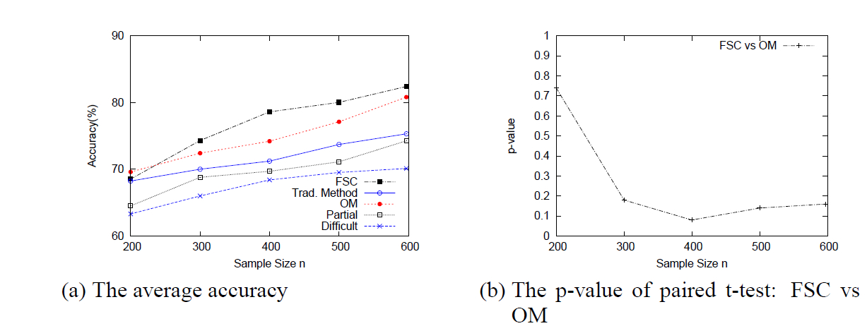
Experiments
Yahoo!News Dataset (Business, Politics and Technique)
Business vs Politics

Slide 13
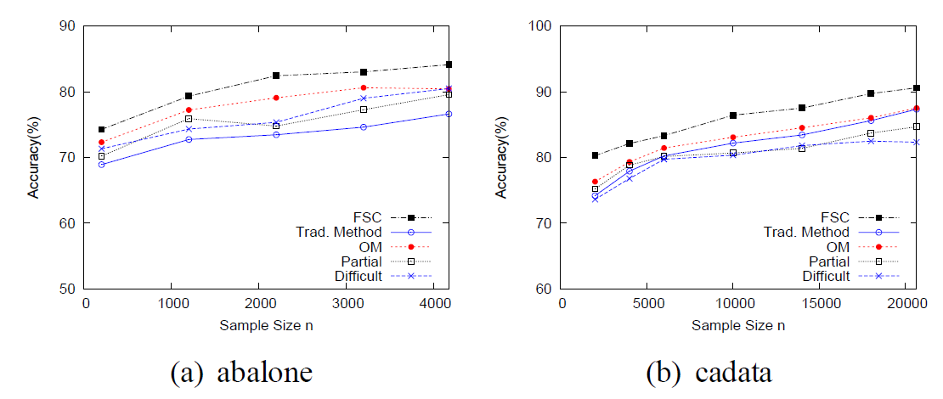
Experiments
Effect of sample size n on the accuracies of classifiers

Slide 14
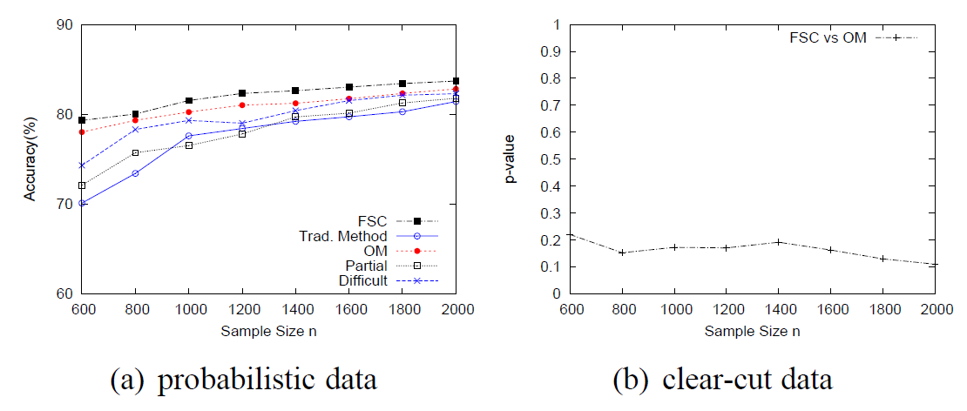
Experiments
IMDb dataset with the paired t-test: FSC vs OM

Slide 15
Conclusion
We propose to learn from probabilistic labels.
We prove that learning from probabilistic labels is more efficient than learning from deterministic labels.
We give an extensive experimental study on our proposed method.

