Slide 1
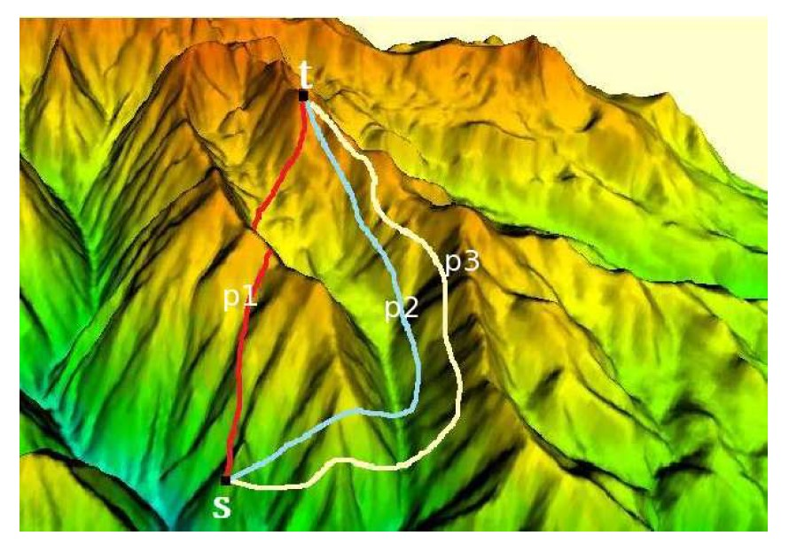
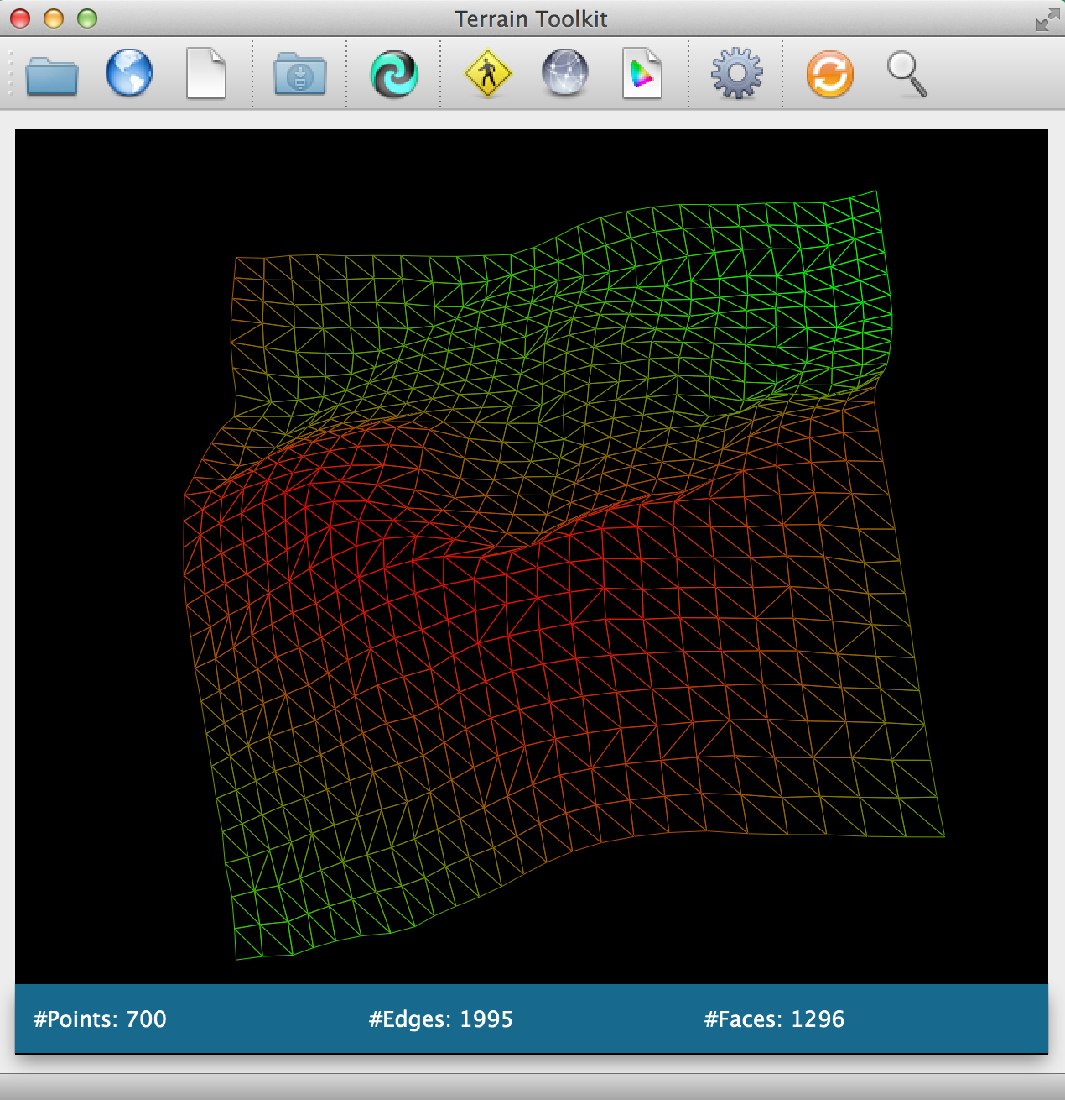
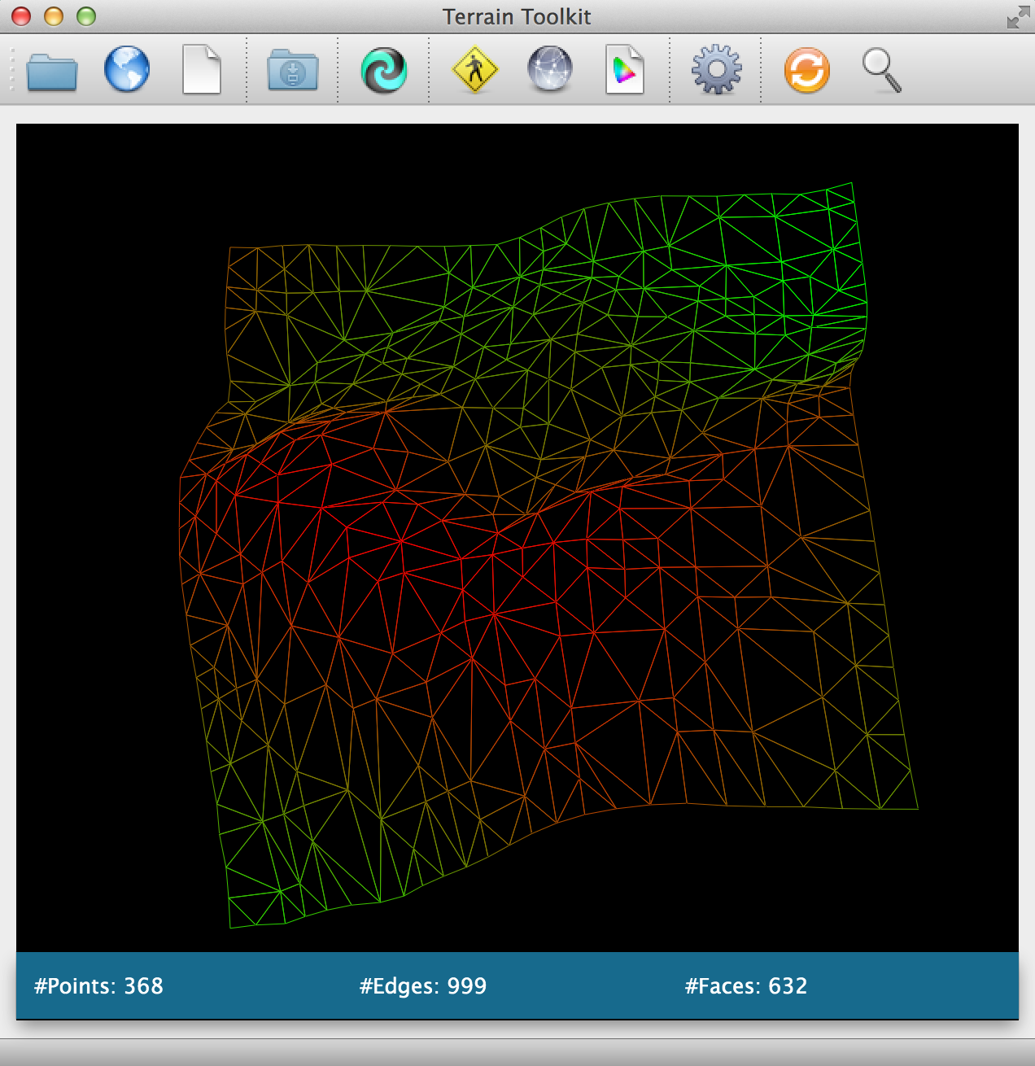
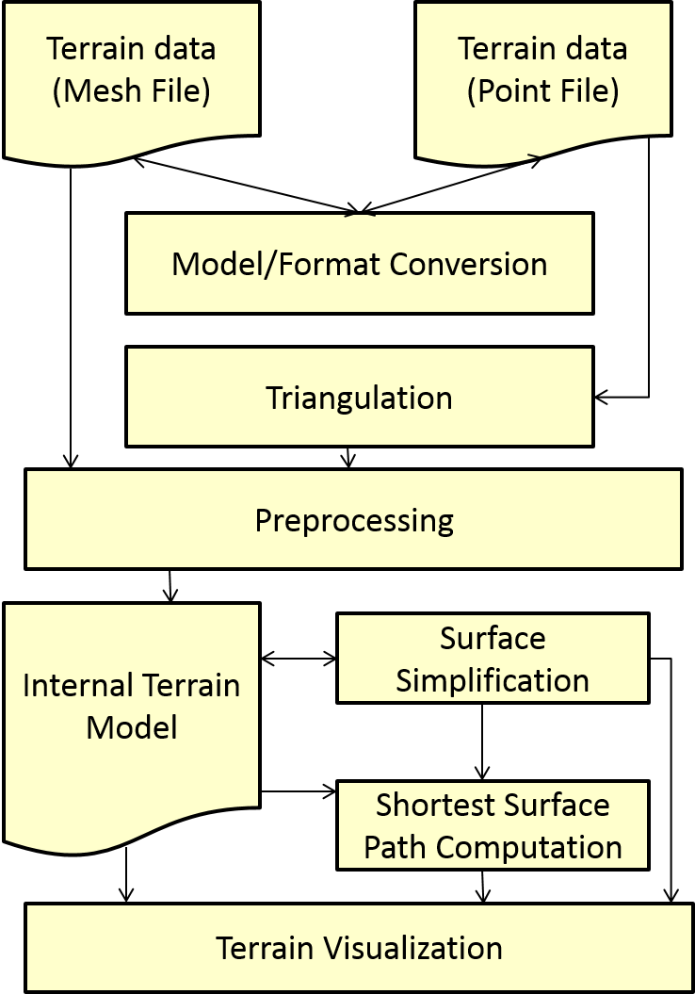
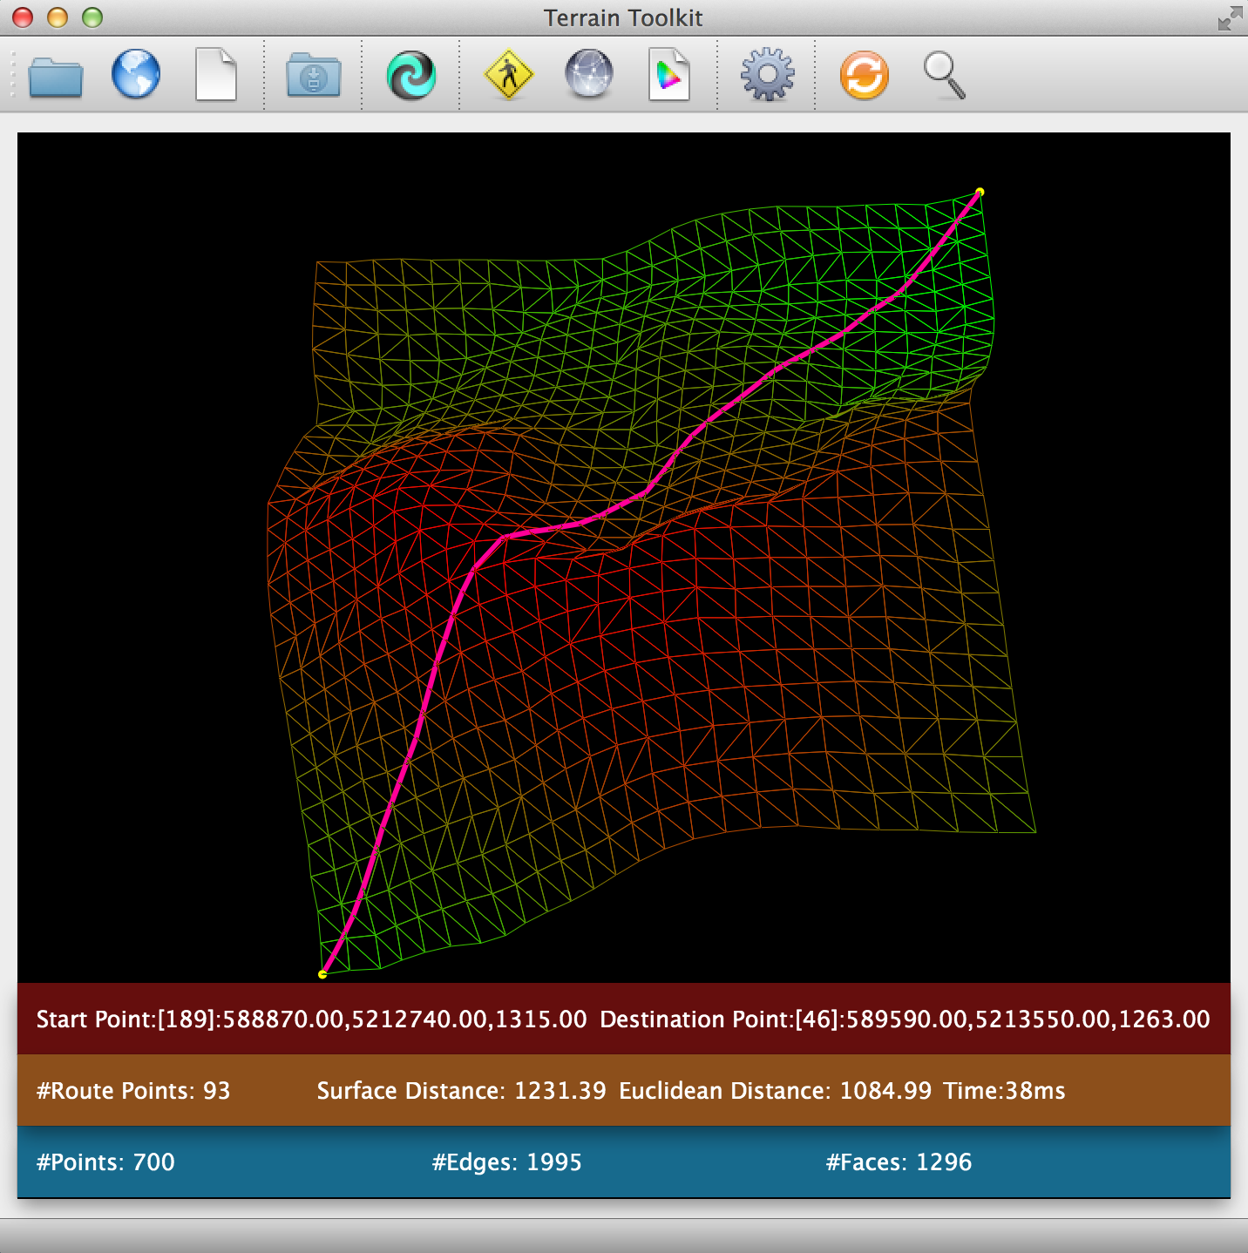
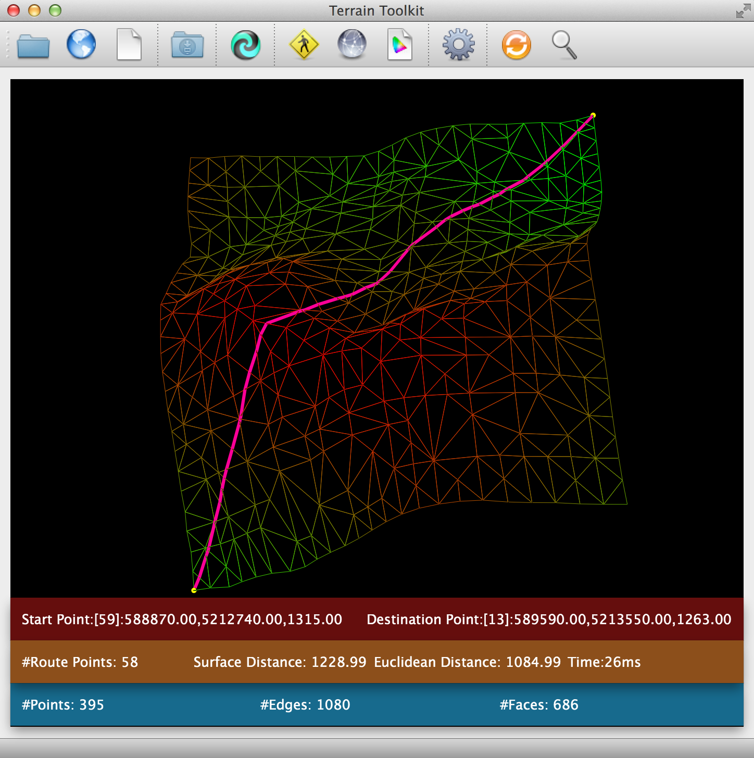
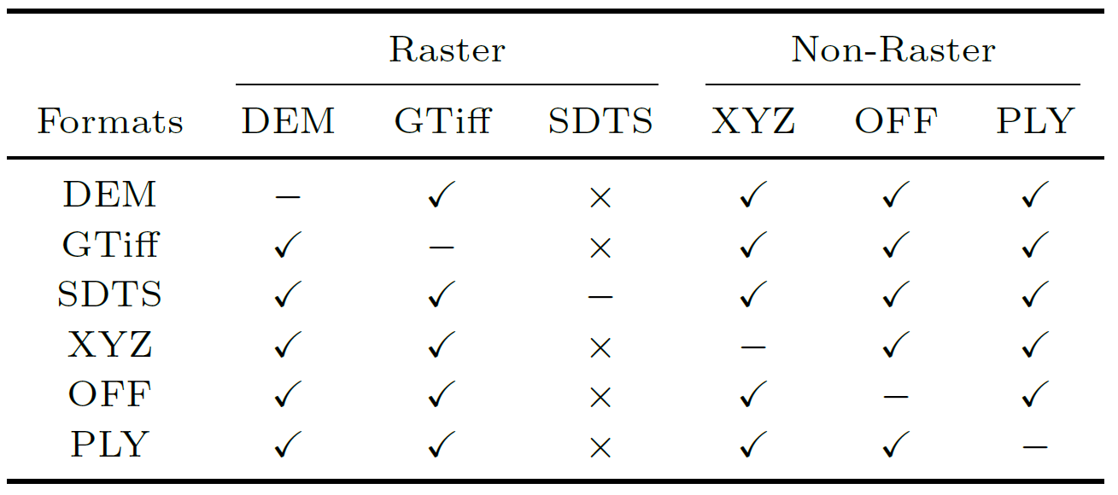
Terrain-Toolkit: A Multi-Functional Tool for Terrain Data
Qi Wang¹, Manohar Kaul², Cheng Long³, Raymond Chi-Wing Wong³
¹Zhejiang University, ²Aarhus University, ³The Hong Kong University of Science & Technology
Introduction:
Terrain data: land surface, or simply surface
Model: Digital Elevation Model (DEM)
Raster (uniform-grid structure)
Triangular Irregular network (TIN)
Existing visualization tools: Meshman, CityGML, Terraserver, Google Earth, Spaceye (a survey could be found at http://vterrain.org/)
Motivation: Existing tools
Insufficient model conversion:
Raster: DEM, GTiff, and SDTS
Non-Raster: XYZ, OFF, PLY
No surface simplification facility
shortest surface path: O(n²)
Do surface simplification first
No surface distance operator
Length of the path on the surface
kNN, RkNN and Range query, etc.
Terrain-Toolkit:
Extensive model conversion:
Supported formats include: DEM, GTiff, SDTS, XYZ, OFF, and PLY
Surface simplification facility
Kaul et al.’s algorithm
Accuracy guarantee
Surface distance operator
Chen and Han’s algorithm: O(n²)
Improved version (by Xin et al)
Design:
Architecture:
Model conversion matrix:
Demonstration:
(a) Original terrain
(b) Simplified terrain
(c) Shortest surface
distance (on the
original surface)
(d) Shortest surface
distance (on the simplified surface)

