Slide 1
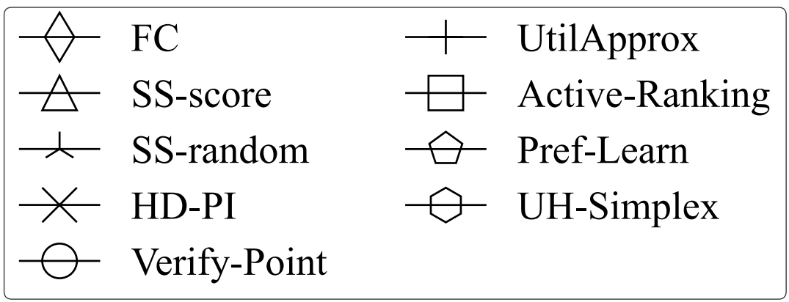
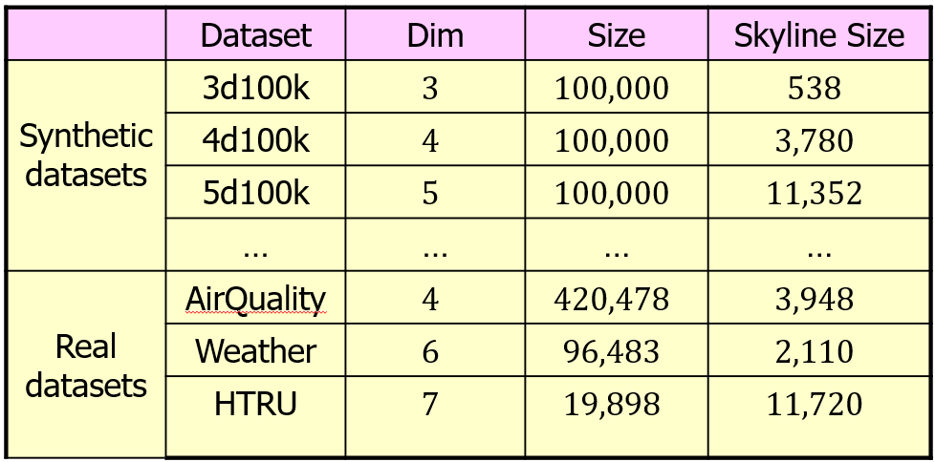
Robust Best Point Selection under Unreliable User Feedback
Qixu Chen, Raymond Chi-Wing Wong
The Hong Kong University of Science and Technology
Overview
To help the user find the most favorite point in the database, the interactive queries learn the user’s preference by asking them several rounds of questions, each requiring him/her to compare 2 points for choosing a more preferred one. However, in real-world scenarios, users may provide unreliable answers due to two major types of errors, namely persistent errors and random errors. Existing interaction algorithms either simply assume that all answers provided by the user are reliable, or are capable of handling random errors only, which can lead to finding undesirable points.
In this work, we propose more generalized algorithms that are robust to both persistent and random errors made by the user. Comprehensive experiments demonstrate that our algorithms achieve more than 10% higher accuracy on retrieving the best point compared to existing methods, even with a small number of questions asked.
Introduction
How can Alice find her favorite house in this dataset?
A House Dataset
House | Price | Size | Dist. to Work
$$p_{1}$$ | 300 | 125 | 9.4
$$p_{2}$$ | 270 | 110 | 5.7
$$p_{3}$$ | 150 | 135 | 20.8
$$p_{4}$$ | 160 | 80 | 14.2
Assume that we know Alice’s utility function (represented by a utility vector $u$).
Range of $u$ when no preference is indicated
range of $u$ with 2 preferences (assuming no user errors)
$$1.30$$
$$f\left(p\right)=u⋅p$$
$$1.45$$
$u$ must be in $R_{5}^{0}$ if no user error is made.
$u$ must be in $R_{5}^{1}$ if at most 1 error is made.
$$1.40$$
$$1.35$$
How to know Alice’s utility function?
Return the house with the highest score.
$$R_{5}^{0}$$
$$R_{5}^{1}$$
Existing methods:
1
Partition
Display two houses $p$ and $q$.
3
The partition of a convex point $p_{i}$, denoted as $P_{i}$, is the set of utility vectors that rank $p_{i}$ as the best point.
Assume that the user makes at most $i$ errors in $t$ rounds.
If $R_{t}^{i}$ does not intersects with $P_{j}$, then $p_{j}$ cannot be the best point.
2
Learn Alice’s utility vector $u$ based on the feedback.
Alice selects the one she prefers.
Repeat until the favorite house can be determined using the learnt utility vector.
$p_{3}$ is the best point iff $u$ is in $P_{3}$.
$u$ must be in $R_{5}^{1}$ if at most 1 error is made.
1
2
3
$$P_{1}$$
$$P_{1}$$
In reality: Alice may make mistakes!
$$P_{2}$$
$$P_{3}$$
$$P_{4}$$
$$P_{5}$$
$$P_{2}$$
$$P_{3}$$
$$P_{4}$$
$$P_{5}$$
1
Display two houses $p$ and $q$.
3
Partitions of a dataset with 5 convex points, $p_{1},…,p_{5}$
Only $P_{3}$, $P_{4}$ and $P_{5}$ intersects with $R_{5}^{1}$. $p_{3}$, $p_{4}$ and $p_{5}$ are possible best points.
2
May learn a wrong utility vector based on wrong feedback.
Alice selects the less preferred one with a small probability.
Algorithm Framework
Missing the favorite house using the wrong utility vector!
Maintain
$k+1$ confidence regions $R_{t}^{0},..,R_{t}^{k}$ ($k$ is derived from the target return size $l$).
Set $X_{t}^{0},…,X_{t}^{k}$, where $X_{t}^{i}$are the set of partitions intersecting with $R_{t}^{i}$.
Ask questions until the size of $X_{t}^{k}$is at most $l$.
Guaranteed to be satisfied due to our setting of $k$.
Return the set of points corresponding to the partitions in $X_{t}^{k}$.
Two Types of User Errors
Random errors:
The answer to a question is wrong with some probability.
Persistent errors:
The answer to a question is consistently wrong.
It is more difficult to detect and handle persistent errors.
Two Algorithms: SS and FC
Differ in how the questions are chosen in each round.
SS uses heuristic approaches to select questions.
Two variants: SS-score and SS-random.
Uses a small number of questions empirically, but no theoretical guarantee.
FC employs a strategy using an asymptotically optimal number of rounds.
Related Work
Studies not considering user errors:
[SIGMOD12, SIGMOD19, SIGMOD21, VLDB22]
Studies considering random errors only:
[WWW21, ICDE23]
Studies considering persistent errors:
[NIPS11, VLDB15] – Their objectives are not retrieving the best point for the user. They tend to ask many questions before termination.
Experiments
Algorithms
Ours: SS-score, SS-random. FC.
Competitors: Verify-Point (ICDE23), HD-PI (SIGMOD21), Pref-Learn (VLDB15), UH-Simplex (SIGMOD19), UtilApprox (SIGMOD12), Active-Ranking (NIPS11).
Measurements
Accuracy of returning the best tuple; # of rounds before termination; processing time required for each round.
Contribution
The first to consider both persistent errors and random errors in interactive queries.
Propose two algorithms that find the best point with provable probability guarantee.
An algorithm that uses a small number of rounds empirically.
An algorithm that uses an asymptotically number of rounds.
Problem Definition
Given a dataset $D$, a user error rate $θ$ and a return size $l$, interact with the user and return a set of points with size at most $l$, such that the probability that this set contains the user’s favorite tuple is maximized.
Varying dataset size
Our Methods
Two data structures: confidence region and partition.
Varying user error rate
Two user studies
The first user study aims to study the accuracy of each algorithm in real-world user cases.
The accuracy of our algorithm is above 90%, but existing algorithms have only 50% to 80% accuracies.
The second user study aims to show the presence of persistent errors, in which
33% of the users are prone to persistent errors.
24% of the users miss their best point due to persistent errors.
Confidence Region
The $i$-th confidence region just after round $t$, denoted as $R_{t}^{i}$, is the set of all possible utility vectors if the user makes at most $i$ errors in $t$ rounds.
Notes:
1

